Slide 1

SpeedPod
Sliding Door Measurement
Preliminary analysis for inline measurements of sliding door performance.
Technology applies to both linear roller or classic sliding door mechanisms.
© 2023 EZMetrology

Slide 2

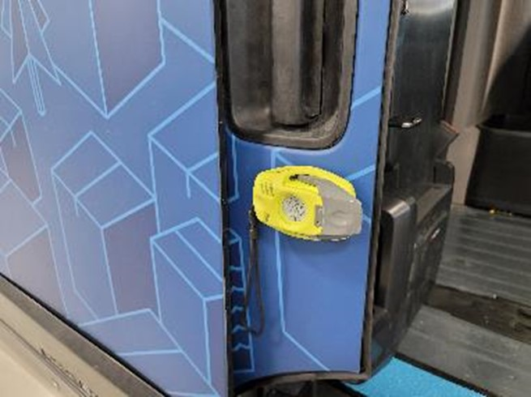
INDEX
Objectives
Technology
Speed Value
Friction Value
SEPA005, Slide 2
© 2023 EZMetrology

Slide 3

1. OBJECTIVES
SEPA005, Slide 3
© 2023 EZMetrology

Slide 4
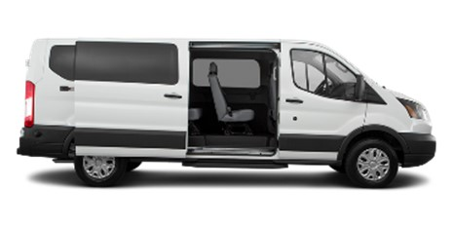
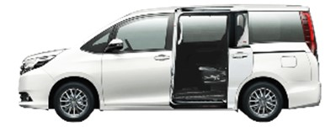
1.1 Objectives
Feasibility of the EZMetrology SpeedPod technology to measure sliding door quality:
  Closing Efforts/Energy from Full Open
Evaluating the smoothness of the door travel
  Measure the friction, force or energy loss of the door system and quantify the quality of the door operation
  Minimum Closing Speed
Standard operation to measuring lowest closing speed
This metric will quantify the seal and latch performance
Note: This technology is widely used for hinged doors, and so is also applicable for hinged doors on the same vehicle.
SEPA005, Slide 4
© 2023 EZMetrology

Slide 5
2. TECHNOLOGY
SEPA005, Slide 5
© 2023 EZMetrology

Slide 6

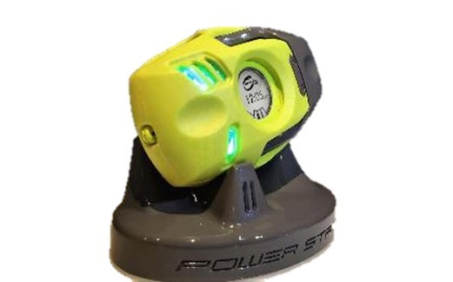
2. TECHNOLOGY
2.1 Speedpod
Auto Start/Stop | SpeedPod detects when it is mounted to a door and starts the appropriate acquisition. The measurement ends when the gauge is removed.
Single-Operation Suction Cup | The suction cup activation mechanism can be mounted in a single smooth motion and hold the device firmly on the closure.
Bright LED Status (Go/No-Go) | Four multicolor lights will provide immediate feedback on the status of the measurement, including a clear green/red as final pass/fail conclusion.
High-Contrast Ink Screen | SpeedPod comes with a high-contrast, low-power ink screen technology for best reading of multipurpose information.
Scratch-Resistant Domed Glass | The screen is protected by a scratch-resistant dome glass for strength and clarity.
Onboard Memory | In stand-alone mode, SpeedPod can store measurement values on the device that can be downloaded via USB.
Dual-Core Processing | Onboard dual-core processor will perform all necessary signal processing to provide a turn-key system and display the values in real time on the screen
SEPA005, Slide 6
© 2023 EZMetrology

Slide 7
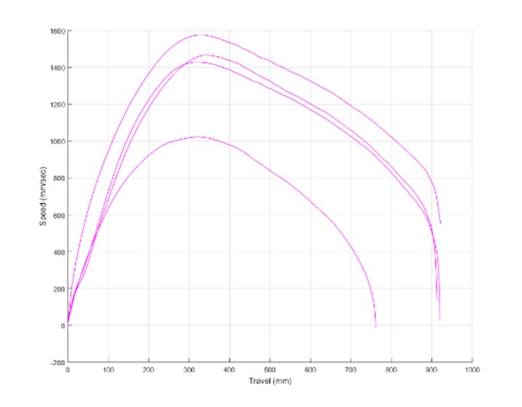
2. TECHNOLOGY
2.2 single door – Recording
Release Point
Install SpeedPod
Place SpeedPod on the curbside door using the single action suction cup
Acquisition
Recommend to take 3 readings per door. This would take approximately 30 seconds
Data Analysis
  SpeedPod records the speed profile (speed as a function of travel)
  Acceleration: When the operator is pushing the door
  Peak Speed: Release Point, when the operator stops pushing
  Deceleration: Friction is at play and slowing down the door
  Impact: Speed right before latching
  Travel distance provides information on
  Closed: Full travel (~900mm)
  Not Closed: Partial travel (~750mm)
Open
Not closed
Closed
SEPA005, Slide 7
© 2023 EZMetrology

Slide 8
3. SPEED VALUE
SEPA005, Slide 8
© 2023 EZMetrology

Slide 9
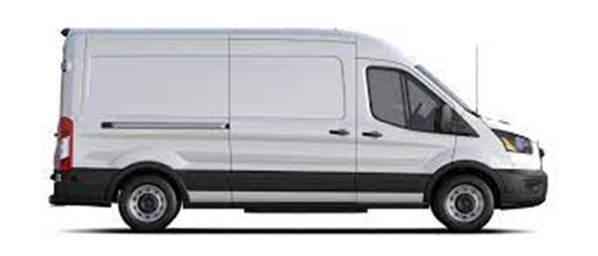
3. SPEED VALUE
3.1 Movement ANALYSIS
Linear
Linear Portion (near)
The initial movement is a near linear movement mainly in the x-direction
Rotating Portion
Towards the end of the travel, the linear movement comes to a stop, and the energy is converted into a rotation around Z.
When the door does not latch, it is visible on the C pillar.
Implication Concerning Speed
  Speed is different for every point on the door
  Speed in x-direction only:
  Vector Speed (3D) of a specific point
Rotation
SEPA005, Slide 9
© 2023 EZMetrology

Slide 10
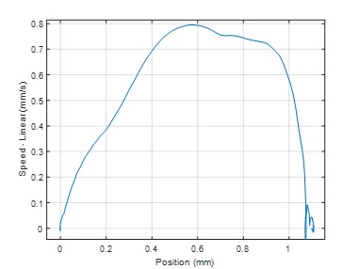
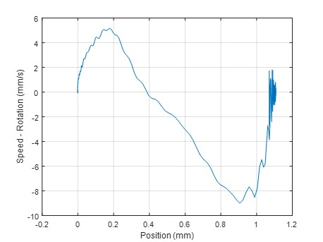
3. SPEED VALUE
3.2 Movement
Linear
Rotation
SEPA005, Slide 10
© 2023 EZMetrology

Slide 11
4. FRICTION VALUE
SEPA005, Slide 11
© 2023 EZMetrology

Slide 12
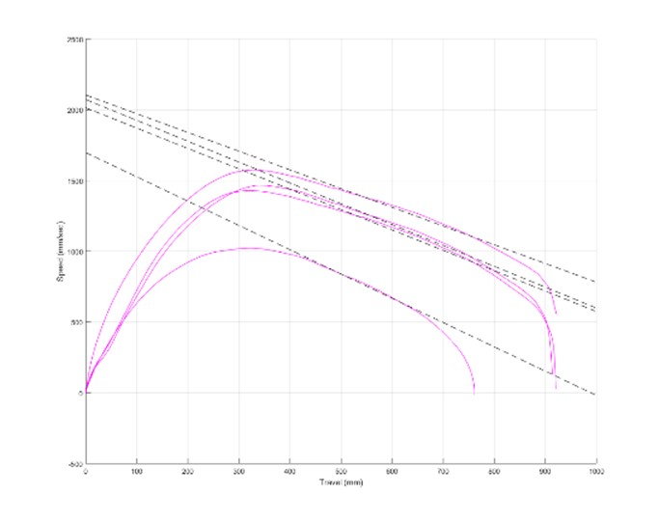
4. FRICTION VALUE
4.1 single door – signal processing
Slope
Impact Speed
For each recording, the system determines:
Slope of deceleration
From the release point (peak speed) to impact point.
Kinetic Energy Loss is directly correlated to Friction Force.
Impact Speed
Speed reading when the door has reached its final travel distance of around 900mm. Quantifying the energy required for seal and latch engagement.
Friction Force x Travel
Friction Energy
Kinetic Energy Loss
SEPA005, Slide 12
© 2023 EZMetrology

Slide 13
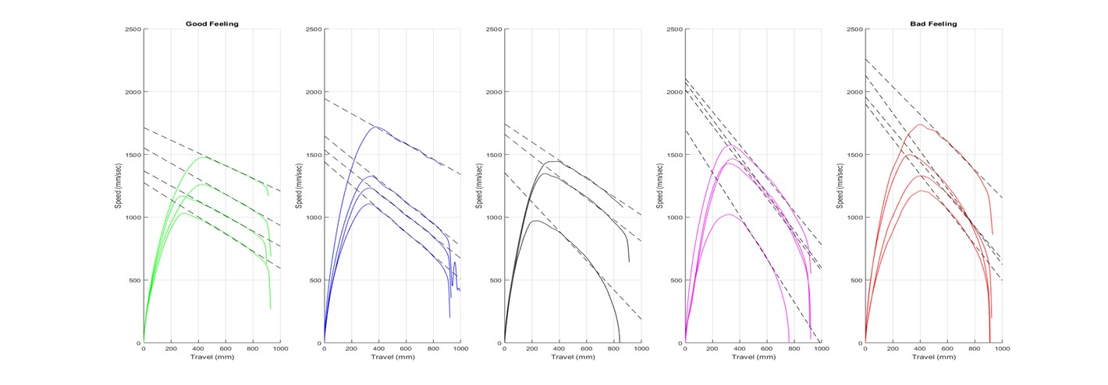
4. FRICTION VALUE
4.2 EXAMPLEs
Sorted based on a subjective good (left) to bad (right)
Sample of 5 different vehicles of the same model. One vehicle per graph.
Recording 3 to 4 closings per door. Represented by different lines in each graph.
SEPA005, Slide 13
© 2023 EZMetrology

Slide 14
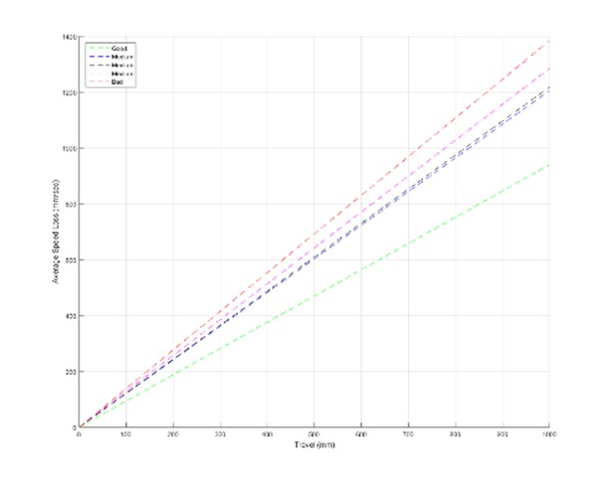
4. FRICTION VALUE
4.3 Evaluation of 5 Samples
Typical Slope: User-Independent Method
Within the EZSlam platform, multiple samples can be collected to provide a “typical slope of the door.” This compensation is being performed in real time. SpeedPod eliminates user dependency of the operation.
The “not closed” recordings (door stops too soon) will be excluded.
Overall Comparison of the different samples
When comparing the slopes, the system could distinguish between the good doors with a small slope and the bad doors with a much higher slope.
 | Slope Value
Best | 0.94
Medium Good | 1.20
Medium | 1.21
Medium Bad | 1.28
Worst | 1.38
SEPA005, Slide 14
© 2023 EZMetrology

Slide 15
THANK YOU.
info@ezmetrology.com
support@ezmetrology.com
www.ezmetrology.com
portal.ezmetrology.com
academy.ezmetrology.com
SEPA005, Slide 15
© 2023 EZMetrology

