Slide 1

SpeedPod Solutions
Warranty and Calibration
Look into all possibilities to keep your investment protected and calibrated in the most convenient and cost-effective way.
Confidential
© 2025 EZMetrology

Slide 2

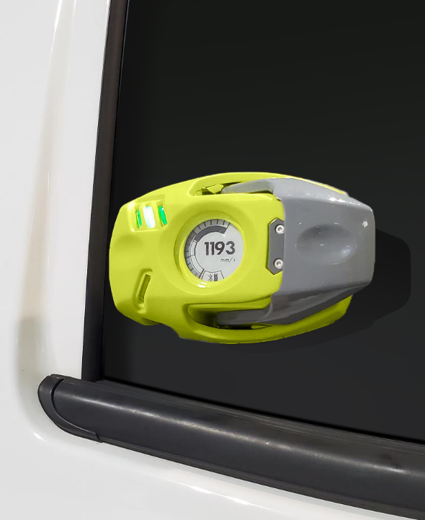
INDEX
Introduction
SPC
Gauge Verification
Gauge Calibration
Confidential
© 2025 EZMetrology

Slide 3

1. SpeedPod
Confidential
© 2025 EZMetrology

Slide 4
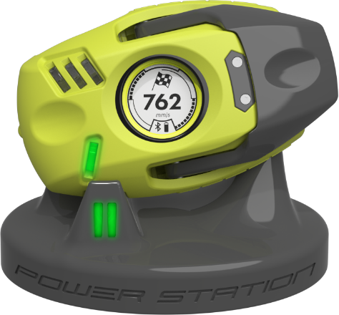
1. Speedpod
1.1 technology
  SPEEDPOD
  The technology is based on two sensor types and processing unit:
    Gyroscope : capture angular speed
    Accelerometer : capture linear acceleration
    Processor : Signal processing and reporting
  Verification:
  In situations where an occasional drop can occur, regular verifications is considered good practice.
  Calibration:
  A calibration interval of 12 months is recommended.
Confidential
© 2025 EZMetrology

Slide 5
2. SPC Program
Confidential
© 2025 EZMetrology

Slide 6
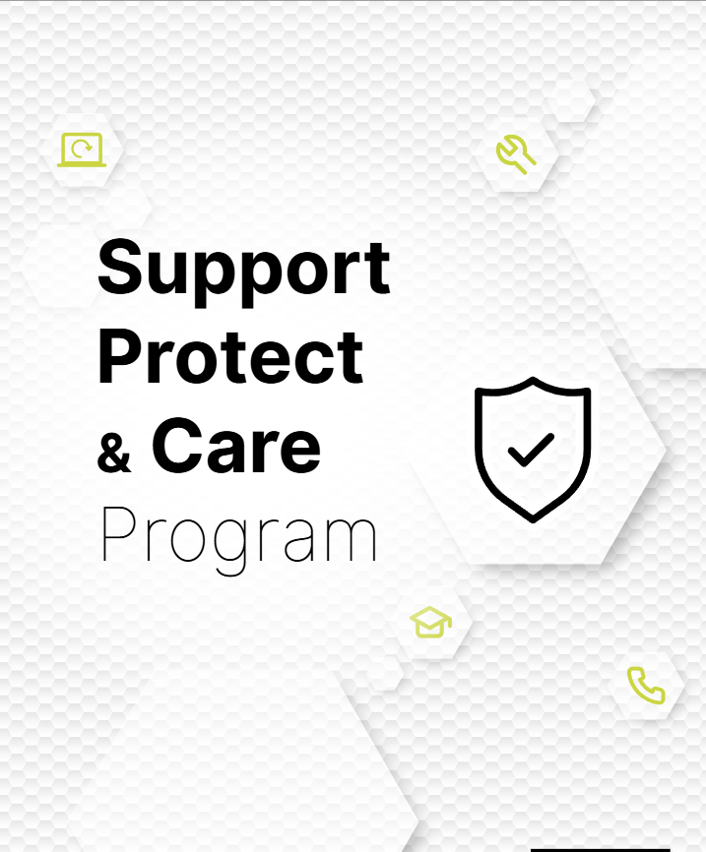
2. SPC Program
2.1 coverage
Peace of mind for your investment.
Software Updates
      Keep your system up to date
      New features
      Enhanced user interaction
Tech Support
      support@ezmetrology.com
Repairs
      Coverage for all essential components
Academy
      academy.ezmetrology.com
Terms
      First year Included
      Subsequent years Subscription
Confidential
© 2025 EZMetrology

Slide 7
3. Verification
Confidential
© 2025 EZMetrology

Slide 8
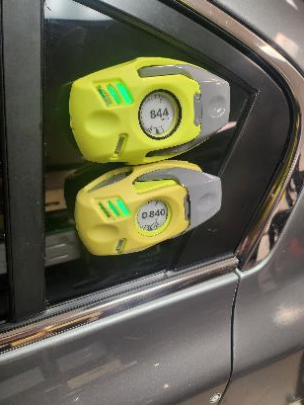
3 verification
3.1 side by side
Verify SpeedPods by comparing them to each other.
Operation
      Compare the readings between the gauges on same door.
Key Characteristics
      Simple and Fast
      Relative comparison, not absolute standard
      Subjective observation
      No traceability
Cost Elements
      No cost
Confidential
© 2025 EZMetrology

Slide 9
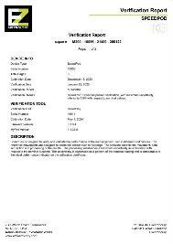
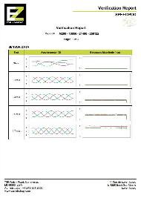
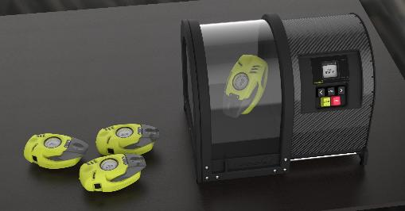
3 verification
3.2 in-house verification
Using dedicated tool to verify the performance of the gauges in your lab at any time.
Operation
      Use the SpeedBay tool
      Fully automated procedure in MyPod
      Less than 5 minutes
      Activate verification reminders on gauge
Key Characteristics
      Traceable Report with serial numbers, results and dates
Cost Elements
      SpeedBay Tool
Confidential
© 2025 EZMetrology

Slide 10
4. Calibration
Confidential
© 2025 EZMetrology

Slide 11
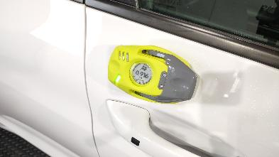

4. calibration
4.1 Factory calibration
  Send your SpeedPod back to EZMetrology for the annual calibration process.
Key Characteristics
      Schedule it at a time of your convenience
      Repairs can be performed (*)
      Upgrades can be performed (*)
      Per device
Lead-Time
      Transit time + 4 Days in Lab
Cost Elements
      Calibration fee
      Shipment – Insurance
  (*) SPC program would cover all internal repairs and updates
Confidential
© 2025 EZMetrology

Slide 12
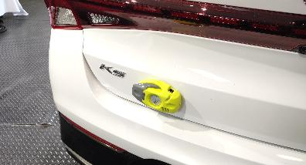

4. calibration
4.2 On-Site calibration
Our expert comes to your factory, bringing all the tools to calibrate the SpeedPod(s) on-site.
Key Characteristics
      Schedule at a time of your convenience
      Limited downtime
      No transit delays or fees
      Multiple Devices can be grouped
Lead-Time
      2 Days in Lab
Cost Elements
      Calibration fee
      Travel Cost for one expert
      Logistics for Calibration Tools
Confidential
© 2025 EZMetrology

Slide 13
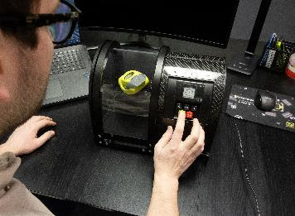

4. calibration
4.3 in-house calibration
      Eliminate logistic hassles, you have the tools to perform the calibration in-house.
Key Characteristics
      Use the SpeedBay tool
      Recalibrate the SpeedPod
      Technical support for calibration process
      SpeedPod is updated to reflect new information and adjustments
      Calibration Report Header with all serial numbers, dates and the results
      Verify and/or Calibrate as often as required
      Activate verification reminders on gauge
Lead-Time
      Immediate
Cost Elements
      SpeedBay Tool
      Calibration Software
      Tool calibration
Confidential
© 2025 EZMetrology

Slide 14
Thank you.
info@ezmetrology.com
support@ezmetrology.com
www.ezmetrology.com
portal.ezmetrology.com
academy.ezmetrology.com
Confidential
© 2025 EZMetrology

Slide 15
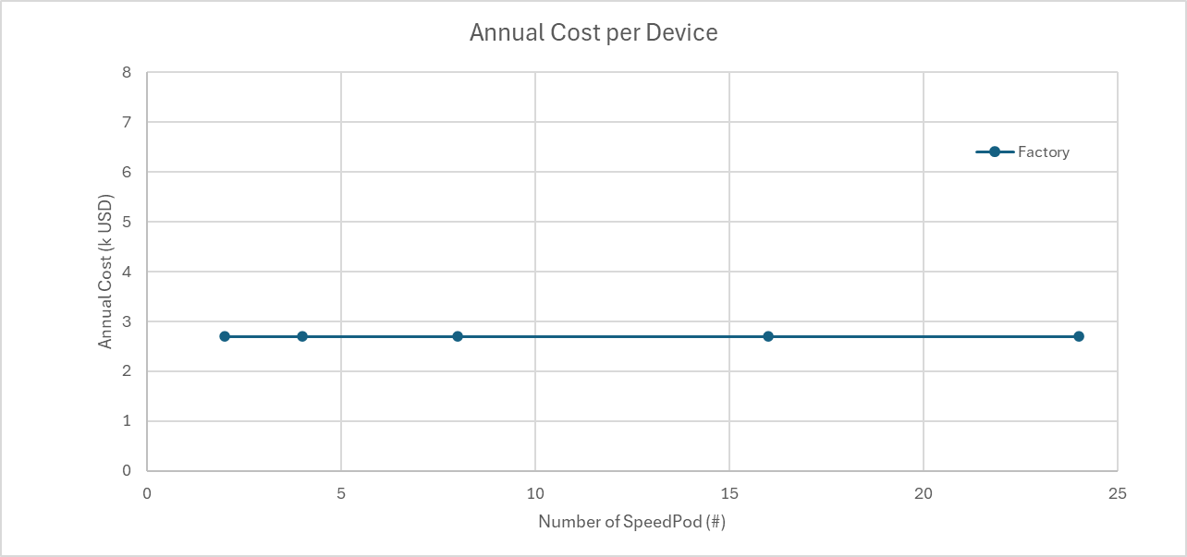
Factory calibration
Per device
Individual Costs (per device)
      Calibration fee $ 1.2k
      Logistic Costs $ 0.3k ~ 1.5k
Total cost is the Individual Costs x Number of Pods. Making it also the average cost per device
Savings can be achieved by grouping shipments and reduce shipping fees.
Confidential
© 2025 EZMetrology

Slide 16
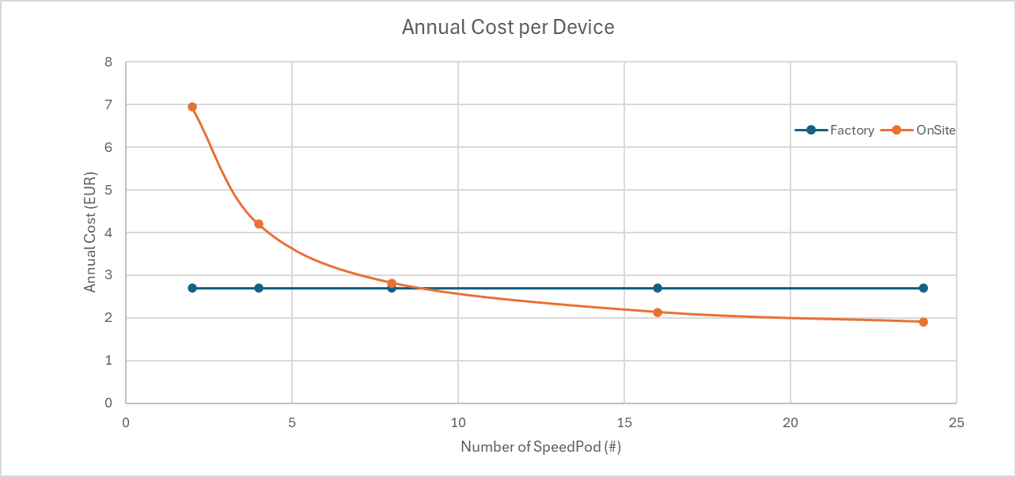
On-site calibration
Full Service
Shared Costs
      Travel $ 4.0k ~ 6.0k
      Logistic Costs $ 0.6k ~ 2.9k
      Premium $ 4.9k
Individual Costs (per device)
      Calibration fee $ 1.2k
Average cost per device is lower when more devices are included in the process.
The break-even point is around 9 SpeedPod devices.
This does not consider the time-saving by avoiding any logistics preparations or delays.
Confidential
© 2025 EZMetrology

Slide 17
In-house calibration
Return of Investment
As an alternative to factory calibrations, In-House calibration capabilities are more economical after about 18 calibrations
Tooling Costs
      SpeedBay $ 16.0k
      Tool Calibration (every 2 year) $ 2.8k
Proportional Costs
      Calibration License $ 1.2k
  The following simulation shows costs (red) or savings (green) when choosing for in-house calibration.
  It is expressed as a function of number of SpeedPod and over an extended period.
  Example: For 4 Pods, an in-house approach generates savings from the 4th year on.
Confidential
© 2025 EZMetrology

