Slide 1

Power Door Systems
Measurement Strategies
Overview of the important role that measurement technology plays in the design, fine tuning and inspection of power door systems.
© 2023 EZMetrology

Slide 2

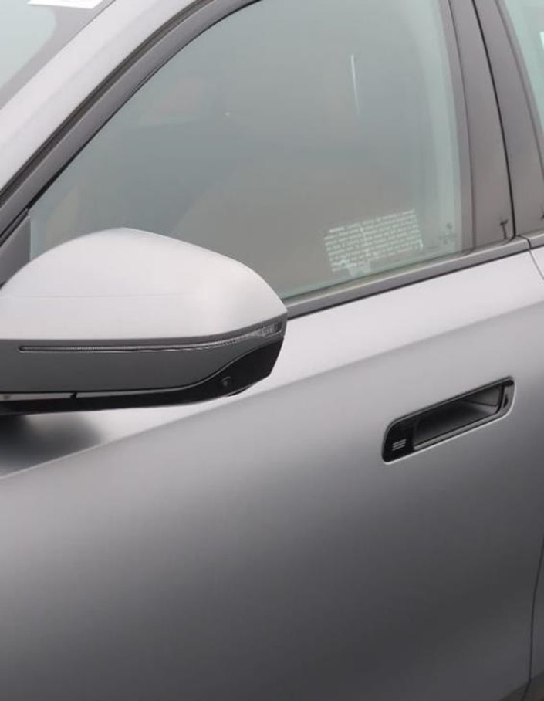

Index
Introduction
Key Questions
Measurement Solutions
Data Solutions
© 2023 EZMetrology

Slide 3

1. Introduction
© 2023 EZMetrology

Slide 4
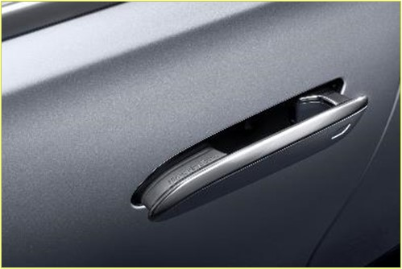
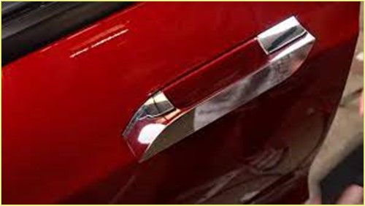
1. INTRODUCTION
1.1 Power door systems
Power door systems will bring a new experience to end users and are gaining popularity.
The functional system will be part of the character of the vehicle, stand for quality, and provide recognition of the brand.
Main questions in designing and testing a system:
  What is the User Expecting?
What is the user’s definition of quality?
What profile feels good?
What is the practical, expected behavior?
What about mixed operation: button / manual actuation?
© 2023 EZMetrology

Slide 5
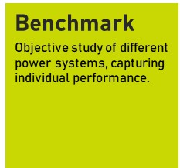
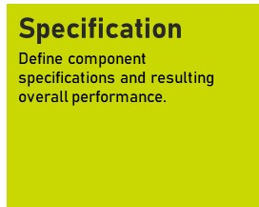
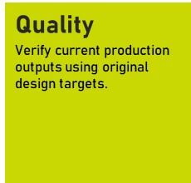
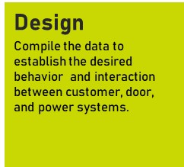
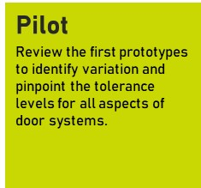
1. Introduction
1.2 Measurement Milestones
Measurement objectives will evolve during the design cycles of a power door system.
© 2023 EZMetrology

Slide 6
2. Key Questions
© 2023 EZMetrology

Slide 7
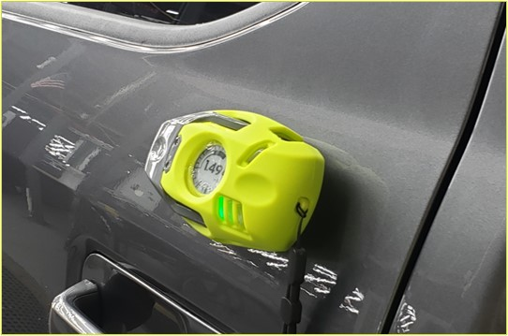
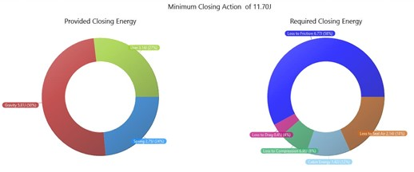
2. KEY questions
2.1 Metrology
The new technology is designed to answer essential questions regarding the door system.
All obtained values are
Accurate
Reproducible
User Independent
The values quantify the performance of a total system.
With the numbers, it becomes possible to compare, tune, and make informed decisions in the design process to set and achieve goals.
© 2023 EZMetrology

Slide 8
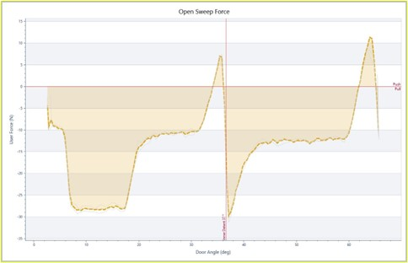
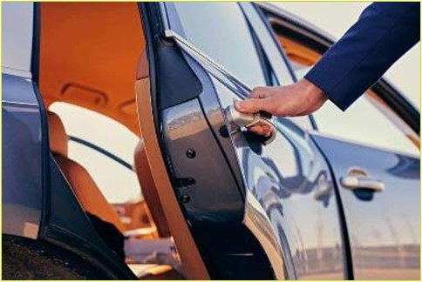
2. KEY questions
2.2 CLASSIC - NoT powered door
Should the electric system mimic a traditional door?
If so, what are the baseline characteristics?
User Input
How much effort or energy does a customer have to provide to close the door? What value feels right? Too light a sensation is often perceived as inferior quality.
Free Travel
What are the detent characteristics? What is the magnitude of forces involved to keep the door in a steady position?
Moment of Impact
How much force or energy is required to compress the seal system and reach the latch while maintaining sealing quality sufficient to minimize water intrusion and maximize noise insulation?
Latching Event
What is expected from the latch with respect to its activation trigger and holding power?
© 2023 EZMetrology

Slide 9
2. KEY questions
2.3 Kinematic BREAKDOWN
User Input
What mechanism is used to trigger the movement? Button or a manual push? In the second case, what is the threshold value and how will the system respond to different inputs?
Door Travel
What happens during travel regarding speed control, force control, and obstacle detection? All this while also dealing with friction, gravity, and increasing seal compression.
Obstacle Detection and Reaction
At what point does the system trigger an emergency stop? What is a delay and/or resulting maximum impact force?
Impact
Does the system provide sufficient kinetic energy or torque to compress the seals and bring the door into the first latch position?
Latching
What are the constraints on the latch as far as travel and forces?
Pinch Safety
Is there any system guarding the user from an accidental pinch situation? And, if so, what level of pinch force can be expected?
© 2023 EZMetrology

Slide 10
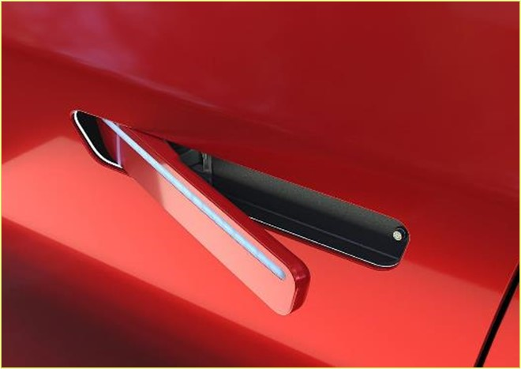
2. KEY questions
2.4 CONTROL SYSTEM
Power / Current Consumption
What electrical power control measures are in place and what are the minimum requirements or maximum limits?
Timing
When using multiple ICU’s, what is the overall response time in a wide variety of situations involving button input, door manipulation, and obstruction? How long does it take to stop?
Pinch Safety
What is the resulting pinch force before the system identifies a pinch situation and is activated?
© 2023 EZMetrology

Slide 11
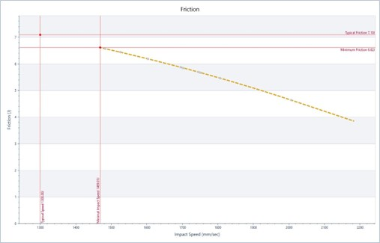
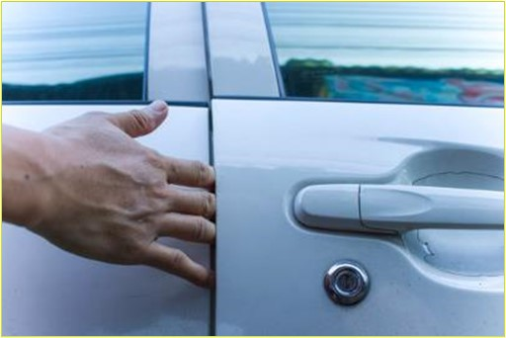
2. KEY questions
2.5 SYSTeM PERFORMANCE
Durability
What is the resulting performance after an estimated life cycle of a system, door components, and power system components?
Safety
Are all potential harmful situations covered in the design and how do they perform?
Climate Testing
How does the system perform in the wide range of climate conditions?
Case Studies
How does the system respond to external slopes and wind gusts?
© 2023 EZMetrology

Slide 12
3. Measurement Solutions
© 2023 EZMetrology

Slide 13
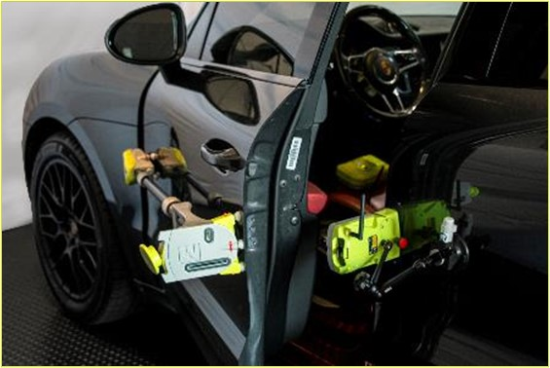
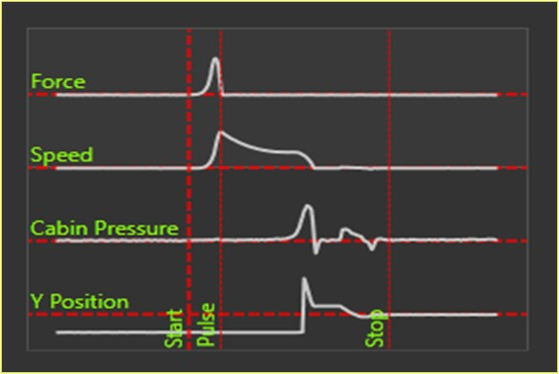
3. Measurement SOLUTIONS
3.1 User sensation – EZSLam
Quantify the user interaction with the door and the individual component contributors to the overall system operation.
Door Characteristics
Closing speed
Speed vs. Angle
Closing energy
Hinge inclination
Seal compression
Force vs. Angle
Weight
Air management in cabins and seals
© 2023 EZMetrology

Slide 14
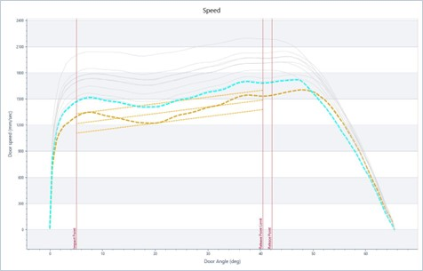
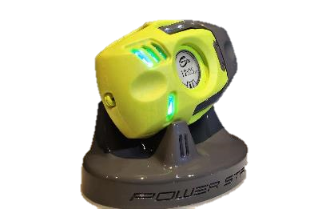
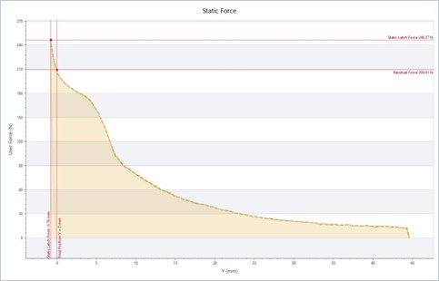
3. Measurement SOLUTIONS
3.2 Movement ANALYSIS - PODs
Pod, EZ’s latest platform, contains the latest generation measurement sensors and modular systems that can be used individually or in a set with synchronization.
Speed Pod
Capture the full speed curve as a function of the door angle
Include acceleration and deceleration effects
Determine hinge inclination
Force Pod
Capture the force from the user interaction with the door system:
Initial force pulse
Obstacle force
Seal compression force
© 2023 EZMetrology

Slide 15
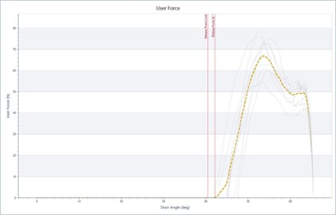
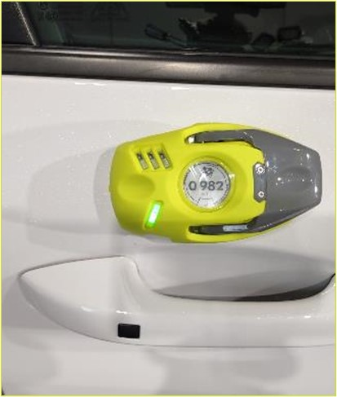
3. Measurement SOLUTIONS
3.3 System ANALYSIS – PODS
Pod modules allow the user to easily capture and synchronize force, speed, and other characteristics.
Sensor Pod
Capture a wide variety of other signals (analog or digital signals)
Digital control lines
Analog signals / counters
Electrical components: voltage and current
CAN Signals
Signals or message that would be communicated via CAN are included in the recording.
© 2023 EZMetrology

Slide 16
4. Data Solutions
© 2023 EZMetrology

Slide 17
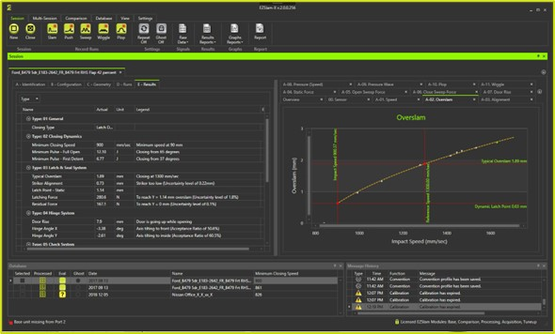
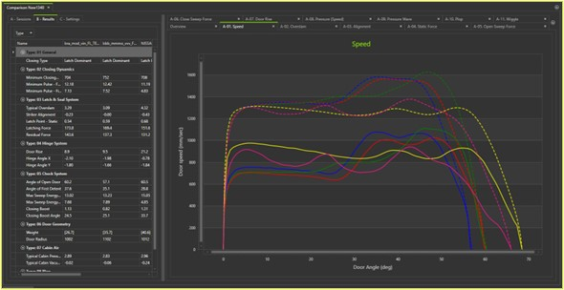
4. Data Solutions
4.1 Turn-key Analysis
The EZSlam software includes capabilities for all critical data collection, processing , and presentation in a standard reliable way. No further development is needed for the most popular metrics or visual representations.
Turn-key System : EZSlam
    Fully automated analysis of door characteristics
    Real-time feedback on channel status
    Automatic naming of recording sequences based on templates
    Data overview at the end of each recording
© 2023 EZMetrology

Slide 18
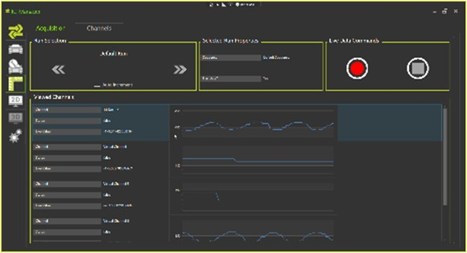
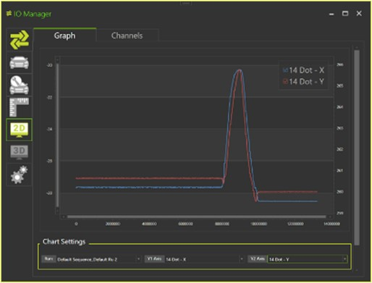
4. Data Solutions
4.2 Signal - curves
A flexible configuration where the complete analysis including recording, processing and reporting, can be customized to extract specific signal characteristics.
Ultimate Flexibility
    Record individual sensor data
    Includes signal processing
    Template processing
    Automated reporting
Examples
    Speed vs. Electrical Power
    Force vs. Speed
    Speed vs. Angle
    Current vs. Force
© 2023 EZMetrology

Slide 19
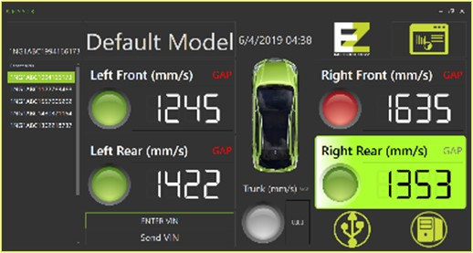
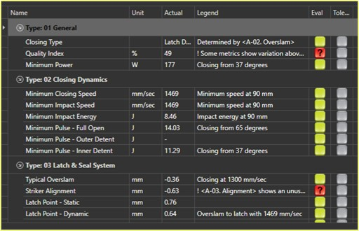
4. Data Solutions
4.3 Metrics - Values
An increase in simplicity where only one or a few individual values are determined and can be used for an evaluation of the performance over time or in different configurations
Single Target Values : PLS
    Straightforward go/no-go check of system performance
    Key values can be monitored over time for durability specifications
Examples
Electrical power
Impact speed
Trajectory time
© 2023 EZMetrology

Slide 20
Thank you
info@ezmetrology.com
support@ezmetrology.com
www.ezmetrology.com
portal.ezmetrology.com
academy.ezmetrology.com
© 2023 EZMetrology

Slide 21


Company Pages

Slide 22
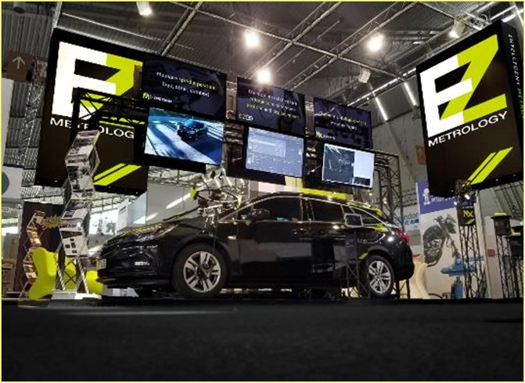
COMPANY OVERVIEW
Founded in 2006 by Carine Woldanski and Tom Van Esch
Global Operations:
  USA Headquarters in Michigan
  Europe Support office in Luxemburg
  Asia Partnerships
EZMetrology:
  70% Development and Engineering
    Fast product development and interactive evolutions
  20% Support and Training
    Ensuring a transfer of knowledge to our customers
  10% Administration and Sales
    Manage customs and sales procedures
Consistent annual growth of 50% over the past years
Developing innovative, creative and practical products
© 2023 EZMetrology

Slide 23

SHARING OUR PASSION WORLDWIDE WITH CUSTOMERS AT
ALPINE
ARRIVAL
AUDI
BMW
BROSE
CANOO
CATERPILLAR
CHRYSLER
DACIA
DAIHATSU
DAIMLER
DENSO
FAW
FAURECIA
FERRARI
FIAT
FORD
GAC
GENERAL MOTORS
GG MOTORS
HUMANETICS
HONDA
HYUNDAI
INFINITI
JAGUAR
JEEP
KASEIKOGYO
KIA
KIEKERT
LADA
MACK
MAHINDRA
MARUTI
MASERATI
MAZDA
MITSUBISHI
MULTIMATIC
NISSAN
NITTO DENKON
POLARIS
PORSCHE
PROTON
PSA
QOROS
RENAULT
RIVIAN
SAIC MOTOR
SEAT
SIEMENS
STELLANTIS
SUBARU
SUZUKI
TATA MOTORS
TESLA
TOGG
TOYODA GOSEI
TOYOTA
VOLKSWAGEN
VOLVO
VOLVO TRUCKS
- EZM HEADQUARTERS
- EZM PARTNERS
- EZM CUSTOMERS
© 2023 EZMetrology

Slide 24


