Slide 1

SensorPod
4-CHANNEL ANALOG INPUT POD
TECHNOLOGY TO ACCURATELY AND EASILY CAPTURE AND TRANSFER
ANALOG SIGNALS FROM A VARIETY OF INSTRUMENTS IN COMBINATION WITH POSITION OR MOVEMENT SENSORS..
Confidential
© 2025 EZMetrology

Slide 2

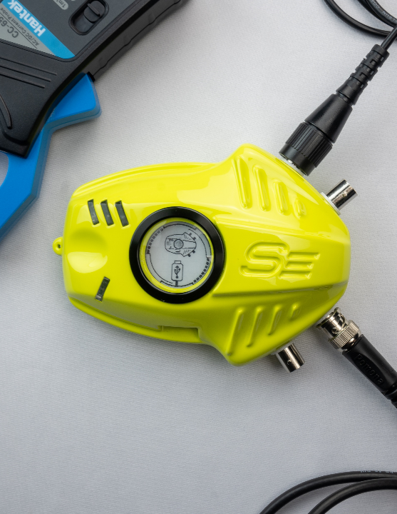


INDEX
Introduction
Innovations
Operation
Data Management
Support and Service
SensorPod Variants
Confidential
© 2025 EZMetrology

Slide 3

1. Introduction
Confidential
© 2025 EZMetrology

Slide 4
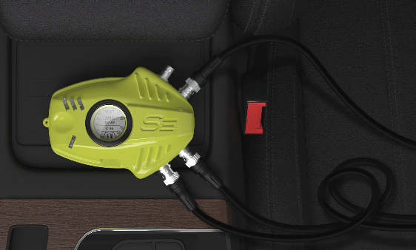
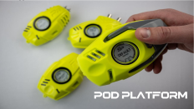

1. Introduction
1.1 new generation
  With thousands of satisfied users, EZMetrology has consolidated all feedback, made key upgrades, and developed this new next-generation analog signal hub.
  SENSORPOD
  Part of the Pod product family, which stands for innovation on many levels:
    Improved accuracy
    Reduced measurement time
    Simplified operation
    Reduced size and weight
    Improved connectivity
    Inter-device compatibility
Confidential
© 2025 EZMetrology

Slide 5
2. Innovations
Confidential
© 2025 EZMetrology

Slide 6
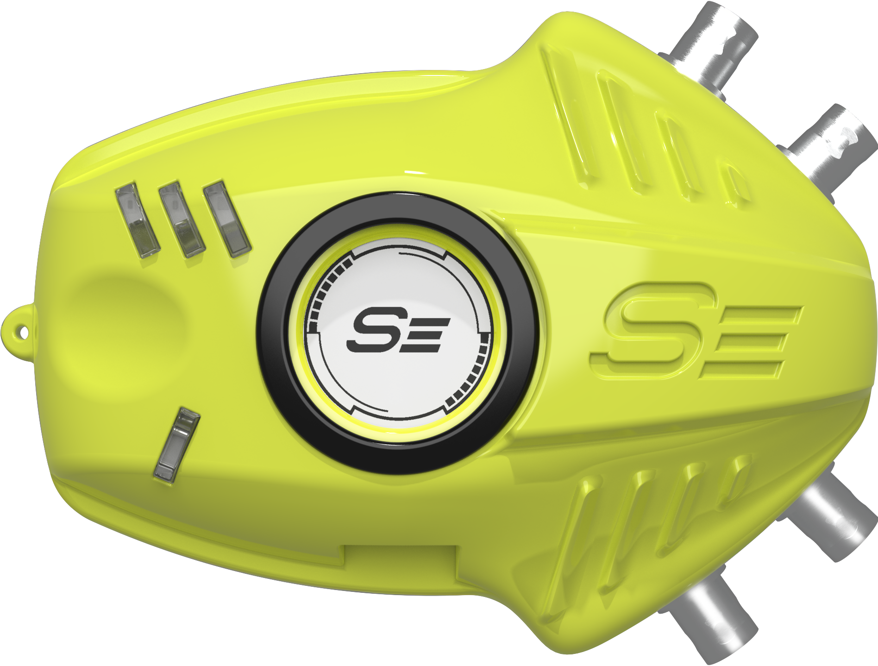

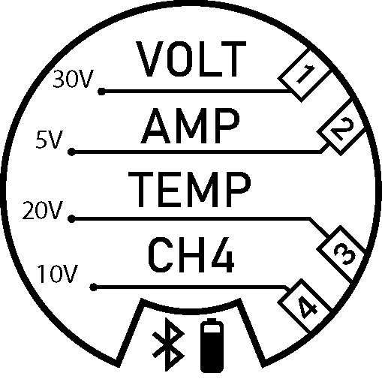
2. innovations
2.1 processing POWER
  Dual-core processor power for real-time processing.
Smart Processing
Per-channel customizable gain + offset
Variable channel range
24-bit AD conversion
Automatic lowpass filtering
2kHz sample rate
Smart Measurements
  Universal BNC connectors
  Device configuration feedback from screen + LEDs
Confidential
© 2025 EZMetrology

Slide 7
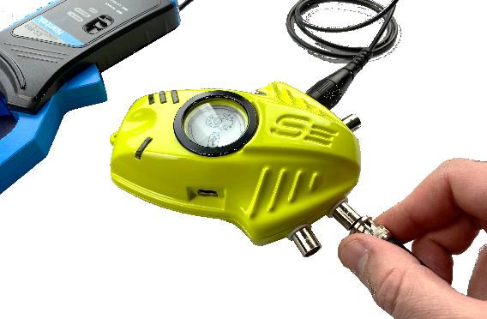
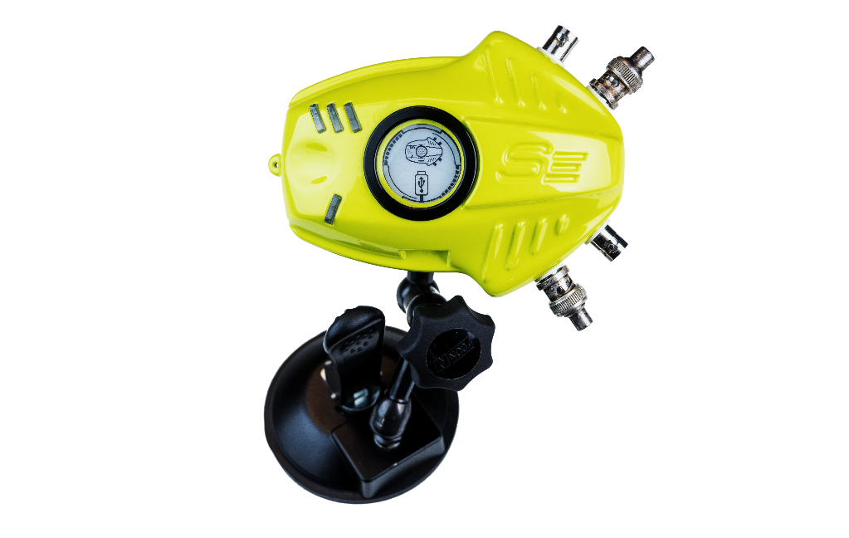
2. innovations
2.2 functional design
Safe and Secure Installation
Rubber base for placement on any surface
Non-slip, stable feet
M5 thread mount for attachment to external arms, etc.
Battery Technology
      Battery operated – 6-10 hrs idle
      USB-C fast charging
      Sleep Mode
Data Management
16GB on-board memory (SD card)
Bluetooth and Wi-Fi ready
Confidential
© 2025 EZMetrology

Slide 8
3. Operation
Confidential
© 2025 EZMetrology

Slide 9
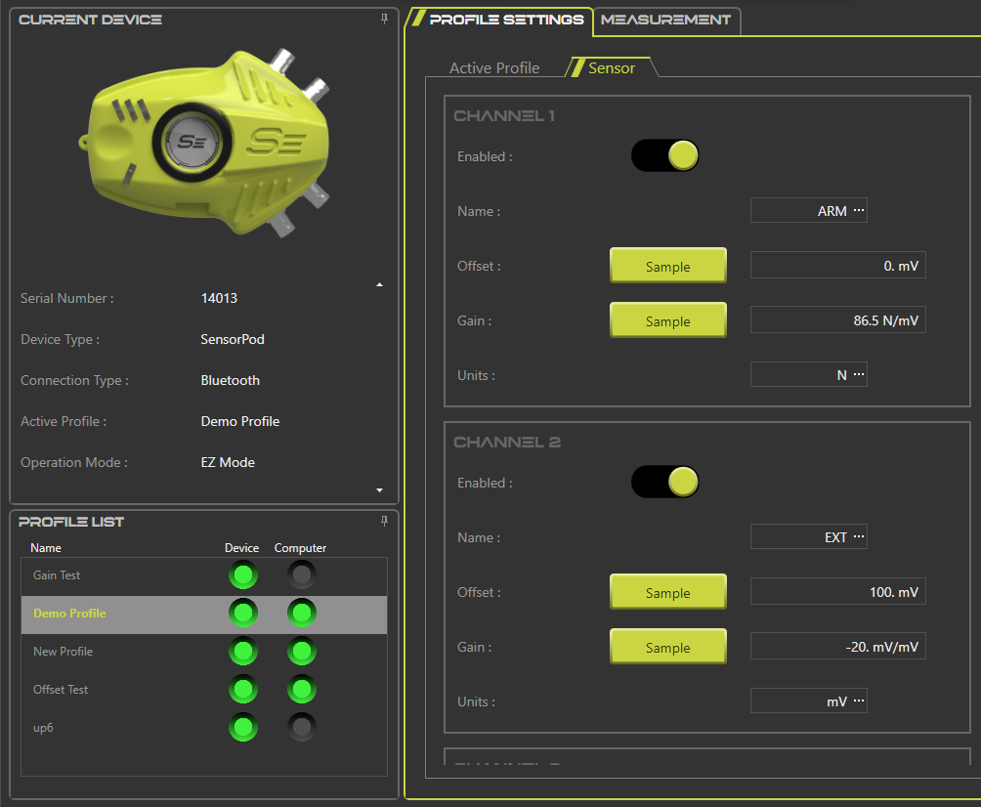
3. operation
3.1 Easy operation
One-Click Configuration
Custom name channels
Preset Gain + Offset factors
Organize Profiles in MyPod
Quick Installation
Fully portable – anywhere cables can reach
Visual Confirmations
Screen displays active channel(s)
LED recording/streaming status indicators
Passthrough Streaming
Record raw sensor data (MyPod)
Input alongside other Pods (IOManager)
Confidential
© 2025 EZMetrology

Slide 10
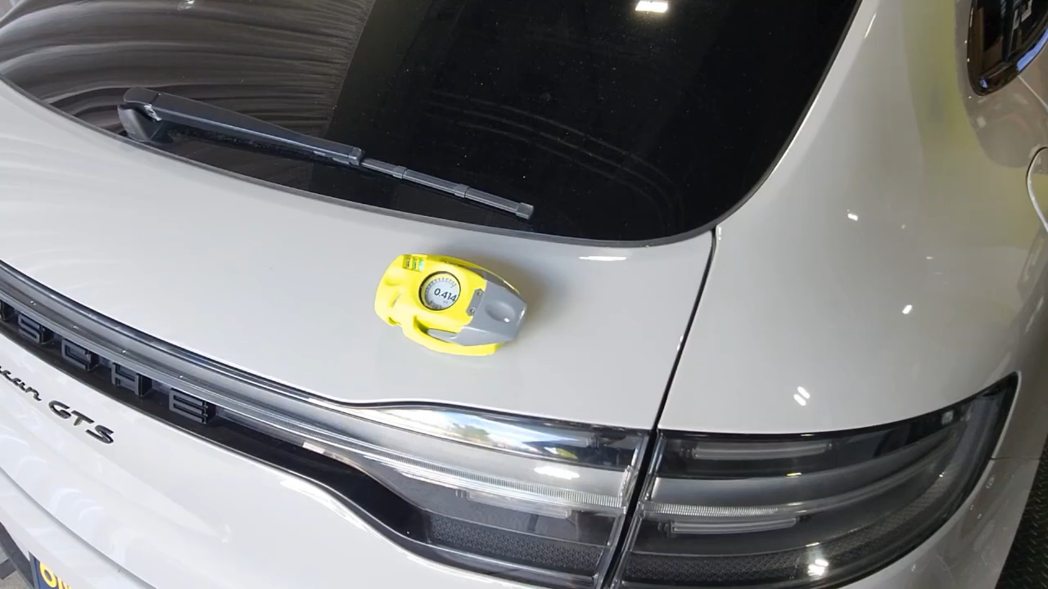
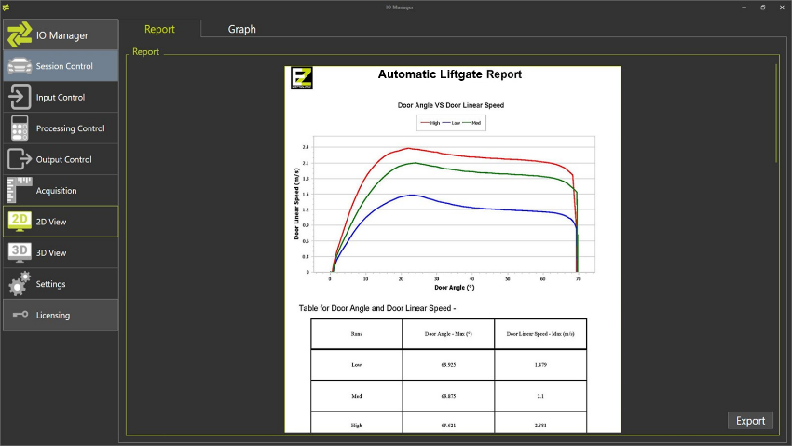
3. operation
3.2 FIELD EXAMPLE
Quick Installation + Multi-level Measurement
    Connect sensor BNCs
    Connect to MyPod
    Set Gain + Offset
    (or apply Profile)
With MyPod Data Logging Module
    Record
    Save to CSV
With IOManager for In-Depth Analysis
    Connect to IOManager
    Configure calculations
    Stream and Record
1112 x 540 17.8 MB
Confidential
© 2025 EZMetrology

Slide 11
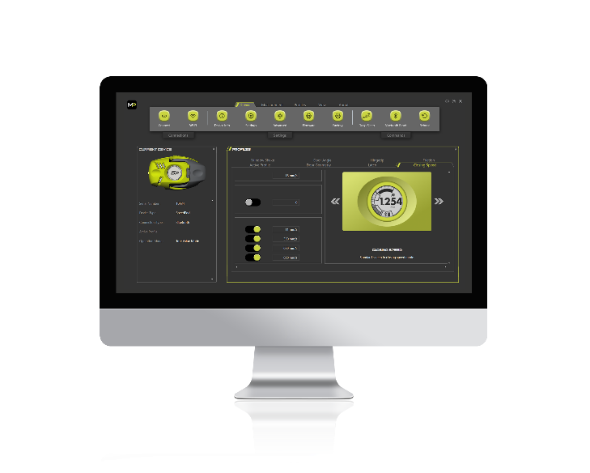
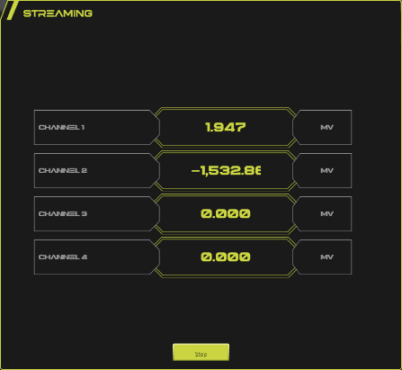
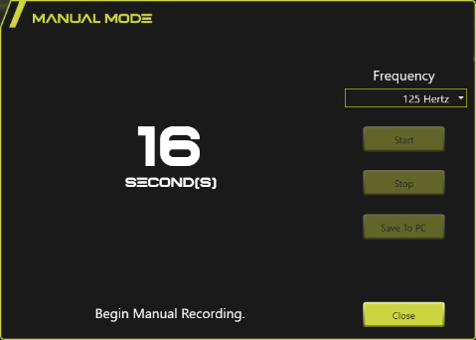
3. operation
3.3 configuration
Set up the SensorPod with MyPod configuration software.
Individual Settings
      Per-channel units
      Gain and Offset
        “Sampling” quick-apply
      Enable/disable channels
      Custom name channels
Profiles
      Store a collection of specific settings
      Collection of connected devices
      Single-click recall
  Specials
      Access to updates
      Manual Recordings
      Quick-reference Streaming console
Confidential
© 2025 EZMetrology

Slide 12
4. Data Management
Confidential
© 2025 EZMetrology

Slide 13


4. Data management
overview
Choose the right level of data logging.
Level 1 : Manual logging to text file
Level 2 : Log raw data and perform analysis
Confidential
© 2025 EZMetrology

Slide 14
5. Support and Service
Confidential
© 2025 EZMetrology

Slide 15

5. Support and service
5.1 WORKSHOPS
EZMetrology experts share knowledge on the technology and applications.
On-Line Workshops
      Collection of 4h workshops
      Each workshop focused on application-specific setup
In-Person Workshops
      Collection of training topics based on the customer configuration
      Includes hands–on exercise
  Installations and/or Integrations (optional)
      On-site installation and configuration
      Custom integration (communication, reporting…)
      Typical for in-line solutions
Confidential
© 2025 EZMetrology

Slide 16

5. Support and service
5.2 SPC Program
Peace of mind for your investment.
Software Updates
      Keep your system up to date
      New features
      Enhanced user interaction
Tech Support
      support@ezmetrology.com
Repairs
      Coverage for all essential components
Academy
      academy.ezmetrology.com
Terms
      First year Included
      Subsequent years Subscription
Confidential
© 2025 EZMetrology

Slide 17
6. SensorPod Variants
Confidential
© 2025 EZMetrology

Slide 18
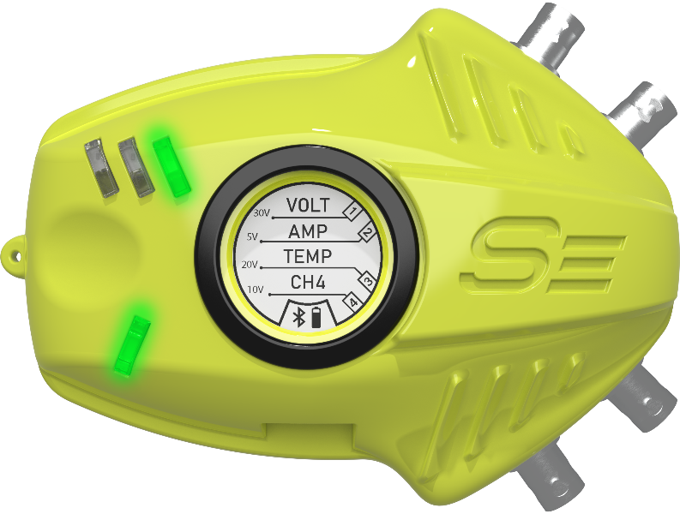

6. Sensorpod variants
6.1 SensorPod flex
Data Logging Module
      Log measurement data to CSV
      Manual Record raw data to file
Streaming Module
      Connection to IOManager
Confidential
© 2025 EZMetrology

Slide 19
6. sensorPod variants
6.2 Maintenance
Annual Calibration – Return to Factory
      Return to factory for annual calibration
Annual Calibration – On-Site
      Premium on-site calibration service
SPC Subscription
      Updates
      Support
      Warranty
      Academy
Confidential
© 2025 EZMetrology

Slide 20
Thank you.
info@ezmetrology.com
support@ezmetrology.com
www.ezmetrology.com
portal.ezmetrology.com
academy.ezmetrology.com
Confidential
© 2025 EZMetrology

Slide 21


Company Pages

Slide 22
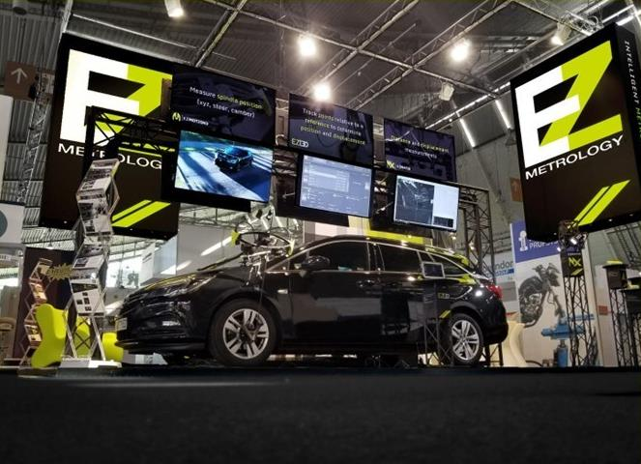
COMPANY OVERVIEW
Founded in 2006 by Carine Woldanski and Tom Van Esch
Global Operations
  USA Headquarters in Michigan
  Europe Support office in Luxembourg
  Asia Partnerships
EZMetrology
  60% Development and Engineering
  30% Support and Training
  10% Administration and Sales
Consistent annual growth over the past 15 years.
Developing innovative, creative and practical products.
Confidential
© 2025 EZMetrology

Slide 23

SHARING OUR PASSION WORLDWIDE WITH CUSTOMERS AT
ALPINE
ARRIVAL
AUDI
BMW
BROSE
CANOO
CATERPILLAR
CHRYSLER
DACIA
DAIHATSU
DAIMLER
DENSO
FAW
FAURECIA
FERRARI
FIAT
FORD
GAC
GENERAL MOTORS
GG MOTORS
HUMANETICS
HONDA
HYUNDAI
INFINITI
JAGUAR
JEEP
KASEIKOGYO
KIA
KIEKERT
LADA
MACK
MAHINDRA
MARUTI
MASERATI
MAZDA
MITSUBISHI
MULTIMATIC
NISSAN
NITTO DENKON
POLARIS
PORSCHE
PROTON
PSA
QOROS
RENAULT
RIVIAN
SAIC MOTOR
SEAT
SIEMENS
STELLANTIS
SUBARU
SUZUKI
TATA MOTORS
TESLA
TOGG
TOYODA GOSEI
TOYOTA
VOLKSWAGEN
VOLVO
VOLVO TRUCKS
- EZM HEADQUARTERS
- EZM PARTNERS
- EZM CUSTOMERS
© 2025 EZMetrology

Slide 24


Slide 25
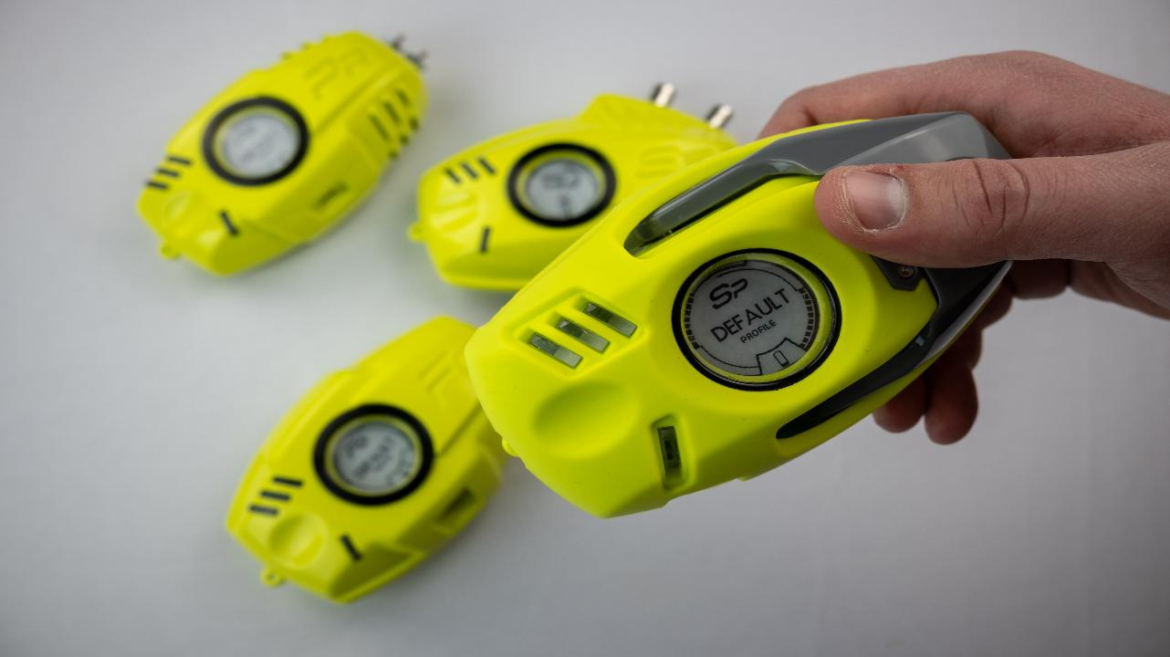
1. Introduction
1.1 new generation
POD PLATFORM
Confidential
© 2025 EZMetrology

Slide 26
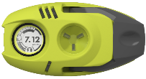
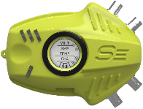
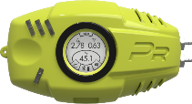
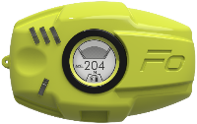
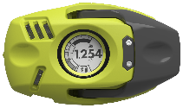
POD PLATFORM
Energy
POD
  “Making it possible for anybody to measure all key characteristics of a door system.”
  Speed and EnergyPod
    For closing energy, speed, or other dynamic characteristics
  PressurePod
    For pressure effects in cabin due to closing event
  SensorPod
    Capture electrical control signals from automated systems
  ForcePod
    Capture a wide variety of load cases
    Use gauges individually or in group to enhance understanding.
Sensor
Pod
Pressure
Pod
Force
Pod
Speed
Pod
Confidential
© 2025 EZMetrology

Slide 27
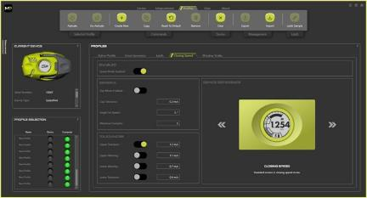

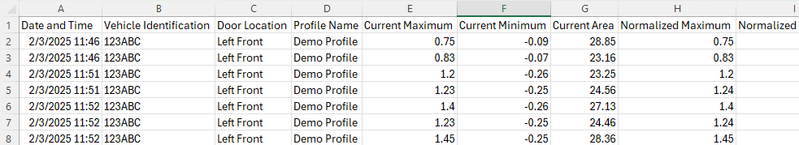
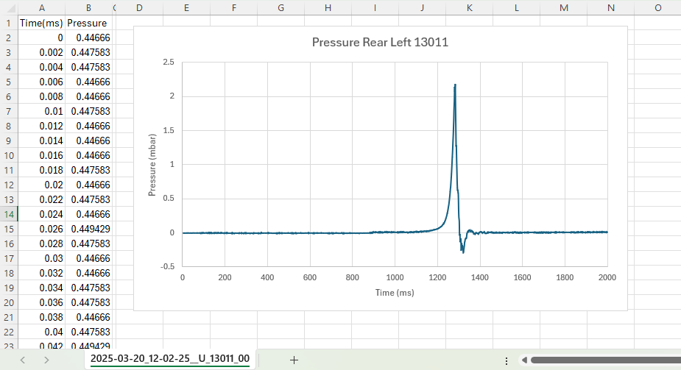
Values can be saved to computer for graphing, analysis or future processing.
For Raw Data
      Save raw sensor values to CSV file
      Processing in (for example) Excel
Software
      Requires Data Logging Module (MyPod )
      No additional software
Confidential
© 2025 EZMetrology

Slide 28
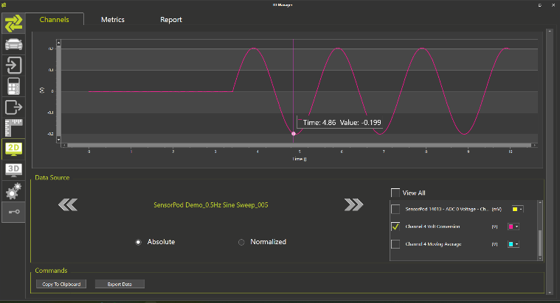

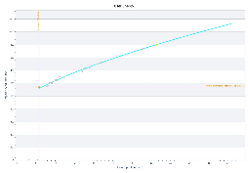
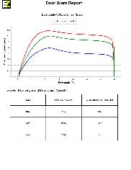
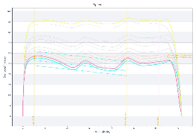
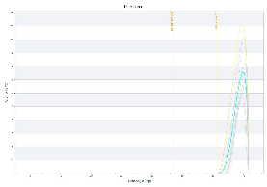
Analysis platform for detailed view and troubleshooting.
Objective
      Connect to multiple EZM devices at the same time
      Configure processing for custom analysis
      Use Acquisition, Processing and Reporting templates
Applications
Use templates to generate a custom report
Automatic door actuation + Closing Speed
EZMotion applications
Wind tunnel output speed, angle, …
External dynamics sensors
…
Software
      Requires IOManager License
      Requires Streaming Module
Confidential
© 2025 EZMetrology

