Slide 1

EZMetrology
PRODUCTION Line Solution
Latest technology to perform validation of door closing efforts for final vehicles, from partial sampling to 100% inline validation.
Confidential
© 2024 EZMetrology

Slide 2

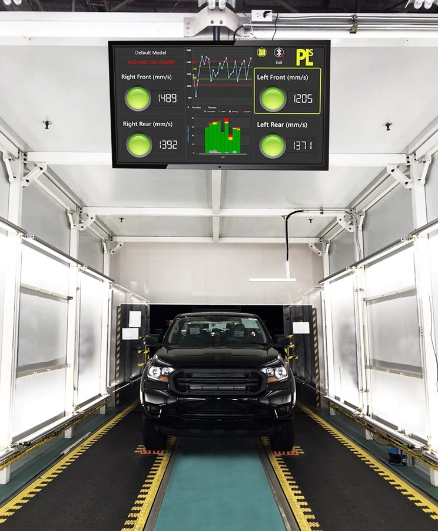
INDEX
Fundamentals
Technology Platform
Implementation
Conclusion
Confidential
© 2024 EZMetrology

Slide 3

1. Fundamentals
Confidential
© 2024 EZMetrology

Slide 4
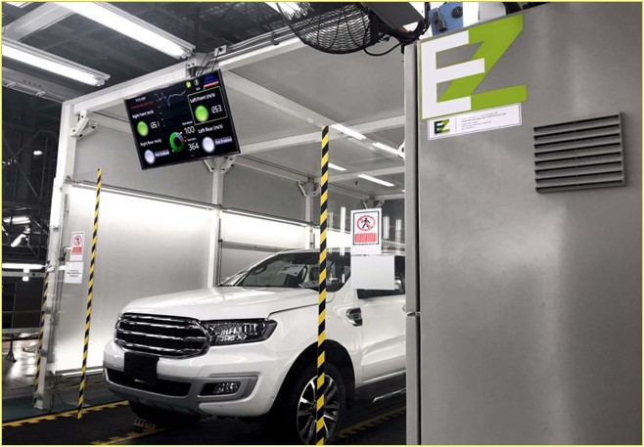
1. Fundamentals
1.1 WHY ?
  “One of the customer’s very first impressions about the quality of the car is given by the behavior of the doors when opening and closing.”
  - Society of Automotive Engineers (SAE) International
  Therefore, door closing efforts can be evaluated for two reasons:
  Process Control
  Ensuring the production process performs consistently and to the design standards, limiting rework and variation in the final vehicle.
  Outgoing Quality
  Delivering vehicles which meet the product specifications, resulting in high customer approval ratings.
  Latest developments in inspection technology and solutions from EZMetrology are designed to cover all requirements.
Confidential
© 2024 EZMetrology

Slide 5
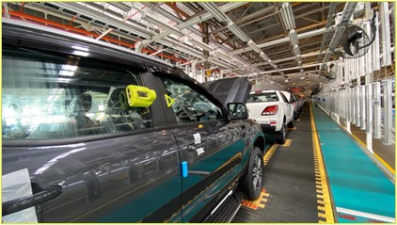
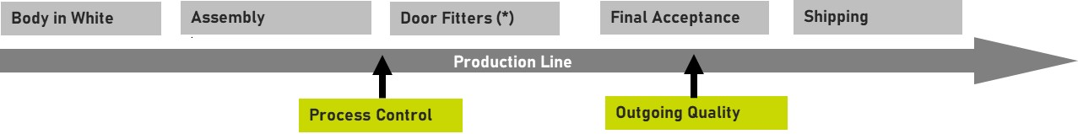
1. Fundamentals
1.2 Where ?
  In the most demanding case, inspection is performed inline, on all vehicles leaving the production site.
  In each plant, different environments and objectives might motivate a preferred layout.
  Before Door Fitters
  Data obtained at this particular location will provide the most accurate information on the performance of the door assembly and installation process.
  Examples: seal gap consistency, hinge installation, and door positioning
  After Door Fitters (Final Acceptance)
  Following the manual intervention of the fitters, the objective is to verify the outgoing product quality and performance.
  (*) Door Fitters: Station where operators manually adjust the door position to improve fit, flush and gap or closing efforts.
Confidential
© 2024 EZMetrology

Slide 6
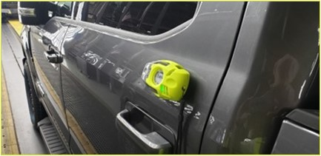
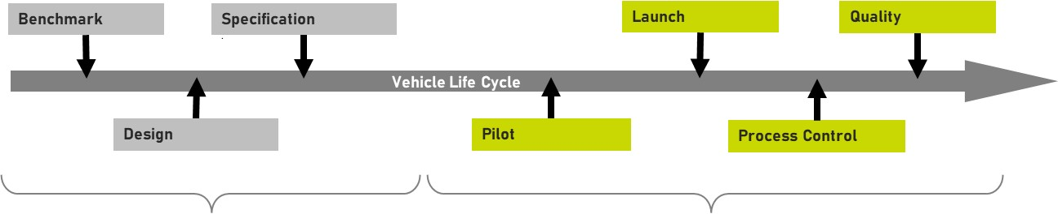
1. Fundamentals
1.3 WHEN ?
  Requirements on sample frequency of testing evolve over the duration of vehicle’s life cycle.
  Pilot / Launch / Model Update
  High Sampling Rate: Fast-evolving changes, important for a dense sampling to follow progressive improvements.
  Process Control
  Medium-Low Sampling Rate: Ensure the consistency of the production process over the course of time.
  Quality Control
  Medium-Low Sampling Rate: Observe the outgoing quality and watch for unforeseen product variation.
  Frequency can also be a function of process capability (Cpk) or how much margin there is around the tolerances with respect to the amount of process variation.
Confidential
© 2024 EZMetrology

Slide 7
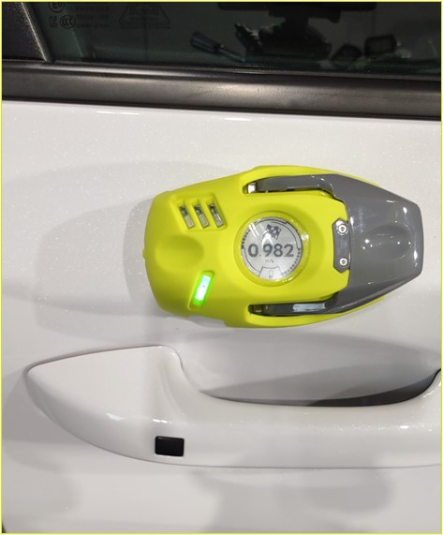
1. Fundamentals
1.4 HOW ?
  Three ingredients are required for a successful installation:
  Measurement Gauge
  The equipment used to measure closing efforts has to be simple, reliable, and accurate.
  Process Control Software
  The managing software must be able to guide the operators through the measurement process, providing instructions, adherence to preset sampling rates, and comparisons to tolerances.
  Data Traceability
  The recorded data must be reported to a quality system so results are associated with a particular vehicle.
  “Production Line Solution” or PLS is an off-the-shelf product that matches the criteria and has been installed at many OEMs’ production lines.
  This solution has been assisting manufacturers to monitor and improve their door quality ratings.
Confidential
© 2024 EZMetrology

Slide 8
2. Technology Platform
Confidential
© 2024 EZMetrology

Slide 9
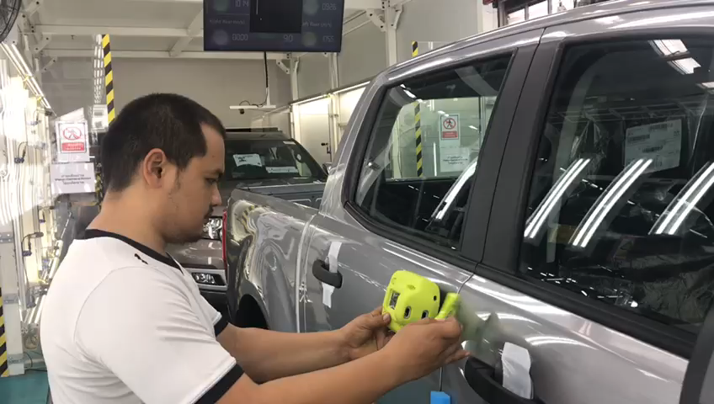
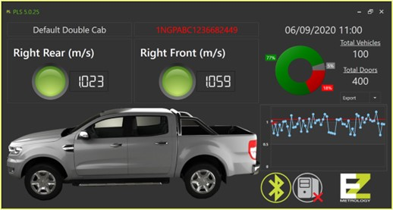
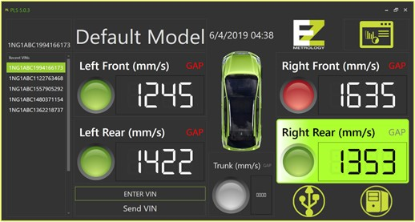
2. Technology platform
2.1 PLS software
  PLS systems can be adapted to different layouts with applications summarized in 4 steps:
  1. Acquisition of VIN and Closing Speeds with EZMetrology Measurement Gauge
  VIN number of the vehicle is registered
  Operator uses gauge to measure door closing efforts
  2. Collecting all Data
  All data for the vehicle is collected in line with the inspection plan and compared to the applicable tolerances
  Minimum closing speed and vehicle symmetry can be evaluated
  3. Visualization of the data
  Data can be displayed locally or remotely in customer specific formats and graphs
  4. Reporting the data
  Recorded data is exported in any desired format to be registered in the OEM’s vehicle database
Confidential
© 2024 EZMetrology

Slide 10
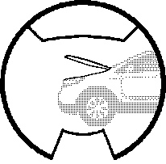
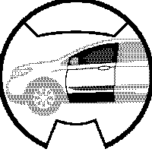
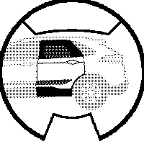
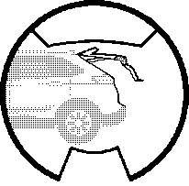
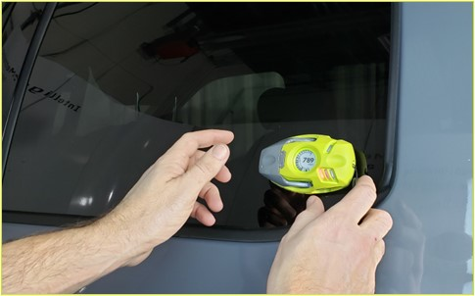
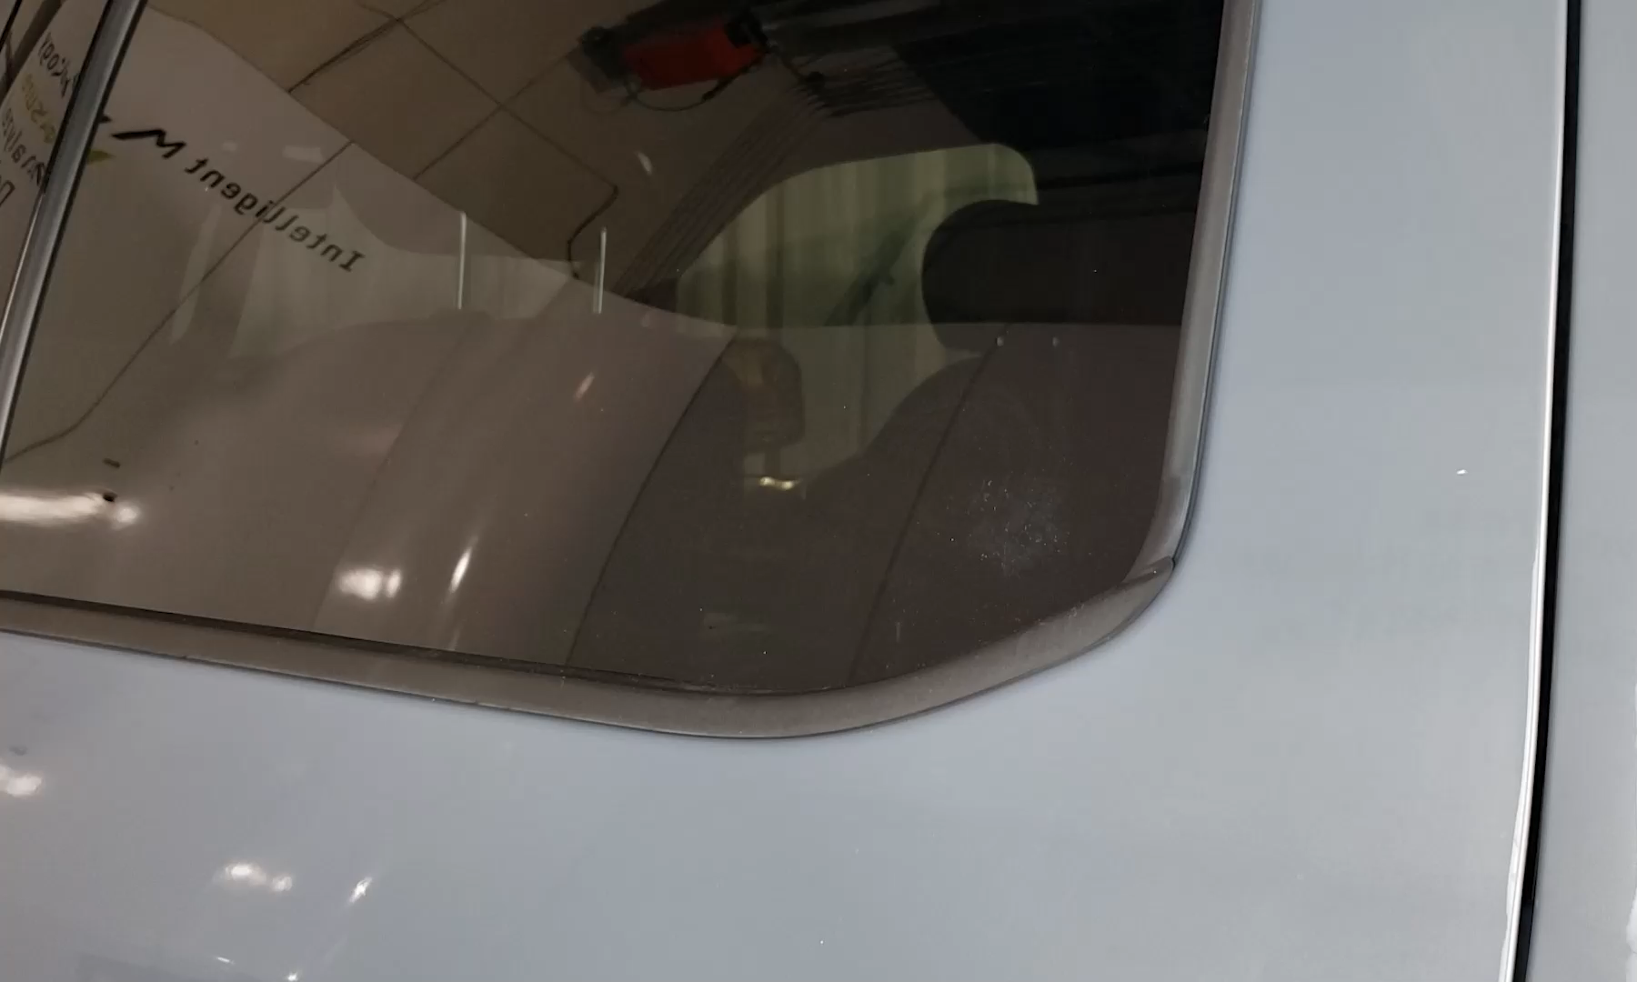
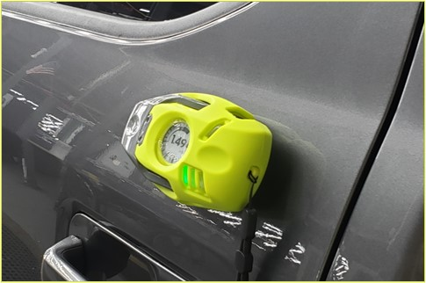
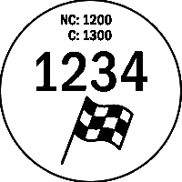
2. Technology platform
2.2 SpeedPod – Fast and EASY
  SpeedPod is the newest technology for evaluating door closing efforts by measuring minimum closing speed:
  User Feedback
  The operator receives instructions on where to mount the gauge
  Multiple bright LEDs indicate the progress or state of the measurement
  Fast Installation
  The gauge is installed within seconds anywhere within a mounting region
  No Buttons and No User Input Required
  The algorithm recognizes all movements; there is no user input required
  Opened, closed, latched or not latched conditions are identified
  Measurement Complete : Finish Flag
  The gauges indicate when the measurement is completed and when the device can be removed for the next stage
Confidential
© 2024 EZMetrology

Slide 11
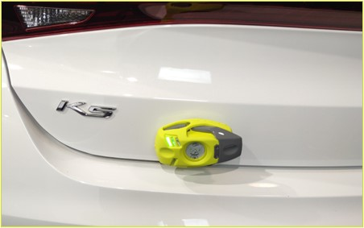
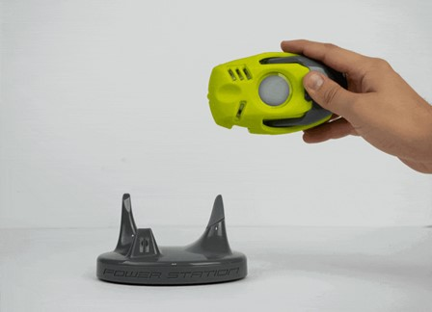
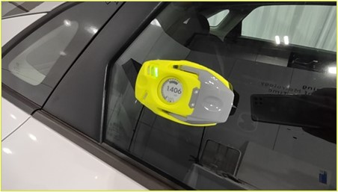
2. Technology platform
2.3 SpeedPod – INDUSTRIAL Design
  In addition to the ease of use, SpeedPod is designed to be robust and capable of being used 24/7.
Integrated Protective Cover
  Impact-resistant cover to protect gauge from an accidental drop.
  Accurate
  The SpeedPod has the best-in-class accuracy of better than 1.5%.
  Wireless Operation
  Any collected data is communicated to the software for traceability via wireless link.
  High-Contrast Screen
  Screen provides necessary instructions or feedback to the user.
  Fast-Charging Docking Station
  Docking Station will keep the device fully charged even with short charging intervals during breaks or lunch.
Scratch-Resistant Glass
  The screen is protected by scratch-resistant dome glass for strength and clarity.
Confidential
© 2024 EZMetrology

Slide 12










2. Technology platform
2.4 STATION INTEGRATION – DATA FLOW
PLS Software Platform
VIN Scanner
Click to zoom
VIN Decoder
Click to zoom
Specifications
Acquisition
Instructions
Click to zoom
VIN, Door, Value, Go/No-Go
Click to zoom
PLS Output
Click to zoom
PLS Database (local)
Confidential
© 2024 EZMetrology
Notes:
Remind EZSpeed Box

Slide 13
3. Implementation
Confidential
© 2024 EZMetrology

Slide 14
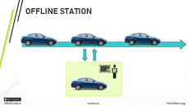
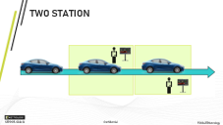
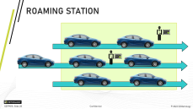
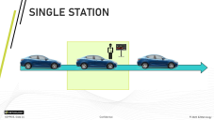
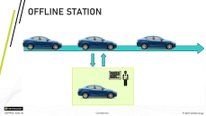
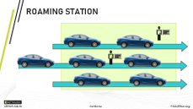
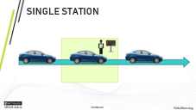
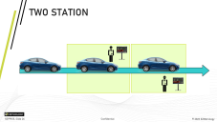
3. implementation
3.1 POPULAR Layouts
  There are 4 popular station layouts. The preferred layout is driven by the following requirements:
    Physical Space: How much room is there in the line?
    Cycle Time: How much time is available for monitoring per vehicle?
    Available Operators : How many operators are allocated to the door station?
    Sample Frequency : What percentage of vehicles will be checked?
    Repair Policy : Who performs the repair if the door is not in specification?
Click to zoom
Click to zoom
Click to zoom
Click to zoom
Confidential
© 2024 EZMetrology

Slide 15
4. Conclusion
Confidential
© 2024 EZMetrology

Slide 16
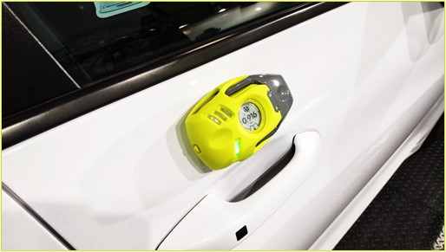
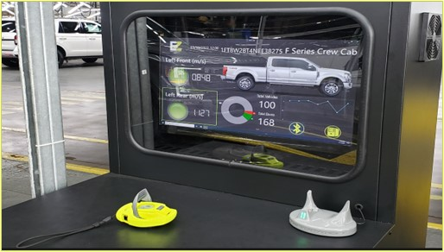
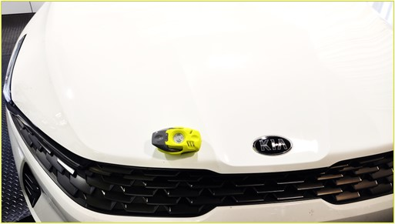
4. Conclusion
  Advantages of PLS & SpeedPod inspection stations can be summarized below:
  Capable for 100% sampling rate in quality door test operations
  All door types can be measured and recorded to the database
  Unique graphs give insightful analysis of measurement data to supervisors and line managers
  Latest technology
  Uninterrupted operation
  Onsite installations and training
  Global support is available online and onsite
  Worldwide references
Confidential
© 2024 EZMetrology

Slide 17

SHARING OUR PASSION WORLDWIDE WITH CUSTOMERS AT
ALPINE
ARRIVAL
AUDI
BMW
BROSE
CANOO
CATERPILLAR
CHRYSLER
DACIA
DAIHATSU
DAIMLER
DENSO
FAW
FAURECIA
FERRARI
FIAT
FORD
GAC
GENERAL MOTORS
GG MOTORS
HUMANETICS
HONDA
HYUNDAI
INFINITI
JAGUAR
JEEP
KASEIKOGYO
KIA
KIEKERT
LADA
MACK
MAHINDRA
MARUTI
MASERATI
MAZDA
MITSUBISHI
MULTIMATIC
NISSAN
NITTO DENKON
POLARIS
PORSCHE
PROTON
PSA
QOROS
RENAULT
RIVIAN
SAIC MOTOR
SEAT
SIEMENS
STELLANTIS
SUBARU
SUZUKI
TATA MOTORS
TESLA
TOGG
TOYODA GOSEI
TOYOTA
VOLKSWAGEN
VOLVO
VOLVO TRUCKS
- EZM HEADQUARTERS
- EZM PARTNERS
- EZM CUSTOMERS
© 2024 EZMetrology

Slide 18
Thank you
info@ezmetrology.com
support@ezmetrology.com
www.ezmetrology.com
portal.ezmetrology.com
academy.ezmetrology.com
Confidential
© 2024 EZMetrology

Slide 19
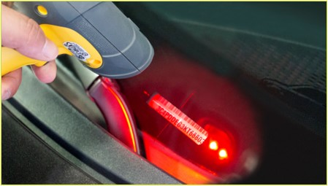
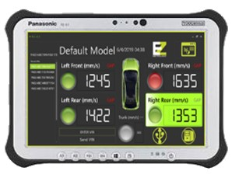
Station integration
2.4.1 VEHICLE IDENTIFICATION
  Identify the vehicle in station for data collection and traceability .
VIN
  The 17- or 18-digit VIN number is recommended because its unique composition and the embedded information can be extracted to identify the vehicle at all times.
  Obtain the VIN number with standard tools:
Via Line Controller
  Obtain the VIN via communication with the line controller for the vehicle currently in the station.
Manual Wireless Hand Scanner
  Operator scans the barcode or QR code using an industrial grade wireless hand scanner.
Tablet Based Barcode Scanner
  Operator uses a tablet-based barcode scanner to have all functions at hand.
Confidential
© 2024 EZMetrology
Notes:
Remind EZSpeed Box

Slide 20
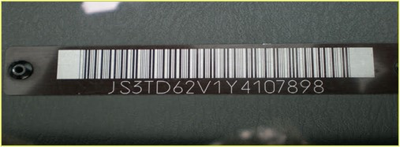
Station integration
2.4.2 VIN DECODING
  Based on the VIN number, the software will load the required specifications:
Type of Vehicle
  For example, Model A, Model B, or Model C
Inspection Procedure
  Provide instructions to the operator for the inspection procedure
  For example, which doors need to be inspected, for what characteristics, and what are tolerance levels
  The process is shown on the computer screen and device display
Number and Type of Doors
  How many and what type of doors?
  For example, side swing, sliding, hood, tailgate, and liftgate
Tolerances (optional aging curve)
  Use tolerances and warning levels to provide an objective verdict
Database Entry
  Save all relational data to the database under the specific VIN
Reporting Format
  Communicate the results to an upstream database with reference to the vehicle
Confidential
© 2024 EZMetrology
Notes:
Remind EZSpeed Box

Slide 21
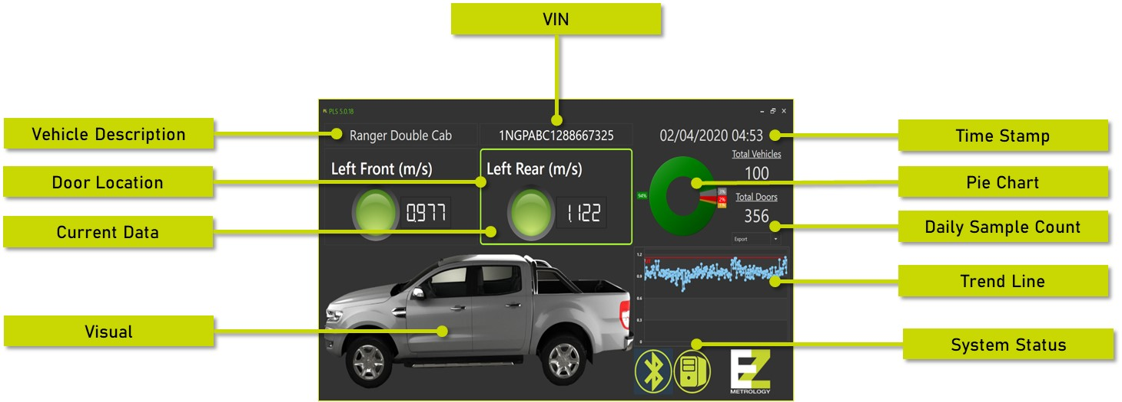
Station integration
2.4.3 OPERATOR INSTRUCTIONS
  The overhead screen provides a clear status of the station and helps as a guide for the operator.
Confidential
© 2024 EZMetrology

Slide 22
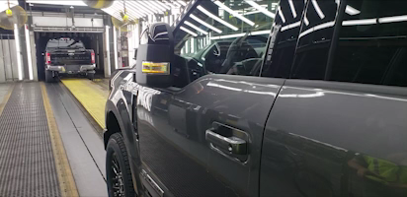
Station integration
2.4.4 MEASURMENT PROCESS
  Once in station, the acquisition process can start.
Mount SpeedPod
  Mounting instructions to place the gauge above the handle
Maximum of 3 Measurements
  Time allows the operator a maximum of 3 attempts (~20sec)
Conclusion
  If the data confirms a reading within tolerances, measurement is complete
Dismount SpeedPod
  Remove SpeedPod
Confidential
© 2024 EZMetrology

Slide 23



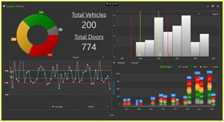
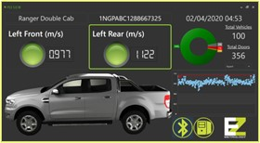
Station integration
2.4.5 Reporting Formats
Per Vehicle (Text)
VIN Input
Daily Export (Text)
PLS Solution
SpeedPod
Serial Communication
TCP/IP
File Interface
Live Screen
SQL Database
QDA Database
Inspect Database
FIS-EQS
Confidential
© 2024 EZMetrology

Slide 24
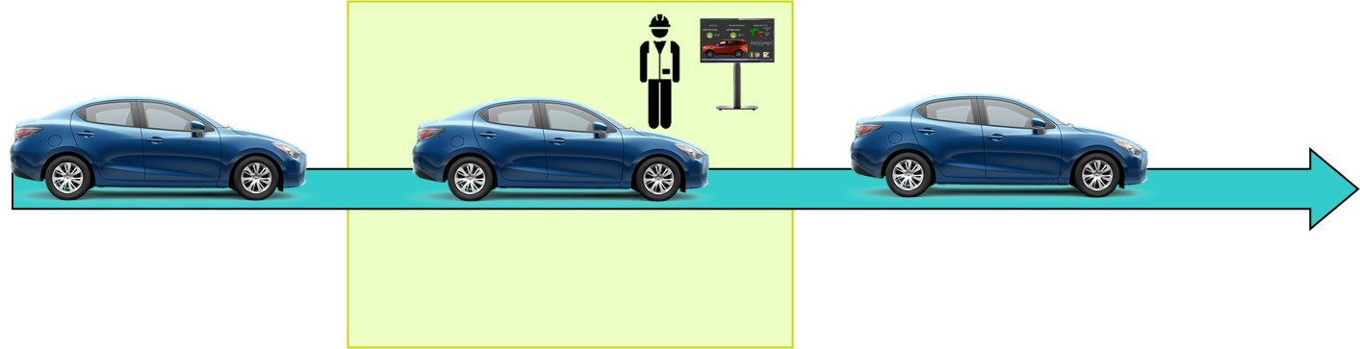
SINGLE STATION
Confidential
© 2024 EZMetrology

Slide 25




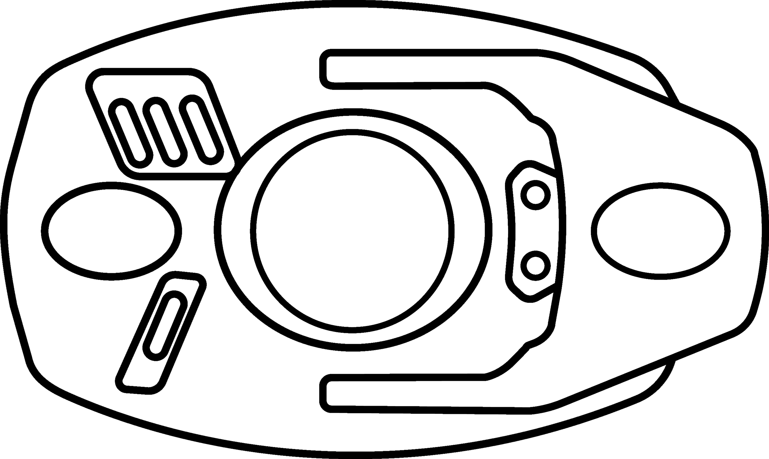


3. implementation
3.1.1 SINGLE station LAYOUT
All doors on 1 vehicle
Cycle time about 100 seconds
1 operator
1 static station with SpeedPod & PLS software
No time to repair in station
Data upload to cloud
Advantage!
Confidential
© 2024 EZMetrology

Slide 26
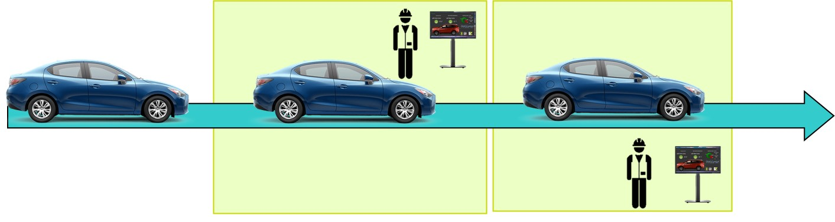
TWO STATION
Confidential
© 2024 EZMetrology

Slide 27

3. implementation
3.1.2 TWO station layout
Station A for left side, Station B for right side
Cycle time about 40 seconds
2 operators
2 static stations : SpeedPod & PLS software
No time to repair in station
Data upload to cloud
Advantage!
Station A
Station B
Confidential
© 2024 EZMetrology

Slide 28
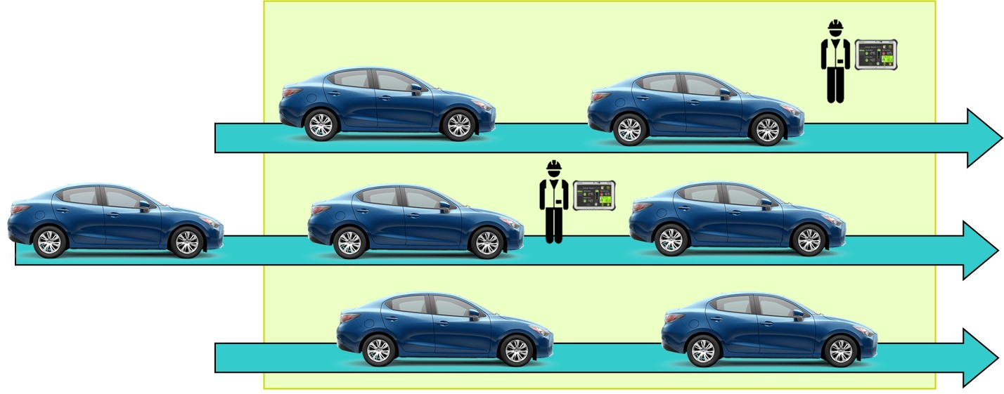
ROAMING STATION
Confidential
© 2024 EZMetrology

Slide 29
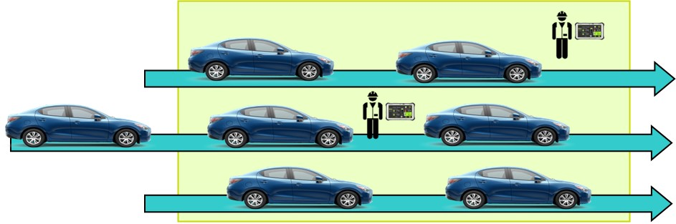
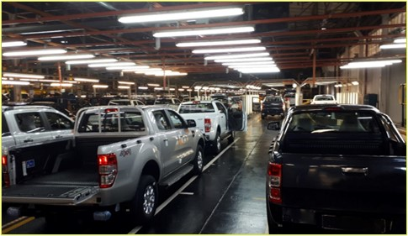
3. implementation
3.1.3 ROAMING station layout
All doors on 1 vehicle
Unlimited cycle time
N operators -- easy to adjust based on need
Roaming stations with SpeedPod & PLS software on tablet
Immediate repair possible
Final data (after repair) uploaded to cloud
Advantage!
Advantage!
Confidential
© 2024 EZMetrology

Slide 30
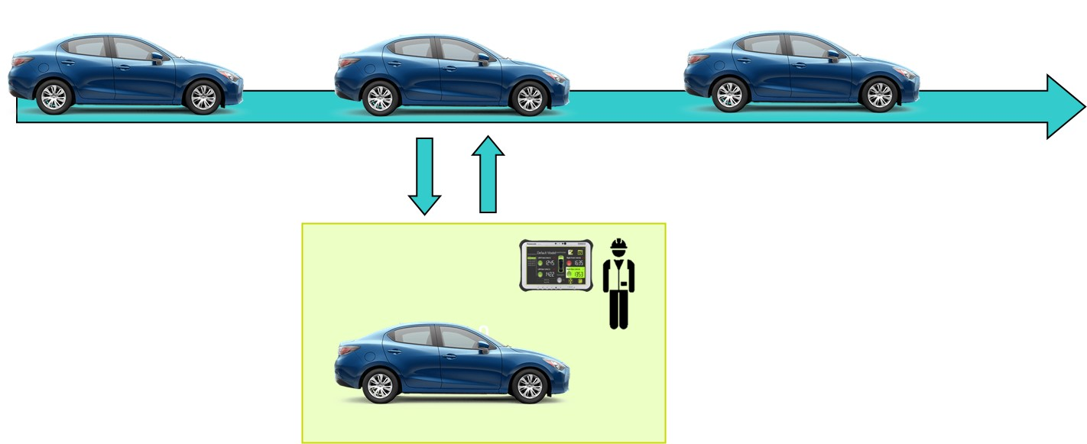
OFFLINE STATION
Confidential
© 2024 EZMetrology

Slide 31
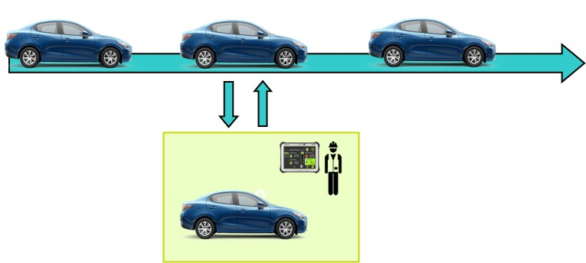
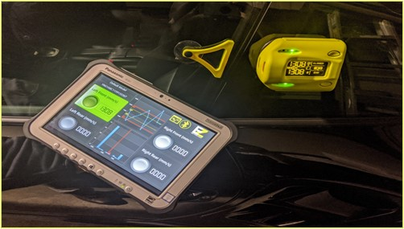
3. implementation
3.1.4 OFFLINE STATION LAYOUT
All doors on 1 vehicle
Unlimited cycle time
1 operator
1 roaming station : SpeedPod & PLS software on tablet
Immediate repair in station
Final data (after repair) uploaded to cloud
Advantage!
Advantage!
Confidential
© 2024 EZMetrology

