Slide 1

Optical Metrology
for
Aerostructures
Methodology and advantages of
optical measurement technology
for aerostructures
© 2023 EZMetrology

Slide 2

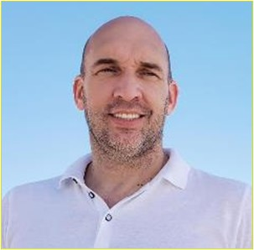
Author: Tom Van Esch, EZMetrology
Electromechanical Engineer from DeNayer Institute in Belgium and INSA of Toulouse in France.
Three decades of experience in optical metrology.
Specialized in dimensional dynamic measurements of structures.
Holder of multiple patents and innovations.
Owner and Founder of EZMetrology.
SEPA007, Slide 2
© 2023 EZMetrology

Slide 3
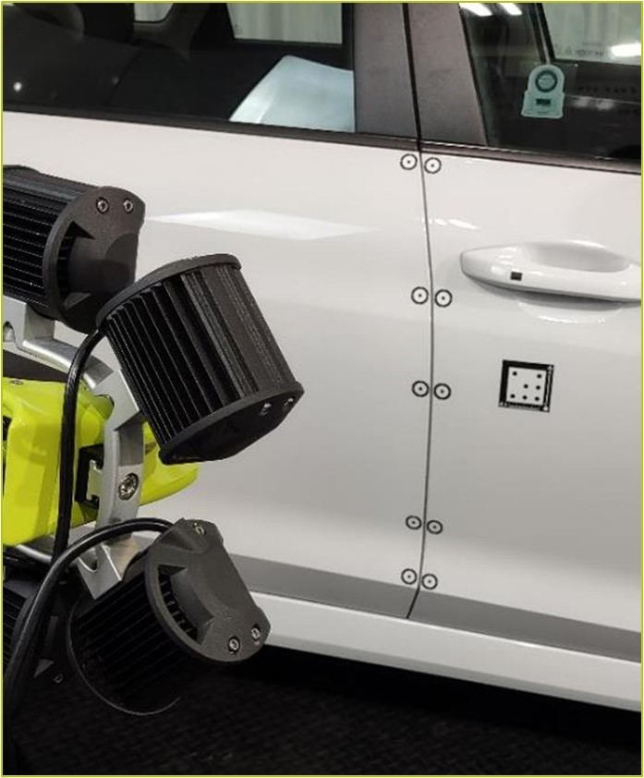
INDEX
Introduction
Principles
System Design
Remarkable Advantages
Elementary Building Blocks
Deflection Types
Applications
Conclusion
SEPA007, Slide 3
© 2023 EZMetrology

Slide 4

1. Introduction
SEPA007, Slide 4
© 2023 EZMetrology

Slide 5
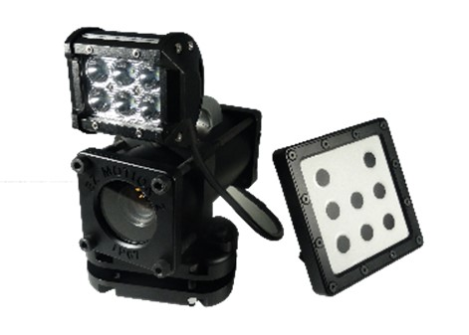
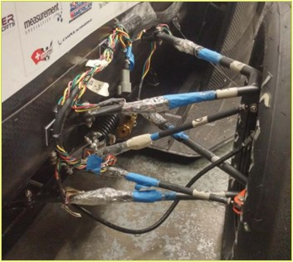
1. introduction
QUESTION: Why are optical systems gaining importance ?
1.1 Technology
  Recent Camera Evolutions:
  Higher Resolution
  Increased Sensitivity
  Higher Frame Rates
  These enhanced sensors are ideal for applications to detect and quantify spatial deformations:
  Accurate Measurements
  Faster Tracking
  Easy Installation with No Added Weight or Structural Influence
  Establishes an excellent new platform for quasi-static measurements or measurements with frequencies from 0 to 1000Hz where conventional accelerometers generally underperform.
Optical lenses and trackers
Accelerometers application
SEPA007, Slide 5
© 2023 EZMetrology
Notes:
Over the past decade, optical technologies evolved with the new camera chips with higher resolution and increased sensitivity allow to detect micro displacements.
With this extraordinary sensitivity, these sensors are ideal for applications to detect essential information to quantify for example structural deformations.

Slide 6
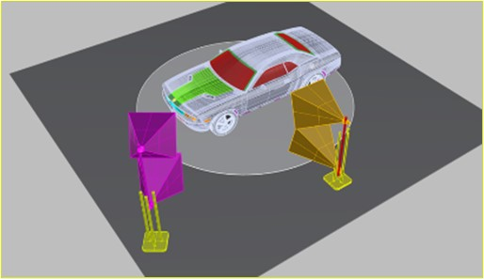
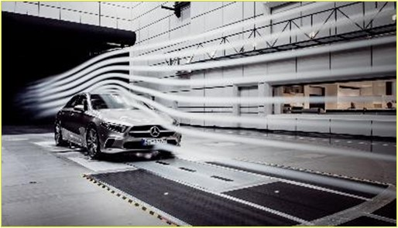
1. introduction
QUESTION: Why use 3-dimensional data ?
1.2 ADVANTAGES
  In aerodynamics, the objectives of optical technologies are to observe the detailed structural displacements, surface deflection, or shape deformation under wind load.
  The obtained trajectory data contributes to
Product Simulations
  Input refinement or model validation
Structural Evaluations
  Quantify current and future performance for dynamic or static behavior of the test structure
Design Optimization
Understand and identify opportunities to improve structures
Camera network simulation for scale 1:1
Example 1:1 scale wind tunnel
SEPA007, Slide 6
© 2023 EZMetrology

Slide 7
2. Principles
SEPA007, Slide 7
© 2023 EZMetrology

Slide 8
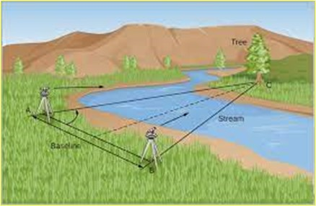
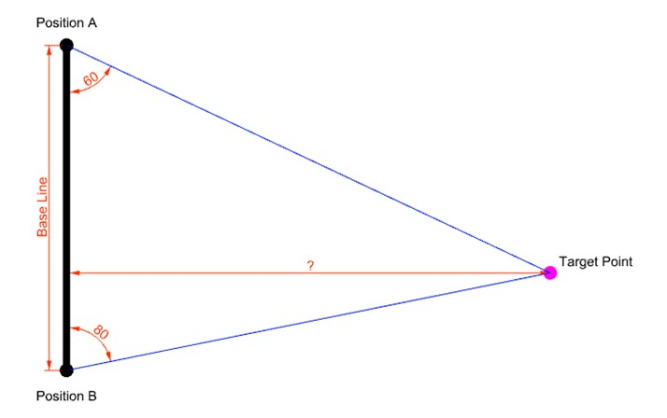
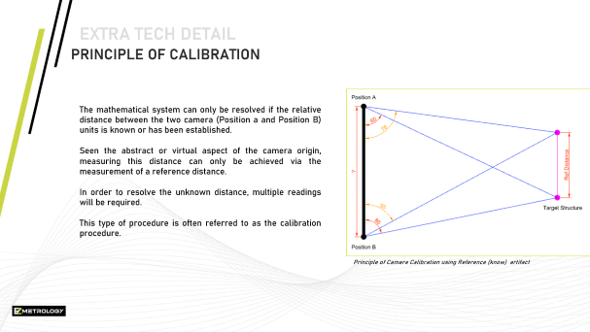
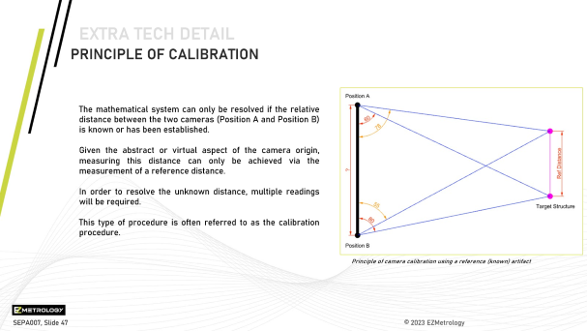
2. principles
2.1 2D Triangulation
  The basic principle of triangulation is that the system can observe a common point from two distinct locations. If the relative location from the two observation points is known, the method can determine the missing dimension.
Triangulation using theodolite system for land surveying
Extra Tech Detail: Camera Calibration
SEPA007, Slide 8
© 2023 EZMetrology

Slide 9
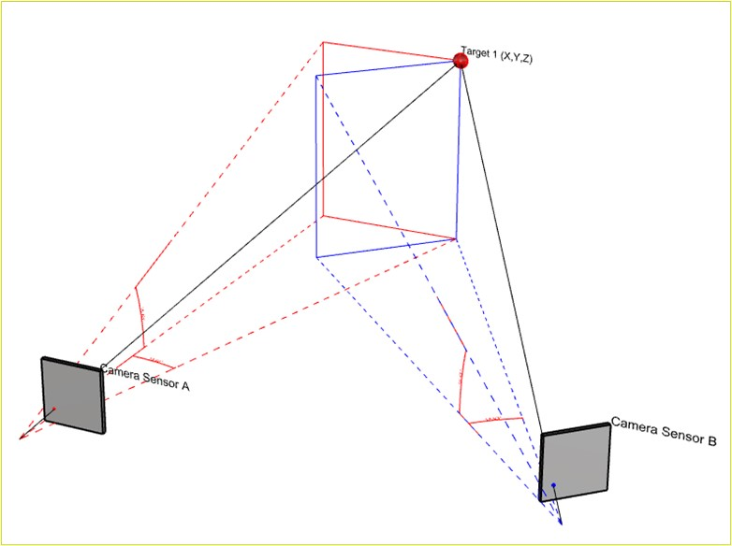
2. principles
2.2 3D Triangulation
  2D principles can be expanded to 3D camera triangulation.
  The measurement from each position will, in this case, provide two angles:
  Longitude
  Angle in the horizontal plane
  Latitude
  Angle in the vertical plane
  The combination of both angles can now be used to reconstruct the 3-dimensional XYZ position of the Target Point.
Triangulation using camera imaging
SEPA007, Slide 9
© 2023 EZMetrology
Notes:
This triangulation calculation can be performed for each acquired image pair. When the camera is capable to records images at 400Hz, the system can calculate the resulting XYZ position of each measurement point for each of the 400-image pair. The collection of consecutive positions make up the trajectory of one or more Target Points

Slide 10
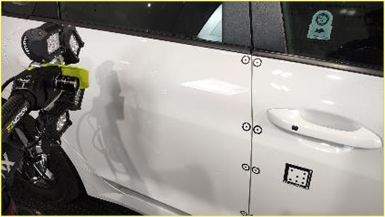
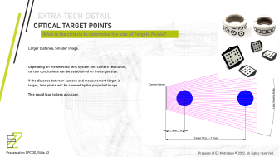
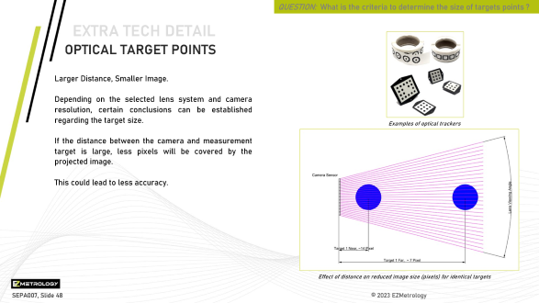
2. principles
QUESTION: What can the camera system track ?
2.3 optical target points
The points that are measured with a camera-based system have the following criteria:
  Color perspective
  High contrast black and white target patterns for edge detection
  Shape
  Round targets will enable the determination of the virtual center point
  Size
  For shape reconstruction (circle), the projected image needs to cover multiple pixels
The optimal target will be a function of the installation requirements.
Visible optical targets to monitor dynamic flush and gap
Extra Tech Detail: Target Dimensioning
SEPA007, Slide 10
© 2023 EZMetrology
Notes:
The high contrast will enable the algorithm to find the desired point and separate it from any other pattern or image noise in the background of the image.
The physical size of the target will have a direct influence in the capability of the image processing to determine its location. A correctly dimensioned target will appear in the image across multiple pixels. When multiple pixels are representing the round target, a virtual center point of this circular target can be calculated. This virtual center point will achieve positional accuracy and resolution in sub-pixel range. This means the result can be more precise than the actual resolution of the image.

Slide 11
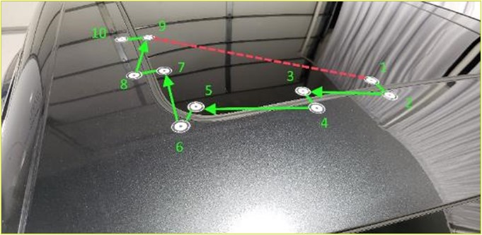
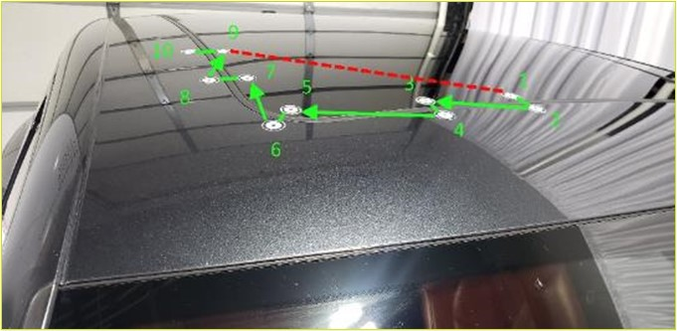
2. principles
QUESTION: How can we do triangulation if there are multiple points in the same image ?
2.4 POINT matching
  When multiple points are present in the image, the algorithm has to match each point in the image from the left to a point in the image of the right camera.
  A technique of pattern recognition is used to identify each individual point in both images.
Left camera and established point pattern
Right camera following the same pattern to match the established point pair
SEPA007, Slide 11
© 2023 EZMetrology
Notes:
Continue: The optical targets are easy to recognize by the image processing algorithm. When many targets are being used in a measurement or image, their relative position or pattern can be made unique so that the processing module can make a clear distinction when selecting matching targets between the two images

Slide 12
3. System Design
SEPA007, Slide 12
© 2023 EZMetrology

Slide 13
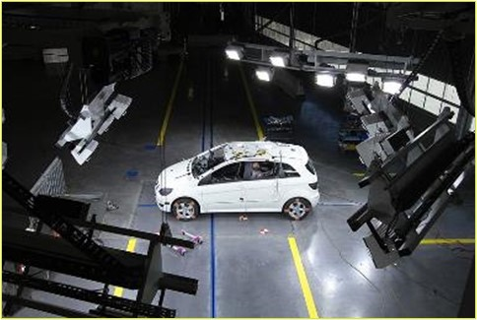
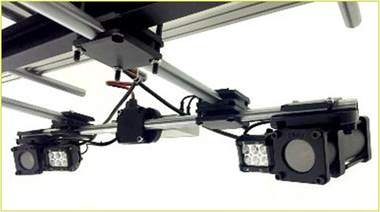
3. System design
QUESTION: What are the main criteria to design optimal optical systems ?
3.1 performance
A system design takes 3 main criteria into account:
  Measurement Volume
  Example: (1x2x1)m, (4x2x3)m, …?
  Desired Accuracy
  Example: 0.1mm, 0.5mm, …?
  Acquisition Speed
  Example: 50Hz, 500Hz ,…?
Secondary aspects will further drive the choice of architecture:
  Real-Time Requirement
  Recording Time
  Environmental ( temperature, humidity, dust )
Crash test installation with excess light for high frame rates
EZMotion optical measurement system in rugged housing
SEPA007, Slide 13
© 2023 EZMetrology

Slide 14
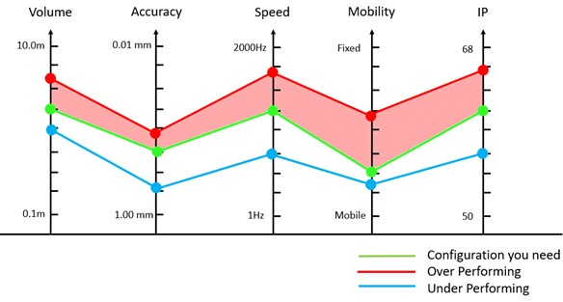
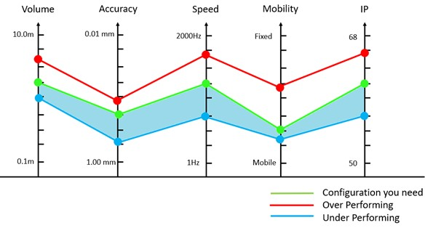
3. System design
3.2 Mismatched performance = Mismatched Cost
Solution that over-performs:
System performs better than specifications
Risk of adding overhead costs
Risk of increased complexity for training and normal operations
Price will be excessive
Solution that under-performs:
System that performs worse than specifications
Risk of not reaching objectives (certainty)
Potentially less expensive
SEPA007, Slide 14
© 2023 EZMetrology
Notes:
In case the applications would require higher framerate, the systems can be configured at higher speeds, however in these more extreme cases real time might no longer be available. When considering high speed application, cost has potentially being taken into account as not only is the camera hardware exponential for increasing framerates, there are the additional lighting requirements for short exposure times that are typical for the high speed recordings.

Slide 15
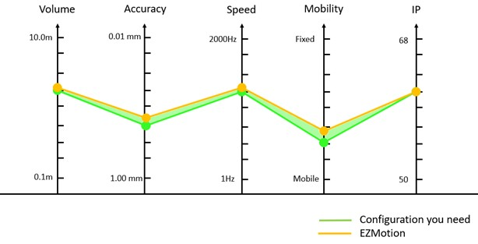
3. System design
QUESTION: How to get the best performance for your investment ?
2.4 MATCHED PERFORMANCE
EZMotion is engineered to match specifications:
Best fit to requirements:
Meets technical performance
Minimum complexity to meet objectives
Optimal cost
The system provider needs experience in the application and a detailed understanding of both the objectives as well as the options available for optical solutions:
  Lens Design
  Sensor Choice
  Target Choice
  Calibration Method
  Processing Capacity
  Lighting Condition
SEPA007, Slide 15
© 2023 EZMetrology
Notes:
In case the applications would require higher framerate, the systems can be configured at higher speeds, however in these more extreme cases real time might no longer be available. When considering high speed application, cost has potentially being taken into account as not only is the camera hardware exponential for increasing framerates, there are the additional lighting requirements for short exposure times that are typical for the high speed recordings.

Slide 16
4. Remarkable Advantages
SEPA007, Slide 16
© 2023 EZMetrology

Slide 17
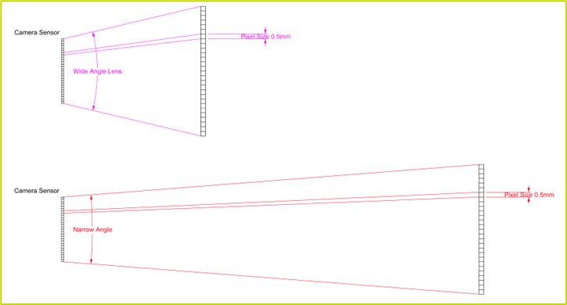
4. Remarkable advantages
QUESTION: Does air flow in a wind tunnel affect visibility ?
4.1 Standoff and Laminar Flow
  Based on the physical size and layout of the wind tunnel, the optical measurement system can be designed to be installed outside the laminar flow around the object.
  The increased stand off distance or distance between object and camera sensor can be compensated using zoom lenses to maintain sufficient resolution on the target.
Illustration to simulate identical resolution at different distances using adapted lens
SEPA007, Slide 17
© 2023 EZMetrology
Notes:
In a wind tunnel, the instrumentation should not interfere with laminar air flow. The camera units are therefore placed outside the air flow, at a safe distance from the part. In order to maintain the right resolution on the part, the camera will be equipped with a narrow angle, zoom lens. This lens configuration will maintain an accurate resolution.

Slide 18
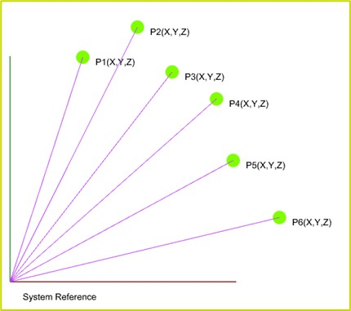
4. Remarkable advantages
QUESTION: How many points can be measured ?
4.2 Point CLOUD
  If the objective of the measurement is to establish the movement of individual points in space, there is no theoretical limit to the number of measurement points.
  Each point in the field of view will be tracked and can provide
  Position
  X, Y and Z
  Displacement
  dX, dY, dZ and dV
  Velocity
  dX/dt, dY/dt, dZ/dt, dV/dt
  Acceleration
  dX/dt², dY/dt², dZ/dt², dV/dt²
Cloud: multiple individual 3D points
SEPA007, Slide 18
© 2023 EZMetrology
Notes:
The collection of all points can help understand the deflection of the whole structure. With this information, there is an opportunity that the movement or velocity of virtually any point on that part can be determined.

Slide 19
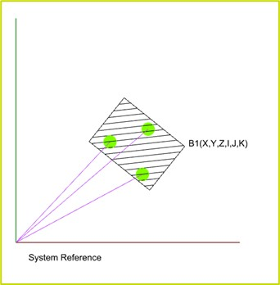
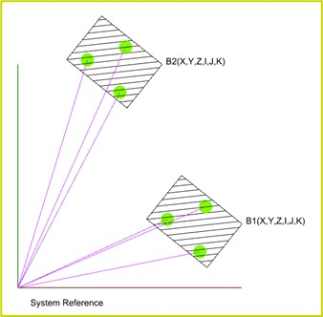
4. Remarkable advantages
QUESTION: How can an optical system monitor full 6D movements ?
4.3 Rigid Bodies
  A rigid body is a non-deformable structure that will move as a body in the spatial measurement volume.
  To achieve this goal, it is sufficient to attach 3 or more points on the structure. The movement of the 3 individual points will allow the mathematics to determine the full 6D position of the body.
  A rigid body movement can provide
    Position and Orientation
    Displacement; Linear or Angular
    Velocity; Linear or Angular
    Acceleration; Linear or Angular
  The next slide will illustrate the numerous advantages that rigid body objects have versus classic independent gauges such as accelerometers or string pods. The capabilities are difficult or almost impossible to achieve with the classic gauges.
Single rigid body using 3 points
Double rigid body using 3 points each
SEPA007, Slide 19
© 2023 EZMetrology
Notes:
The collection of all points can help understand the deflection of the whole structure. With this information, there is an opportunity that the movement or velocity of virtually any point on that part can be determined.
6D six degrees of freedom : XYZ position and IJK orientation

Slide 20
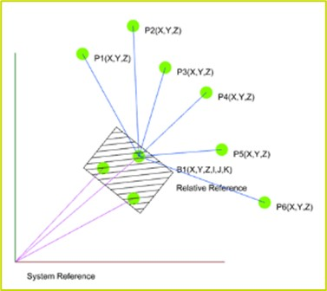
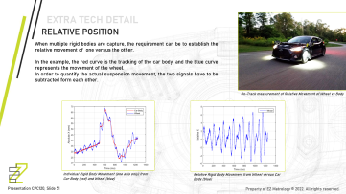
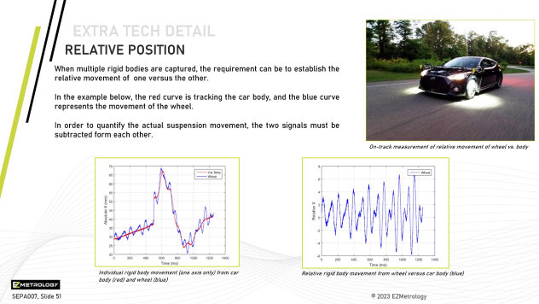
4. Remarkable advantages
QUESTION: How to obtain relative movements ?
4.3.1 RiGid BODY : relative position
  Rigid bodies can be used to determine accurate relative movements.
  In stead of reporting on the absolute position of a particular measurement tracker or point, its movement can be expressed relative to the reference body.
  Typical examples
    Movement of wheel versus the body
    Movement of body panels with respect to the body.
    Movement between two adjacent parts and observe, for example, flush and gap change
This technology is also used to filter out any movement from the camera system caused by vibration in its support or building structure.
Relative position from points vs rigid body
Extra Tech Detail: Relative Measurements
SEPA007, Slide 20
© 2023 EZMetrology

Slide 21
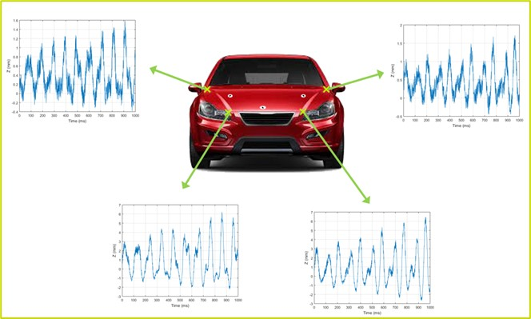
4. Remarkable advantages
QUESTION: Can a system measure displacement of invisible or specific physical points ?
4.3.2 RiGid BODY : VIRTUAL POINTS
  Rigid bodies, by nature, determine the movement of any point on the structure. The point might be invisible to the camera system and/or match a particular point of interest that cannot be marked with an optical target.
  When translations are combined with rotations, each physical point of the rigid body will have a unique amplitude in its movement.
  The object can be measured as a whole and mathematically. The movement of multiple points, for example attachment points or bumper mounts, can be established, helping in the characterization of the requirements for these elements.
Single rigid body using 3 target points but reporting 4 alternate points
SEPA007, Slide 21
© 2023 EZMetrology

Slide 22
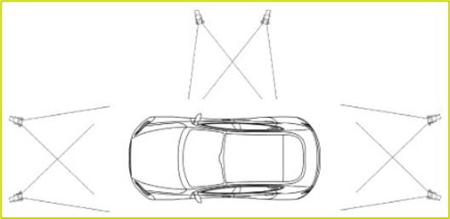
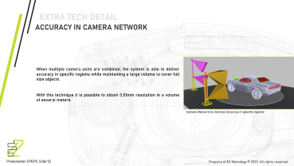
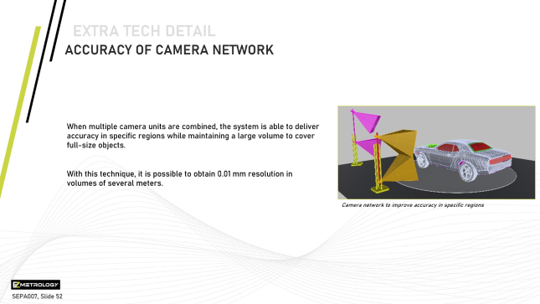
4. Remarkable advantages
QUESTION: How can an optical system measure around a corner or when the points are not visible from a single location ?
4.4 camera network
  Camera networks are configurations with multiple cameras working together to open the application space even further based on two factors:
    Line of Sight
  A camera network or multiple cameras working together can resolve these line-of-sight issues. An extra camera set can be aimed at locations invisible to the first camera unit.
    Accuracy
  A way of maintaining superior accuracy in very large volumes. A camera network can bring single-camera precision to much larger volumes. This is achieved by intelligent volume mapping, where a preferred camera has better performance in a given field of view.
Camera network to measure around a car (line of sight)
Extra Tech Detail: Camera Network
SEPA007, Slide 22
© 2023 EZMetrology

Slide 23
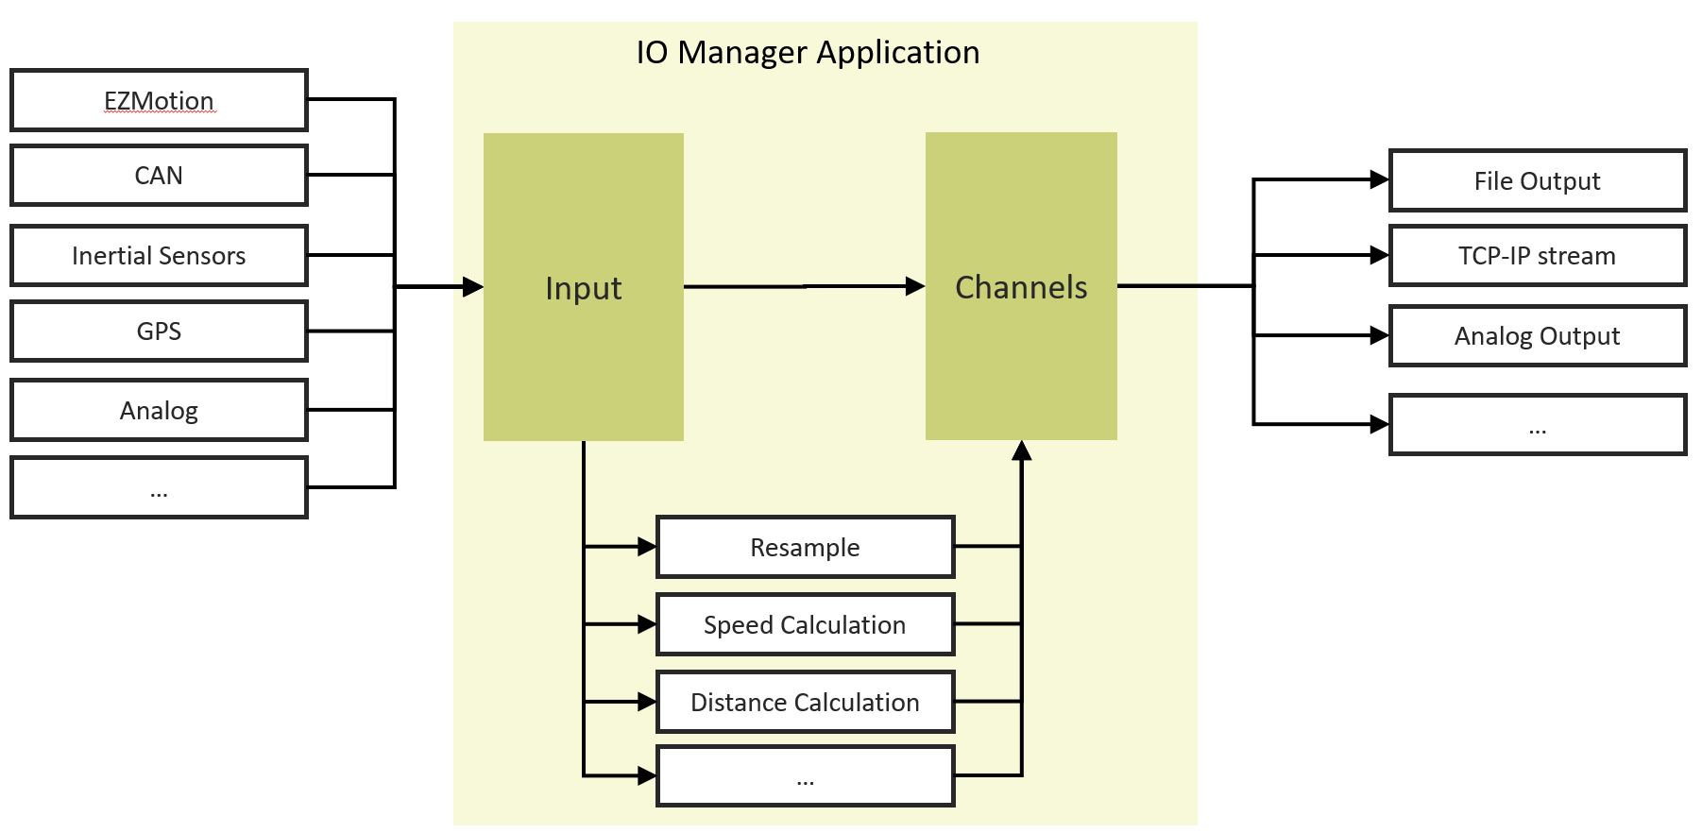
4. Remarkable advantages
QUESTION: How does the system handle multi-sensor measurements ?
4.5 Multi sensor integration
TCP/IP Stream
Example of system architecture covering multiple inputs, processing ,and specific output channels (reference IOManager)
SEPA007, Slide 23
© 2023 EZMetrology
Notes:
In the complex world of structural engineering, most challenges are not a one-dimensional problem. One sensor or one metric will not be able to describe the full dynamic or even static behavior of a component. The reality is often the combination of temperature, wind speed, load case, pressures, position, and orientation of assemblies… so the instrumentation of a test is a collection of technologies to document and record all inputs.
The acquisition system that manages the data collection must control time carefully. All sensors must be recording in the same time domain. This includes not only the start trigger (t=0 sec) but also all potentially independent sample rates.
For this aspect of the data collection, dedicated systems such as IOManager are designed for this exact purpose. Recording digital inputs, analog inputs, CAN input, TCPIP input…

Slide 24
5. Elementary Building Blocks
SEPA007, Slide 24
© 2023 EZMetrology

Slide 25
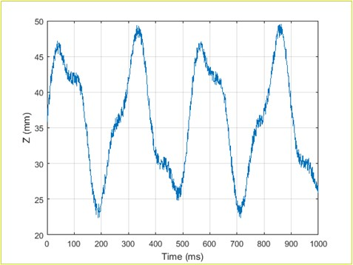
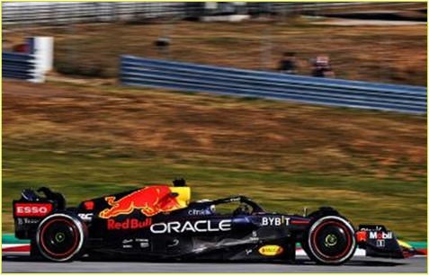
5. ELEMENTARY building blocks
5.1 body location
This rigid body measurement can be the objective of the study itself.
Recent evolutions in Formula 1 have brought the effect of resonance, or “the porpoise effect,” back to the forefront.
The body movement can also serve as a relative reference to study the deflection of parts that are installed on the body, such as spoilers, doors, and fenders. In this case, the movement of the body is excluded from the analysis, and the deflection is isolated from the deflection of the part by itself.
Vertical body displacement (Porpoise Effect)
High Speed aerodynamic effects in Formula 1
SEPA007, Slide 25
© 2023 EZMetrology
Notes:
Porpoise: The situation is a clear demonstration of an unbalanced aerodynamic state cause excessive body pitch. (vertical shake)

Slide 26
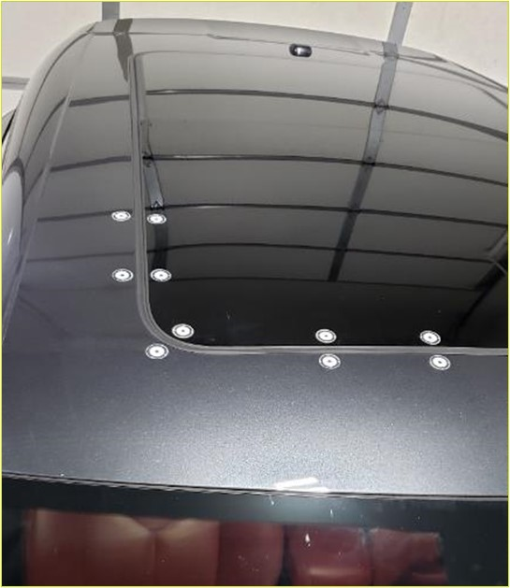
5. Application building blocks
5.2 car body components
Another addition to analysis is the measurement and observation of individual parts in the form of individual 3D points or a point cloud.
Each point will establish the trajectory and can represent the deflection of the part during the different wind load conditions.
Location, fit , displacement and vibration between body and sun roof
SEPA007, Slide 26
© 2023 EZMetrology

Slide 27
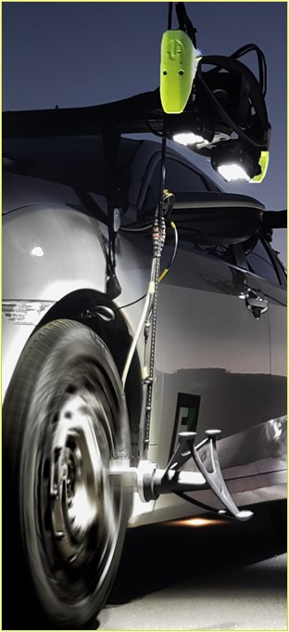
5. Application building blocks
5.3 Rolling Road and Spindle Position
To replicate the dynamics of a vehicle in motion, the rolling road becomes an important contribution to the accuracy of the test.
The wireless, weightless instrumentation can be installed on the wheel and can serve to observe wheel axel position during the test to isolate any tire or suspension dynamics.
Spindle tracking using EZMotion
(On Track Example)
SEPA007, Slide 27
© 2023 EZMetrology
Notes:
Due to the centrifugal force tires will change shape and will displace the axle position. As the vehicle is connected via the axles now the vehicle position will be adjusted versus the rolling road.

Slide 28
6. Deflection Types
SEPA007, Slide 28
© 2023 EZMetrology

Slide 29
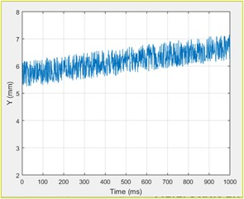
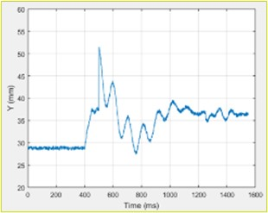
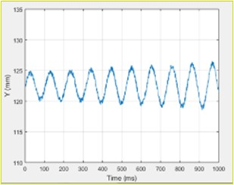
6. Deflection Types
QUESTION: What type of signal do we expect to observe ?
5.1 Static, transient and dynamic type
The nature of the expected behavior will drive the choice of timing and measurement frequency. It is always good practice to reflect on the potential outcomes when choosing optimal settings and configurations.
Quasi-Static Deformation or Drift
Transient or Peak Effects
Steady State Dynamic Movement
SEPA007, Slide 29
© 2023 EZMetrology
Notes:
1- A steady state wind load will introduce a force on the body panels.
These body panels will transfer the force to the chassis and via the suspension system and wheels will transfer the force to the road.
Seen the steady state aspect, some of these effects could be predictable in simulation. However, the measurement and actual data of all elements will present a great opportunity to improve the model and therefore the outcome.
Optical system, as they are position based, can accurately measure these semi static displacements. This is of great benefit as classic accelerometers are not designed to measure any type of static or quasi static offset.
2 - Seen the high-speed, real-time nature of the measurement, any transient effects that occur only during a brief time interval under specific conditions, is captured in detail.
The focus is to
observe,
quantify,
understand
these effects and the resulting temporary behavior.
3.Outside the previously mentioned effects, there is a family of permanent resonance situations that cause unstable vibrations.
Here as well the continuous tracking technology allows to observe, quantify the oscillations, deflections, vibrations of the loaded structure.
When taken into the frequency domain, the natural frequency of the elements and the original excitations can be identified.

Slide 30
7. Applications
SEPA007, Slide 30
© 2023 EZMetrology

Slide 31
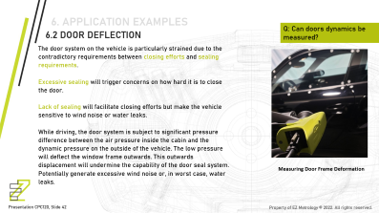
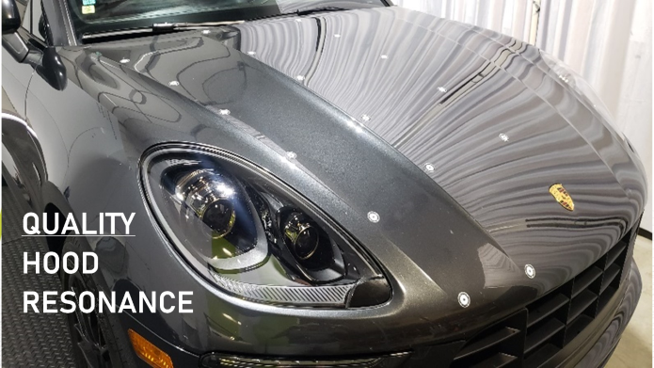
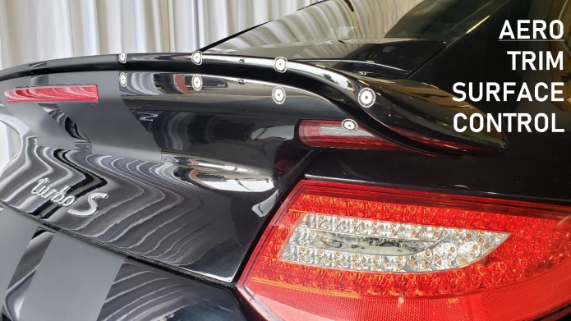
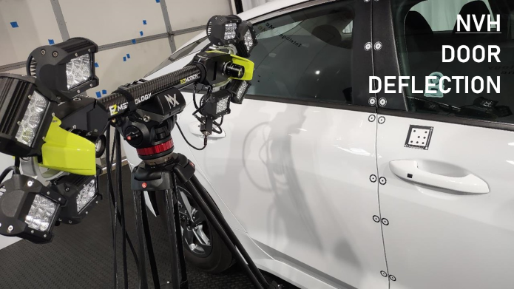
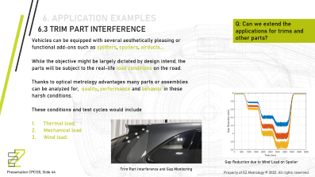
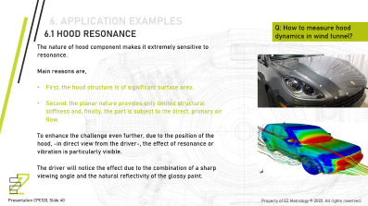
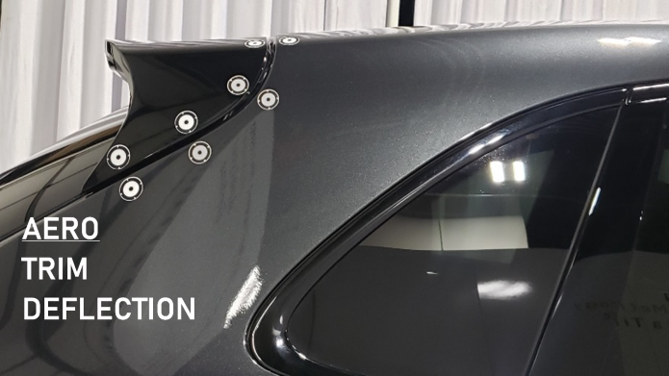
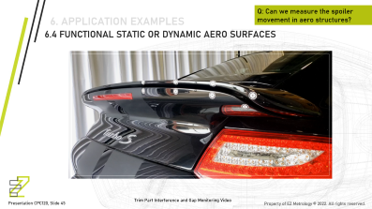
SEPA007, Slide 31
© 2023 EZMetrology

Slide 32
8. Conclusion
SEPA007, Slide 32
© 2023 EZMetrology

Slide 33
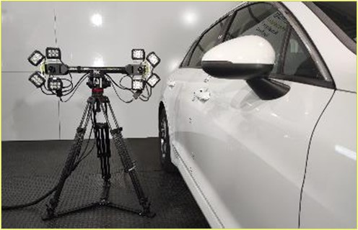
8. conclusion
8.1 conclusion
There are many objectives that will be addressed in wind tunnel testing: fuel economy, comfort, NVH, and performance
Even if the goals are very different, the tools used to achieve the goal can often be shared. For the same reason, a wind tunnel is an important asset, as is the instrumentation that provides active feedback of the performance.
Optical technology has evolved rapidly and is continuing to expand the measurement range in the most important aspects: accuracy and speed.
Optical technology can capture shape, position, deflection as the characteristics of the design.
The results from the optical system contribute significantly to the analysis package and are part of the bundle that leads to correct understanding of the behavior.
SEPA007, Slide 33
© 2023 EZMetrology

Slide 34
THANK YOU.
info@ezmetrology.com
support@ezmetrology.com
www.ezmetrology.com
portal.ezmetrology.com
academy.ezmetrology.com
SEPA007, Slide 34
© 2023 EZMetrology

Slide 35
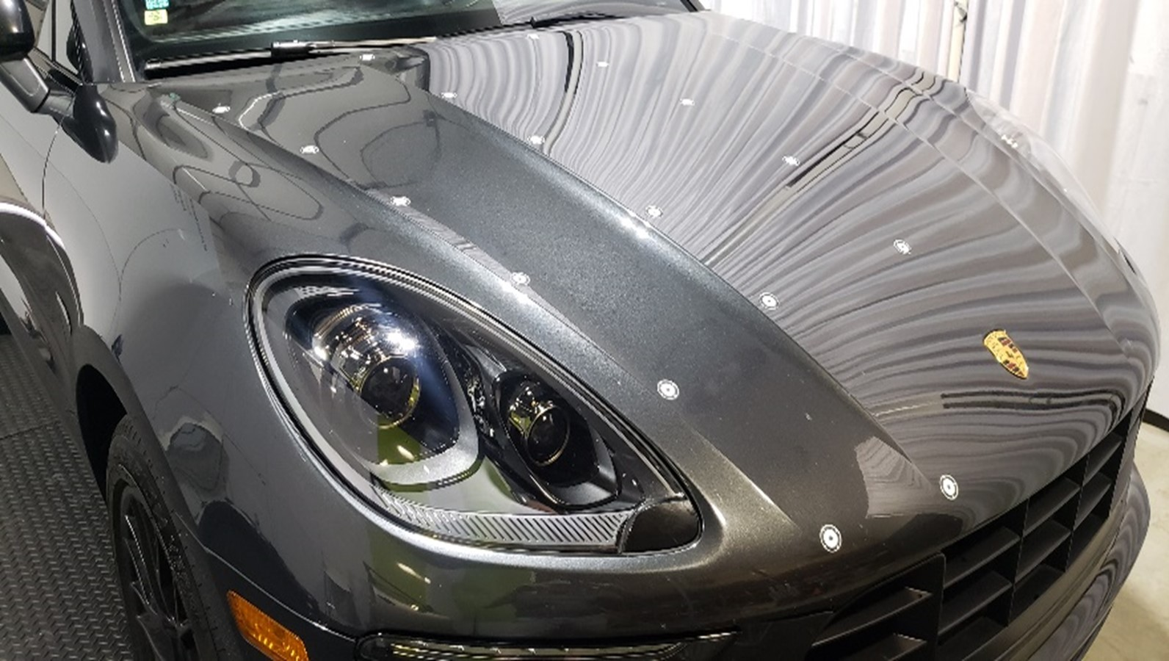
6. Application examples
QUALITY
hood
resonance
Notes:
Strong air flow over the hood and the associated pressure fluctuations can cause oscillations. Depending on the latch location(s), hinges stiffness, hinge mounting points, seal system or over slam bumpers, the part is subject to constant push and pull forces.

Slide 36


7. Application examples
QUESTION: How best to measure the perceived quality of hood vibration due to wind load ?
7.1 hood resonance
The hood component is, by nature, extremely sensitive to resonance:
Significant surface area
Planar nature has limited structural stiffness
Exposed to the direct, primary air flow
This is enhanced due to the direct view from the driver and the visible effect of resonance or vibration:
Tangential viewing angle
Reflective surface
Mastering the control of this feature will contribute to the perceived quality.
Test samples equipped with optical targets (Cloud)
Anticipated steady state pressure distribution (Static)
SEPA007, Slide 36
© 2023 EZMetrology
Notes:
Strong air flow over the hood and the associated pressure fluctuations can cause oscillations. Depending on the latch location(s), hinges stiffness, hinge mounting points, seal system or over slam bumpers, the part is subject to constant push and pull forces.

Slide 37


7. Application examples
7.1 hood resonance
A network of 3D points can be spread over the surface.
The near-zero thickness does not interfere with any airflow dynamics.
The spatial measurement will establish the frequency and amplitude of the movement of each point in any direction.
The understanding of the low frequency vibration spectrum assists in evaluating:
    Part flexibility
    Mounting stiffness
    Latch dynamics
    Damper / bumper dimensioning in the amplitude and frequency domains
Numerical results of vertical displacement in all points
Visual representation of vector movement per point
SEPA007, Slide 37
© 2023 EZMetrology

Slide 38

NVH
Door
DEFLECTION
Notes:
While these effects are known the quest for new, lighter materials combined with the ever-evolving acceptance tolerance of the end user, verifying the design conforms to the specification remains essential.

Slide 39


7. Application examples
QUESTION: Is the door seal system still functional when sealing under wind loads ?
7.2 door deflection
The door system on the vehicle is particularly strained due to the contradictory requirements between closing efforts and sealing requirements.
Excessive sealing will trigger concerns for how hard it is to close the door.
Lack of sealing will facilitate easier closing efforts but make the vehicle sensitive to wind noise and water leaks.
While driving, additional constraints are added into the equation as the door will deflect outwards in direct relation to windspeed.
Optical systems are perfectly suited to capture an accurate image of the deformation on different areas of the door.
Measuring door deflection using EZMotion
Door deflection per point with changing wind speeds
SEPA007, Slide 39
© 2023 EZMetrology
Notes:
While these effects are known the quest for new, lighter materials combined with the ever-evolving acceptance tolerance of the end user, verifying the design conforms to the specification remains essential.
While driving, the door system is subject to significant pressure difference between the air pressure inside the cabin and the dynamic pressure on the outside of the vehicle. The low pressure will deflect the window frame outwards. This outwards displacement will undermine the capability of the door seal system. Potentially generate excessive wind noise or, in worst case, water leaks.

Slide 40

7. Application examples
7.2 door deflection
The acquired 3D data for different points around the circumference of the door will have different amplitudes.
The amplitudes are also a function of windspeed.
Green Points:
The top of the window frame shows the largest deformation, up to 4mm. The thickness of the cloud indicates the level of vibration in the given state.
Blue Points:
The bottom of the window frame, where the structure is stiffer, shows less amplitude and less vibration.
Measuring Door Frame Deformation
Point displacement and vibration as a function of wind speed
SEPA007, Slide 40
© 2023 EZMetrology
Notes:
The optical system can observe multiple 3D points on the structure. To enhance the effect and increase the accuracy of the measurement, the relative displacement of the door versus the body can be determined. These results and the identification of the weaker area’s will be the basis for design improvements and control the effect to meet criteria.

Slide 41

AERO
TRIM
DEFLECTION
Notes:
The criteria of acceptance include general durability but when referring to wind load and dynamic forces and resulting risk of contact, vibration, ticking and resulting vibration noises will come to foreground during the evaluation. The understanding of amplitude and direction of deflection will assist in resolution of the matter.

Slide 42

7. Application examples
QUESTION: Is the door seal system still functional when sealing under wind loads ?
7.3 trim part interference
Vehicles can be equipped with several aesthetically pleasing or functional add-ons such as splitters, spoilers, and airducts.
While the objective might be largely dictated by design intent, the parts will be subject to the real-life load conditions on the road.
The behavior and failure modes can be monitored with optical 3D targets and can be used to quantify:
  Thermal load
Climate chambers, -40 to 80deg C
  Mechanical load
Durability cycles, load simulation
  Wind load
Wind tunnel applications
Optical targets installed to observe gap variation on a spoiler
SEPA007, Slide 42
© 2023 EZMetrology
Notes:
The criteria of acceptance include general durability but when referring to wind load and dynamic forces and resulting risk of contact, vibration, ticking and resulting vibration noises will come to foreground during the evaluation. The understanding of amplitude and direction of deflection will assist in resolution of the matter.

Slide 43

7. Application examples
7.3 trim part interference
The trim and the gap/flush fit is set to nominal geometry under conditions with no load.
Under high wind load, the force on these parts increases and imposes a displacement or deflection.
The deflection could reduce the gap and, in extreme conditions, be in physical contact and cause paint or part damage.
The deflection is measured and can be matched with a nominal gap to ensure contact-free deflection.
Gap reduction in function of wind load
SEPA007, Slide 43
Notes:
The criteria of acceptance include general durability but when referring to wind load and dynamic forces and resulting risk of contact, vibration, ticking and resulting vibration noises will come to foreground during the evaluation. The understanding of amplitude and direction of deflection will assist in resolution of the matter.

Slide 44

AERO
Trim
Surface
control
Notes:
Components that have a true function and where the individual performance is key to the overall performance or handling of the vehicle, will require the extra level of engineering and understanding.
It is a well-known fact that the shape of these elements, is part of the key how they achieve the right balance between drag and downforce. Especially combined with lightweight structures, it comes as no surprise that these elements, when exposed to the acting force, will deform.
The question the optical system will answer is that how these parts are displaced or deformed. When these measurements are combined with the resulting forces on the whole vehicle, relations can be established, and engineering can be redirected. The conclusions can identify opportunities to improve the shape, the stiffness, the displacement, or rotation of the structure.

Slide 45

7. Application examples
QUESTION: Do active surfaces operate as in simulation ?
7.4 Functional Static or Dynamic Aero Surfaces
Tracking dynamics of active aero surfaces
SEPA007, Slide 45
Notes:
Components that have a true function and where the individual performance is key to the overall performance or handling of the vehicle, will require the extra level of engineering and understanding.
It is a well-known fact that the shape of these elements, is part of the key how they achieve the right balance between drag and downforce. Especially combined with lightweight structures, it comes as no surprise that these elements, when exposed to the acting force, will deform.
The question the optical system will answer is that how these parts are displaced or deformed. When these measurements are combined with the resulting forces on the whole vehicle, relations can be established, and engineering can be redirected. The conclusions can identify opportunities to improve the shape, the stiffness, the displacement, or rotation of the structure.

Slide 46

7. Application examples
7.4 Functional Static or Dynamic Aero Surfaces
Points distributed in the shape of the spoiler will be monitored.
    Below Threshold Speeds (<2000sec)
Only minor deflection is observed
    Threshold Speed (@3000sec)
The spoiler is extended to increase downforce
    Beyond Threshold Speeds (>3000sec)
The spoiler system continues to show some deflection as a function of windspeed
4-point location on an active spoiler at incremental wind load
SEPA007, Slide 46
© 2023 EZMetrology
Notes:
In line with the other applications, the technology captures all dimensional effects in a semi-static, transitional, or full dynamic state. The measurements can therefor quantify not only deflection but also the active control system to position the key surfaces in the right angle and position.

Slide 47

EXTRA TEcH Detail
Principle of Calibration
The mathematical system can only be resolved if the relative distance between the two cameras (Position A and Position B) is known or has been established.
Given the abstract or virtual aspect of the camera origin, measuring this distance can only be achieved via the measurement of a reference distance.
In order to resolve the unknown distance, multiple readings will be required.
This type of procedure is often referred to as the calibration procedure.
Principle of camera calibration using a reference (known) artifact
SEPA007, Slide 47
© 2023 EZMetrology
Notes:
Left Image Notes: The system registers the viewing angle from Position A towards the Target Point. In this figure it corresponds to 60 degrees. That same Target Point is observed from Position B at a viewing angle of 80 degrees.

Slide 48


EXTRA TEcH Detail
QUESTION: What is the criteria to determine the size of targets points ?
optical target points
Larger Distance, Smaller Image.
Depending on the selected lens system and camera resolution, certain conclusions can be established regarding the target size.
If the distance between the camera and measurement target is large, less pixels will be covered by the projected image.
This could lead to less accuracy.
Examples of optical trackers
Effect of distance on reduced image size (pixels) for identical targets
SEPA007, Slide 48
© 2023 EZMetrology
Notes:
The high contrast will enable the algorithm to find the desired point and separate it from any other pattern or image noise in the background of the image.
The physical size of the target will have a direct influence in the capability of the image processing to determine its location. A correctly dimensioned target will appear in the image across multiple pixels. When multiple pixels are representing the round target, a virtual center point of this circular target can be calculated. This virtual center point will achieve positional accuracy and resolution in sub-pixel range. This means the result can be more precise than the actual resolution of the image.

Slide 49

EXTRA TEcH Detail
TARGET PIXEL SIZE
The images on this page are from an identical target at different distances from the sensor.
Understanding that the goal is to determine an accurate center point of the round dot, the image with limited pixels will clearly have more difficulty performing an accurate estimation.
SEPA007, Slide 49
© 2023 EZMetrology
Notes:
A target that would be too small will only appear as a single pixel, or 3 or 4 pixels in the image. In this situation, the circular shape cannot be reconstructed, nor can a center be calculated. This leads to the fact that measurement accuracy is limited to the resolution of the image. The simple image resolution is often insufficient for the desired measurement accuracy.

Slide 50


EXTRA TEcH Detail
Pixel interpolation
A simplified 2D representation of projected image size can illustrate how an image covering multiple pixels is much more reliable for determining the peak center :
Centroid determination on single-pixel projection: Not Optimal
Centroid determination on multi-pixel projection: Optimal
SEPA007, Slide 50
© 2023 EZMetrology
Notes:
As illustrated in left, when the observed target is small or less than 1mm. The size is now such that the projected image on the camera will only fall on one single pixel. The image can in this case only determine if the target is one this specific pixel or the next pixel over. This will result in a 1 mm resolution. In other words, the system can hardly determine any displacement inferior to 1 mm.
In an optimized situation, as illustrated in right, the target with the size of maybe 7mm will covers more pixels when projected. With the information spread over multiple pixels, the algorithm can reliably determine a virtual center point of the gaussian distribution. This virtual center point will respond to displacements smaller than the actual pixel size. This is what is called a pixel-interpolation or sub-pixel resolution and can be provide up to 100 times higher or improvement of the resolution.

Slide 51



EXTRA TEcH Detail
relative position
  When multiple rigid bodies are captured, the requirement can be to establish the relative movement of one versus the other.
  In the example below, the red curve is tracking the car body, and the blue curve represents the movement of the wheel.
  In order to quantify the actual suspension movement, the two signals must be subtracted form each other.
On-track measurement of relative movement of wheel vs. body
Individual rigid body movement (one axis only) from car body (red) and wheel (blue)
Relative rigid body movement from wheel versus car body (blue)
SEPA007, Slide 51
© 2023 EZMetrology
Notes:
Top Right picture shows application to study the kinematic behavior of a suspension system, the movement of the wheel should be expressed with respect to the movement of the car body

Slide 52

EXTRA TEcH Detail
Accuracy OF camera network
When multiple camera units are combined, the system is able to deliver accuracy in specific regions while maintaining a large volume to cover full-size objects.
With this technique, it is possible to obtain 0.01 mm resolution in volumes of several meters.
Camera network to improve accuracy in specific regions
SEPA007, Slide 52
Notes:
The optical noise from a single camera will become more pronounced when the target is further away from that sensor. This can be represented visually by a cone shape. The pixel noise combined with the opening angle of the lens represents the noise band. When combining the cone from each camera, the uncertainty on the triangulation is represented by the intersection of both cones. Visually, a target point at larger distance from the camera will be subject to more noise.
When adding another camera unit, the target can be in close proximity and therefore located in a narrow part of the cone, resulting in better resolution and accuracy of the data.
Example
The uncertainty using a single camera pair is a function of the distance between the actual camera unit and the actual optical target. A single camera unit might be optimal in the near range and achieve measurement accuracies of 0.05mm at 1.5m offset. If the points are moved back to 4m from that same camera unit uncertainty could go up to 0.2mm.
So, by adding another camera unit for which the second point is closer to its base, will reduce the uncertainty of this point from 0.2mm to the equal accuracy of 0.05mm. In advanced applications, the images of any camera pair can be combined to optimize the optimal positions for the entire volume. In this configuration, more weight is assigned to the optimal dimensions.

Slide 53


EXTRA TEcH Detail
Accuracy in camera network
When multiple camera units are combined, the result can be corrected for optimal accuracy in the full measurement volume.
The sketch below illustrates the respective volumes of uncertainty for a given region in the field of view.
Optical Lenses and trackers
Pixel noise amplification and effects of distance
Camera network to improve accuracy in certain regions
SEPA007, Slide 53
© 2023 EZMetrology
Notes:
The optical noise from a single camera will become more pronounced when the target is further away from that sensor. This can be represented visually by a cone shape. The pixel noise combined with the opening angle of the lens represents the noise band. When combining the cone from each camera, the uncertainty on the triangulation is represented by the intersection of both cones. Visually, a target point at larger distance from the camera will be subject to more noise.
When adding another camera unit, the target can be in close proximity and therefore located in a narrow part of the cone, resulting in better resolution and accuracy of the data.
Example
The uncertainty using a single camera pair is a function of the distance between the actual camera unit and the actual optical target. A single camera unit might be optimal in the near range and achieve measurement accuracies of 0.05mm at 1.5m offset. If the points are moved back to 4m from that same camera unit uncertainty could go up to 0.2mm.
So, by adding another camera unit for which the second point is closer to its base, will reduce the uncertainty of this point from 0.2mm to the equal accuracy of 0.05mm. In advanced applications, the images of any camera pair can be combined to optimize the optimal positions for the entire volume. In this configuration, more weight is assigned to the optimal dimensions.

