Slide 1

EZMotion
Motion Reference System
Confidential
© 2023 EZMetrology

Slide 2

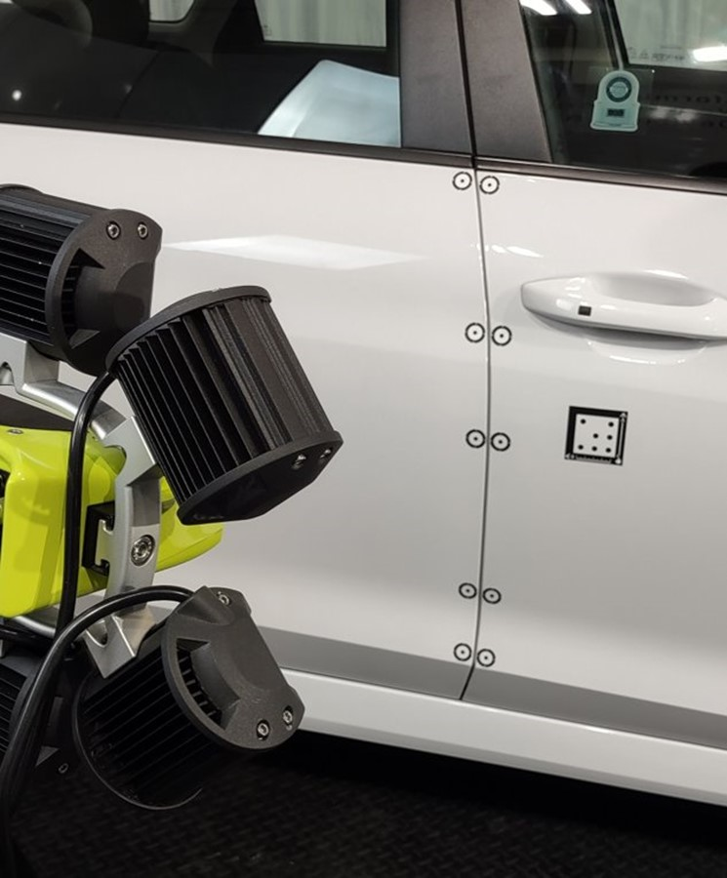
Index
  Noise Propagation
  Single Tracker
  Multiple Trackers
Confidential
© 2023 EZMetrology

Slide 3

1. Noise Propagation
Confidential
© 2023 EZMetrology

Slide 4

1. Noise propagation
1.1 influence on measurement accuracy
In this presentation, we will elaborate on the influence of measurement setup and configuration for measurement accuracy and noise propagation.
In this presentation, we will refer to the noise, N, of a single tracker as N_{single .}
The choice of setup and configuration is very application-driven:
Accessible Space for Targets: What is the volume available to mount the targets to the object? Can there be multiple targets in a “triangle shape” ? *
Expected Movement: What is the expected amplitude of the motion? What would be an acceptable noise level?
Relative Movement**: What is the chance that the camera might be subject to movement? Is the requested information a relative movement of two parts?
* When using multiple trackers to define an object, make sure that they form a triangular base and are co-linear.
** Dynamic referencing will always increase the static noise. It is, however, an improvement if the mechanical situation causes measurement effects superior to the noise increase.
Confidential
© 2023 EZMetrology

Slide 5
2. Single Tracker
Confidential
© 2023 EZMetrology

Slide 6
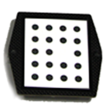
2.Single tracker
2.1 static reference
Offset = 0
Reported measurement point is located in the cone (back of the tracker). The position is relative to the camera (or static reference). Rotational uncertainty is better for larger trackers.
N_{single} = Best sensitivity and accuracy
Application: Camera is stable and object moves with respect to camera
Offset = (x,y,z)
Reported measurement point is located at a distance (x,y,z) from the cone. Rotational uncertainty is better for larger trackers. Sensitivity and accuracy decrease with increased offset.
N_{single} = N_{single} * Offset / Width
Example: If the user defines the offset at 300 mm for a 100 mm size tracker, the noise will be approximately 3 time higher than the tracker with no offset.
Application: Camera is stable; object moves with respect to camera;
The point of interest is not too far from the physical tracker (small offset).
Width
Offset
Confidential
© 2023 EZMetrology

Slide 7
2.Single tracker
2.2 DYNAMIC reference
Width
Offset = 0
Reported measurement point is located in the cone (back of the tracker). The position is relative from one tracker to the other. Rotational uncertainty of the reference influences the position accuracy of the tracker.
N_{dyn} = N_{single} * Offset / Width + N_{single}
Application: Camera is not stable; objects move relative to each other.
The objects are close to each other.
Offset = (x,y,z)
Reported measurement point is located at a distance (x,y,z) from the cone. The position is relative from one tracker to the other. Rotational uncertainty is better for larger trackers. Sensitivity and accuracy decreases with increased offset.
N_{dyn_offset} = N_{single} * Offset_ref / Height_ref + N_{single} * Offset / Height
Application: NOT recommended as the addition of all offsets decreases overall performance.
Offset
Height
Reference
Height
Offset
Reference
Offset
Confidential
© 2023 EZMetrology

Slide 8
3. Multiple Trackers
Confidential
© 2023 EZMetrology

Slide 9
3. Multiple Trackers
3.1 Static Reference
Offset = 0
Reported measurement point is composed of 3 trackers. Optimally, in the middle or surrounded by the trackers. The position is relative to the camera (or static reference). Rotational uncertainty is better when the trackers are spaced far apart.
N_{multi} = N_{single} / n
Application: Optimal accuracy for position and angle.
Offset = (x,y,z)
Reported measurement point is composed of 3 trackers. The reported point is at a distance from the middle of the tracker configuration. The larger spacing between the trackers will minimize the angular effects. The position is relative to the camera (or static reference).
N_{multi_offset} = N_{multi} * Offset / Width
Application: Optimal accuracy for position and angle when offset is required.
Width
Offset
Confidential
© 2023 EZMetrology

Slide 10
3. Multiple Trackers
3.2 DYNAMIC Reference
Offset = 0
Reported measurement point is located in the cone (back of the tracker) relative to the other 3 trackers.
N_{multi} = N_{single} / n + N_{single}
Application: Optimal Accuracy for position and angle when relative motion is required.
Offset = (x,y,z)
Reported measurement point is located in the cone (back of the tracker) relative to the other 3 trackers. The tracker is not within the triangle formed by the trackers but outside.
N_{multi_offset} = N_{multi} * Offset / Width N_{single} + N_{single}
Application: Optimal accuracy for position and angle as long as the trackers are placed properly.
Width
Offset
Confidential
© 2023 EZMetrology

Slide 11
Thank you.
info@ezmetrology.com
support@ezmetrology.com
www.ezmetrology.com
portal.ezmetrology.com
academy.ezmetrology.com
Confidential
© 2023 EZMetrology

