Slide 1

IO Manager
Integrating Multiple Sensors
Enhance the utility of EZMotion and collect synchronized data from a multitude of sensors.
One platform for acquisition, real-time or post-processing, and output.
Confidential
© 2023 EZMetrology

Slide 2

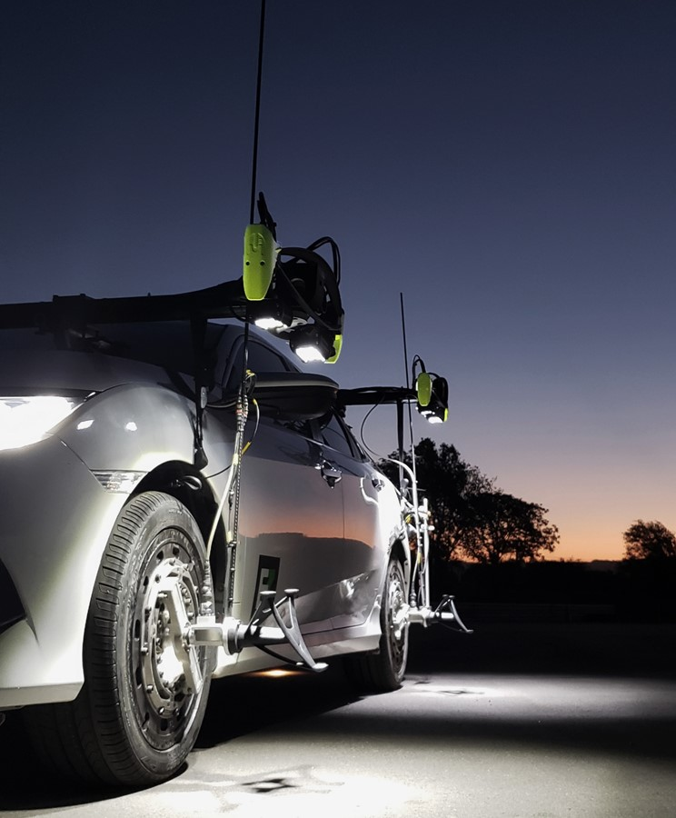


Index
Introduction
Modules
Data Acquisition
Viewing Data
Applications
Conclusion
Confidential
© 2023 EZMetrology

Slide 3

1. Introduction
Confidential
© 2023 EZMetrology

Slide 4
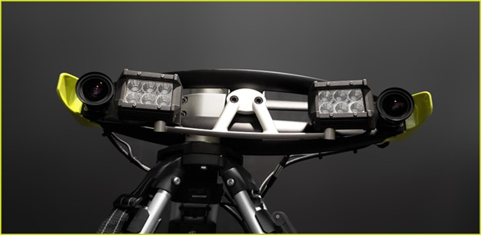
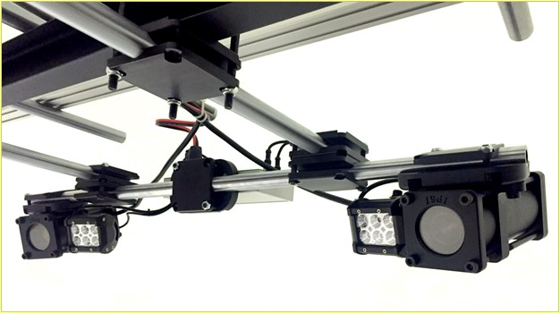
1. Introduction
1.1 Expand your EZMotion Systems
  Combine Positional Data Gathered from EZ Systems with:
    Force
    Temperature
    GPS readings
    Pressure
  In a comprehensive organized dataset:
    Simplify setup of many type of sensors or inputs
    Installation and verification of all channels
    Visual feedback for simple operation
    Include essential signal processing or synchronization
    2D and 3D feedback
    Universal or custom output formats available
Confidential
© 2023 EZMetrology

Slide 5
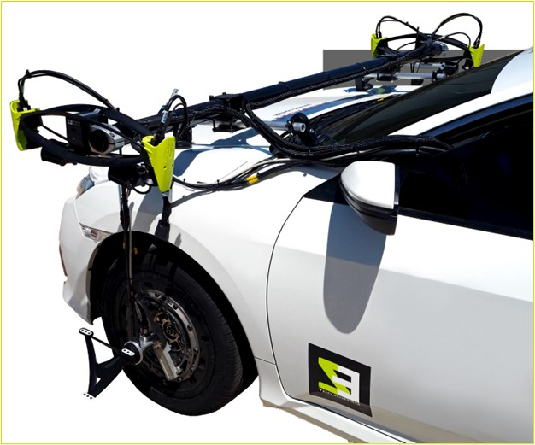
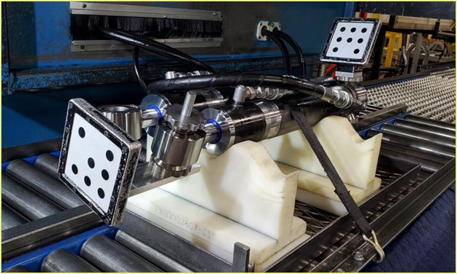
1. Introduction
1.2 Typical Applications
Fully understand the kinematic dynamics of a system by capturing a wide variety of parameters.
All sensor readings are recorded in the same timeline and available as a universal format.
For Uses in:
    Suspension K & C Research and Tuning
    Simulation Input Collection
    Flexibility: Force and Position Correlation
    Pressurization: Pressure and Deflection
Confidential
© 2023 EZMetrology

Slide 6
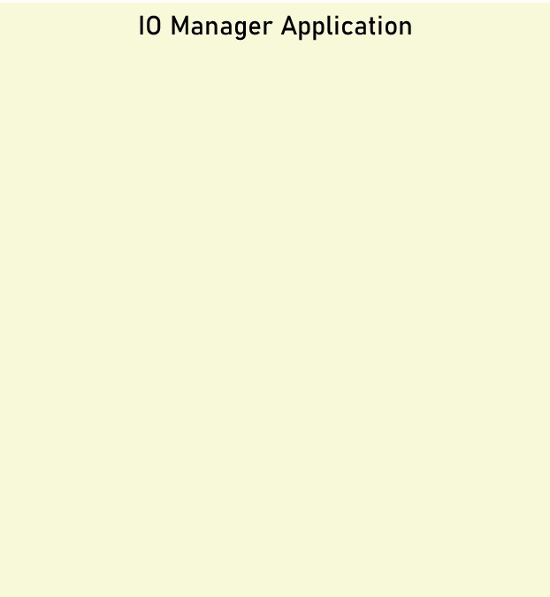
1. Introduction
1.3 Architecture
EZMotion
CAN
Input
Channels
File Output
Inertial Sensors
TCP/IP Stream
GPS
Analog Output
Analog
…
…
Resample
Speed Calculation
Distance Calculation
…
Confidential
© 2023 EZMetrology

Slide 7
2. Modules
Confidential
© 2023 EZMetrology

Slide 8
2. Modules
2.1 Input modules
Input Modules Characteristics:
    All channels have a start sync at time = 0
    All channels have independent frequencies
    Interface to existing hardware can be developed
Note that hardware is not included
EZMotion
XYZ , IJK of wheel(s)
Engine Motion
…
HW: EZMotion
Analog
Force Sensor
Temp Sensor
…
HW: Analog / Card
CAN
Pedal Position
Internal Data
…
HW: CAN Unit
GPS
Latitude
Longitude
Heading
…
HW: GPS Sensor
Inertial Sensors
Roll Pitch Yaw
Lateral Acceleration
…
HW: Accel.
Custom
…
HW:
Confidential
© 2023 EZMetrology

Slide 9
2. Modules
2.2 Processing modules
Processing Modules Characteristics:
    All channels can be used to recreate a new virtual channel
    Each module has its own settings and operation
    View real-time processed signals:
      Speed based on position samples
      Resampling to have all signals sampled at a common frequency
Speed
Linear Speed (1,2,3D)
Angular Speed
…
Math
Add, Subtract
Multiply, Division
…
Filters
Crop
Low Pass
…
Resampling
Resample Frequency
Programmable Latency
…
Custom
Ask for Your Math
…
Confidential
© 2023 EZMetrology

Slide 10
2. Modules
2.3 Output modules
Output Modules Characteristics:
    All channels can be exported
    Each module has its specific configuration
    Wide variety of formats are available and can be developed
2D Report
Line or Scatter Plot
Channel vs Time
Channel vs Channel
…
CAN Output
Channel ID
Channel Values
…
HW: Can Unit
Analog Output
Channel
Analog Conversion
…
HW: Analog Card
File Output
File Location
File Format and Content
…
Serial /TCPIP Stream
Communication Format
Communication Port
…
Confidential
© 2023 EZMetrology

Slide 11
3. Data Acquisition
Confidential
© 2023 EZMetrology

Slide 12
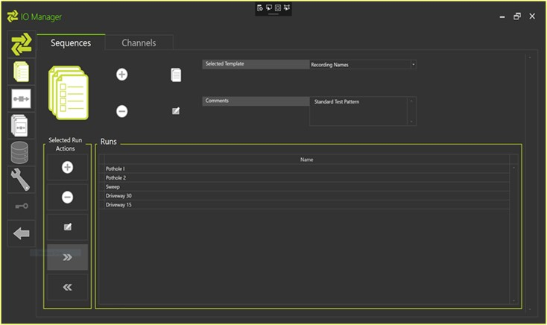
3. Data Acquisition
3.1 Configuration
Templates For Fast And Simple Setup:
Define, configure and save a setup for repeated use. This will facilitate the daily routine of setting up the system for your applications.
Separate Templates:
    Input : What sensors are connected?
    Processing : What signal processing should be performed ?
    Output : How is the data made available?
Profile Function:
    Group compatible templates to have the whole system configured with one click
Confidential
© 2023 EZMetrology

Slide 13
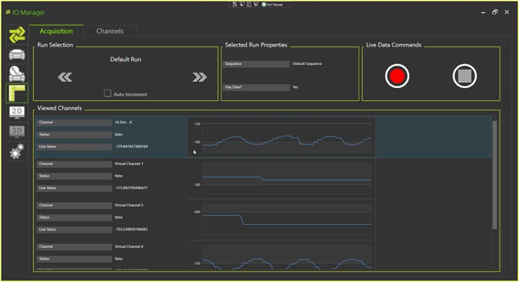
3. Data Acquisition
3.2 Recording
Designed For One Click Operation:
    Easy-to-use touch screen operation
      Typical in car operation
    Real-time feedback on channel status
    Automatic naming of recording sequences based on template
    Data overview at the end of each recording
Confidential
© 2023 EZMetrology

Slide 14
4. Viewing Data
Confidential
© 2023 EZMetrology

Slide 15
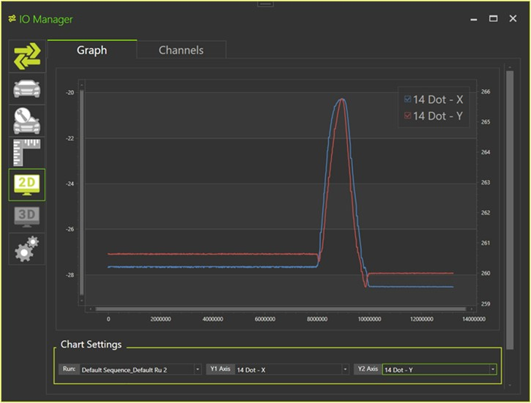
4. Viewing Data
4.1 2D view
Review Your Data in a Simple 2D Overview:
    Select any channel for review
    View channel content versus time or versus another channel
    Crop data for efficiency gain
    Export the graphical views for additional reporting
Confidential
© 2023 EZMetrology

Slide 16
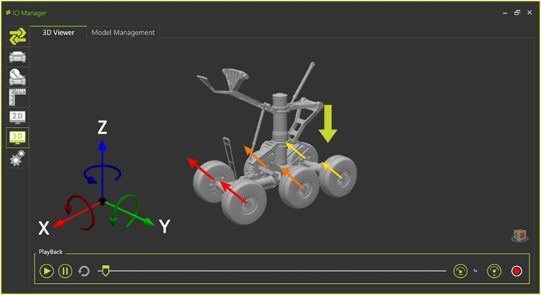
4. Viewing Data
4.2 3D view
Visualize and Review Your Data in 3D Animation:
    Setup the animation using 3D models for a realistic representation
    Use position or color scaling to show specific channels
    Amplify the motion for better visualization
    Replay data in slow motion or sped up motion
Confidential
© 2023 EZMetrology

Slide 17
5. Applications
Confidential
© 2023 EZMetrology

Slide 18

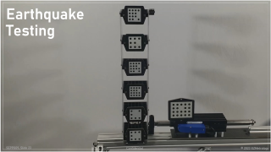


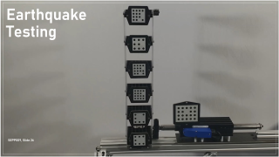

5. applications
Confidential
© 2023 EZMetrology

Slide 19
6. Conclusions
Confidential
© 2023 EZMetrology

Slide 20
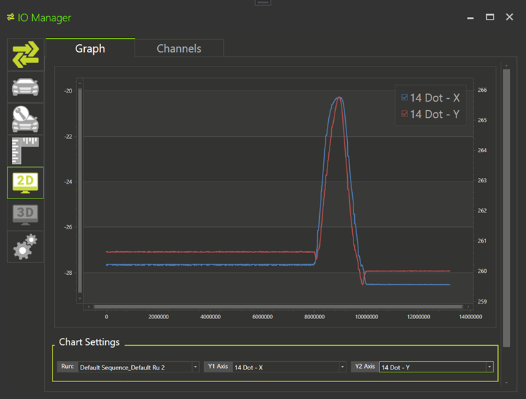
6. Conclusions
    IO Manager will collect information from a wide variety of sensors and bring them all to the same environment:
    View all channels
    Combine data from all channels to identify correlations
    Report or visualize measured events
    Export output in real time
      Position data for closed loop
      Position data for guided assembly
Confidential
© 2023 EZMetrology

Slide 21
Thank you.
info@ezmetrology.com
support@ezmetrology.com
www.ezmetrology.com
portal.ezmetrology.com
academy.ezmetrology.com
Confidential
© 2023 EZMetrology

Slide 22


Company Pages

Slide 23
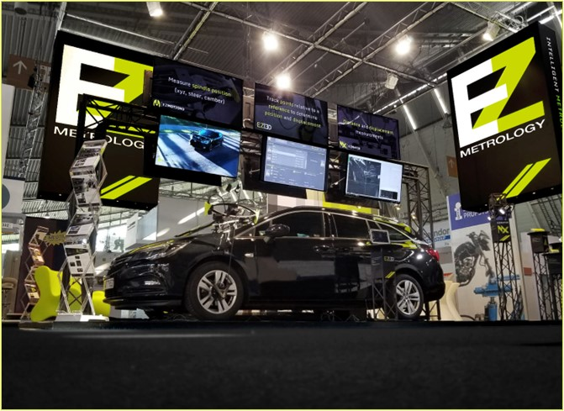
COMPANY OVERVIEW
Founded in 2006 by Carine Woldanski and Tom Van Esch
Global Operations:
  USA Headquarters in Michigan
  Europe Support office in Luxemburg
  Asia Partnerships
EZMetrology:
  70% Development and Engineering
    Fast product development and interactive evolutions
  20% Support and Training
    Ensuring a transfer of knowledge to our customers
  10% Administration and Sales
    Manage customs and sales procedures
Consistent annual growth of 50% over the past years
Developing innovative, creative and practical products
Confidential
© 2023 EZMetrology

Slide 24



SHARING OUR PASSION WORLDWIDE WITH CUSTOMERS AT
ALPINE
ARRIVAL
AUDI
BMW
BROSE
CANOO
CATERPILLAR
CHRYSLER
DACIA
DAIHATSU
DAIMLER
DENSO
FAW
FAURECIA
FERRARI
FIAT
FORD
GAC
GENERAL MOTORS
GG MOTORS
HUMANETICS
HONDA
HYUNDAI
INFINITI
JAGUAR
JEEP
KASEIKOGYO
KIA
KIEKERT
LADA
MACK
MAHINDRA
MARUTI
MASERATI
MAZDA
MITSUBISHI
MULTIMATIC
NISSAN
NITTO DENKON
POLARIS
PORSCHE
PROTON
PSA
QOROS
RENAULT
RIVIAN
SAIC MOTOR
SEAT
SIEMENS
STELLANTIS
SUBARU
SUZUKI
TATA MOTORS
TESLA
TOGG
TOYODA GOSEI
TOYOTA
VOLKSWAGEN
VOLVO
VOLVO TRUCKS
- EZM HEADQUARTERS
- EZM PARTNERS
- EZM CUSTOMERS
© 2023 EZMetrology

Slide 25
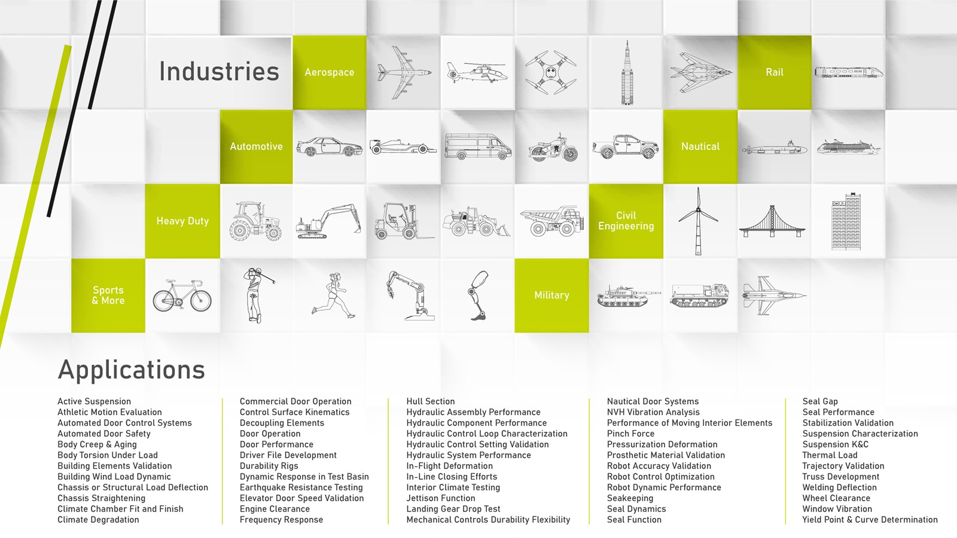

Slide 26
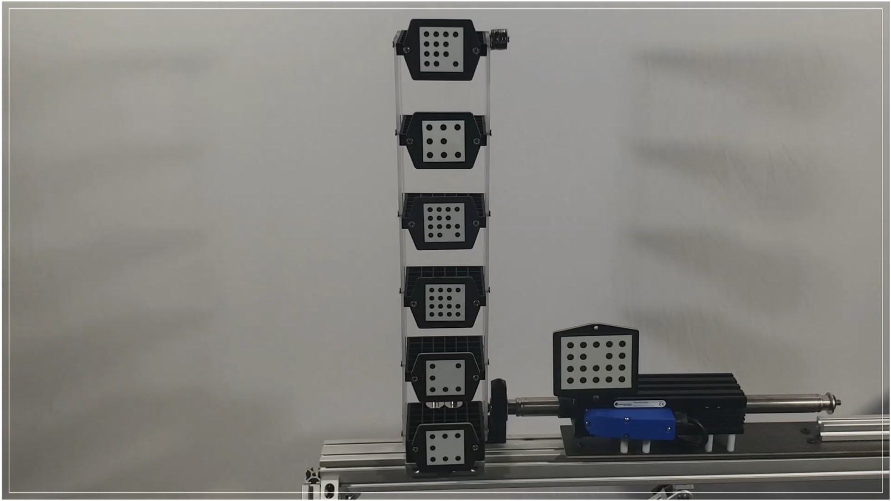
Earthquake Testing
Confidential
© 2023 EZMetrology

Slide 27
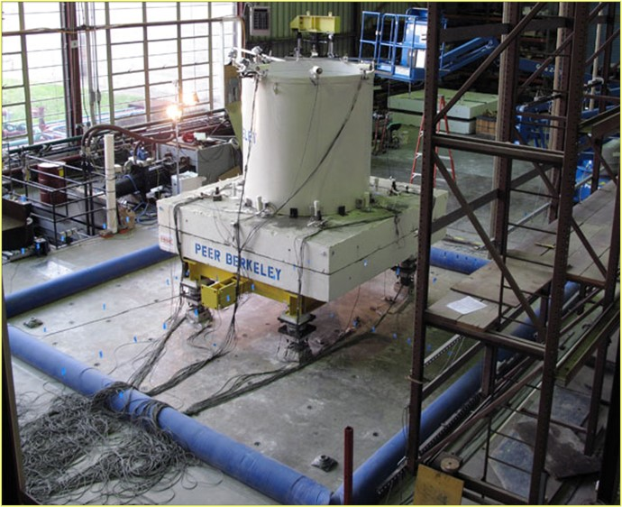
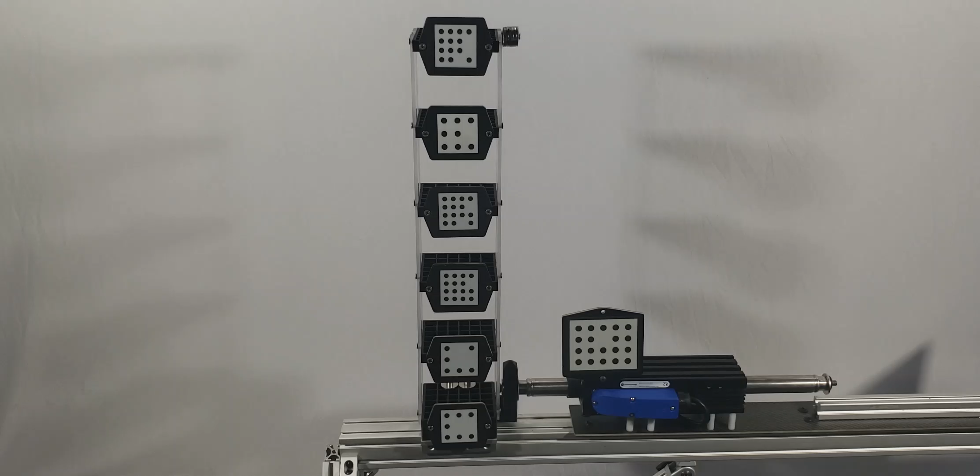
Applications
Earthquake Test instrumentation
EZMotion monitors structures and structural elements under dynamic loads from simulated earthquakes.
The massive shaker table, with up to 6 degrees of freedom, will shake the full or scaled structure to monitor displacements and resonance of the components.
Combine data from displacement and deflection with:
Actuator / Drive Signal
Strain Gauge
Confidential
© 2023 EZMetrology

Slide 28
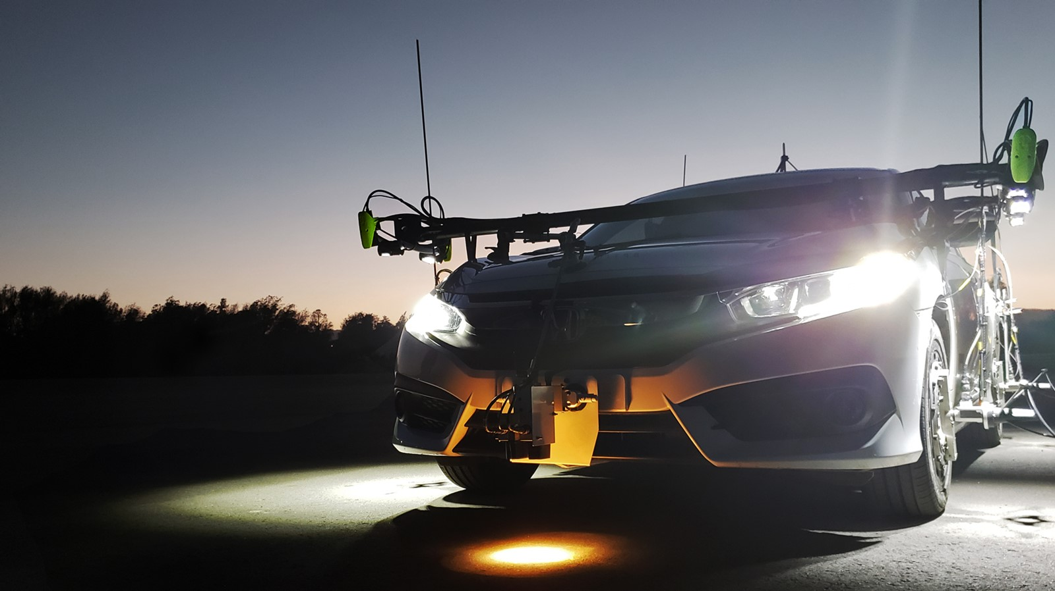
Tire and Wheel Development
Confidential
© 2023 EZMetrology

Slide 29
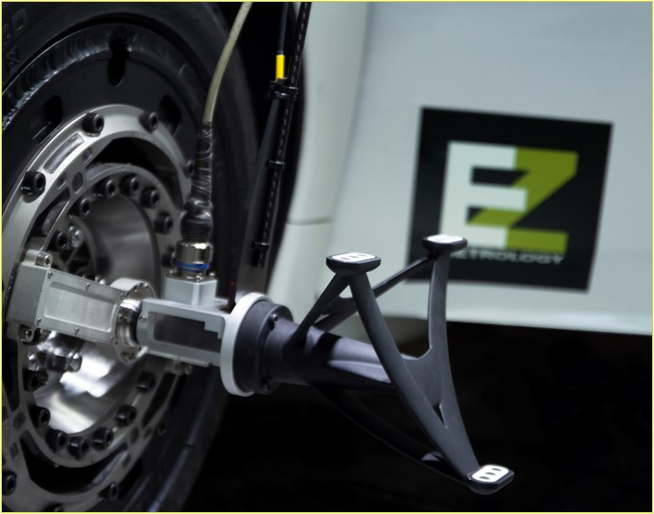
Applications
Tire and Wheel
EZMotion establishes accurate relationships between the wheel axis position and orientation relative to the road surface, a crucial parameter in tire testing and simulation.
Wheel to body measurement can be extended with
GPS location for track location
Slip angle sensor
Wheel force transducer
Tire temperature
Tire pressure
Body roll
Confidential
© 2023 EZMetrology

Slide 30
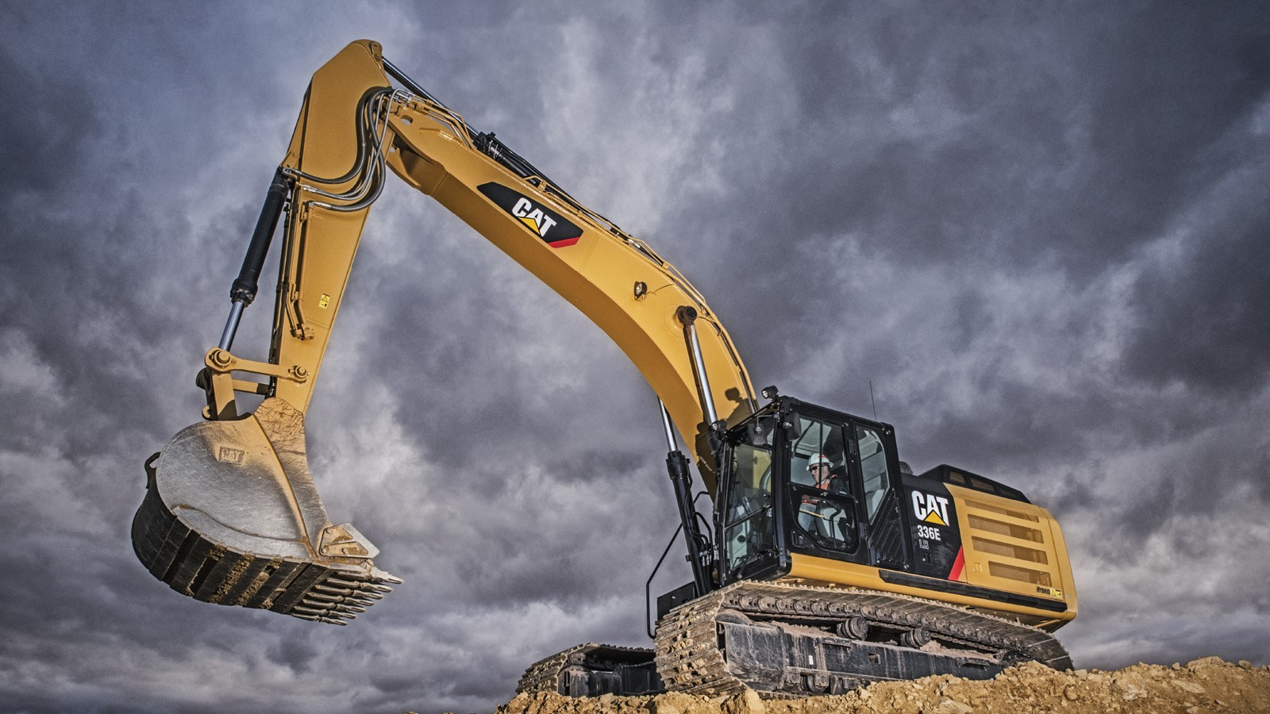
Hydraulic Kinematics
© 2023 EZMetrology
Confidential
© 2023 EZMetrology

Slide 31
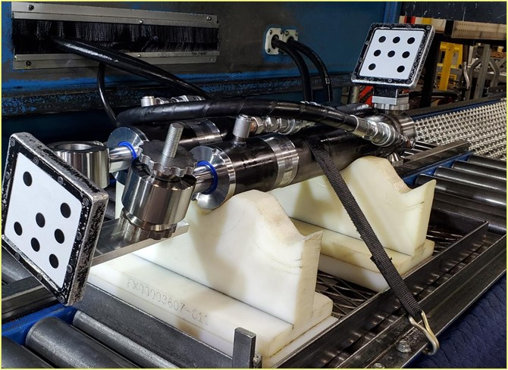
Applications
Hydraulic Kinematics
EZMotion tracks the dynamic performance of hydraulic assemblies to document and establish speed performance, total travel, drifts, snubber effects, and more.
The actuators position and displacement speed can be correlated with:
Oil pressure
Oil temperature
Valve control system signals
Confidential
© 2023 EZMetrology

