Slide 1

EZMotion - IOManager
Signal Latency Analysis
This study provides insight into the latency of the system configuration where position data from EZMotion is converted to an analog output.
Confidential
© 2023 EZMetrology

Slide 2

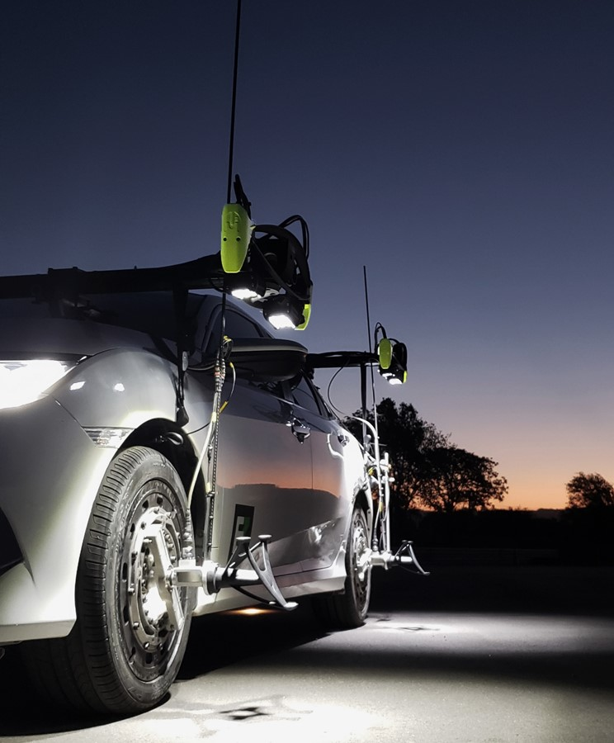
INDEX
Introduction
Timing Results
Resampling Module
Confidential
© 2023 EZMetrology

Slide 3
1. Introduction
Confidential
© 2023 EZMetrology

Slide 4

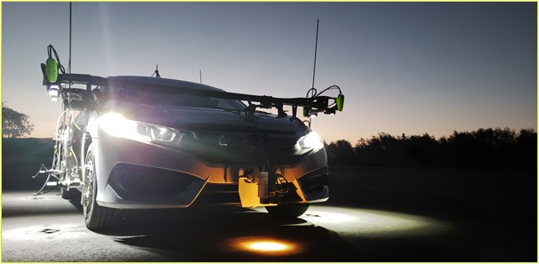
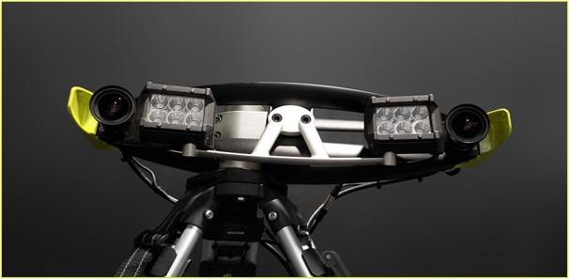
1. Introduction
1.1 Architecture
EZMotion:
Camera-based measurement system with real-time analysis of one or multiple optical trackers in the field of view. EZMotion generates 3D or 6D data as absolute motion or as a relative displacement.
IOManager:
IOManager will take single or multiple sensor inputs and assure the best possible time synchronization. Additionally, the software can be configured to perform signal analysis, resampling, processing, or calculation and provide a multitude of output channels, such as file output, analog, or streaming over TCP/IP.
Analog Output Module:
An output module in IOManger converts a measurement channel to an analog output pin on the analog expansion box connected to the controller.
Confidential
© 2023 EZMetrology

Slide 5
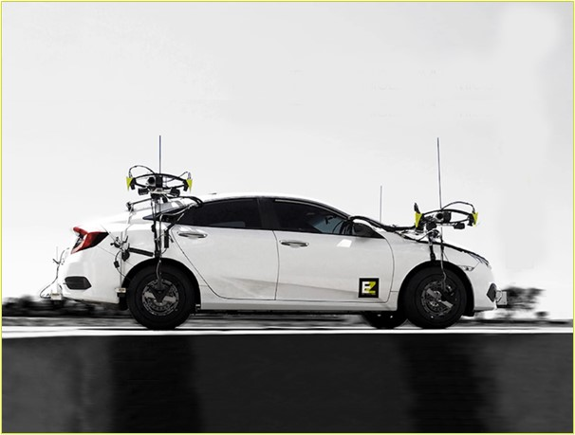
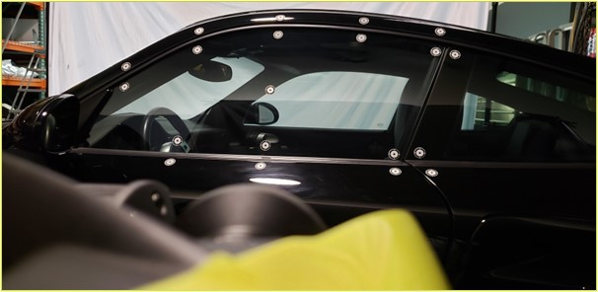
1. Introduction
1.2 Configuration
There are a wide variety of configurations possible based on the number of trackers, processing modules, and extra input channels. The current evaluation covers most of the basic elements. Alternate or more specific test configurations are possible upon request.
EZMotion:
    6D Tracker, sufficient light sources
    Standard Integrated lights
IOManager:
    Recording of 6 motion channels (XYZIJK)
    No additional signal processing is configured
Analog Output:
    Setup to output 3 channels to a predefined output port
Processing Platform:
    Intel i9 microprocessor with Windows 10 operating system
    Standard EZMotion processing platform
Confidential
© 2023 EZMetrology

Slide 6
1. Introduction
1.3 Process Break Down
Each sample follows a similar trajectory through the software architecture
IMPORTANT NOTE: the size of the blocks is not related to the actual time for that step
EZMotion
IOManager
Image Capture
Registering Sample
Data Pipeline
Image Processing
Signal Processing
Analog Output
Timeline
Event
Signal Output
Confidential
© 2023 EZMetrology

Slide 7
2. Timing Results
Confidential
© 2023 EZMetrology

Slide 8
2. Timing Results
2.1 Statistical reporting FOR approxIMATELY 2000 Samples
 | Exposure (ms) | Image Processing (ms) | Data Pipeline (ms) | Registering Sample (ms) | Processing (ms) | Analog Output (ms)
Average (50%) | 0.2 | 1.44 | 0.73 | 0.12 | 2.18 | 0.16
2σ (95%) | 0.2 | 1.53 | 1.68 | 0.66 | 4.85 | 0.85
Function of light conditions; sunlight conditions will reduce this to les than 0.1ms
Average (50%) | 3.19
2σ (95%) | 4.98
A near constant value as soon as the tracker is located and tracked. Startup or transient situations could cause a temporary delay.
The random effect of system delays results in overall better performance than the individual statistics combined.
Confidential
© 2023 EZMetrology

Slide 9
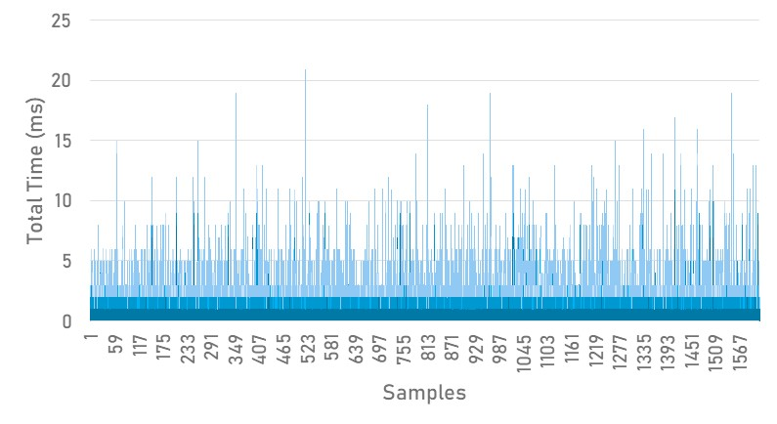
2. Timing Results
2.2 Timing Samples Graph
The system is running on a Windows platform.
While it is not classified as a real-time operating system, the modularity and universal connectivity to networks provide a reliable solution. The occasional peak in latency time on rare occasions is a side effect.
The graph below shows a collection of approximately 2000 consecutive samples.
Alternate solutions are available as described in the next topic.
Confidential
© 2023 EZMetrology

Slide 10
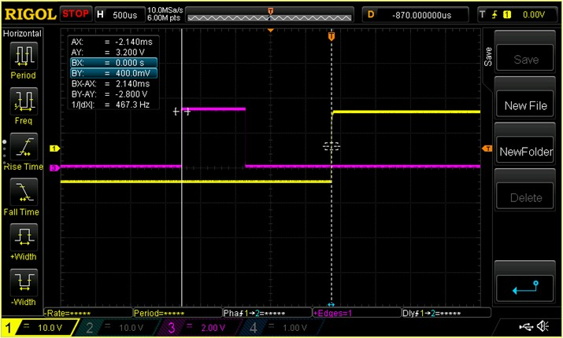
2. Timing Results
2.3 Objective ConFirmation
Following an internal timing study of the different steps, a practical setup was made using electrical signals from the processor unit.
The image from an oscilloscope represents 3 events:
    The rising edge of the magenta line illustrates the reception of the image in the image processing module.
    The falling edge of the magenta line illustrates the finalization of the image processing (0.750ms).
    The rising edge of the yellow line corresponds to the analog output from that newly obtained result. In this case, it is set as a step function to pinpoint the timestamp (1.000ms).
Of course, this is a single illustration of a generic sample of the observations from the previous pages.
Confidential
© 2023 EZMetrology

Slide 11
3. Resampling Module
Confidential
© 2023 EZMetrology

Slide 12
3. Resampling Module
3.1 Latency control
The resampling module is an available method to control latency.
The resample module generates a signal at a constant frequency at a predefined latency.
By setting the allowed latency, the system will accurately control the output generation. With this module, time control is as accurate as the variation of the last step; based on the previous data collection, on average, time control is expected to be accurate within 0.16 ms with a 2σ variation of 0.85 ms.
EZMotion
IOManager
Image Capture
Registering Sample
Image Processing
Signal Processing
Resampling
Analog Output
Timeline
Event
Signal Output
Confidential
© 2023 EZMetrology

Slide 13
Thank you.
info@ezmetrology.com
support@ezmetrology.com
www.ezmetrology.com
portal.ezmetrology.com
academy.ezmetrology.com
Confidential
© 2023 EZMetrology

