Slide 1


EZMetrology
EZSlamx Energy Models
Confidential
© 2023 EZMetrology

Slide 2

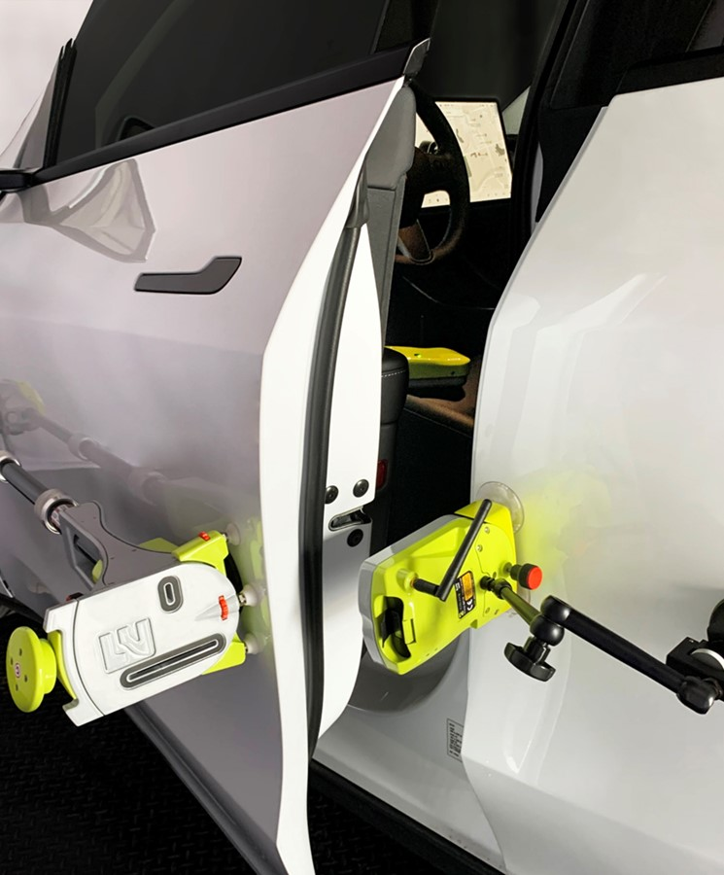
INDEX
Introduction
Typical Closing Energy Pie Graphs
Flush Sensitivity
Energy Buildup
Confidential
© 2023 EZMetrology

Slide 3

1. Introduction
Confidential
© 2023 EZMetrology

Slide 4
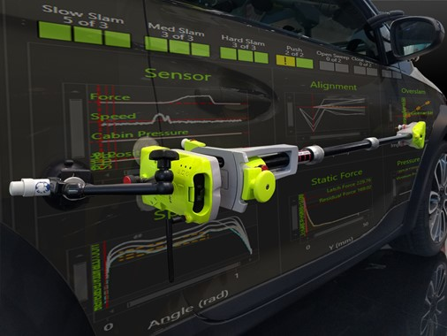
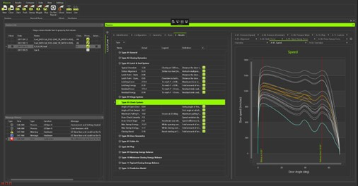
1. Introduction
EZSLAMX
1.1 EZSLAM SUMMARY
  Short summary, in case you are not familiar with the EZSlam platform.
EZSlam
Measurement technology based on multiple sensors, dedicated software analysis, and a standard measurement protocol to determine all significant parameters regarding door behavior.
Energy Metrics
Evaluation through energy measurements allows one to have identical units for all characteristics.
Speed, pressure, and force can all be expressed in Joules to enable relative comparisons.
Confidential
© 2023 EZMetrology

Slide 5
2. Typical Closing Energy Pie Graphs
Confidential
© 2023 EZMetrology

Slide 6
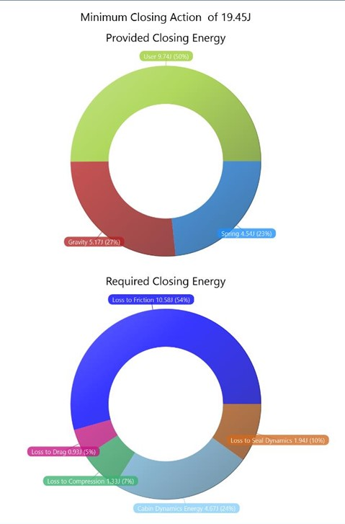
2. Typical ClOSING ENERGY PIE Graphs
EZSLAMX
2.1 COMPARISONS
  A standard test can determine the energy distribution for minimum closing situations.
In a “good”-“bad” comparison, all metrics will be different because of the significantly different situations.
  Minimum closing speed is lower:
    Cabin pressure peak is lower
    Therefore, energy input is lower
    Drag is also lower
It can be challenging to determine the cause and consequences of all the differences.
Confidential
© 2023 EZMetrology

Slide 7
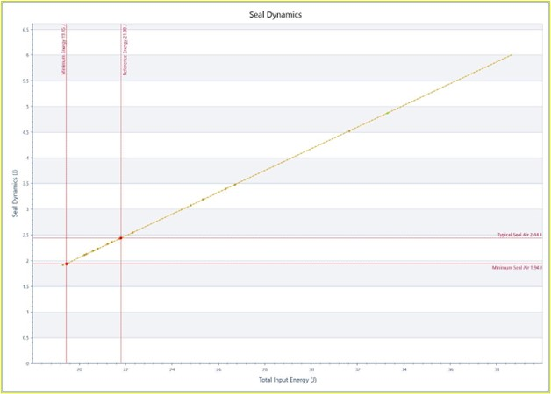
2. Typical ClOSING ENERGY PIE Graphs
EZSLAMX
2.2 ESTABLISH RELATIONSHIPS
  The solution is to determine the energy distribution for a given or “typical” situation.
  Establish relationship for each characteristic as a function of speed or energy.
  Each slam test adds a point for a specific characteristic.
  Interpolation techniques can be used to determine the effect at a preselected speed or energy.
  This method applies to
    Friction
    Seal Compression
    Cabin Air
    Seal Air
    Drag
Confidential
© 2023 EZMetrology

Slide 8
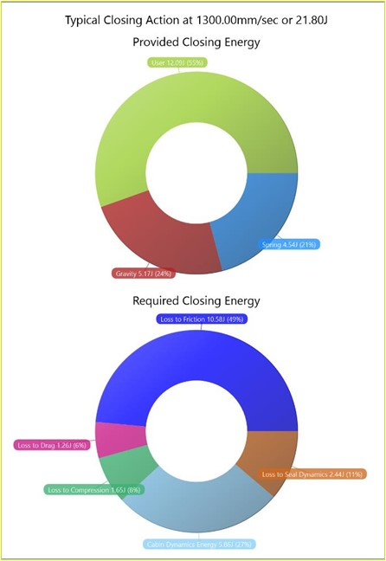
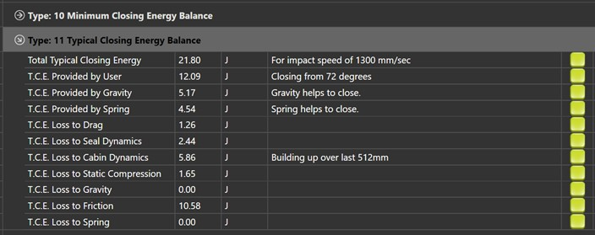
2. Typical ClOSING ENERGY PIE graphs
EZSLAMX
2.3 Energy distribution
  When all values are established for a given energy or speed, they are combined into one energy distribution pie.
Confidential
© 2023 EZMetrology

Slide 9
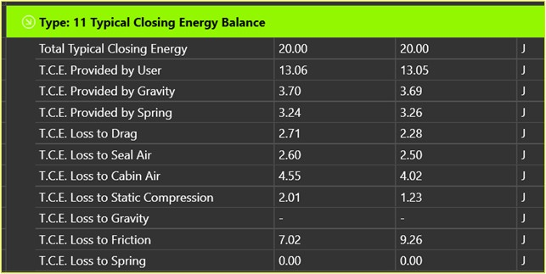
2. Typical ClOSING ENERGY PIE
EZSLAMX
2.4 Comparison in identical situation
  Comparison of different vehicles when closing in a numerically identical situation.
  A minimum closing situation will often show changes on many levels.
  Comparing situations with identical energy/speed makes the characteristics stand out more.
Confidential
© 2023 EZMetrology

Slide 10
3. Flush Sensitivity
Confidential
© 2023 EZMetrology

Slide 11
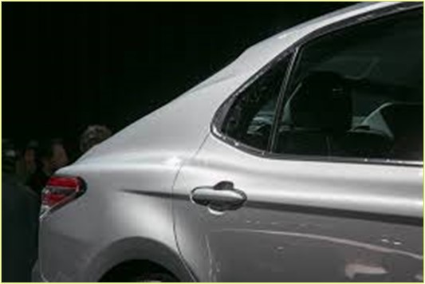
3. Flush Sensitivity
EZSLAMX
3.1 POPULAR Layouts
  Exploring the effects of product variation on closing efforts.
Practical Situation
  The door might be adjusted to obtain a desired flush condition.
  In the majority of cases, this is done by moving the striker.
Question
  What is the effect of this adjustment on the closing efforts?
Confidential
© 2023 EZMetrology

Slide 12
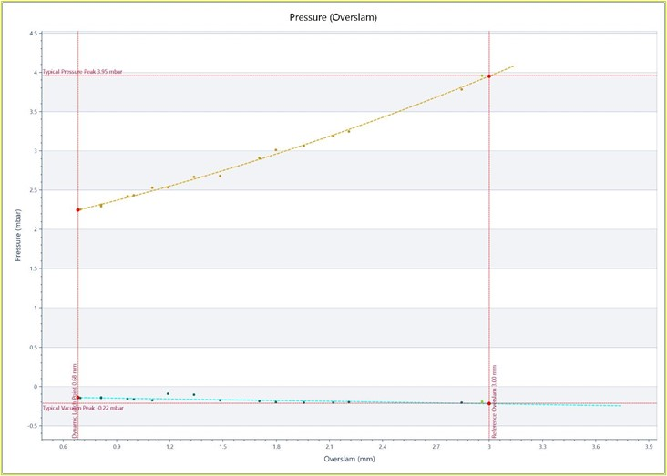
3. Flush Sensitivity
EZSLAMX
3.2 OVERSLAM RELATION
  Based on the standard measurement session, the software determines the relation of each characteristic to the overslam.
  Moving Latch Inboard = Requires more overslam.
    more resistance from each component.
  Moving Latch Outboard = Requires less overslam
    less resistance from each component.
  This applies to
    Friction
    Seal Compression
    Cabin Air
    Seal Air
    Drag
    Static Compression
Confidential
© 2023 EZMetrology

Slide 13
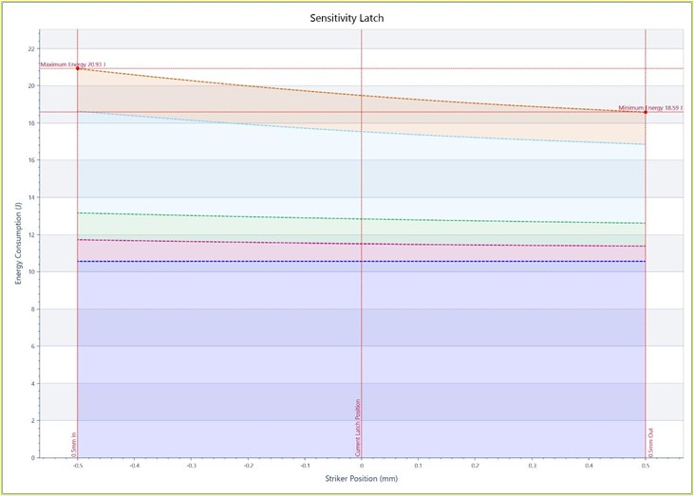
3. Flush Sensitivity
EZSLAMX
3.3 Cumulation of components
  The overall behavior is the cumulation of all individual components.
  The graph visualizes the sum of energies as a function of latch position.
Conclusions (Example)
  Current striker position, 0 mm:
  + 0.5mm >> Closing Energy 17.3J
  - 0.5mm >> Closing Energy 14.7J
  Total variation of 2.6J for the user with a build tolerance of 0.5mm.
Confidential
© 2023 EZMetrology

Slide 14
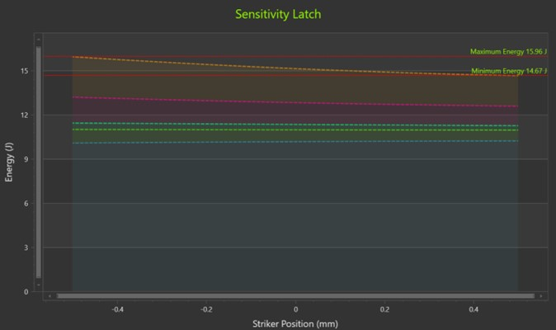
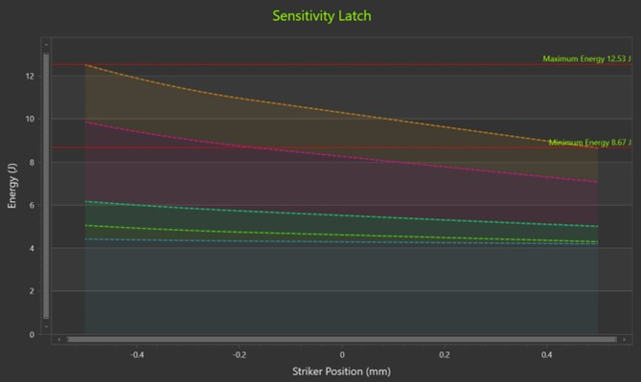
3. Flush Sensitivity
EZSLAMX
3.4 Low vs. high closing energy values
  Low Value (ex. 1.3J)
  Closing efforts will hardly be affected by flush adjustments.
  High Value (ex. 3.9J)
  Closing efforts will significantly be affected by flush adjustments.
Confidential
© 2023 EZMetrology

Slide 15
4. Energy Buildup
Confidential
© 2023 EZMetrology

Slide 16
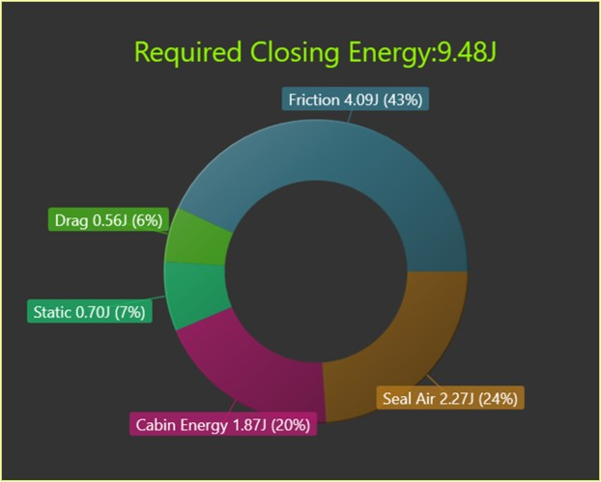
4. Energy buildup
EZSLAMX
4.1 values are interdependent
  Exploring the effects from one component on the other components.
Practical Situation
  If one characteristic is modified, then all values change.
  All effects are dependent on each other.
Critical Question
  What overall improvement can be expected when improving a specific single aspect?
Confidential
© 2023 EZMetrology

Slide 17
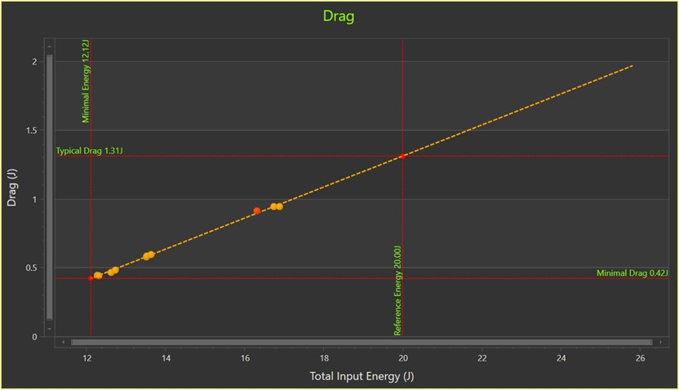
4. Energy buildup
EZSLAMX
4.2 Step 1 – Establish requirements
  Analysis of energy consumption for a step-by-step increment of input energy.
Step 1
  Establish energy requirements of each characteristic as a function of energy input.
  This applies to
    Friction
    Seal Compression
    Cabin Air
    Seal Air
    Drag
    Static Compression
Confidential
© 2023 EZMetrology

Slide 18
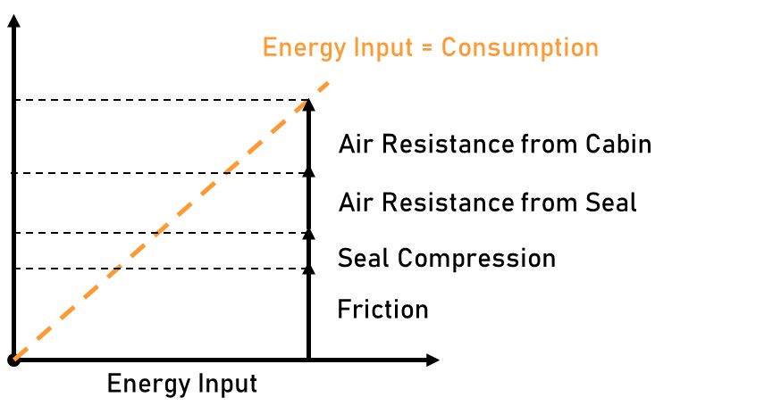
4. Energy buildup
EZSLAMX
4.3 Step 2 – Establish input vs. consumption
  Analysis of energy consumption for a step-by-step increment of input energy.
Step 2
  Establish cumulative energy input vs. energy consumption.
Energy Consumption
Confidential
© 2023 EZMetrology

Slide 19
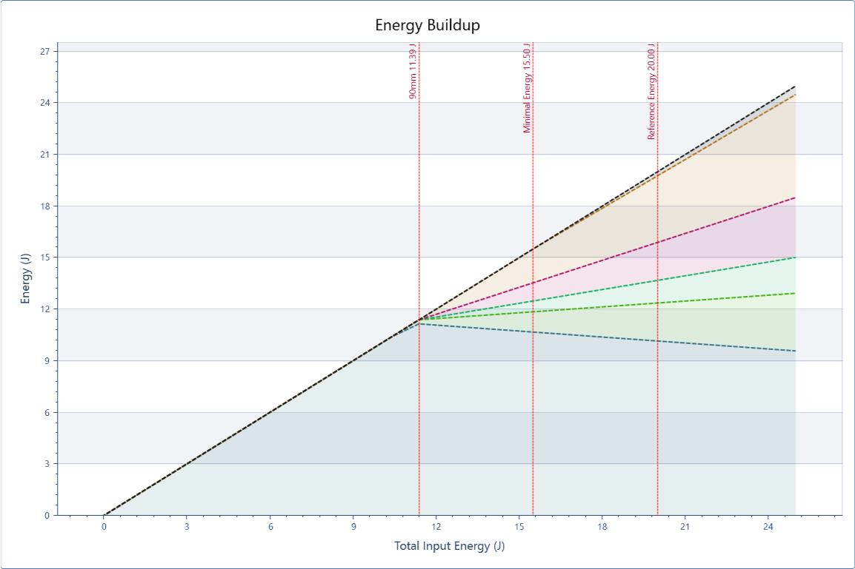
4. Energy buildup
EZSLAMX
4.4 first example
  INPUT OF ONLY 2 JOULES...
Practical
  With only 2J, the door will stop somewhere halfway on the check.
Energy
  There is not enough energy to overcome the friction.
  All input is absorbed by friction.
Seal Air
Cabin Air
Drag
Seals
Friction
Confidential
© 2023 EZMetrology

Slide 20
4. Energy buildup
EZSLAMX
4.5 second example
  INPUT OF 6 JOULES...
Practical
  With only 6J, the door will still stop halfway on the check.
Energy
  There is simply not enough energy to overcome the friction.
  All provided energy is consumed by friction.
  Because the door comes to a stop relatively quickly, there is almost no drag component.
Seal Air
Cabin Air
Drag
Seals
Friction
Confidential
© 2023 EZMetrology

Slide 21
4. Energy buildup
EZSLAMX
4.6 third example
  INPUT OF 11 JOULES...
Practical
  With 11J, the door will arrive at Y=90mm.
Energy
  There is just enough energy to overcome friction.
  Now we also start to compress the seals.
  The vast majority of the provided energy is consumed by friction.
Seal Air
Cabin Air
Drag
Seals
Friction
Confidential
© 2023 EZMetrology

Slide 22
4. Energy buildup
EZSLAMX
4.7 fourth example
  INPUT OF 14 JOULES...
Practical
  With 14J, the door will approach the closing situation.
Energy
  There is enough energy to overcome friction.
  The system starts to compress the seals and feels resistance from the cabin air and drag.
Seal Air
Cabin Air
Drag
Seals
Friction
Confidential
© 2023 EZMetrology

Slide 23
4. Energy buildup
EZSLAMX
4.8 fifth example
  INPUT OF 18 JOULES...
Practical
  With 18J, the door will be slammed and closed.
Energy
  There is plenty of energy to be absorbed by all components.
  Friction, seals, drag, cabin air, and seal air are all gradually increasing.
Seal Air
Cabin Air
Drag
Seals
Friction
Confidential
© 2023 EZMetrology

Slide 24
4. Energy buildup
EZSLAMX
4.9 SIXTH example
  INPUT OF X JOULES...
Practical
  At a sufficiently high energy level, the door will be slammed and closed.
Energy
  There is plenty of energy to be absorbed by all components.
  Friction, seals, drag, cabin air, and seal air are all gradually increasing.
Seal Air
Cabin Air
Drag
Seals
Friction
Confidential
© 2023 EZMetrology

Slide 25
4. Energy buildup
EZSLAMX
4.10 SIXTH example
  IMPROVE ONE, IMPROVE ALL...
Action
  Reduce Cabin Air (Pink) by a given value by improved air extraction.
Energy
  Other components will now also require less energy.
  The total cumulative energy will reduce more than the original improvement from the individual component.
Seal Air
Cabin Air
Drag
Seals
Friction
Confidential
© 2023 EZMetrology

Slide 26
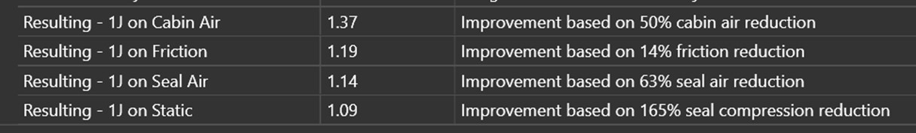
4. Energy buildup
EZSLAMX
4.11 Reporting improvements
  Reporting Method...
Practical Example
1) Improvement
  Improving the cabin air extraction by 1J will result in an overall energy reduction of 1.37J.
  Reducing the friction by 1J will result in an overall energy reduction of 1.19J.
2) Relative improvement
  1J on cabin air represents a 50% improvement. This is a lot.
  On friction, however, 1J improvement is only 14% of the current value. This might be doable.
Confidential
© 2023 EZMetrology

Slide 27
Thank you
info@ezmetrology.com
support@ezmetrology.com
www.ezmetrology.com
portal.ezmetrology.com
academy.ezmetrology.com
Confidential
© 2023 EZMetrology

