Slide 1


EZSlamX
Computation Aspects & Vision Strategy
Confidential
© 2023 EZMetrology

Slide 2

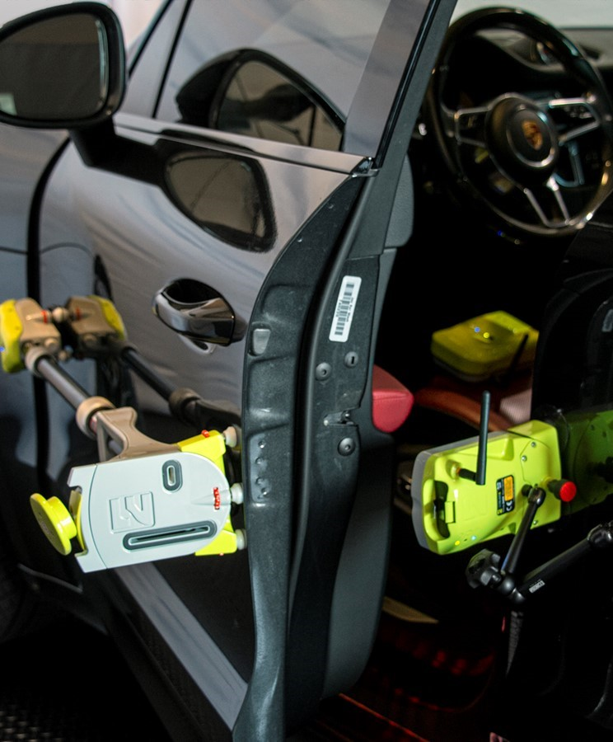
Index
Computational Aspects
  Uncertainty Propagation
  Iteration Conditions
  Dependency of the Metrics
  Mathematical Model Evolution
Version Strategy
  License Compatibility
  Download Center
Confidential
© 2023 EZMetrology

Slide 3

1. Computational Aspects
Confidential
© 2023 EZMetrology

Slide 4
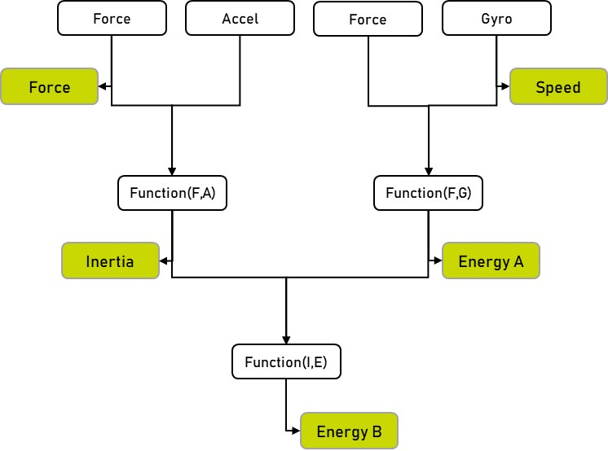
1. Computational Aspects
1.1 Uncertainty Propagation
Type 1 : Measured values
Results based on a direct reading from a sensor
Uncertainty ~ 3%*
Closing Force, Speed, Pressure, and Alignment
Type 2 : Derived values
Values deduced through derivation or a combination of type 1 values
Uncertainty ~ 6%*
Input Energy, Angle, Compression Energy, and Inertia
Type 3 : Combined values
Values deduced through derivation or a combination of type 1 or 2 values
Uncertainty ~ 9%*
Seal Dynamics, and Watts
* Representative value
Confidential
© 2023 EZMetrology

Slide 5
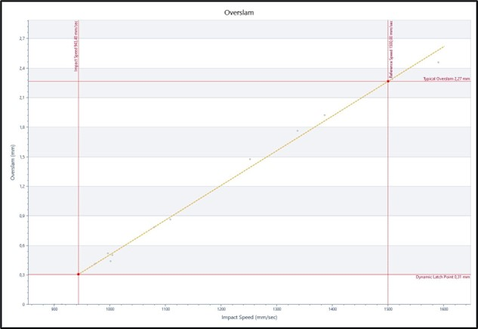
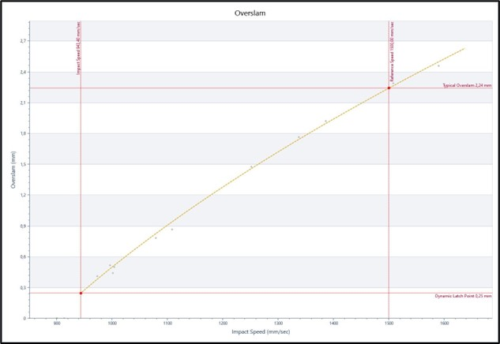
1. Computational Aspects
1.2 Iteration Conditions
Models and algorithms used in EZSlam are based on a measured point cloud and iterative least-squares polynomial fit.
A slight change to the point cloud could exceptionally results in a different optimal polynomial solution.
The figures illustrate a side-by-side comparison of two different outcomes based on slightly dissimilar evolutions of the door radius for the same data. Where latch point could drift mathematically from 0.31mm to 0.25mm or for a typical overslam from 2.27 to 2.24mm.
Confidential
© 2023 EZMetrology

Slide 6
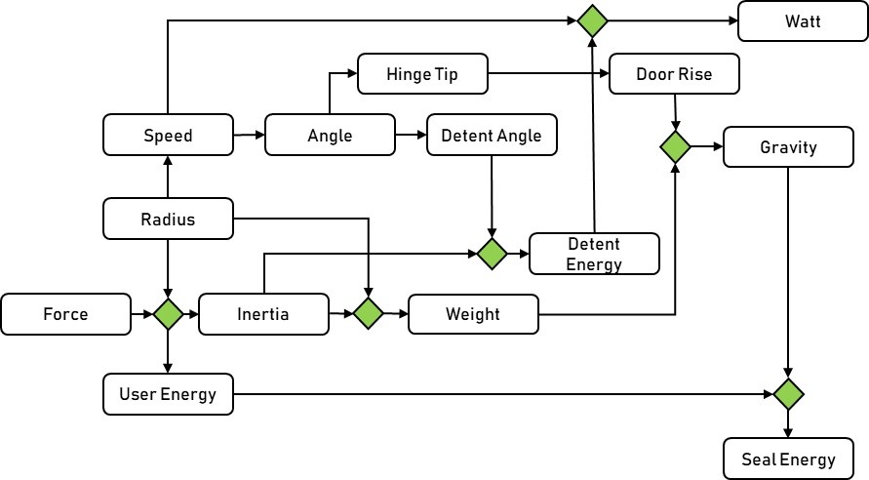
1. Computational Aspects
1.3 Dependency of the metrics
There is an obvious physical and mechanical dependency between several of the metrics.
A change in a single characteristic has a ripple effect throughout the related characteristics.
The example below is a partial representation of the connections between a subset of metrics.
Confidential
© 2023 EZMetrology

Slide 7


Computational Aspects
1.4 Mathematical Model Evolution
The mathematical models used and developed in EZSlam evolve over time to improve the accuracy of all interconnected effects.
EXAMPLE: EZSlam’s modeling regarding its weight compensation.
1st generation: Weight compensation based on the kinetic energy
2nd generation: Implemented the effects of decreased cabin pressure from reduced velocity
3rd generation: Improved the weight modeling by adjusting gravity input and associated drag
$$Eclosing=Emeasured −\frac{1}{2} ∆m v^{2}$$
$$Eclosing=Emeasured−\frac{1}{2} ∆m v^{2}−k1 P\left(v\right)$$
$$Eclosing=Emeasured−\frac{1}{2} ∆m v^{2}−k1 P\left(v\right)+∆m g h+k2 D\left(v\right)$$
Confidential
© 2023 EZMetrology

Slide 8
2. Version Strategy
Confidential
© 2023 EZMetrology

Slide 9
2. Version Strategy
2.1 License Compatibility
Full Licenses:
Recorded data : Data is universal and compatible between all the versions.
  Recommend using export and import functions.
Results : Results are version-specific based on the previous slides.
To compare results, it is recommended to have the data processed in the same version.
Viewer Licenses:
Results: Data is not reprocessed, so it is important to import sessions processed in a matching version.
v1 - Full License
Recorded Data
Results v1
v2 - Full License
Recorded Data
Results v2
v3 - Full License
Recorded Data
Results v3
v1 - Viewer License
Only views v1 results
v2 - Viewer License
Only views v2 results
v3 - Viewer License
Only views v3 results
Confidential
© 2023 EZMetrology

Slide 10
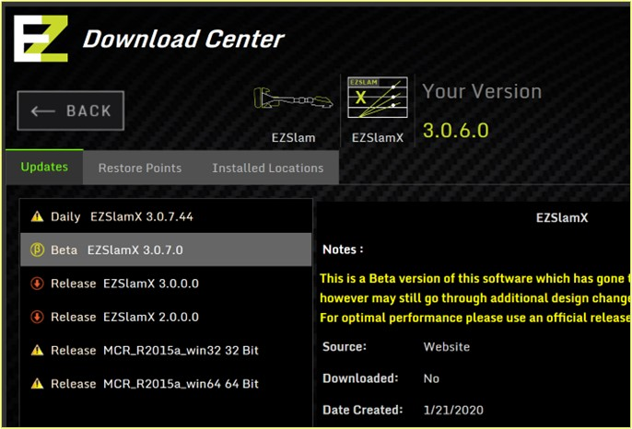
2. Version Strategy
2.2 Download Center
Major Release 3.x.x.x
    New release with significant changes
Minor Release 3.1.x.x
    Update of the previous major release with minor bug fixes or improvements
Beta Release 3.1.4.x
    Test version of the latest improvements
    Only to be used with our recommendation
Daily 3.1.4.33
    Untested latest build
    Only to be used with our expressed recommendation
Use the restore point to secure all data and configurations.
Confidential
© 2023 EZMetrology

Slide 11
Thank you.
info@ezmetrology.com
support@ezmetrology.com
www.ezmetrology.com
portal.ezmetrology.com
academy.ezmetrology.com
Confidential
© 2023 EZMetrology

