Slide 1
EZSlam
Closing Efforts Analysis
Making it possible for anybody to capture all key metrics of a door in quick and simple operation.
For nearly 20 years, the leading innovation for door system analysis.
Confidential
© 2023 EZMetrology

Slide 2
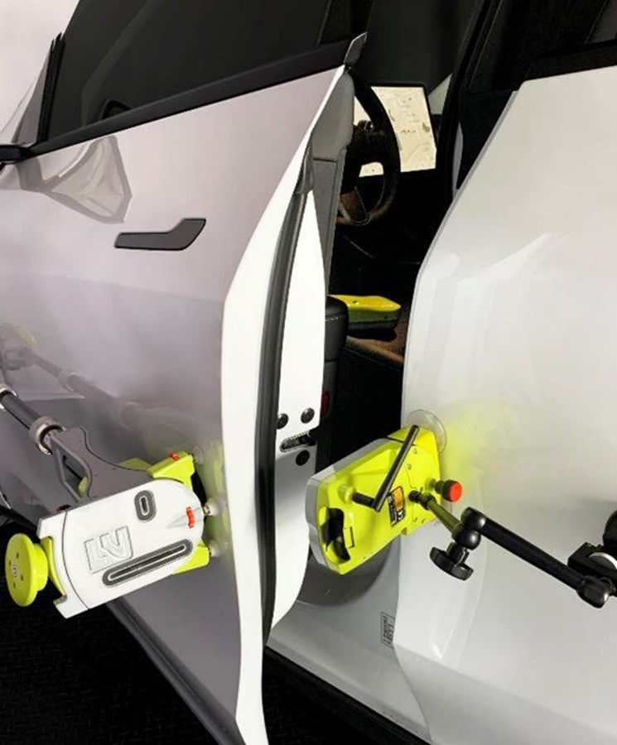


Index
Introduction
EZSlam Concept
Technology
Energy Balance
Software Suite
Applications
Conclusion
Confidential
© 2023 EZMetrology

Slide 3
1. Introduction
Confidential
© 2023 EZMetrology

Slide 4
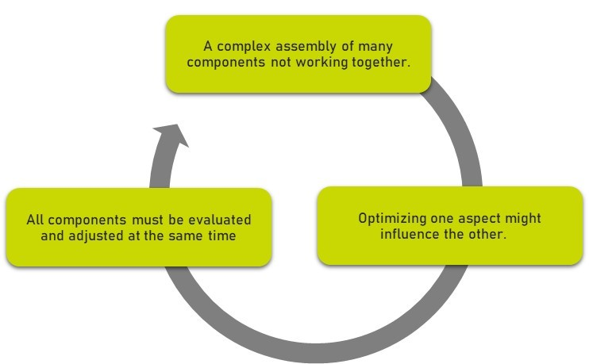

1. Introduction
1.1 Door systems
What constitutes a good door ?
How do you measure the quality of a door ?
How do you benchmark door systems ?
How do you set the targets for your customer experience ?
Confidential
© 2023 EZMetrology

Slide 5
1. Introduction
1.2 any time is a good time
Benchmark
Extensive objective study of a larger group of doors to understand the available parameters and establish design criteria.
Specification
Define component specifications and resulting overall performance.
Test multiple components to evaluate their performance with respect to targets.
Launch
During a rapid changing launch process, identify as soon as possible faulty or out of specification components.
Quality
Verify current production output using original design targets.
Associate out of tolerance situations to specific causes at component level as fast as possible.
Vehicle Life Cycle
Design
Compile the data to establish a desired feel of the door closing event.
Pilot
Review the first samples to identify variation and pinpoint the tolerance level on all aspects of closing efforts.
Process
Review the process capability and identify specific process variation that contributes to closing efforts.
Confidential
© 2023 EZMetrology

Slide 6
2. Concept
Confidential
© 2023 EZMetrology

Slide 7
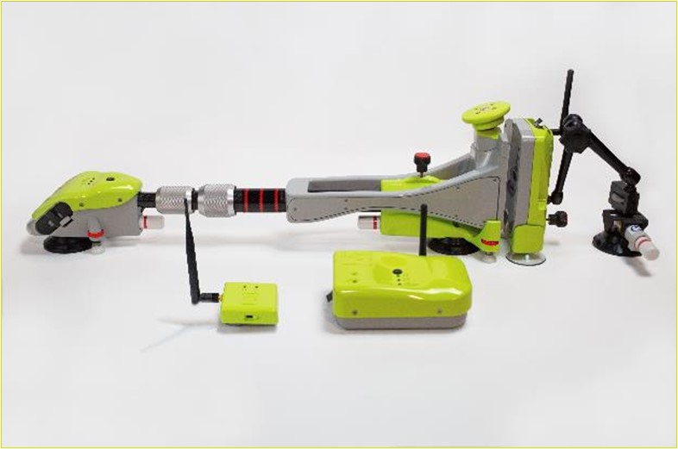
2. Concept
2.1 Overview
DOOR UNIT
Force and motion sensor technology to be mounted on door
BODY UNIT
Mounted on body as reference for striker alignment and relative motion
BASE UNIT
USB station for wireless communication
CABIN UNIT
Placed in the cabin for air pressure monitoring
Confidential
© 2023 EZMetrology

Slide 8
2. Concept
2.2 Installation & Acquisition
1. Installation
EZSlam can be installed in a few minutes using the suction cups on its adjustable units.
2. Acquisition
Perform a standard “recipe” acquisition:
Slam
Sweep
Wiggle
Push
Plop
From fully opened, close the door at different speeds
Slowly move the door over the check system, in both open and close directions
Rapid back and forth movement to establish the weight of the door
Push the door slowly to latch to establish seal compression
Identify the unlatching of the door
3. Results
Instant Feedback : Results are shown immediately following the measurement.
Instant Comparison : Results are compared to nominal or target values.
Confidential
© 2023 EZMetrology

Slide 9
2. Concept
2.3 Advantages
Standardized Process
EZSlam measurements are always executed in the same way and provides a standardized format for any users in any location.
Self Compensating
EZSlam knows its own weight and takes its effect into account.
Mobile Equipment
EZSlam comes in a compact rugged transport case and can easily be taken from one site to another.
Adjustable Mounting
EZSlam can be used on a multitude of different car door designs, curvatures and character lines.
    Small contact area
    Telescopic arms
    Roll angle adjustment
    Support point adjustment
Wireless Operation
No cables are required, removing trip hazard and installation complexity.
Confidential
© 2023 EZMetrology

Slide 10
3. Technology
Confidential
© 2023 EZMetrology

Slide 11
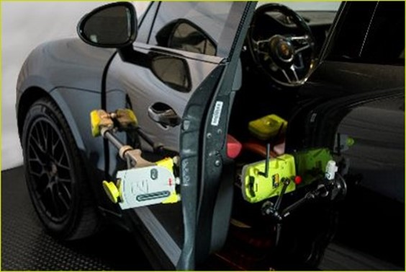
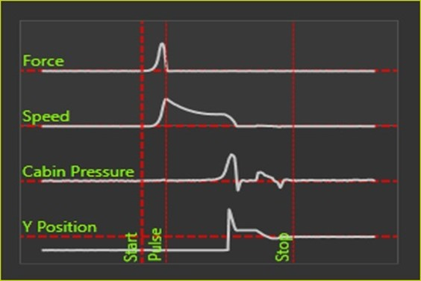
3. Technology
3.1 Sensor Collection
Sensors
Wide variety of sensors collect data for the following characteristics
  Trajectory
  Angle
  Speed
  Acceleration
  Force
  Pressure
The multi-processor setup collects all sensor data at 500 Hz.
Synchronization and correlation between all sensors is part of the technology so the results can be accurate and independent of the user.
Confidential
© 2023 EZMetrology

Slide 12
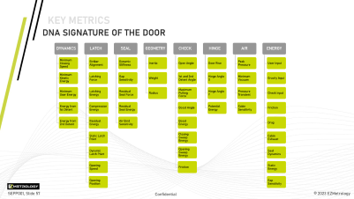
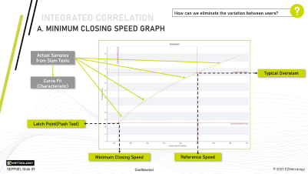
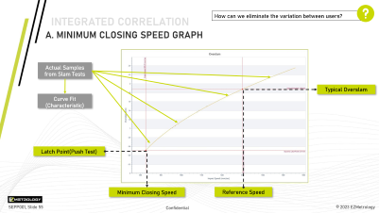
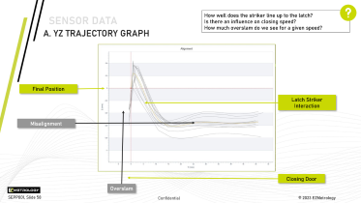
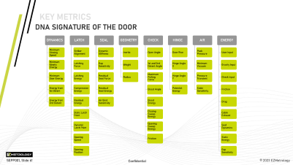
3. Technology
3.2 Data processing
Sensor Data
Signals from all sensor will capture the door behavior from different perspectives.
Force, Speed, Pressure, and Alignment
Integrated Correlation
Automated correlation will be performed to eliminate user influence and improve accuracy.
Closing Energy, Overslam, and Compression Energy
Key Metrics or ‘DNA’
Key characteristics will be determined to provide an objective description of the door system. Enabling studies and comparisons.
Confidential
© 2023 EZMetrology

Slide 13
3. Technology
3.3 Data interpretation
Minimum Closing Energy?
Analysis Steps
To simplify analysis, differences and characteristics are evaluated in the sequence they would occur during a closing process.
Numerical evaluation
Each consecutive event is associated with a specific metric and can be evaluated for deviation.
Identification
In case a difference is observed in the specific set of metrics, the components in question can be identified as being different and investigated in more detail.
NOK
OK
Minimum Closing Speed ?
NOK
OK
Issue Component:
Hinge & Check
Static Latch Energy ?
OK
NOK
Issue Component:
Seal or Seal Gap
Pressure Transient Behavior ?
NOK
OK
Issue Component:
Air Bind Seals
Issue Component:
Cabin Air Evacuation
Confidential
© 2023 EZMetrology

Slide 14
4. Energy Balance
Confidential
© 2023 EZMetrology

Slide 15







4. Energy Balance
4.1 Introduction
Incomparable Metrics
  Problem: Many characteristics are expressed in different units, making it impossible to understand the relative importance of one in the overall system.
  Solution: Converting all to an energy equivalent makes the comparison possible.
1. User Input
N
Joule
2. Speed
m/ sec
Joule
3. Hinge Inclination
Degrees
Joule
4. Friction
Nm
Joule
5. Pressure
mbar
Joule
6. Seal
N / mm
Joule
Confidential
© 2023 EZMetrology

Slide 16
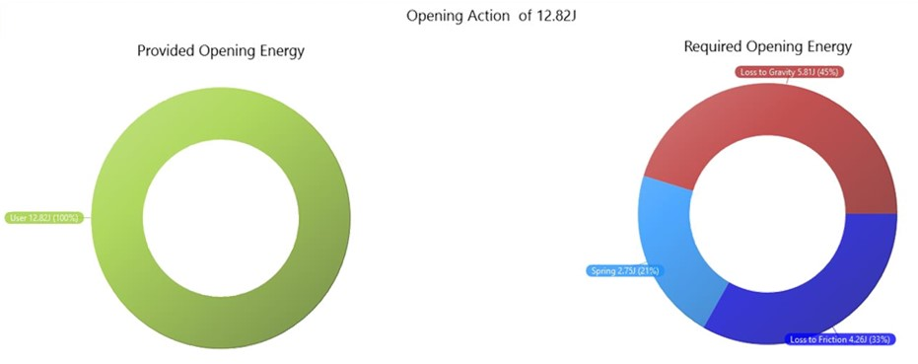
4. Energy Balance
4.2 Opening Action
  Opening the door requires an amount of energy.
  Some elements make it move (Provided)
  Other elements will absorb the provided energy (Required)
Active Energy Components:
  User : Customer that pushes or pulls the door open
  Gravity : The tilt angle of the hinges will make the door go up or down
  Spring : Energy storage capability of the door check
  Friction : Door check and hinges will participate in overall friction component
Confidential
© 2023 EZMetrology

Slide 17
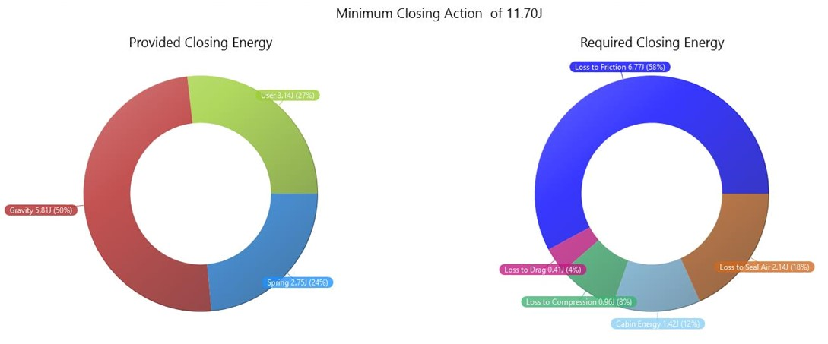
4. Energy Balance
4.3 Minimum Closing Action
Active Energy Components:
  Same elements as in the opening balance: User, Gravity, Friction and Spring
  New elements: Seal Compression with Latch Energy
  Air related components: Drag, Air trapped in the seals and Air trapped in the cabin
Confidential
© 2023 EZMetrology

Slide 18
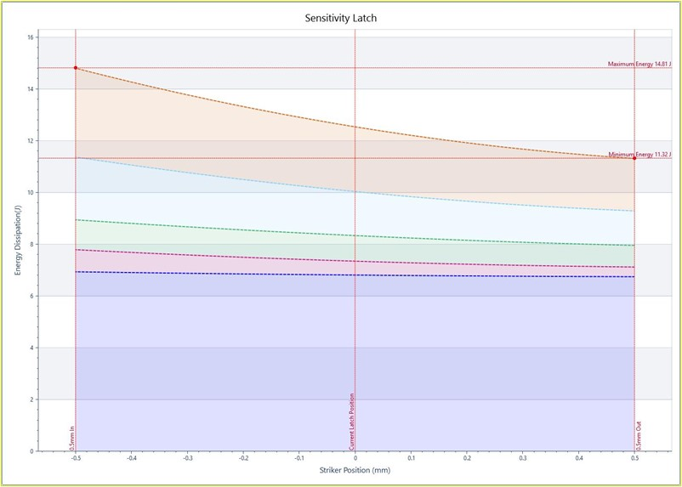
4. Energy Balance
4.4 Predictive : Gap Sensitivity
  Based on a standard session, establish the expected variation of the closing energy as a result of striker adjustment in Y.
Highest Energy
Lowest Energy
-0.5mm (in)
Striker Variation
+0.5mm (out)
Confidential
© 2023 EZMetrology

Slide 19
5. Software Suite
Confidential
© 2023 EZMetrology

Slide 20
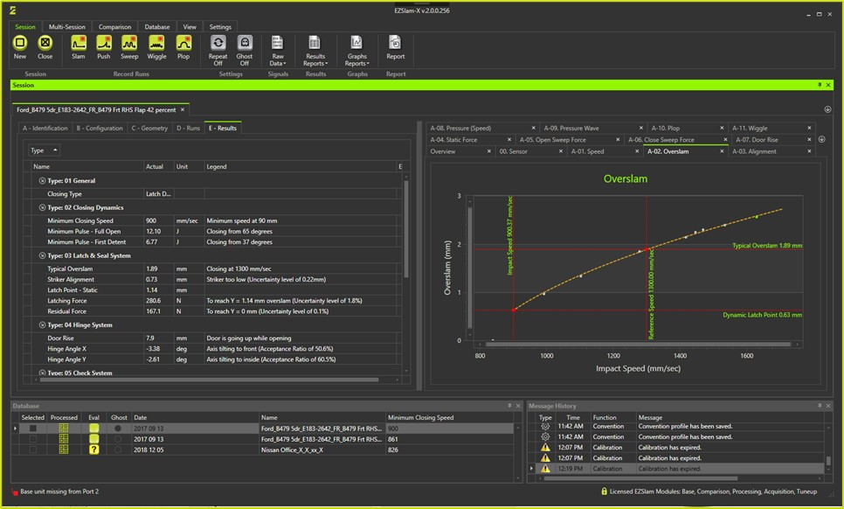
5. Software suite
5.1 overview
  Data, Environment and Acquisition
  Database Management
  Basic, Advanced, Expert View Layout
  Session Overview
  Door Profile
  Convention Profile
  Connectivity Status
  Process Feedback
  Realtime Progress Status
Confidential
© 2023 EZMetrology

Slide 21
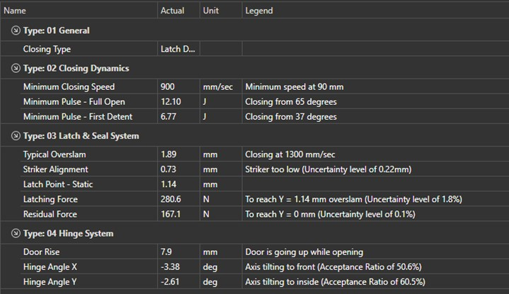
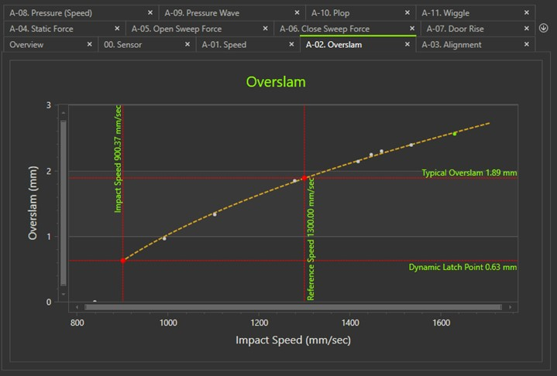
5. Software suite
5.2 Session results
Session Detail
    Graphical Reporting
    Reference Comparison
    Numerical Report for all Metrics
    Feedback on Collected Data
    Test Progress Report
    Profile Settings
    Multiple Report Layout Options
Confidential
© 2023 EZMetrology

Slide 22
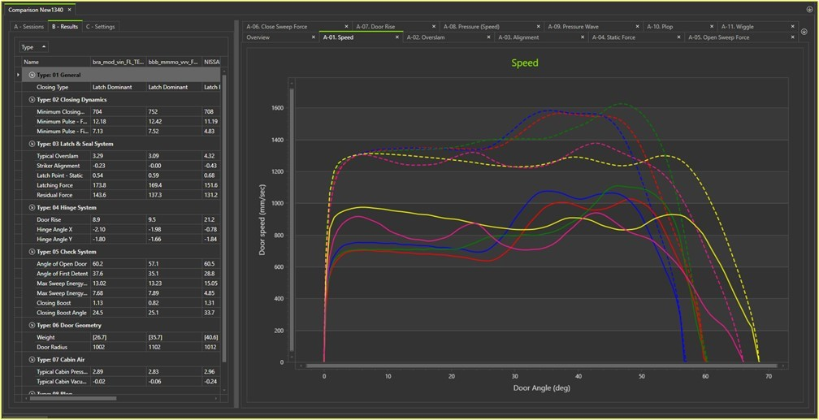
5. Software suite
5.3 comparison
Comparison Utility
    Compare Multiple Sessions
    Graphical Overlay
    Numerical Side-by-Side
    Custom Correlation Graph
    Standard Reporting
Confidential
© 2023 EZMetrology

Slide 23
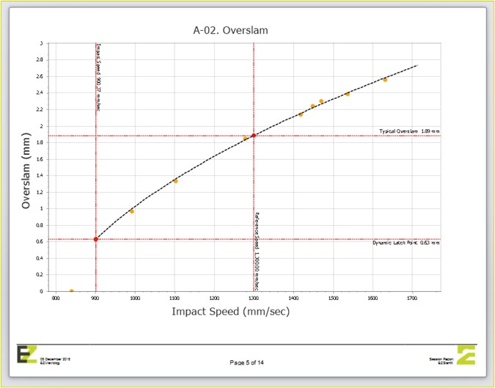
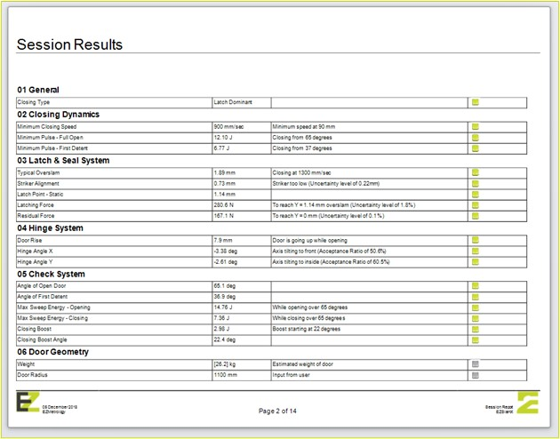
5. Software suite
5.4 REPORTING AND Export
Raw Data
    Typical function to use the raw sensor data outside of the EZSlam software for your own research.
Numerical
    Results from all analysis in numerical form.
Graphical
    Export a particular graph as illustration.
Standard Full Report
    Autogenerated report containing all tables and graphs for a comprehensive understanding.
Confidential
© 2023 EZMetrology

Slide 24
6. Applications
Confidential
© 2023 EZMetrology

Slide 25


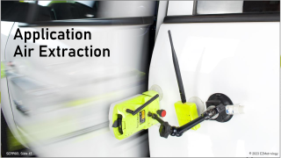

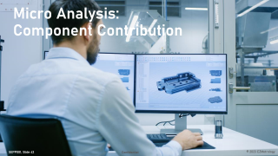


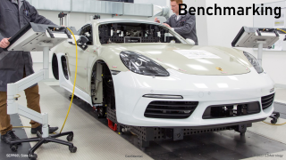


applications
Confidential
© 2023 EZMetrology

Slide 26
7. Conclusion
Confidential
© 2023 EZMetrology

Slide 27

7. Conclusion
    EZSlam technology will bring new opportunities for your door capability with universal numerical evaluation of the system for applications in :
    Benchmarking
    Design
    Specification and Tolerancing
    Prototype Evaluation
    Troubleshooting
Confidential
© 2023 EZMetrology

Slide 28
Thank you.
info@ezmetrology.com
support@ezmetrology.com
www.ezmetrology.com
portal.ezmetrology.com
academy.ezmetrology.com
Confidential
© 2023 EZMetrology

Slide 29
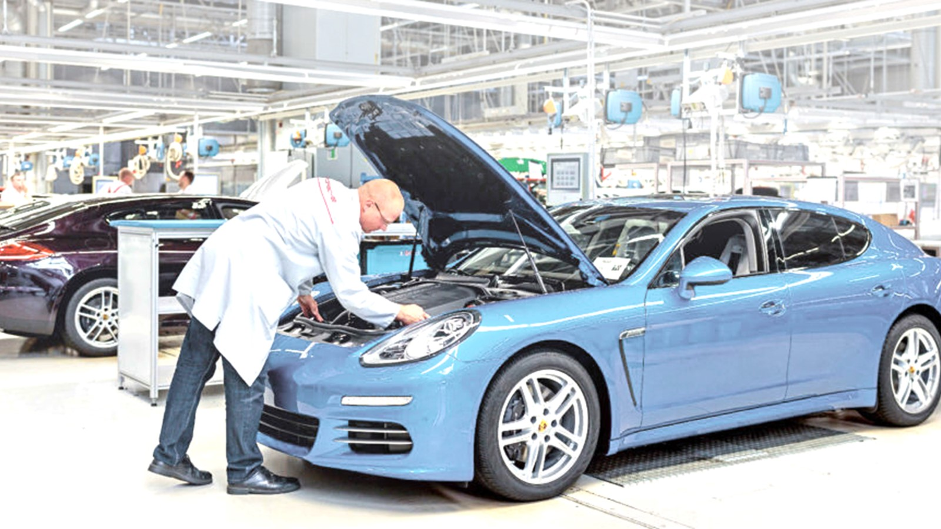
Production Audit /
Trouble Shooting
Confidential
© 2023 EZMetrology

Slide 30
Product audit / Trouble Shooting
A. Important Time Saving
General classic method requires Hours or even Days:
EZSLAM requires ONLY 20 MINUTES :
CMM a
Seal gap ?
EZ SLAM
Seals
Striker
Hinge Tip
Seal gap
Door Check
Air Trap
…
Friction
CMM b
Alignment ?
FORCE
Seals ?
…
Confidential
© 2023 EZMetrology

Slide 31
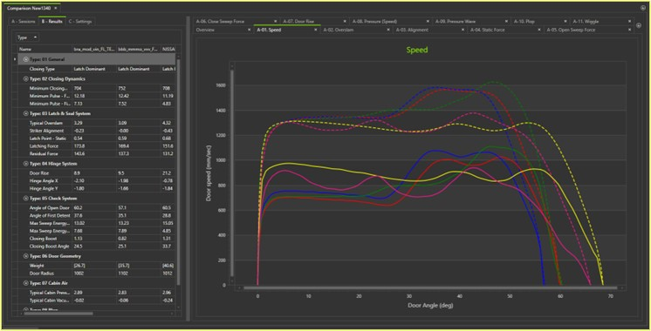
Product audit / Trouble Shooting
b. Baseline for Comparison
Two options to spot the difference:
Another Session
    Good versus Bad
    BOB (Best of Best) or WOW (Worst of Worst)
    Vehicles from the opposite ends of the spectrum.
Nominal Profile
    Nominal profile can be recalled at any time
    includes tolerances.
    Unless nominal data is available, a one-time project to determine the profile and tolerances would be recommended.
    EZSlam has a built-in function to perform this study.
Confidential
© 2023 EZMetrology

Slide 32
Product audit / Trouble Shooting
C. Data processing
Minimum Closing Energy?
Analysis Steps
To simplify analysis, differences and characteristics are evaluated in the sequence they would occur during a closing process.
Numerical evaluation
Compare the different sessions to identify the different characteristics.
Identification
In case of a difference is observed in the specific set of metrics, the components in question can be identified as being different and investigated in detail.
NOK
OK
Minimum Closing Speed ?
NOK
OK
Issue Component:
Hinge & Check
Static Latch Energy ?
OK
NOK
Issue Component:
Seal or Seal Gap
Pressure Transient Behavior ?
NOK
OK
Issue Component:
Air Bind Seals
Issue Component:
Cabin Air Evacuation
Confidential
© 2023 EZMetrology

Slide 33
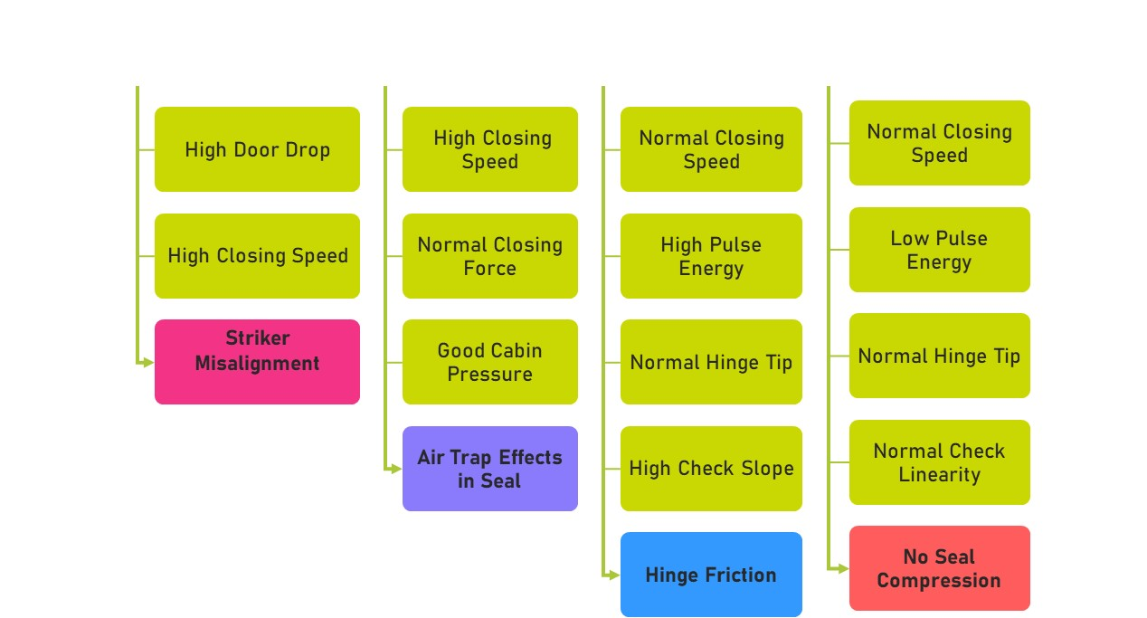
Product audit / Trouble Shooting
D. “DNA-based” identification
Confidential
© 2023 EZMetrology

Slide 34
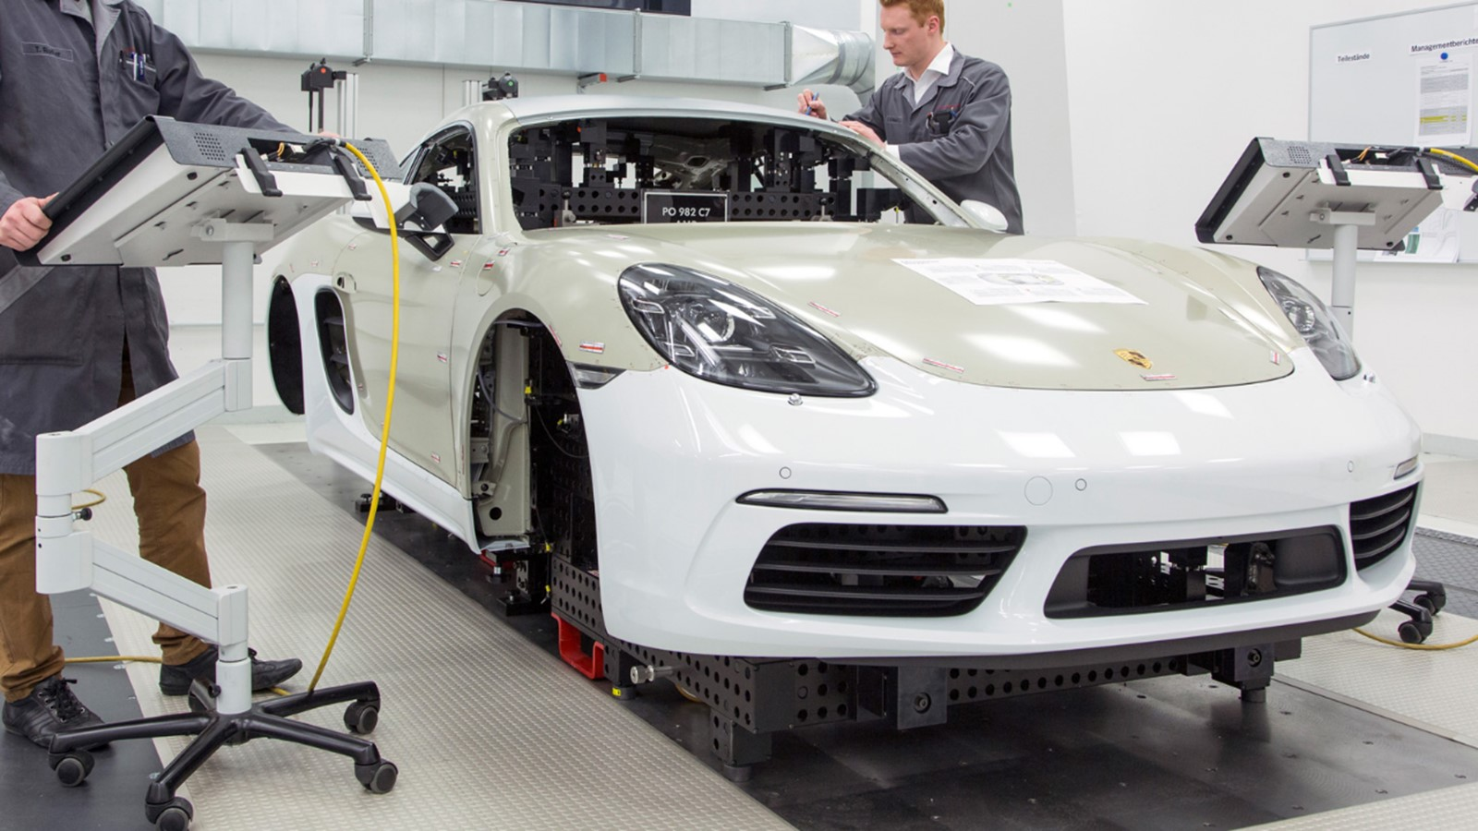
Benchmarking
Confidential
© 2023 EZMetrology

Slide 35
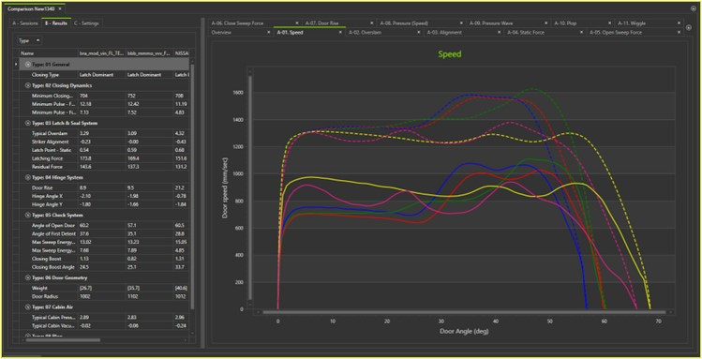
benchmarking
A. Door selection
Benchmarking starts with selecting the samples or test cases. Sample type and sample size has to obviously be in line with the objectives.
Same Segment Samples
    Comparable vehicles that would be considered as references or targets.
Different Segment Samples
    Comparable vehicles with potentially significant different approaches to closing efforts or door design.
Confidential
© 2023 EZMetrology

Slide 36
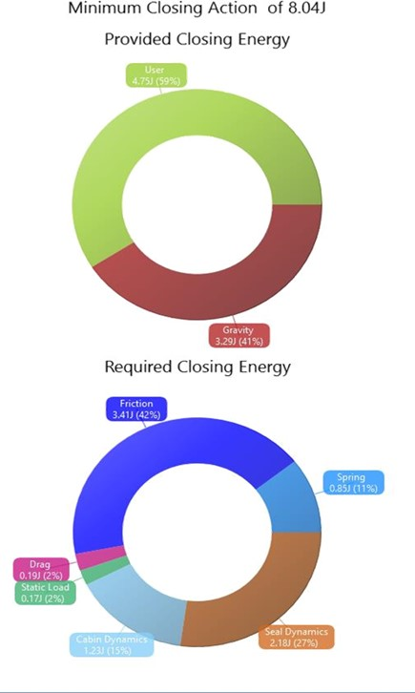
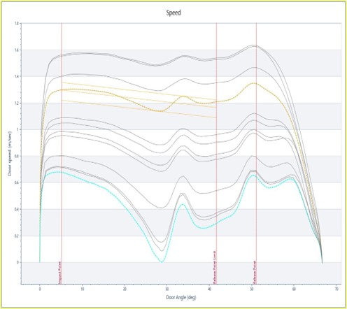
benchmarking
b. Data Collection
Collect EZSlam data of all the test doors. Each session will provide a full characterization of that closure.
Metrics
    Numerical values that describe the behavior of the door in an objective way.
Graphs
    The graphical representation of events such as speed, force, pressure and more will enhance understanding.
Energy Distribution
    Energy analysis will describe the energy contributions of each components in the closure kinematic for each door sample.
Confidential
© 2023 EZMetrology

Slide 37
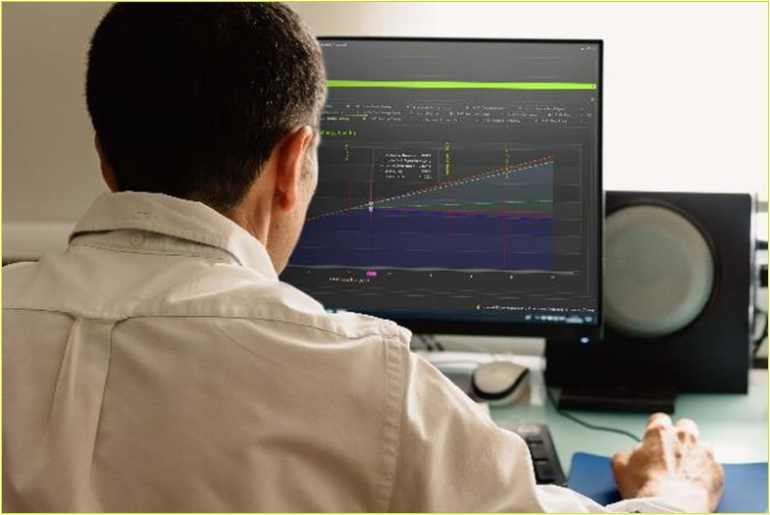
benchmarking
C. review Data
Review the results using the comparison function and illustrate the profiles.
Find Extremes
    Observe the potential target values that other systems can achieve.
Identify Design Choices
    Identify the different approaches to obtain an effect or feeling of the door operation.
Confidential
© 2023 EZMetrology

Slide 38

Macro Analysis: Door System
Confidential
© 2023 EZMetrology

Slide 39
macro-Analysis
a. subjective impression
  EZSlam can be used to correlate the subjective observations with measured metrics.
Find the metrics that correlate to a consensus score
    Speed
    Energy from Full Open
    Force to Open to Inner Detent
  This type of study will assist in establishing overall criteria.
  Built-in functions such as the Quality Index can be used to integrate the findings.
  Note: The question, “How are these targets achieved?” would be the objective of a microanalysis.
Confidential
© 2023 EZMetrology

Slide 40
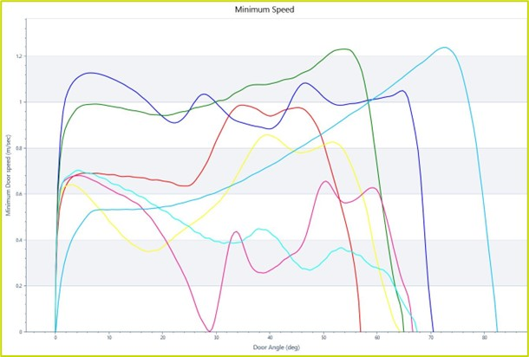
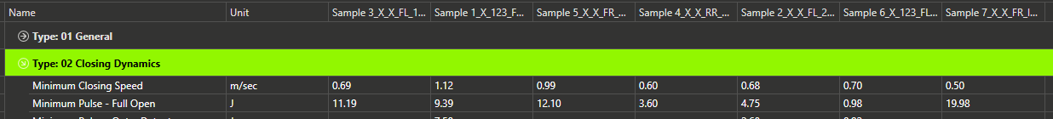
macro-Analysis
b. Minimum Closing Speed and Energy
Numerical
  Minimum closing energy and speed are the primary evaluations of closing quality.
  Graphical
  The associated graph illustrates the different speed profiles. The shape of the speed curve is controlled by nearly all components:
    Hinge Inclination
    Door Weight
    Door Check Profile
    Seal Compression
  The example illustrates the wide range of design concepts that result in significantly different behavior and ultimately different user experiences.
Confidential
© 2023 EZMetrology

Slide 41
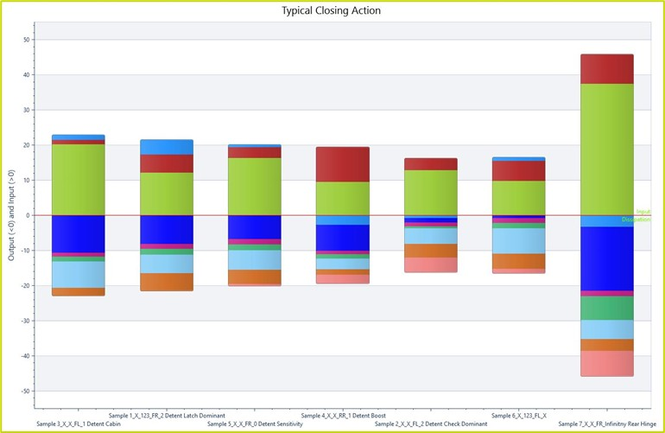
macro-Analysis
c. Closing energy analysis
  Energy Composition
  The software automatically reports the composition of the minimum closing energy.
  Displays how much energy a component provides or absorbs.
  Comparison
  The different colors indicate the participation of a specific component.
  This information can motivate to exchange a component, reflect on design choice to increase or decrease a specific contribution.
Confidential
© 2023 EZMetrology

Slide 42
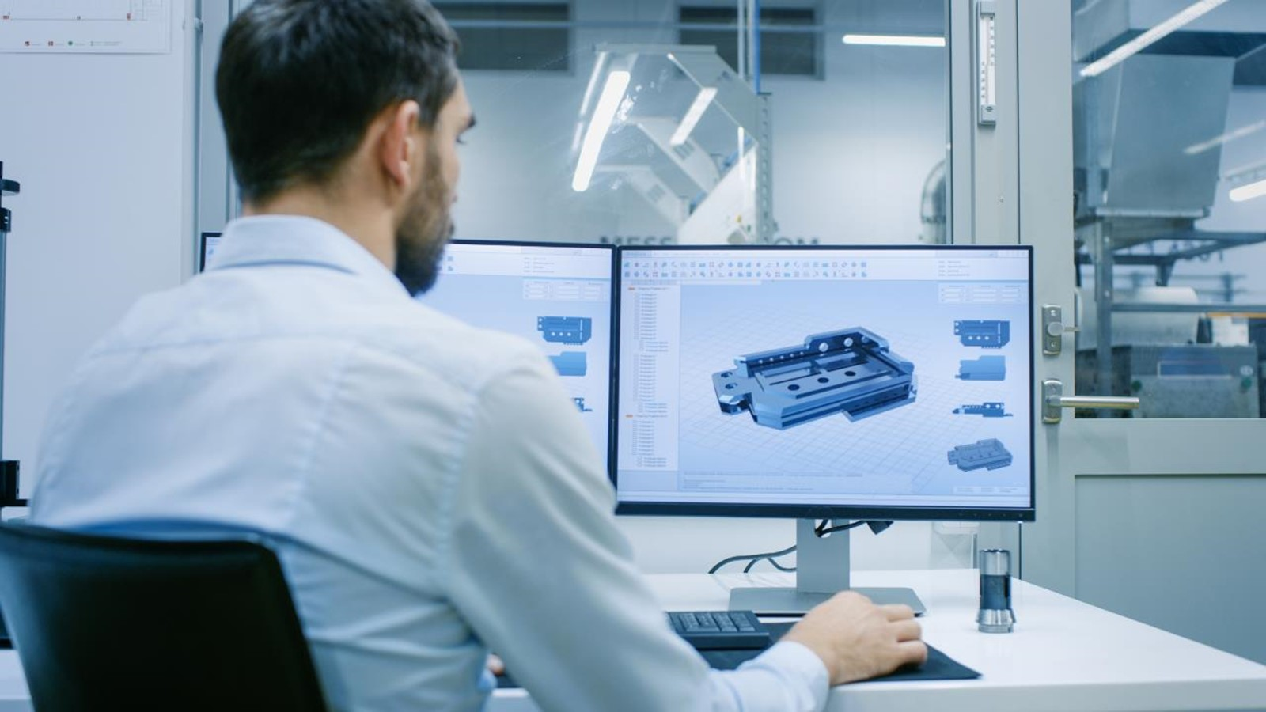
Micro Analysis:
Component Contribution
Confidential
© 2023 EZMetrology

Slide 43
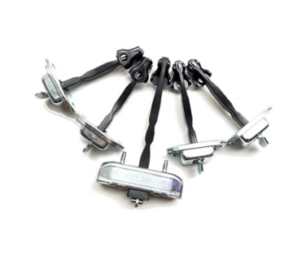
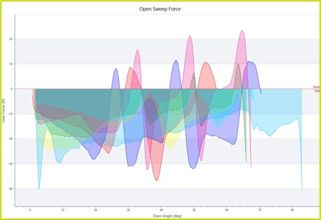
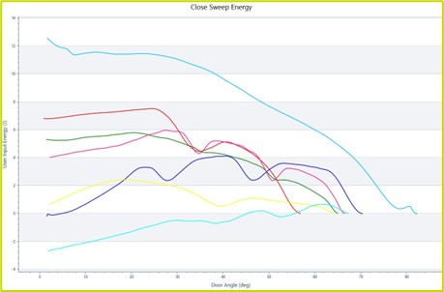
Micro Analysis
a. Door Check
  The numerical evaluation allows for components to be compared to design specifications or expectations.
Force Profile
    How much force is required to move the door in the opening or closing direction?
    How much force is required to get out of a detent?
Energy Profile
    How is the energy distribution during the movement of the door?
    When does the door check accelerate the door and for how much energy?
    When does the door slow down and for how much energy?
Confidential
© 2023 EZMetrology

Slide 44
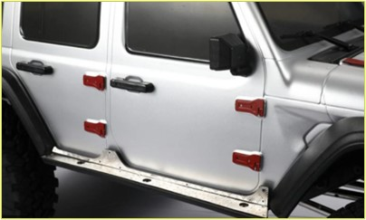
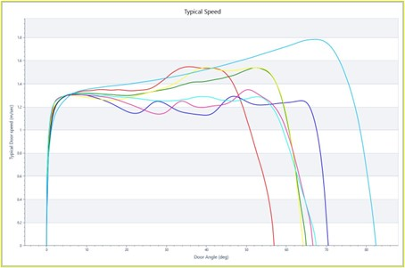
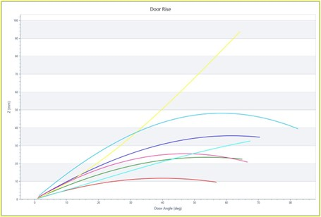
Micro Analysis
B. HINGE EVALUATION
  The placement of the hinges, their friction and the inclination will have an important influence on the behavior of the door system.
Friction
    The typical speed profile illustrates the effect of friction during the travel. In general, a significant decrease shows important friction.
Inclination
    The hinge inclination will determine the contribution from gravity to close the door. Based on the spatial inclination, the door rise - and therefore the potential energy that gravity provides – will be different.
    E_{Potential} = m • g • h
Confidential
© 2023 EZMetrology

Slide 45
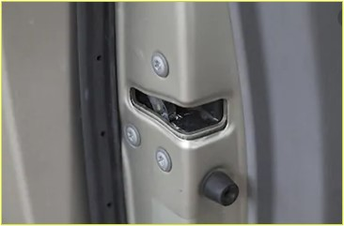
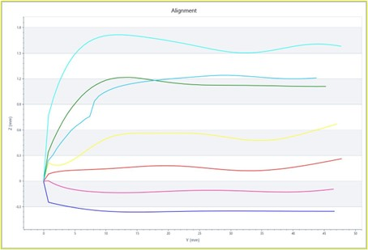
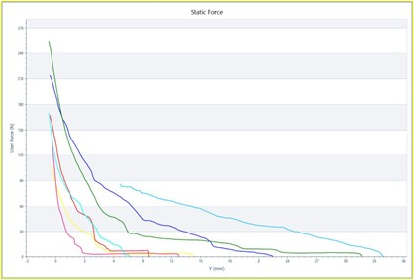
Micro Analysis
C. Seal and Latch: Static
Striker
  Striker alignment is evaluated to ensure correct mechanical mounting or flag a misalignment situation.
Compression
  The static seal compression graph illustrates the seal compression design and execution (seal gap, seal tolerances)
Latch Point
  The system will determine the latch point, or at which y-position, does the latch engage the striker.
  All these components are defined by metrics such as
    Static Seal Compression
    Latch Response
    Striker Alignment
    Residual Compression
Confidential
© 2023 EZMetrology

Slide 46
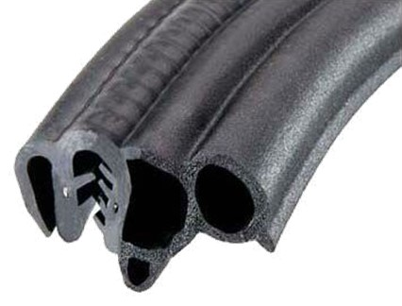
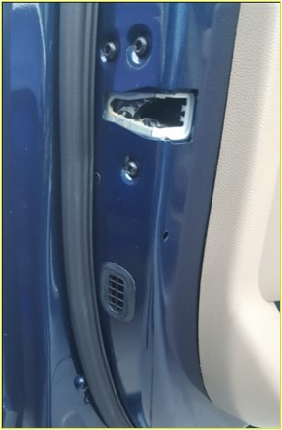
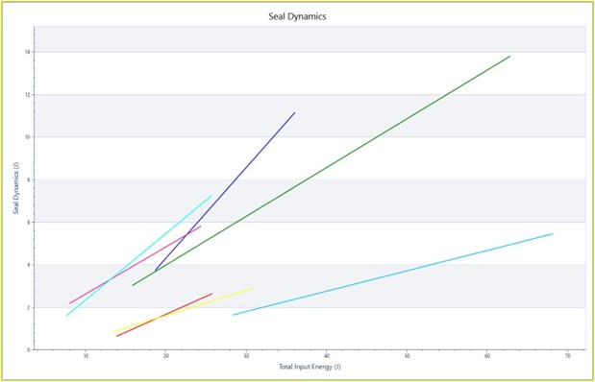
Micro Analysis
d. Seal and cabin Dynamics
  A number of characteristics are dynamic.
  Air Bind in Seals
  The energy required to evacuate the air trapped in the seals during closing.
  A seal system can have a good static characteristic, but in case of bad design, it can have an excessively high dynamic characteristic.
  Air Trapped in Cabin
  The energy required to evacuate the air trapped in the cabin during closing.
  These results can motivate a design change with the focus in this area. The same method can be useful in numerically quantifying the effectiveness of a change.
Confidential
© 2023 EZMetrology

Slide 47
Application
Air Extraction
Confidential
© 2023 EZMetrology

Slide 48
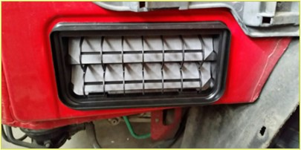
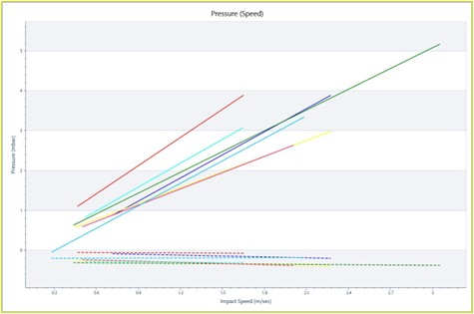
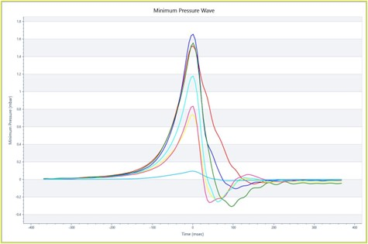
Cabin air Contribution
a. Benchmarking
  Air Trapped in Cabin
  The evacuation of the air trapped in the cabin is an important contributor to closing efforts.
  A system that efficiently allows the air to flow out and reduce the cabin pressure will result in a lower closing effort.
  Progressive or Relative Differences
  Relative improvements between benchmarked solutions or cars can help understand the opportunities to improve this aspect of the performance.
  Effects from design choices such as the number of extractor valves, accessibility of valves, and other venting paths can be quantified.
Confidential
© 2023 EZMetrology

Slide 49
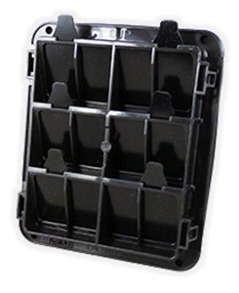


Cabin air Contribution
b. Identification
  In this real-life example, the extraction of the air trapped in the cabin has proven to be an important contributor to the overall closing energy requirement.
Different Options Are Considered
    Different suppliers
    Additional venting
    Optimizing evacuation path
  In order to understand if a proposed change would result in a significant improvement, the study can be focused on these aspects.
Confidential
© 2023 EZMetrology

Slide 50


Cabin air Contribution
c. results
  Component Effect
  From all the different alternatives that have been tested, certain ones show a direct improvement of the cabin pressure
  Resulting Overall Effect
  The results on the final contribution can be evaluated and confirmed as we see a gradual decrease in closing speed or closing energy.
  Cost Effectiveness
  Understanding the overall effect of the change on the quality of the door performance, the solution can now be evaluated based on cost effectiveness of the improvement.
Confidential
© 2023 EZMetrology

Slide 51


Company Pages

Slide 52

COMPANY OVERVIEW
Founded in 2006 by Carine Woldanski and Tom Van Esch
Global Operations:
  USA Headquarters in Michigan
  Europe Support office in Luxemburg
  Asia Partnerships
EZMetrology:
  70% Development and Engineering
    Fast product development and interactive evolutions
  20% Support and Training
    Ensuring a transfer of competence to our customers
  10% Administration and Sales
    Manage customs and sales procedures
Consistent annual growth of 50% over the past years
Developing innovative, creative and practical products
Confidential
© 2023 EZMetrology

Slide 53

SHARING OUR PASSION WORLDWIDE WITH CUSTOMERS AT
ALPINE
ARRIVAL
AUDI
BMW
BROSE
CANOO
CATERPILLAR
CHRYSLER
DACIA
DAIHATSU
DAIMLER
DENSO
FAW
FAURECIA
FERRARI
FIAT
FORD
GAC
GENERAL MOTORS
GG MOTORS
HUMANETICS
HONDA
HYUNDAI
INFINITI
JAGUAR
JEEP
KASEIKOGYO
KIA
KIEKERT
LADA
MACK
MAHINDRA
MARUTI
MASERATI
MAZDA
MITSUBISHI
MULTIMATIC
NISSAN
NITTO DENKON
POLARIS
PORSCHE
PROTON
PSA
QOROS
RENAULT
RIVIAN
SAIC MOTOR
SEAT
SIEMENS
STELLANTIS
SUBARU
SUZUKI
TATA MOTORS
TESLA
TOGG
TOYODA GOSEI
TOYOTA
VOLKSWAGEN
VOLVO
VOLVO TRUCKS
- EZM HEADQUARTERS
- EZM PARTNERS
- EZM CUSTOMERS
© 2023 EZMetrology

Slide 54


Slide 55

Integrated Correlation
How can we eliminate the variation between users?
A. Minimum Closing Speed Graph
Actual Samples
from Slam Tests
Typical Overslam
Curve Fit
(Characteristic)
Latch Point(Push Test)
Minimum Closing Speed
Reference Speed
Confidential
© 2023 EZMetrology

Slide 56





Integrated Correlation
B. Other examples
Many other characteristics are dependent on each other.
Correlation is required to determine a representative value, independent of the user.
  Pressure and Speed
  Friction and Speed
  Drag and Speed
Confidential
© 2023 EZMetrology

Slide 57
Key Metrics
DNA signature of the door
DYNAMICS
Minimum Closing Speed
Minimum Kinetic Energy
Minimum User Energy
Energy from 1st Detent
Energy from 2nd Detent
LATCH
Striker Alignment
Latching Force
Latching Energy
Compression Energy
Residual Energy
Static Latch Point
Dynamic Latch Point
Opening Speed
Opening Position
SEAL
Dynamic Stiffness
Gap Sensitivity
Residual Seal Force
Residual Seal Energy
Air Bind Sensitivity
GEOMETRY
Inertia
Weight
Radius
CHECK
Open Angle
1st and 2nd Detent Angle
Maximum Pulling Force
Boost Angle
Boost Energy
Closing Sweep Energy
Opening Sweep Energy
Friction
HINGE
Door Rise
Hinge Angle X
Hinge Angle Y
Potential Energy
AIR
Peak Pressure
Minimum Vacuum
Pressure Transient
Cabin Sensitivity
ENERGY
User Input
Gravity Input
Check Input
Friction
Drag
Cabin Exhaust
Seal Dynamics
Static Energy
Gap Sensitivity
Confidential
© 2023 EZMetrology

Slide 58

Sensor data
How well does the striker line up to the latch?
Is there an influence on closing speed?
How much overslam do we see for a given speed?
A. YZ Trajectory graph
Final Position
Latch Striker Interaction
Misalignment
Closing Door
Overslam

Slide 59

Sensor data
What is the minimum closing speed?
Any unexpected slow down in the speed profile?
b. Speed in function of angle graph
Initial Speed
Impact Speed
Closed
Open
Impact
Free Motion
Acceleration

Slide 60

Sensor data
How much static seal compression is there?
At what point does the latch engage?
When do I see a significant increase in force?
c. Speed in function of angle graph
Static Latch Force (N)
Static Residual Force (N)
Compression Energy (J)
Latch Point (mm)
Closed Position (0mm)
Slow Motion

Slide 61

Sensor data
How much peak pressure do we establish?
How quickly does the pressure return to ambient levels?
d. Cabin Pressure
Pressure Peak (mbar)
Transient Behavior (wide vs narrow)
Vacuum Minimum (mbar)
Peak Pressure (Time =0)

