Slide 1

EZMetrology
Product Overview Specifications and Functionalities

Slide 2

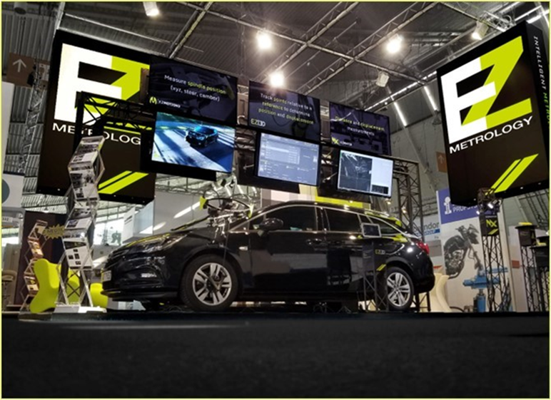
Index
Introduction
Measurement Standards
Applicable Technologies
Specifications
  Table Legend
  Applicable Standards
  Working Conditions
  Test Content
  Technical Requirements
  Software Requirements
  Pressure
Intellectual Property

Slide 3

1. Introduction

Slide 4
1. introduction
1.1 EZMETROLOGY: COMPANY OVERVIEW
Experience
  EZMetrology was founded in 2006
  EZMetrology has been a market leader in door measurement systems for 15 years
Installed Base
  Development and Benchmark Applications
    Over 65 Installations: Ford, Renault, BMW, Mercedes, VW, Volvo, Fiat, Land Rover, Honda, and Mazda
  Production Line Systems: (Inline or Audit Station)
    Over 400 Units: Ford, Renault, BMW, Mercedes, Nissan, Tesla, and Fiat
Industry Reference
  Door and Closure Conference (Germany): main participant for measurement technology
    Refer to presentation TEPS001 EZSlamX Energy Models.ppsx
  Door Summit (Japan): main participant for measurement technology

Slide 5

SHARING OUR PASSION WORLDWIDE WITH CUSTOMERS AT
ALPINE
ARRIVAL
AUDI
BMW
BROSE
CANOO
CATERPILLAR
CHRYSLER
DACIA
DAIHATSU
DAIMLER
DENSO
FAW
FAURECIA
FERRARI
FIAT
FORD
GAC
GENERAL MOTORS
GG MOTORS
HUMANETICS
HONDA
HYUNDAI
INFINITI
JAGUAR
JEEP
KASEIKOGYO
KIA
KIEKERT
LADA
MACK
MAHINDRA
MARUTI
MASERATI
MAZDA
MITSUBISHI
MULTIMATIC
NISSAN
NITTO DENKON
POLARIS
PORSCHE
PROTON
PSA
QOROS
RENAULT
RIVIAN
SAIC MOTOR
SEAT
SIEMENS
STELLANTIS
SUBARU
SUZUKI
TATA MOTORS
TESLA
TOGG
TOYODA GOSEI
TOYOTA
VOLKSWAGEN
VOLVO
VOLVO TRUCKS
- EZM HEADQUARTERS
- EZM PARTNERS
- EZM CUSTOMERS

Slide 6
2. Measurement Standards

Slide 7
2. Measurement standards
2.1 Products, traceability, Gage R&R
Products
  All EZMetrology products are held to the highest industry and metrology standards
Traceability
  All tooling and procedures used to calibrate the technology are traceable to international standards
  >> Reference to document TEPS006 Traceability Charts.ppsx
Gauge R&R
  The technology and software are subject to Gauge R&R testing to prove the robustness of the technology
    >> Reference to document TELD002 SpeedPod Performance Data.pdf
    >> Reference to document TELD008 EZSlam R&R.ppsx

Slide 8
3. Applicable Technologies

Slide 9
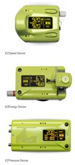
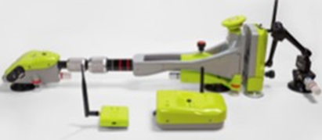
3. Applicable technologies
3.1 audit and ezslam
Audit Solution
  Flexible, modular system for fast, accurate inspection or analysis of door systems:
    Wireless EZSpeed, EZEnergy and EZPressure
    Audit software for data recording, analysis and export
  >> See details SEPP003 Audit.ppsx
  EZSlam Solution
  Industry standard for determining complete door characteristics
    Multiple, synchronized sensor collection: force, speed, pressure, 2D high-speed camera, and acceleration.
    Standardized acquisition procedure (type of test and number of runs)
    Automated analysis and “DNA” determination, down to component level
    Numerical and graphical report including correlations, energy distribution pie charts, and striker sensitivity
    >> See details SEPP001 EZSlam.ppsx

Slide 10
4. Specifications

Slide 11
4. specifications
4.1 Table legend
Side-By-Side Comparison
 | REQUIREMENT | AUDIT | EZSLAM
Item 1 | Provided Document | Yes/No | Yes/No
+++ Item 3 | 3 | 3 | 2
  Good to know
Specification retrieved from provided document
+++ Specifications that are not mentioned but might be considered in the scope of the application
Optional additional explanation regarding the above-mentioned specifications

Slide 12
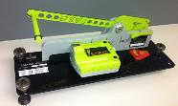
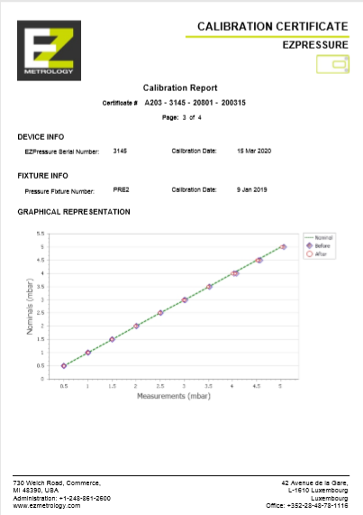
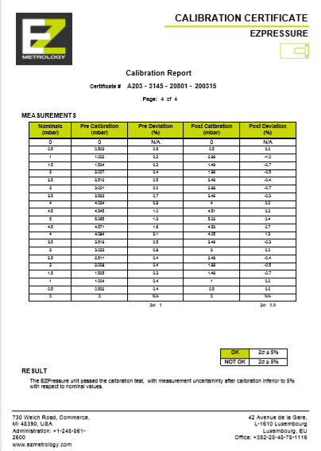
4. specifications
4.2 applicable standards
 | REQUIREMENT | AUDIT | EZSLAM
System Verification | Yes Calibration Accessories | Yes EZSpeed Validator | Yes Tune-Up Module
National Standard | SGS Dimensional Standard | NIST* National Institute for Standards and Technologies | NIST* National Institute for Standards and Technologies
+++ Calibration | - | Yearly | Yearly
+++ Wireless Standard | - | Bluetooth or Wi-Fi | Wi-Fi (2.4GHz)
+++ Electrical Safety and Interference | - | CE | CE
+++ Gauge R & R Data | - | Available | Available
  System performance is best illustrated with R&R testing that includes sensor performance, mounting system, installation, and algorithm sensitivity in a manner that covers different setups and multiple users.
* See separate documentation regarding traceability charts TEPS006 Traceability Charts.ppsx

Slide 13
4. specifications
4.3 working conditions
 | REQUIREMENT | AUDIT | EZSLAM
Type of Vehicles | Pivot, Sliding, Trunk, Liftgate, Tailgate | EZSpeed Pivot, Sliding, Trunk, Liftgate, Tailgate EZEnergy Pivot, Trunk, Liftgate, Tailgate, EZPressure Pivot, Sliding, Trunk, Liftgate, Tailgate | Pivot
Operating Temperature | -40 +70C Sensors Dependent | -20 + 40C* | -20 + 40C*
Humidity | 5% to 95% RH | 0% to 95% RH Noncondensing | 0% to 95% RH Noncondensing
Power Supply | 220V±10%/50Hz±1Hz. DC: 10-32 V | Charger: 100-240v AC 1.5A 50-60Hz | Charger: 100-240v AC 1.5A 50-60Hz
+++ Battery | - | 10.8V 2.4Ah Li-Ion (8-hour operation) | 10.8V 2.4Ah Li-Ion (16-hour operation)
+++ Material Compatibility | Magnet : Steel | Suction Cups Steel, Aluminum, Glass, Plastic | Suction Cups Steel, Aluminum, Glass, Plastic
+++ Computer Operation | Computer Required | Device Only or Optional Computer | Computer is Required
+++ Power Mode | - | Sleep, Low Power or Active | Low Power Mode
  Suction cup mounting of all EZ technology works on steel, aluminum, plastic, and glass doors.
  Wireless operation avoids cable issues for reliability, removes tripping hazards, and simplifies installation.
* Limit for temperature operation is mainly mounting system limits; special attention to the mounting method can enlarge the temperature range.

Slide 14
4. specifications
4.4 Test Content
 | REQUIREMENT | AUDIT | EZSLAM
Closing speed and closing energy of the revolving door, rear lift door, and hood | Yes Energy Module is Purchased | EZEnergy | Side Doors
Sliding Door | Yes Sliding Module | EZSpeed | No
Ear pressure test for vehicle closing at multiple points | Yes; Multiple Points are Limited to Port Availability. | EZPressure (1 sensor, 1 point) Multiple Units, Multiple Points | One Point Only
Correlation test and analysis of air tightness and closing pressure resistance | - | Yes | Yes Automatic Linear or Polynomial Fit
+++ Separate influence from air trapped in cabin and air trapped in sealing system | - | No | Yes
+++ Standard Test Procedure | - | No | Yes
+++ Automatic Correlation (Speed-Pressure, Energy-Speed, Speed-Friction, Speed-Over slam, Speed-Drag) | - | No | Yes Automatic Linear or Polynomial Fit
+++ Automatic Reporting (PDF, XLS, HTML) | - | Yes | Yes
+++ Adapted for Electric Latch | - | Yes | Yes
  EZSlam’s predefined test procedure results in consistent and user-independent evaluation of a door system in all its aspects: speed, energy, pressure, weight, friction, seal compression, air bind, friction, and striker alignment.

Slide 15
4. specifications
4.5.1 TECHNICAL REQUIREMENTS
 | REQUIREMENT | AUDIT | EZSLAM
Closed door energy system | Yes Energy sensor | Yes EZEnergy: Speed, Force, and Energy are measured | Energy, Speed, and Pressure Data along with Analysis
Speed Range | 0.3 - 2.50 m/s Accuracy: ±1% Resolution: 0.01 m/s | EZSpeed: 0.1 -10 m/s Accuracy better than 5%* Resolution 0.001 m/s | 0.1 – 2.50 m/s Accuracy: ±1% Resolution: 0.001 m/s
Energy Range | 0～98N (Units?) Accuracy: ±1% Resolution: 0.01J | 0 - 300 N or 0 - 500N / 0 - 100 J Accuracy * better than 5% Resolution: 0.1N, 0.01J | Force -150 to +500N (Two way) Energy 0 - 85J Uncertainty less than 5%
Automatically determine the closed state of the door | Yes | Single Click on Device + Built-in Logic** | Yes
Semi-closed | Yes | - | Yes
+++ Gap Mode | No | Yes – Validation of Final Accuracy of Minimum Closing Speed/Energy | Yes – Validation of Final Accuracy of Minimum Closing Speed/Energy
  Gap Mode is a method where the lowest closing speed is compared to the highest “not closed speed.” Only when both are within a preset tolerance is the measurement accepted, providing a guarantee of the minimum speed or energy values, independent of the user.
* When not using the full range of the sensor, the accuracy is improved
** Button press only required if new sample is closed and less than the current minimum value

Slide 16
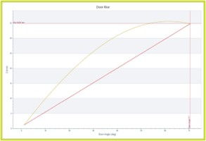
4. specifications
4.5.2 TECHNICAL REQUIREMENTS
 | REQUIREMENT | AUDIT | EZSLAM
Minimum Closing Speed | Yes | Yes | Yes
Closing Energy | Yes | Yes | Yes
Door Rotation Angle and Length of the Motion Path | Yes | Yes | Yes
Quick Installation | - | 20 Seconds for Each Device | 5 minutes
The system can correct the impact of the door shaft tilt angle on the test results to ensure measurement accuracy.* | Requires Weight | No (*) | Fully measured and reported including Weight, Measurement, Hinge Angle, and Door Rise**
  EZSlam is not only acquiring raw data. It also automatically performs all analytical tasks, correlations, and multi-test averaging, and then combines information to iterate the results.**
* Since the hinge angle is a part of the door dynamics and any variation could cause the system not to perform to specifications, compensating for it means that it is being removed from the evaluation, making it less accurate.
** In order to make an accurate compensation, the weight of the door, center of gravity, hinge tip in x- and y-directions, and swing angle are required. EZSlam will measure all characteristics using 2 different types of door manipulations. Using Audit, certain parameters need to be known outside the measurements.

Slide 17
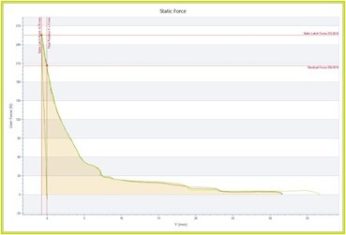
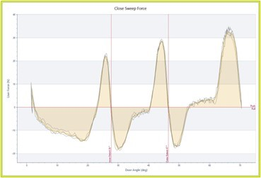
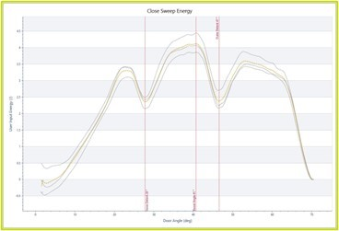
4. specifications
4.5.3 TECHNICAL REQUIREMENTS
 | REQUIREMENT | AUDIT | EZSLAM
+++ Static Closing Force | - | Yes | Yes
+++ Static Latch Energy | - | No | Yes
+++ Door Check Force (vs. Angle) | - | Yes | Yes
+++ Door Check Energy (vs. Angle) | - | No | Yes
+++ Pressure as a Function of Angle | - | Manual | Yes
  Door check and seal compression are critical in the analysis of door systems, including the pressure behavior.

Slide 18
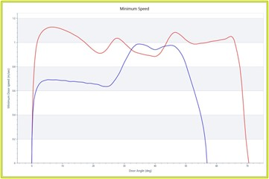
4. specifications
4.6.1 software requirements - measurement
 | REQUIREMENT | AUDIT | EZSLAM
Real-Time Display | Yes | Yes | Yes
Display the Closing Energy/Closing Speed Curve | Yes | Yes | Yes
Simultaneously Measure the Closing Energy, Closing Speed, Pressure Peak | Yes | Yes | Yes With Real-Time Correlation and Correlation Match
+++ Progress Feedback | - | No | Yes Confirm if Sufficient Data has been Acquired for Accurate Results
+++ Real-time Comparison | - | Compare New Data with Reference Curve/Values | Compare New Data with Reference Curve/Values
+++ Recording Time | - | 25 sec | 25 sec
  Real-time graphical overlay from current data and a reference or other door.

Slide 19
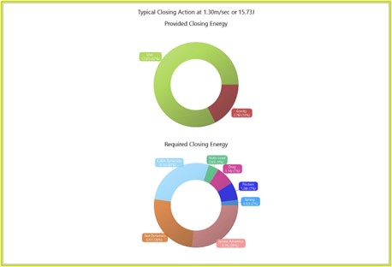
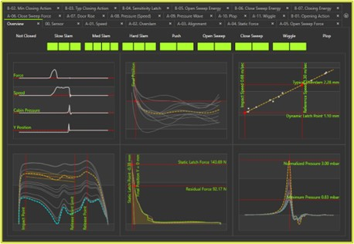
4. specifications
4.6.2 software requirements - PROCESSING
 | REQUIREMENT | AUDIT | EZSLAM
Automatically Judge and Display Half-Closed or Full-Closed | Yes | Software has tolerance setup which would show the measurements in format for not closed/ closed / assumed closed | Yes
Automatically Determine the Minimum Closing Speed | Yes | Yes Upon Reaching Gap Tolerance | Yes
+++ Report Significant Metrics | - | No | Yes 82 Metrics to Characterize Door and Components
+++ Determine Correlation and Report Correlation Error | - | Compare New Data with Reference Curve/Values | Compare New Data with Reference Curve/Values
  Real-time overview of all aspects of the acquisition: progress bar, speed, striker alignment, cabin pressure, and energy distribution.

Slide 20
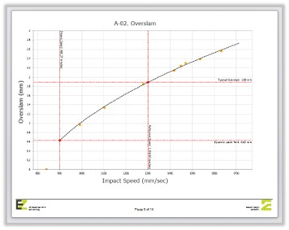
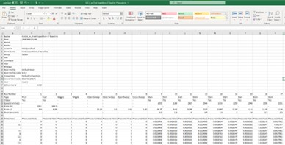
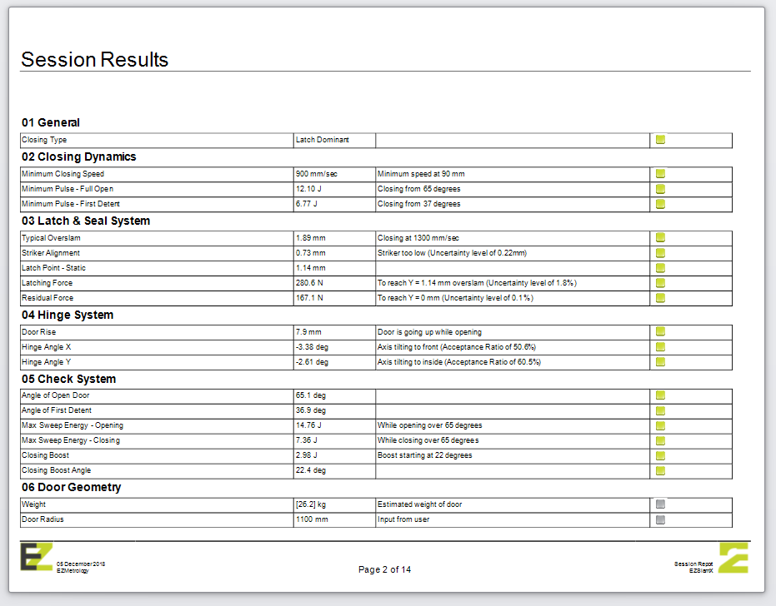
4. specifications
4.6.3 software requirements - REPORTING
 | REQUIREMENT | AUDIT | EZSLAM
Output to Text | Yes | Yes | Yes (Results and Sensor Data)
Data Allows Further Analysis of the Vehicle Model and Door | Yes | Yes Reporting Included | Yes Export to Excel of Graphical or Numerical Values
Traceability of Data with VIN Number and Customized Test Fields | No | Yes | Yes
Export the Measurements in CSV and XLSX Formats | No | Yes | Yes
+++ Additional Graphs | - | Yes | Yes

Slide 21
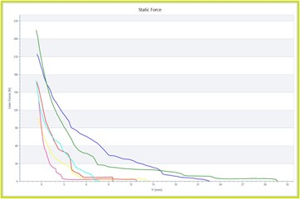
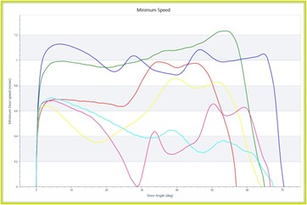
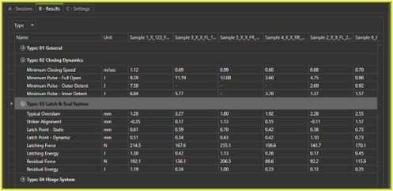
4. specifications
4.6.4 software requirements - comparison
 | REQUIREMENT | AUDIT | EZSLAM
+++ Numerical Comparison of the Multiple Doors | - | Yes All measurements can be viewed in the table. | Yes Full comparison reports can be made between multiple doors or vehicles.
+++ Graphical Comparison of the Multiple Doors | - | Yes All measurements can be presented graphs. | Yes Data can be represented in the same graphs between multiple doors or vehicles.
  The ability to overlay all characteristics between different configurations, door layouts, and components is crucial for analysis.

Slide 22
4. specifications
4.7.1 pressure - measurement
 | REQUIREMENT | AUDIT | EZSLAM
System Test Accuracy | ±1% | ±5% | ±5%
Micro pressure Sensor Accuracy | 0.50% | n/a | n/a
Protection Class | IP54 | IP54 | IP54
High-Speed Data Acquisition System Resolution | 0.01% | n/a | n/a
Single-Channel Sampling Frequency | > 300Hz | 1.2KHz | 400Hz
Automatically Calculate the Maximum, Minimum and Duration for Transient Pressure Curve | Yes | Yes Pressure as a Function of Time Calculate Max, Min, Rise Time, and Fall Time | Yes Pressure as a Function of Time Calculate Max, Min, Rise Time, and Fall Time
+++ Sensor Range (Differential) | - | ±5mbar or ±10mbar | ±5mbar or ±10mbar

Slide 23
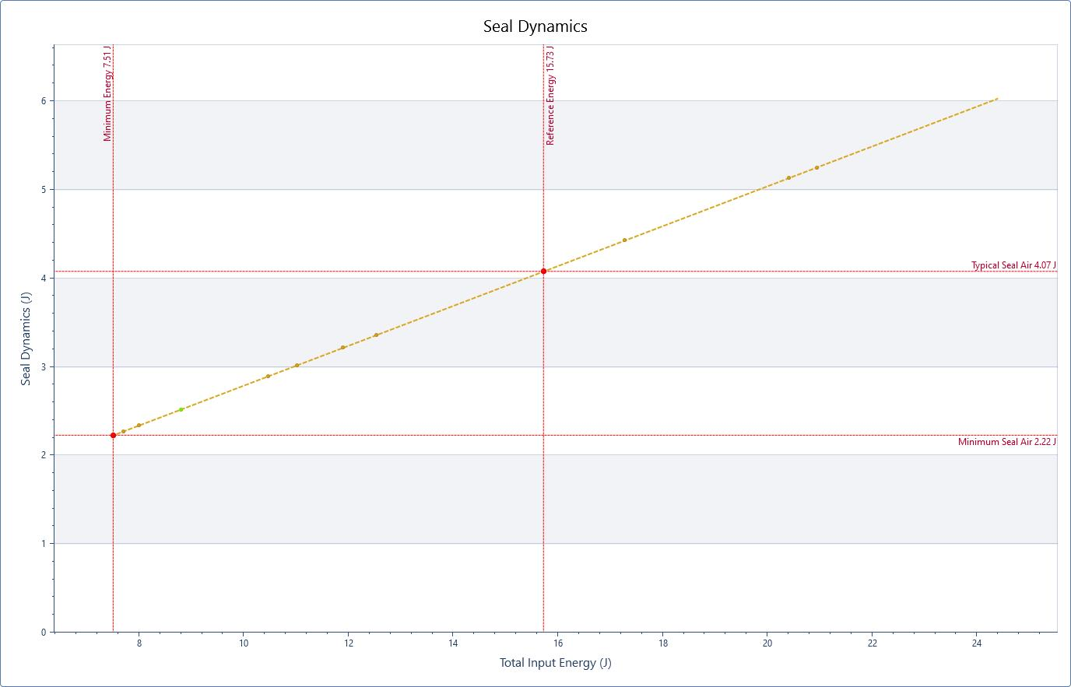
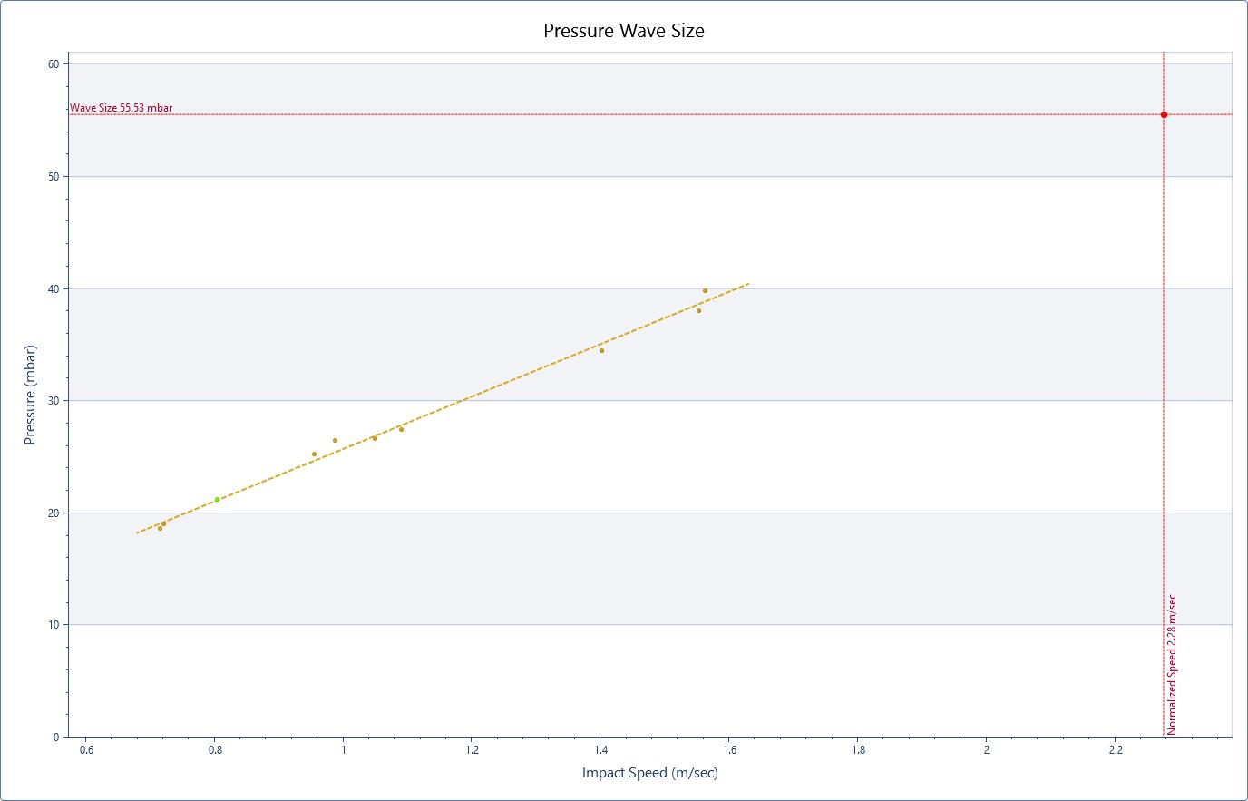
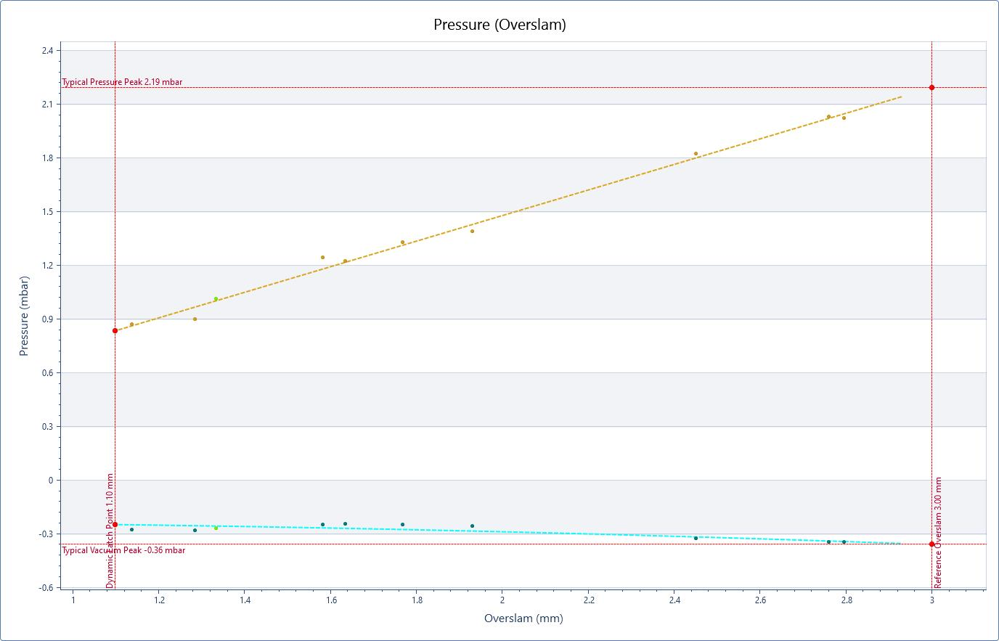
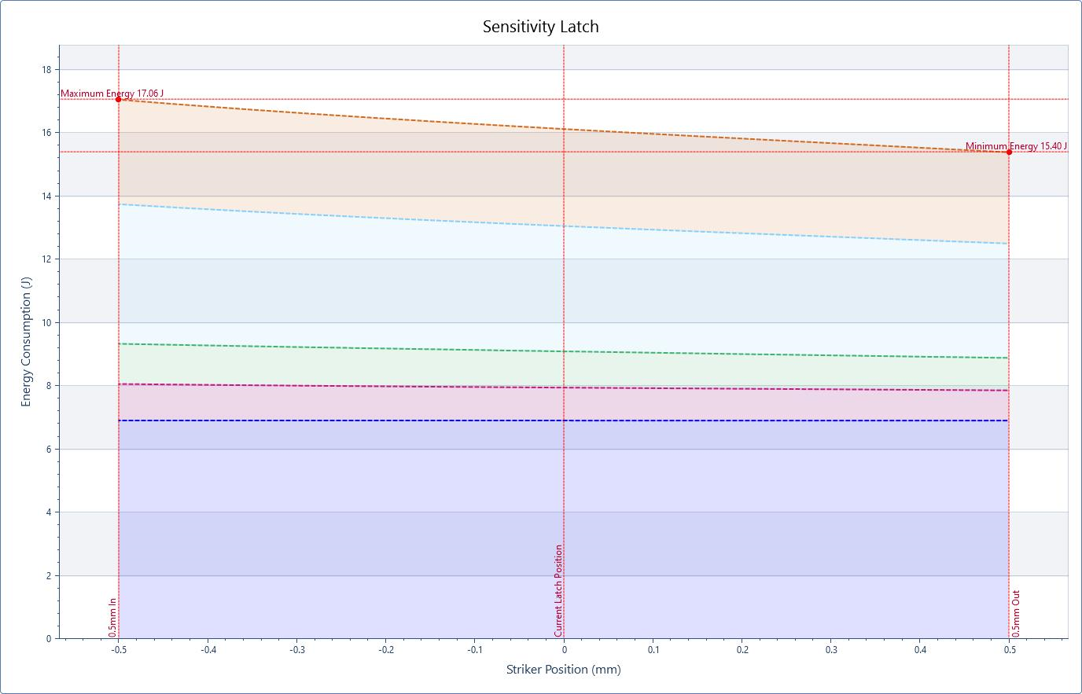
4. specifications
4.7.2 pressure - processing
 | REQUIREMENT | AUDIT | EZSLAM
Calculate the Energy of the Air Pressure Resistance According to the Door Size | - | No | Yes Build in Extensive Pressure Analysis Features
+++ Predict Pressure Characteristics at a Given Speed | - | No | Yes Energy, Peak Pressure, Time at Reference Speed
+++ Separate Cabin, Seal, and Drag Air Dynamics | - | No | Yes
+++ Pressure as a Function of Angle |  | No | Yes
+++ Peak Pressure as a Function of Overslam |  | No | Yes
+++ Pressure Energy vs. Striker Position | - | No | Yes
  Air management is critical and multiple factors need to be observed: pressure vs. speed, pressure transient size, peak value, minimum value, and pressure vs overslam

Slide 24
4. specifications
4.7.2 pressure - additional
 | REQUIREMENT | AUDIT | EZSLAM
Power Circuit with Anti-Reverse Connection, Over-Current Protection, and Surge Protection | Yes | n/a | n/a
Sensor Mounting Bracket | - | Sensor is Placed on Seat | Sensor is Placed on Seat
Tightly Sealed and Protected from Dust; Key Parts Not Exposed | IP54 | IP 54 | IP 54
Small in Size, Easy to Carry, and Convenient for Large-Scale Movement | Less than 4.5kg | EZPressure: 0.71kg including Battery, Onboard Processing Electronics, Wireless Communication and Large Display | Cabin Unit: 0.50kg including Battery, Onboard Processing Electronics, Wireless Communication
Multi-Point Measurement | Up to 6 | 1 Sensor per EZPressure Multiple Units can be Combined for a Single Acquisition | 1 Pressure Sensor
High-Speed Data Acquisition System | - | High-Speed Recording Performed and Optionally Transmitted to the Computer for Further Analysis | High Speed Recording Synchronized with Y-Position and Speed Readings
Double-Ended Sensor to Monitor Atmospheric Pressure Changes | Additional Tubing to outside for reference offset | Build in Automatic Zeroing of Reference Pressure; No Extra Tubing Required | Build in Automatic Zeroing of Reference Pressure; No Extra Tubing Required
Calibration Device Included | - | Yearly Calibration Recommended | Yearly Calibration Recommended Tune-Up Possible for Slight Adjustment
+++ Installation | - | Wireless, Tubeless, Battery-Operated No Interference of Run Wires from Sealing | Wireless, Tubeless, Battery-Operated No Interference of Run Wires from Sealing

Slide 25
5. Intellectual Property

Slide 26
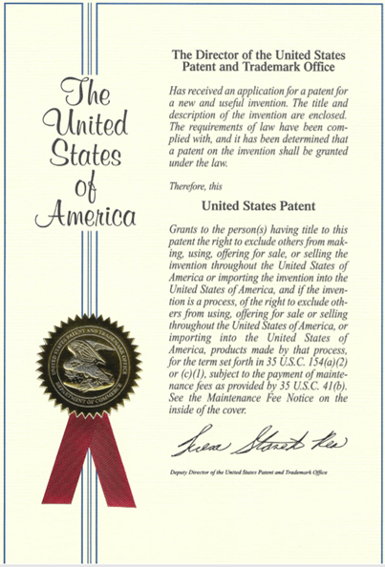
5. Intellectual Property
5.1 Patented technology
Technology
  EZMetrology was awarded a patent for technology principle to characterizing a door with speed and energy measurements.
  The technology patent covers the multi-sensor approach and the correlation methods between the different factors to eliminate user variation.
Advantage
  The patent enables EZMetrology to present our solutions more openly to the automotive engineering community, allowing comprehensive discussions during conferences and other means of distribution.
Attempted Imitations
  EZMetrology will protects its intellectual property against unauthorized copies. This action aims to protect the customer from similar-looking systems that might underperform and do not benefit from EZMetrology’s 16 years of experience in automotive door systems.

Slide 27
Thank you.
info@ezmetrology.com
support@ezmetrology.com
www.ezmetrology.com
portal.ezmetrology.com
academy.ezmetrology.com

