Slide 1

EZSlam Consulting
Consulting Service
EZMetrology's specialized consulting service for maximizing your EZSlam technology
© 2023 EZMetrology

Slide 2

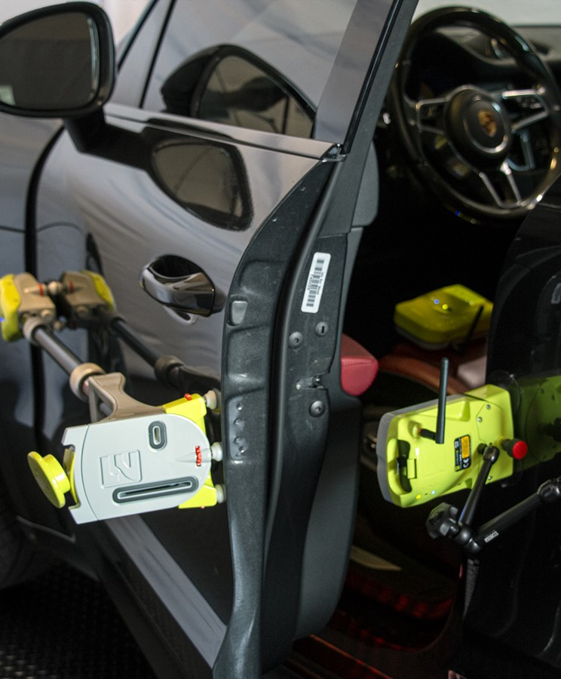
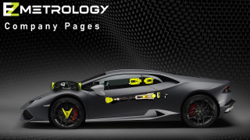
INDEX
Setup
Timely Investigation
Considerations
© 2023 EZMetrology

Slide 3
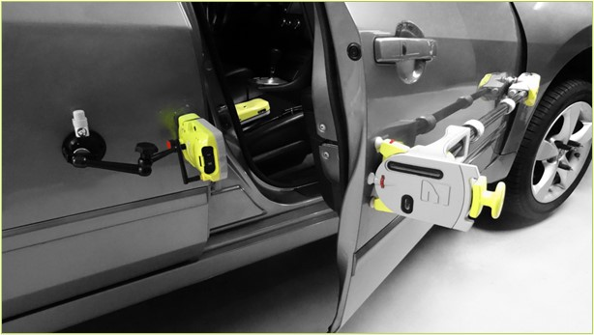
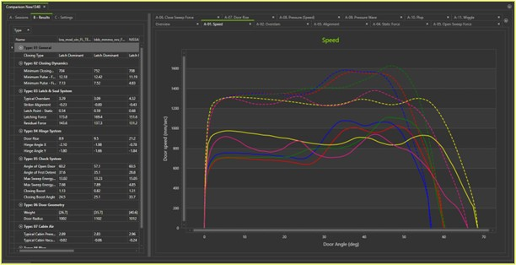
Ezslam consulting
1. Set up
EZMetrology can provide specialized consulting services to assist customers who are in immediate need of enhancing their capabilities and reducing timelines using the world’s leading experts.
This is an all-inclusive consulting service:
Equipment
  Best and latest revision of available equipment
Closure Expert
  Benefit from years of closure experience
Time
  Dedicated time for acquisition, analysis, and reporting
© 2023 EZMetrology

Slide 4
Ezslam consulting
2. Timely INVESTIGATION
Benchmark
Extensive objective study of a larger group of doors to understand the available parameters and establish design criteria.
Specification
Define component specifications and resulting overall behavior. Evaluate multiple components to evaluate their performance with respect to target.
Launch
During a rapid-changing launch process, identify as soon as possible faulty or off- specification components.
Quality
Verify current production output using original design targets.
Associate out-of- tolerance situations to specific causes at the component level.
Vehicle Life Cycle
Design
Compile data to establish a desired feel of the door closing event.
Pilot
Review the first samples to identify variation and pinpoint the tolerance level for all aspects of closing efforts.
Process
Review the process capability and identify specific process variation that contributes to closing efforts.
© 2023 EZMetrology

Slide 5
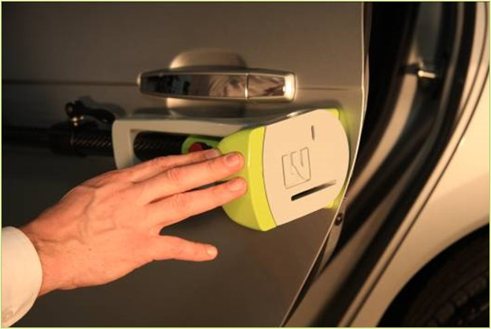
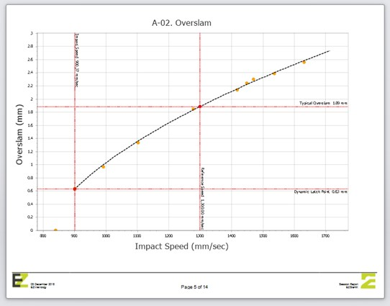
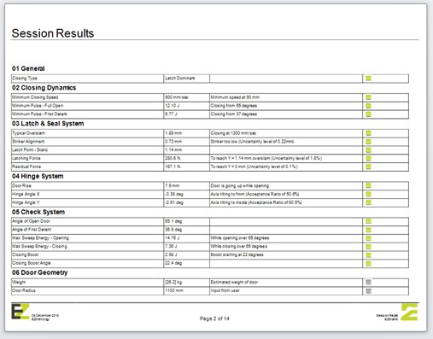
Ezslam consulting
3. Considerations
In order to offer the best consultation, a prior dialogue will determine the length of the consultation and the expected outcomes.
Here are some typical questions that EZMetrology will review in order to establish the optimal approach:
    What is the purpose of the consultation?
    How many doors or vehicles should be part of the study?
    In what stage is the project or research?
    What is the current understanding of the issue(s) ?
    Is rework or modifications required on the vehicles during study?
    Are you looking for data only or full analysis?
    When and where is the consulting work planned ?
    In what format would the results be presented ? Numerical results, graphical or a compilation of essential observations?
© 2023 EZMetrology

Slide 6
Thank you.
info@ezmetrology.com
support@ezmetrology.com
www.ezmetrology.com
portal.ezmetrology.com
academy.ezmetrology.com
© 2023 EZMetrology

Slide 7
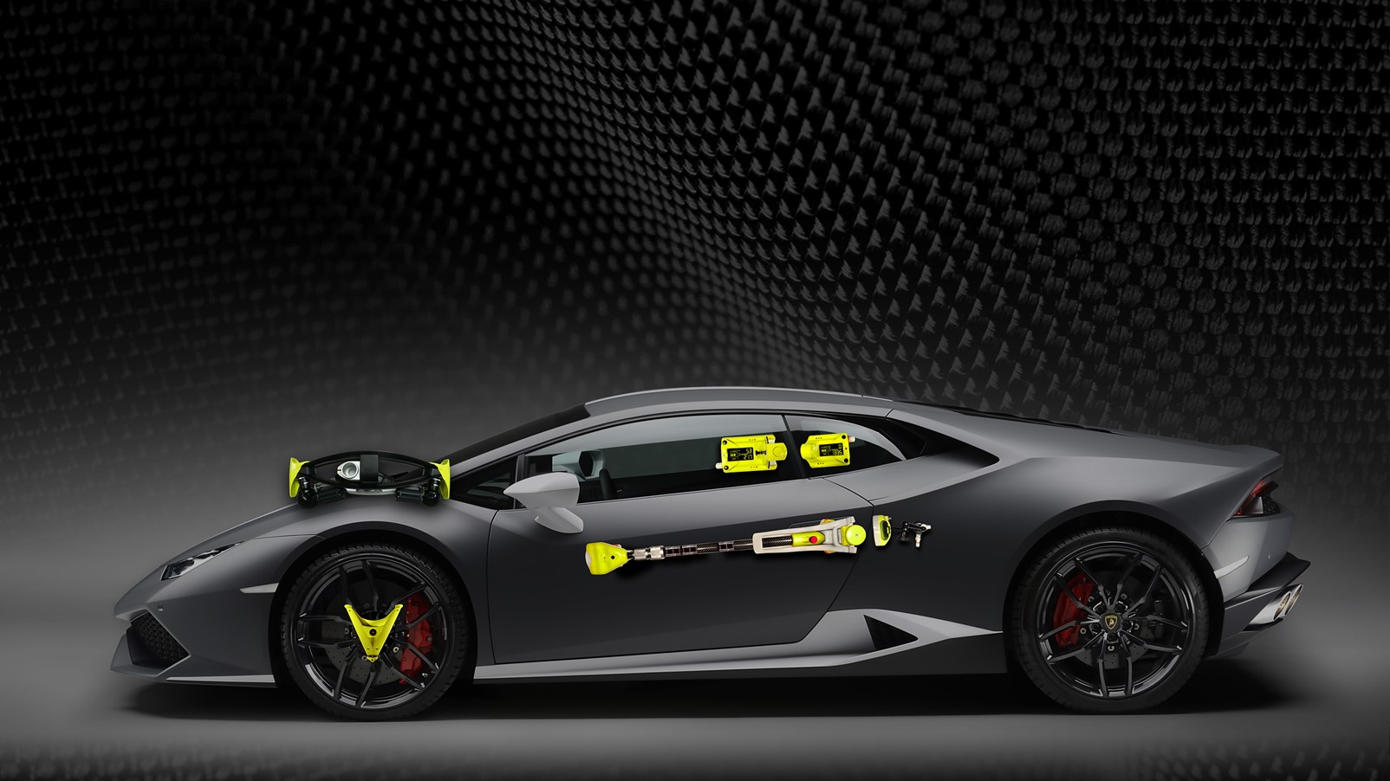

Company Pages

Slide 8
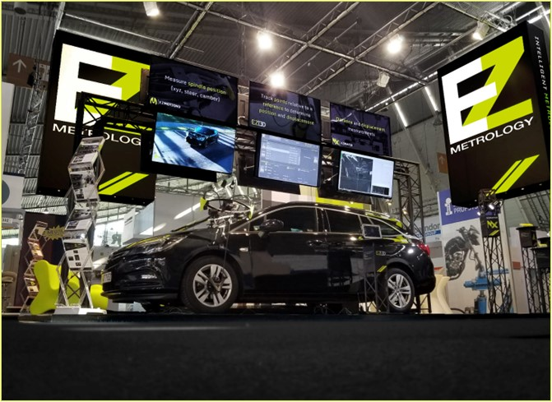
COMPANY OVERVIEW
Founded in 2006 by Carine Woldanski and Tom Van Esch
Global Operations:
  USA Headquarters in Michigan
  Europe Support office in Luxemburg
  Asia Partnerships
EZMetrology:
  70% Development and Engineering
    Fast product development and interactive evolutions
  20% Support and Training
    Ensuring a transfer of competence to our customers
  10% Administration and Sales
    Manage customs and sales procedures
Consistent annual growth of 50% over the past years
Developing innovative, creative and practical products
SEPG003, Slide 8
© 2023 EZMetrology

Slide 9

SHARING OUR PASSION WORLDWIDE WITH CUSTOMERS AT
ALPINE
ARRIVAL
AUDI
BMW
BROSE
CANOO
CATERPILLAR
CHRYSLER
DACIA
DAIHATSU
DAIMLER
DENSO
FAW
FAURECIA
FERRARI
FIAT
FORD
GAC
GENERAL MOTORS
GG MOTORS
HUMANETICS
HONDA
HYUNDAI
INFINITI
JAGUAR
JEEP
KASEIKOGYO
KIA
KIEKERT
LADA
MACK
MAHINDRA
MARUTI
MASERATI
MAZDA
MITSUBISHI
MULTIMATIC
NISSAN
NITTO DENKON
POLARIS
PORSCHE
PROTON
PSA
QOROS
RENAULT
RIVIAN
SAIC MOTOR
SEAT
SIEMENS
STELLANTIS
SUBARU
SUZUKI
TATA MOTORS
TESLA
TOGG
TOYODA GOSEI
TOYOTA
VOLKSWAGEN
VOLVO
VOLVO TRUCKS
SEPG003, Slide 9
- EZM HEADQUARTERS
- EZM PARTNERS
- EZM CUSTOMERS
© 2023 EZMetrology

Slide 10


