Slide 1

EZMotion
Optical Dynamic Tracking
A dynamic, optical tracking system using triangulation technologies for tracking objects in 3D or 6D positions and orientations
Confidential
© 2024 EZMotion

Slide 2

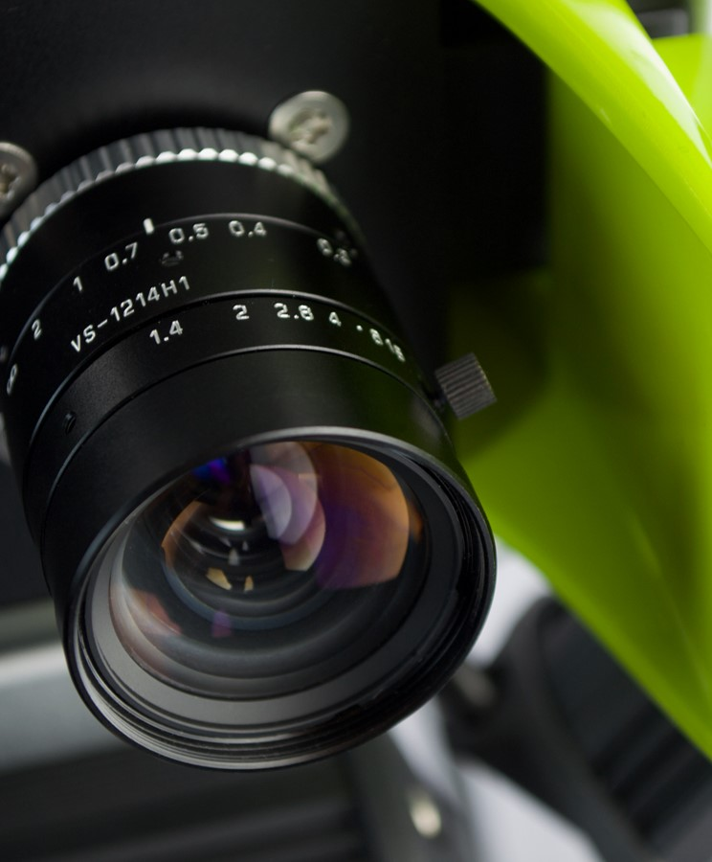


Index
Introduction
Technology
IO Extension
Tailoring
Applications
Confidential
© 2024 EZMotion

Slide 3

1. Introduction
Confidential
© 2024 EZMotion

Slide 4
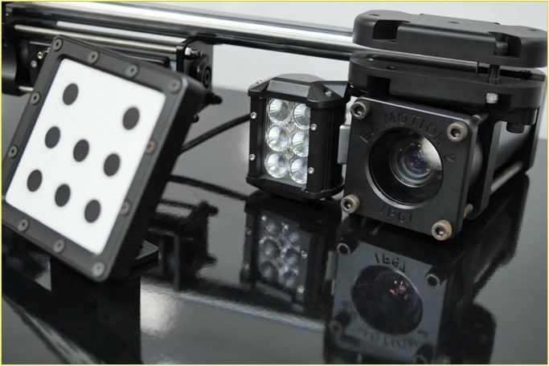
1. Introduction
1.1 EZMotion
EZMotion is a 3D or 6D measuring system based on state-of-the-art stereo vision camera technology .
Tracking
    The system is capable of tracking a multitude of points or objects in space and determining their absolute or relative movement through advanced software.
Adaptability
    The wide variety of available camera sensors and EZMetrology’s flexible platform allows our engineers to design the perfect solution for your application.
Confidential
© 2024 EZMotion

Slide 5
2. Technology
Confidential
© 2024 EZMotion

Slide 6
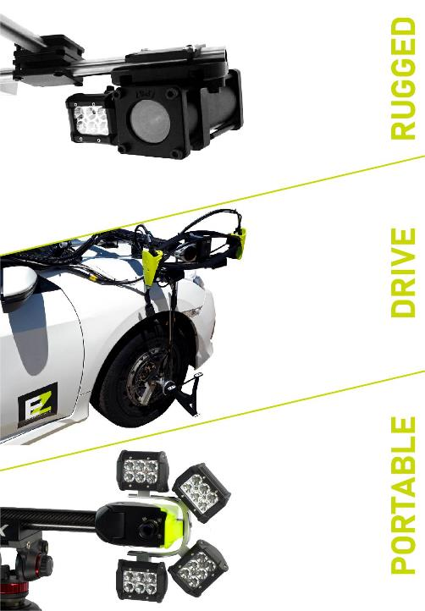
2. Technology
2.1 Camera Technology
When it comes to the selection of the right camera module, our specialists will consider 4 aspects:
Accuracy / Resolution
    Resolutions are available from 1 to 20 megapixels and will play a key roll in reaching the desired accuracy
Acquisition Speed
    Frequencies are available from 1 to 2000 Hz
Measurement Volume
    A wide variety of lenses are available to get the desired volume and standoff
Environment
    Designed for extreme environmental conditions such as temperature, humidity, and water exposure
    Optimized for weight, portability, and power consumption
Confidential
© 2024 EZMotion

Slide 7
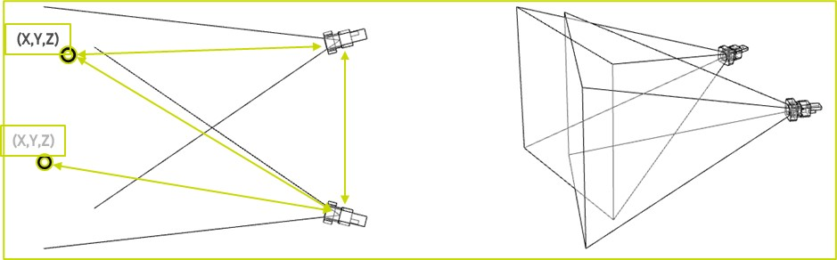
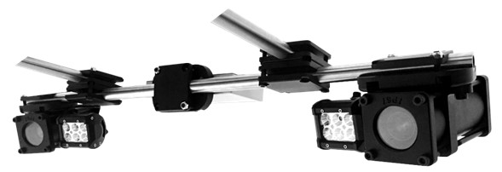
2. Technology
2.2 Triangulation – single pair
Single Pair
EZMotion is composed of 2 cameras to calculate and track objects in the measurement volume.
A dedicated calibration procedure is performed to establish the geometry and enable the triangulation calculation.
The chosen geometrical configuration of a pair is application-specific and based on the distance between the objects and cameras.
Confidential
© 2024 EZMotion

Slide 8
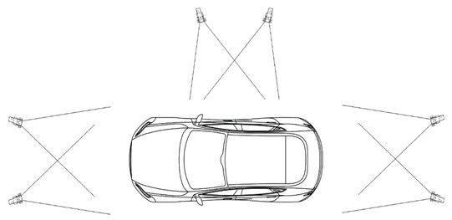
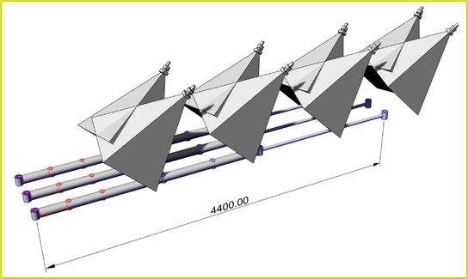
2. Technology
2.3 Triangulation – Camera Network
EZMotion is not limited to two cameras per installation. A network of cameras can be a solution for multiple reasons.
Camera Network : Line of Sight Requirements
    Optical tracking systems need line of sight between the camera and tracker. Multiple cameras can cover or track an object from different angles, allowing full rotations to see opposite faces.
Camera Network : Accuracy Improvements
  Multiple pairs will improve the ratio between volume and accuracy. A network of multiple cameras will result in high resolution in a large volume and, therefore, high performance.
Confidential
© 2024 EZMotion

Slide 9
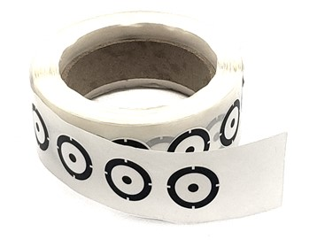
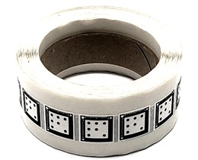
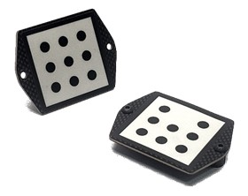
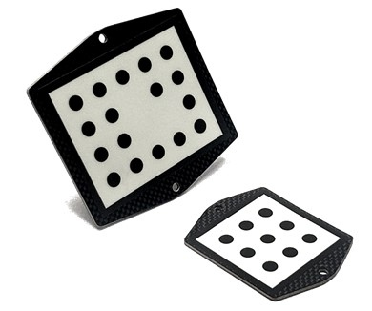
2. Technology
2.4 Optical Trackers
High contrast optical trackers can be used to track objects on different levels.
Single Dot Tracker (3D)
    Track the XYZ Position of a point in space
Tracker (6D)
    Track the XYZIJK position and orientation of a part in space
Tracker Group (6D)
    Combine multiple trackers to establish a new 6D object
    Track multiple objects and determine relative movements
Custom design considerations for applications:
    Weight criteria: Painted, adhesive labels or mechanical design
    Installation criteria: Adhesive or mechanical mounting
    Accuracy criteria: Size and layout of the tracker will influence final performance of position and angular accuracy
Confidential
© 2024 EZMotion

Slide 10
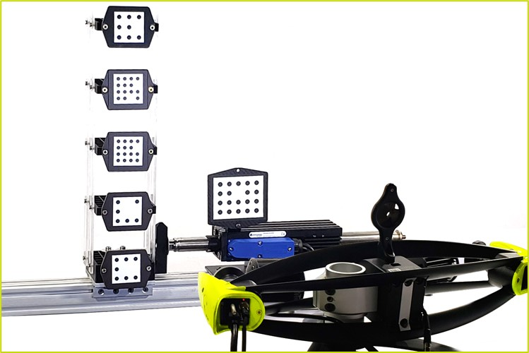
2. technology
2.5 Tracking technology
The intelligent tracking algorithms provide significant advantages over classic image processing.
Optical Robustness
    EZMotion will use this tracking information to keep the focus and ignore other potential optical distractions like sunlight, reflections, welding arcs and spotlights.
Measurement Speed
    The tracking function will enable the algorithm to optimize image processing via ROI (Region of Interest) to extract the accurate positions and parameters to maintain measurements in changing conditions.
Control Adaptability
    The tracking function will steer system controls and parameters to maintain performance over rapidly changing light conditions.
Confidential
© 2024 EZMotion

Slide 11
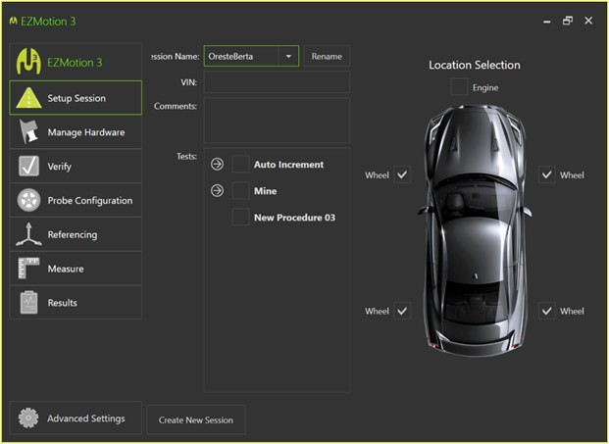
2. Introduction
2.6 Procedures and processing
All optical hardware and integration choices come together in the EZMotion software.
A step-by-step approach will walk a user through the process from setup to review and export of data.
Data management (sessions)
Camera network
Tracker identification
Reference definition
Recording
Reporting and export
Output can be redefined by position, speed, and distance
Output can be made available via file export, graphical representation, real-time analogue signal, and digital output (TCP steam)
Confidential
© 2024 EZMotion

Slide 12
3. IO Extension
Confidential
© 2024 EZMotion

Slide 13
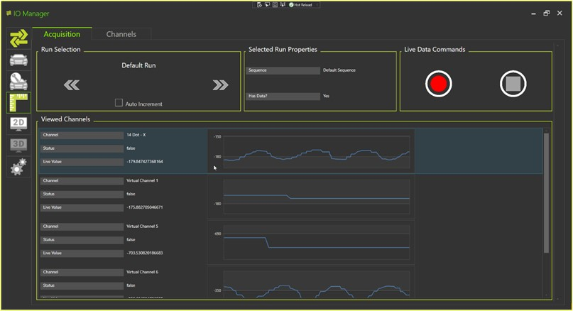

3. Io Extension
3.1 Introduction
IO Manager is an optional extension to EZMotion to expand measurement capabilities.
Input Extensions
    Integrates data stream from other sensors
      Load cell, Pressure Gauges, Accelerometers, GPS, and CAN
    Time synchronization
      Time stamp and TTL
    Data management
      Sessions, Multi-Channel, Channel Conversions, Templates, and Scripts
Confidential
© 2024 EZMotion

Slide 14
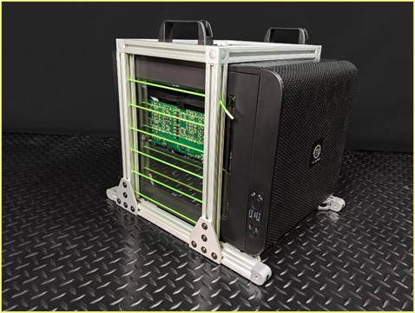
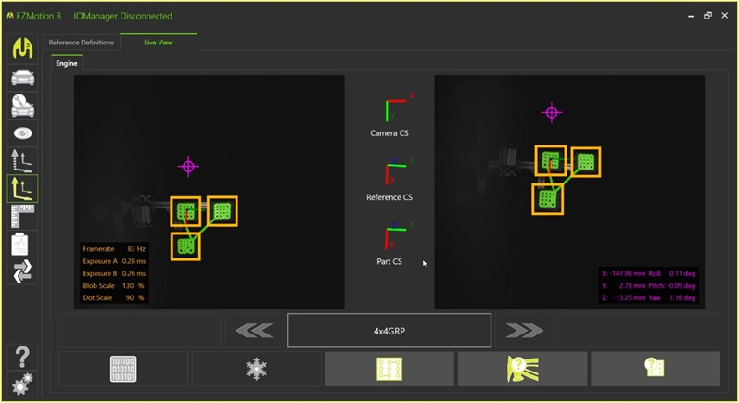
3. Io extension
3.2 processing
Filter and process raw sensor data into the desired measurement value, saving post-processing time.
Real Time Processing
    Mathematical operations
      Speed, Acceleration (derivative), Relative Movement, Distances, Angles
    Signal processing
      Resampling, Low / High Pass Filtering, Latency
    Custom designed data processing
Confidential
© 2024 EZMotion

Slide 15
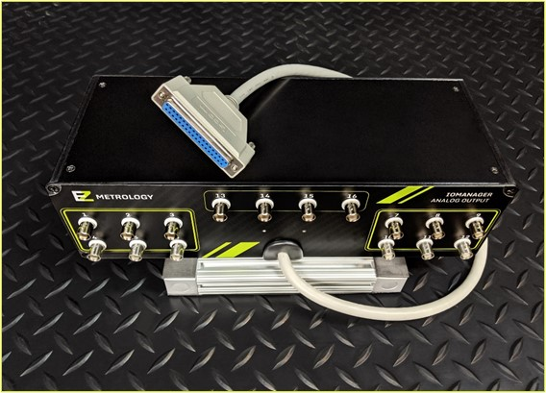
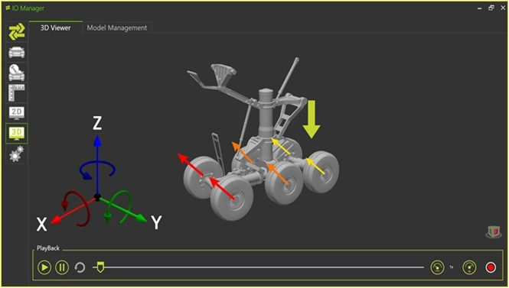
3. Io extension
3.3 Results
Output Options
    File export
      Write numerical results from any incoming or processed channel to a text file
    2D channel graphs
      View channels as signals in a 2D scatter or line plot
    Analog
      Analog real-time output with minimum or controlled latency
    TCPIP
      Streaming output for adaptive systems or closed loop setup
    Rendered animation
      Create realistic animations using data and CAD models.
      Multiple objects can be added to the animation.
      Rendering can use dynamic coloring, amplifications, and slow motion
Confidential
© 2024 EZMotion

Slide 16
4. Tailoring
Confidential
© 2024 EZMotion

Slide 17
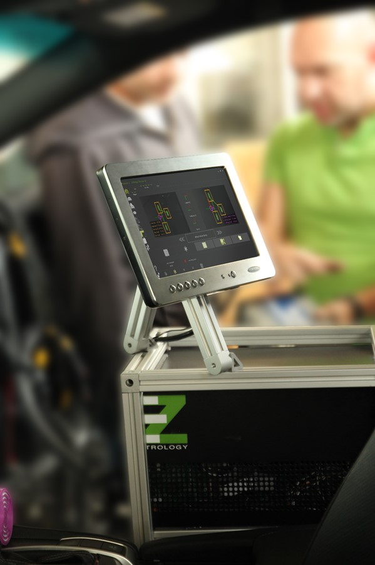
4. tailoring
4.1 Measurement Performance
Meeting Your Individual Needs
EZMotion is a modular stereo-vision solution that can be adapted to meet your specific application when it comes to 3D or 6D tracking and precise measurements.
Your answers to the 3 main aspects will enable our engineers to select the optimal configuration:
Volume
    What are the dimensions of the object to be measured?
Speed
    What is the desired frequency to record position data?
Accuracy
    What is the desired precision of the measurement?
    What is the amplitude of the movement?
.
Confidential
© 2024 EZMotion

Slide 18
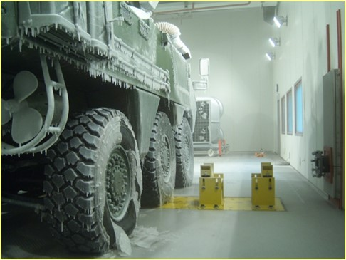
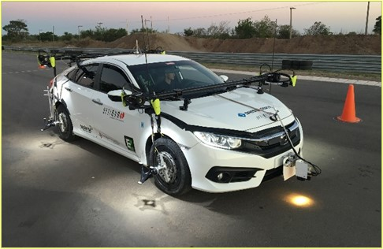
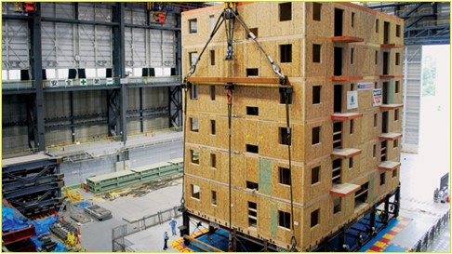
4. tailoring
4.2 Environmental
EZMotion meets requirements for a variety of operating conditions:
Mobile or Fixed
    EZMotion can be configured as a mobile solution enabling systems to be placed in different sites throughout a test lab
    EZMotion can be fully integrated in test rig structures or fixed locations
System Weight
    System weight can be controlled to take into account such considerations as on-track or in-flight solutions
IP Class / Submersible
    Resistant to contamination, EZMotion can be configured for different IP levels.
Operating Temperature
    Temperature-resistant (hot or cold) materials can be used for harsh testing environments
Confidential
© 2024 EZMotion

Slide 19
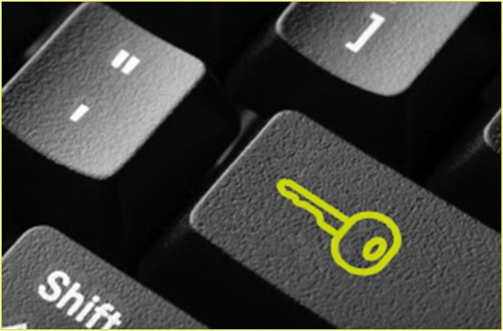
4. tailoring
4.3 operation
EZMotion installation includes integration into test stands and existing work procedures.
Synchronization
    EZMotion synchronizes position data with other systems such as load cells, strain gauges, and pressure gauges
Parent/Child
    As Parent : EZMotion will manage the recording of other sensors
    As Child : EZMotion streams data to other data loggers
Procedure
    A step-by-step procedure is implemented for the end user to have a clear path for measurement set up
Confidential
© 2024 EZMotion

Slide 20
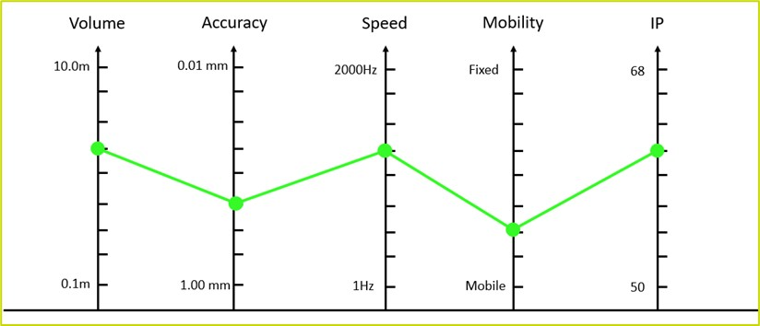
4. tailoring
4.4 Cost effective Solution
Our responsibility is to provide a solution that best meets customer criteria
The collection of desired specifications can be represented in a diagram below:
Confidential
© 2024 EZMotion

Slide 21
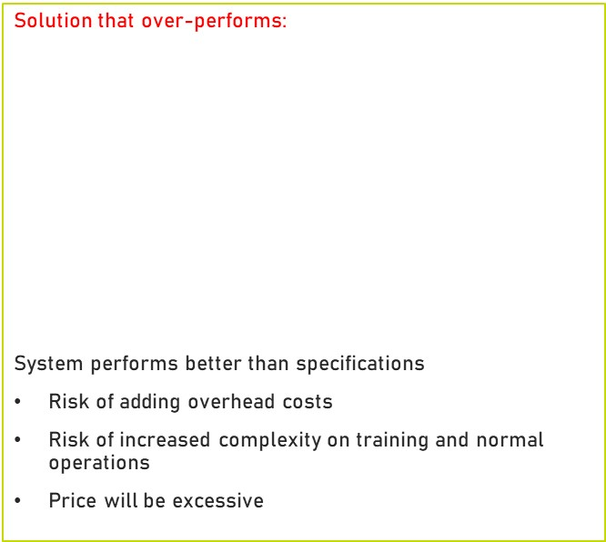
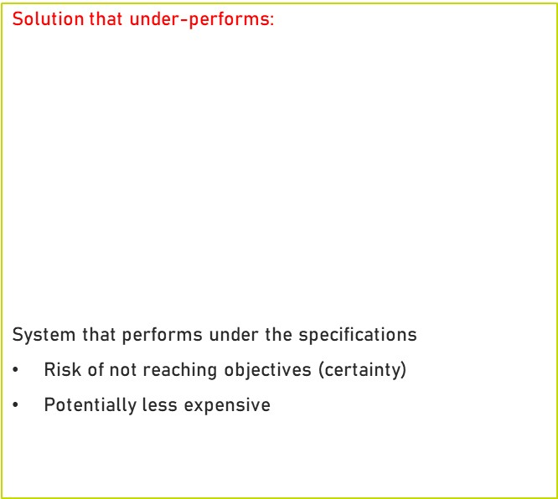
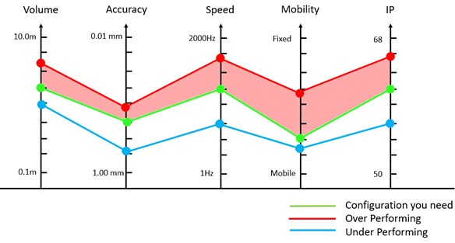
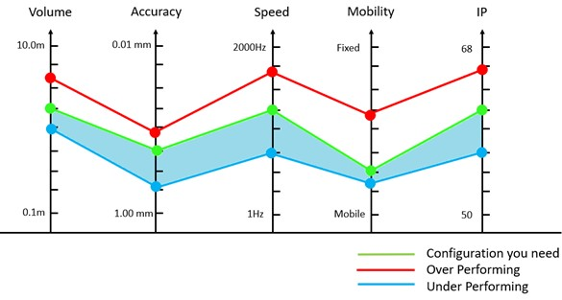
4. tailoring
4.5 Cost effective Solution: ISSUES
Confidential
© 2024 EZMotion

Slide 22
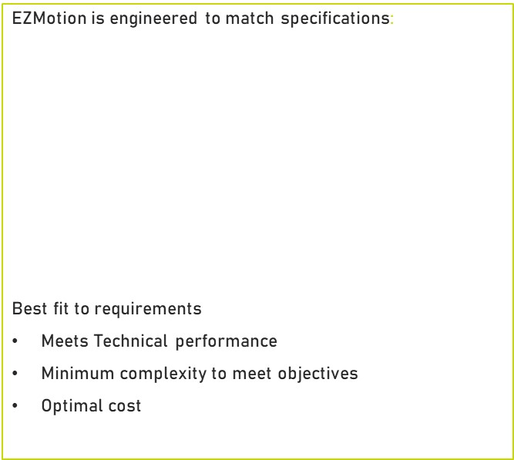
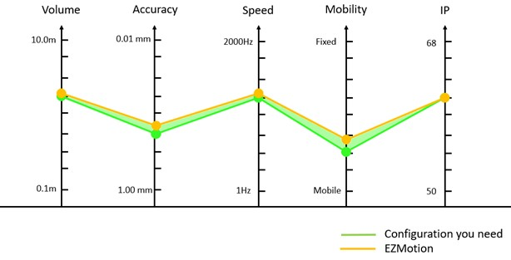
4. tailoring
4.6 Cost effective Solution: BEST FIT
Confidential
© 2024 EZMotion

Slide 23
5. Applications
Confidential
© 2024 EZMotion

Slide 24
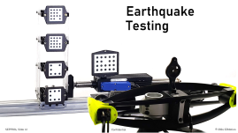

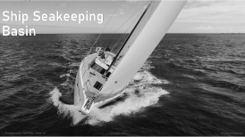
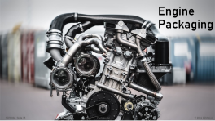

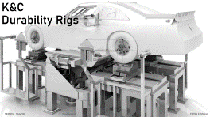
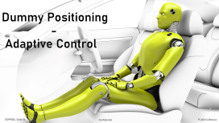


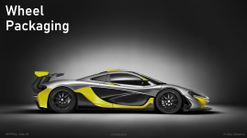
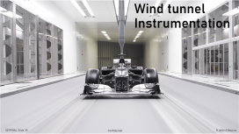

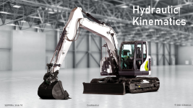
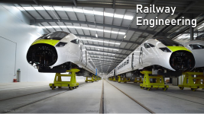







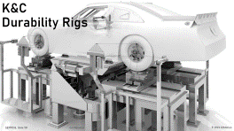


5. applications
Confidential
© 2024 EZMotion

Slide 25
Thank you.
info@ezmetrology.com
support@ezmetrology.com
www.ezmetrology.com
portal.ezmetrology.com
academy.ezmetrology.com
Confidential
© 2024 EZMotion

Slide 26
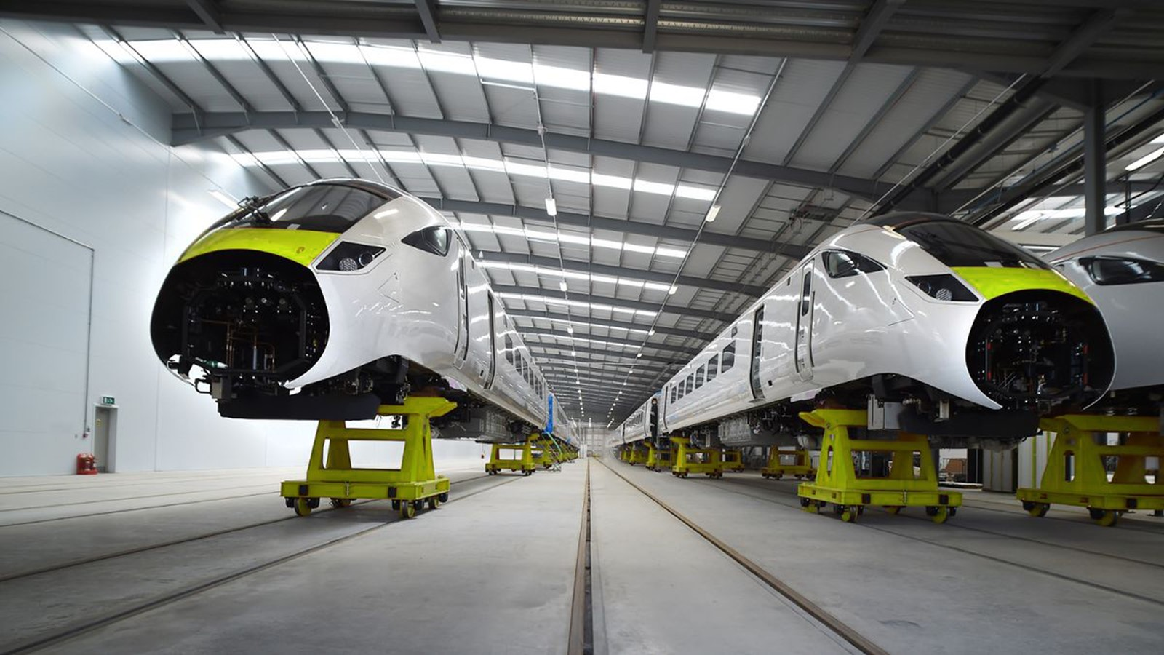
Railway
Engineering
Confidential
© 2024 EZMotion

Slide 27
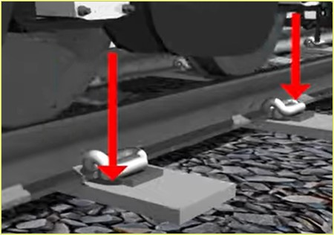
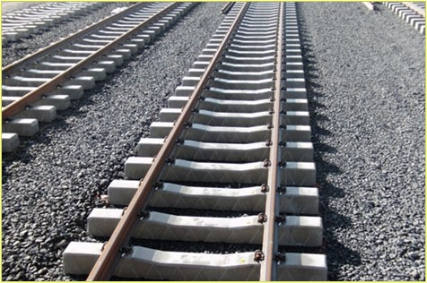
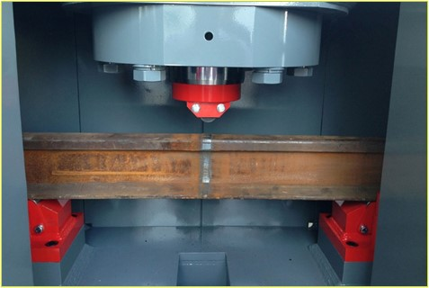
applications
Railway engineering
EZMotion system can be conveniently positioned to measure movements of rail structures, ties, and tracks under different loads (static or dynamic).
Measurements and data acquisition can be performed in a controlled lab environment or can be taken outdoors to collect field data to be used in simulations or test file development.
Confidential
© 2024 EZMotion

Slide 28
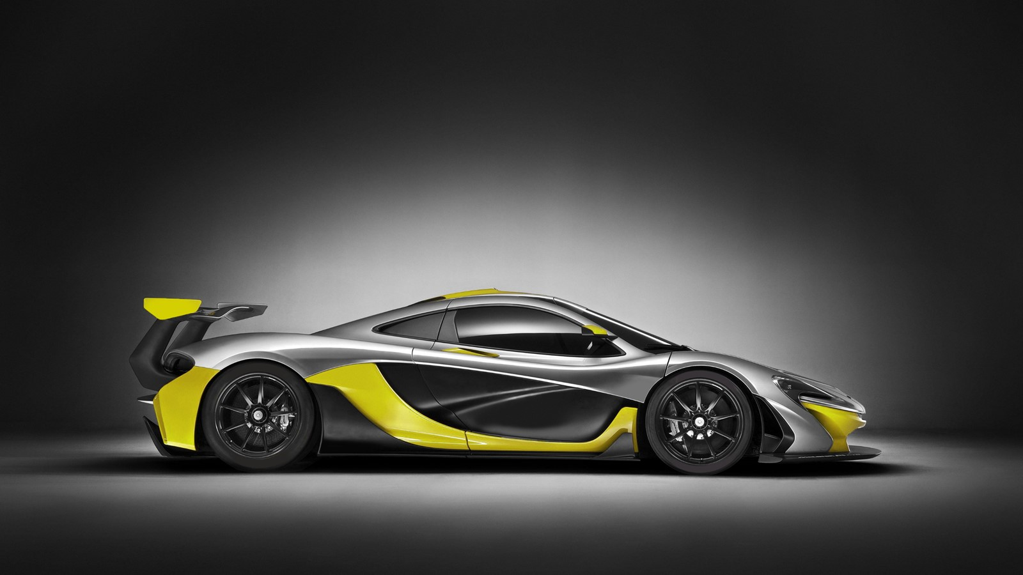
Wheel
Packaging
Confidential
© 2024 EZMotion
Presentation SEPP006, Slide 28

Slide 29
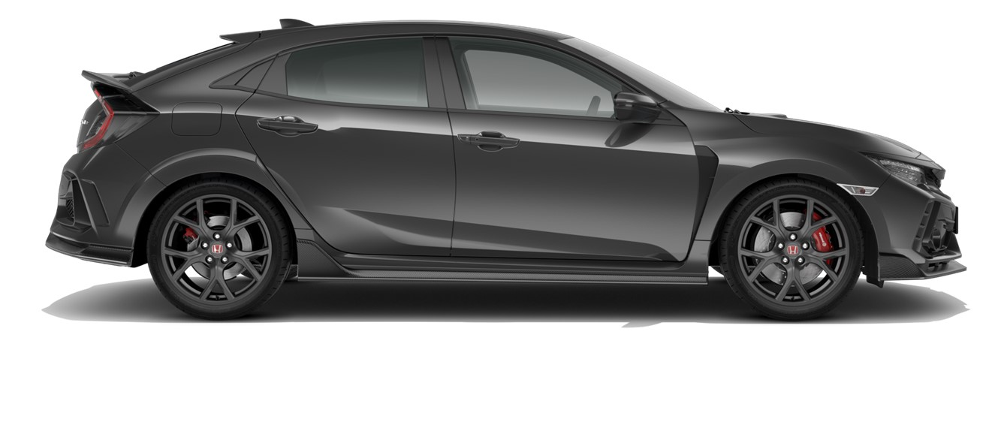
Wheel packaging
Measuring the required Clearance
EZMotion measures wheel movement under real-world load conditions
Data can be used to ensure there is a safe distance between tires and other body components
EZMotion can be used to confirm optimal designs and minimize the amount of lost space around the fender and wheels
Confidential
© 2024 EZMotion

Slide 30
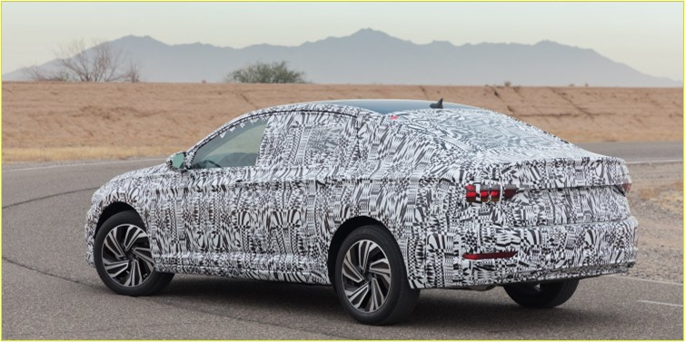
Wheel Packaging
Typical Test Scenario
Generate maximum travel upward, inward, forwards and backwards.
Sample Tests:
    Driveway 15 degrees and 30 degrees (vertical load, one corner, maximum body twist)
    Pothole (impact for one wheel)
    Speed Bump (impact for full axle)
    Curb (slow load, one corner)
    Forward steer / brake (positive load in X)
    Reverse steer / brake (negative load in X)
Confidential
© 2024 EZMotion

Slide 31
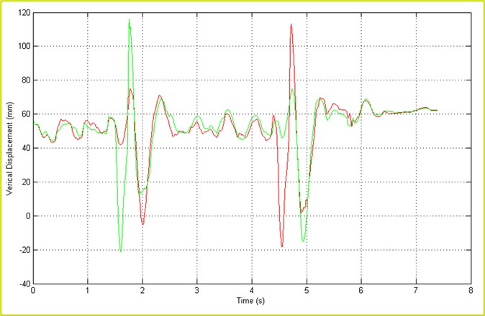
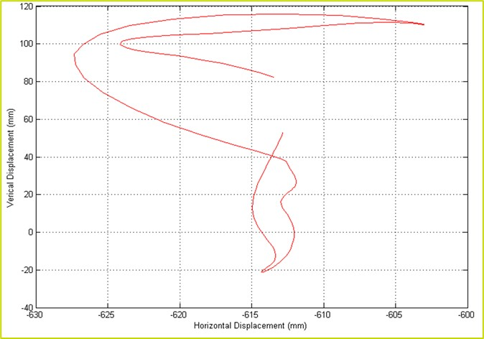
Wheel Packaging
Sample Data
Wheel
Position X, Y, and Z
Orientation, steer, and camber
Each single test records the displacement of the wheel in time and space.
The analysis algorithm will evaluate the most extreme positions.
Confidential
© 2024 EZMotion

Slide 32
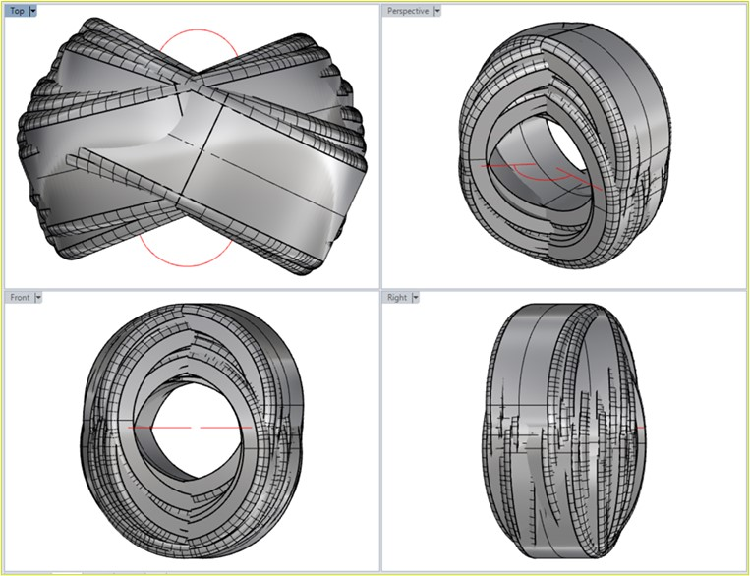
Wheel Packaging
Conclusions
Combining All Trajectories
A test will generate a specific point where maximum vertical displacement + maximum steer + maximum braking will generate an extreme point
Other tests will reach a maximum in other locations
All wheel positions combined with CAD software will determine in which envelope the tire is moving
Design recommendations in accordance with body and suspension specifications to avoid collisions
Confidential
© 2024 EZMotion

Slide 33

Wind tunnel Instrumentation
Confidential
© 2024 EZMotion

Slide 34


Applications
Wind tunnel instrumentation
EZMotion will be used to measure structural deflection or deformation of parts subject to airflow and resultant pressures
A single set can be focused on particular components or a camera network can overview the complete assembly.
EZMotion Specific Advantages:
Optical trackers (adhesives or point) do not interfere with air flow
3D displacement of multiple points
Relative displacement
Position as an important addition to force measurements to establish compliance
Camera system is positioned outside the laminar flow path
Confidential
© 2024 EZMotion

Slide 35

Engine
Packaging
SEPP006, Slide 35
Confidential
© 2024 EZMotion

Slide 36


Engine packaging
Measurement Setup
EZMotion system is mounted on the windshield pointing towards the engine bay
Lightweight engine targets are mounted on the engine block
Displacement is measured during multiple maneuvers
Confidential
© 2024 EZMotion

Slide 37

Engine Packaging
Typical Testing Scenario
Purpose is to generate maximum torque or G forces on the engine.
Sample tests:
Sweep (lateral G)
Clutch release (max torque)
Speed bump (impact full axle)
Engine brake (negative torque)
Durability course (noise)
Confidential
© 2024 EZMotion

Slide 38

Engine Packaging
Conclusions
All Data Combined
Maximum displacement combined with maximum rotation determine the extreme points.
Static Volume
Dynamic Volume
Design recommendations for body and engine mount specifications to avoid collisions.
Confidential
© 2024 EZMotion

Slide 39

ADAS –
Autonomous
System
Confidential
© 2024 EZMotion

Slide 40


Applications
ADAS Evaluation
Cut-In Cut-Out Test / Emergency Brake / Avoidance
Decisions are made for each specific situation. Control systems are at the base but only a part of the chain. For optimal performance, the responding mechanical systems need to all be functioning equally well.
Radar systems will, for example, detect obstacles or situations and make associated reactions to correct the trajectory.
System Response Time
To measure the overall system performance of these systems and compare to others, the slower mechanical action should be included in the evaluation.
EZMotion establishes the intermediate mechanical response to identify the potential latency in the mechanical systems, providing the opportunity to improve the outcome.
Sensor
Latency
Bus System
Processing
Real-time Latency
Algorithm
Response
Steer/Brake
Vehicle Trajectory
Multi Sensor
Action Output
Mechanical System
Grip
Inertia
Bus System
Communication
Exposure
Synchronization
EVENT
CORRECTION
Electronics
Processing
Processing
Processing
Processing
Mechanics
Mechanics
Data
EZMotion
Confidential
© 2024 EZMotion

Slide 41

Earthquake Testing
SEPP006, Slide 41
Confidential
© 2024 EZMotion

Slide 42


Applications
Earthquake Test instrumentation
EZMotion monitors structures and structural elements under dynamic loads from earthquakes.
The massive shaker table, with up to 6 degrees of freedom, will shake the full or partially scaled structure to monitor displacements and resonance of the components.
EZMotion Specific Advantages;
Large volume using a camera network
Low frequency responses with high resolution
Position data
Replaces cumbersome and time-consuming setup of countless string pods, linear displacement sensors, and encoders.
Confidential
© 2024 EZMotion

Slide 43

Ship Seakeeping Basin
Confidential
© 2024 EZMotion

Slide 44

Applications
Ship Seakeeping basin
EZMotion will follow the location of a ship model or maritime platform in a water tank to track the object during wave and current simulations. The position measurement also serves to steer the instrumentation bridge to follow and steer the model.
EZMotion Specific Advantages:
Large volume with camera network
Lower frequency and high resolution
IP68 for humid and underwater environments
Rugged passive tracker
Full integration for closed loop bridge control
Confidential
© 2024 EZMotion

Slide 45

Tire and Suspension Development
Confidential
© 2024 EZMotion

Slide 46

Applications
Tire and Suspension
EZMotion establishes an accurate relationship between the wheel axis position and orientation relative to the road surface, a crucial parameter in tire testing and simulations.
A mobile system records the real behavior on the test track and a fixed configuration is used to reproduce test rig conditions.
EZMotion Specific Advantages:
Fully compatible with high-speed events
6 degrees of freedom
Lightweight, mobile configuration for on-track monitoring
Confidential
© 2024 EZMotion

Slide 47

Aeronautics
Confidential
© 2024 EZMotion

Slide 48

Aeronautics Applications
Landing Gear Drop Test
EZMotion will measure the transient deformation and kinematic behavior of landing gear during a drop test.
EZMotion evaluates the simulated and design characteristics of a wheel and suspension assembly during the impact of a landing.
EZMotion Specific Advantages:
High speed and short recording time
Multiple points for relative displacement
Full 3D displacement for accurate feedback for simulations
Replaces linear sensors, string pods, and 1D laser sensors
Confidential
© 2024 EZMotion

Slide 49

Aeronautics Applications
In-Flight Window vibrations
EZMotion technologies can be adapted for specific requirements and configured to provide solutions for in-flight measurements of the main craft or key sub-structures.
EZMotion Specific Advantages:
Optimized for low frequency vibrations (0-50Hz)
Multiple points for shape deformation
Combine with pressure or force data
Confidential
© 2024 EZMotion

Slide 50

Aeronautics Applications
Door operation or Jettison
EZMotion technologies can be adapted for specific requirements and configured to measure operational and kinematic compliance of multi-axis mechanisms.
The position measurement combined with operational force can provide the necessary insight into the quality and elements of the kinematic structure.
EZMotion Specific Advantages:
Optimized for low frequency vibrations (0-50Hz) or static deformations under load
Multiple points for shape deformation
Combine with force data to measure peak force and displacement
Confidential
© 2024 EZMotion

Slide 51


Aeronautics Applications
PART DYNAMIC response
EZMotion’s optical technology platform is perfect for part dynamic response measurement and quantification. Where accelerometers are excellent for applications in the high-frequency spectrum, optical technology is perfect for the static or low-frequency responses.
A part placed on a test bench and subjected to mechanical or thermal loads will deflect. The displacement of multiple points can be recorded as a function of time. A collection of optical targets, in the form of high-contrast adhesive labels placed on specific points on the part, are measured and provide accurate 3D position at a rate anywhere from 100 Hz all the way up to 2000 Hz.
The obtained measurement data can validate part specifications, such as maximum deflection and resonance peaks, or provide valuable feedback for simulations.
Confidential
© 2024 EZMotion

Slide 52

Aeronautics Applications
Drop Test Dynamic System Validation
EZMotion 3D data combined with force, pressure, or other sensors provides a comprehensive picture of the behavior of the assembly or its kinematics. The individual structures, their kinematics, and compliance can be characterized or evaluated.
The position data can determine specific stress points, joint locations, displacements, repositioning, and flexibility. Based on position, accurate conclusions can be drawn towards velocity (position or angular) and even acceleration.
Having determined the current velocities and damping characteristics, system adjustment can be envisioned to improve the overall performance of the kinematics design.
Confidential
© 2024 EZMotion

Slide 53

Hydraulic Kinematics
Confidential
© 2024 EZMotion

Slide 54

Applications
Hydraulic Kinematics
EZMotion tracks the dynamic performance of hydraulic assemblies to document and establish speed performance, total travel, drift, snubber effect and more.
Component Testing:
Hydraulic test stands run the assembled product through a series of tests to establish the correct operation prior to the installation process on the machine.
EZMotion Specific Advantages:
Dynamic testing
IP68 to resist hydraulic oil
Rugged tracker for 100% in-line inspection
Full integration in test stand controller as closed loop
Confidential
© 2024 EZMotion

Slide 55

Applications
Hydraulic Kinematics
Assembly Evaluation
Upon assembly of the hydraulic system, the overall performance can be evaluated. This includes establishing and verifying the motion specifications.
EZMotion Specific Advantages:
Large volume
Rugged tracker for 100% inspection
Relative or absolute measurements
Confidential
© 2024 EZMotion

Slide 56

Dummy Positioning
-
Adaptive Control
Confidential
© 2024 EZMotion

Slide 57

Applications
Dummy Positioning / Adaptive control
The position information obtained from EZMotion can be used to steer a fully automatic system to obtain a desired specification. The stream of data is used as input to the motion controller and used in a control loop.
Guided Positioning
The guiding application can be performed with manual positioning. For example, the operator can position a dummy in line with a certain impact hammer trajectory to make sure the hit occurs at a specific point on the dummy’s chest.
Typical Applications:
Adaptive control for robot position feedback
Interactive position of dummy on test stand
Confidential
© 2024 EZMotion

Slide 58

K&C
Durability Rigs
Confidential
© 2024 EZMotion

Slide 59

Applications
K&C testing and Durability rig
EZMotion will record with high accuracy the position and angle of the wheel under load. This will map the suspension kinematics (Geometry) and the compliance (Flexibility) of the vehicle
Track Data and Drive File development
For durability testing, EZMotion will be used to synchronize track data with the data from the test stand to make an optimal match and establish a realistic drive file.
EZMotion Specific Advantages:
Large volume with camera network
Lower frequency and high resolution
IP68 for humid and water environments
Rugged passive tracker
Full integration in bridge controller as closed loop
Confidential
© 2024 EZMotion

Slide 60


Company Pages

Slide 61

COMPANY OVERVIEW
Founded in 2006 by Carine Woldanski and Tom Van Esch
Global Operations:
  USA Headquarters in Michigan
  Europe Support office in Luxemburg
  Asia Partnerships
EZMetrology:
  70% Development and Engineering
    Fast product development and interactive evolutions
  20% Support and Training
    Ensuring a transfer of knowledge to our customers
  10% Administration and Sales
    Manage customs and sales procedures
Consistent annual growth of 50% over the past years
Developing innovative, creative and practical products
Confidential
© 2024 EZMotion

Slide 62





SHARING OUR PASSION WORLDWIDE WITH CUSTOMERS AT
ALPINE
ARRIVAL
AUDI
BMW
BROSE
CANOO
CATERPILLAR
CHRYSLER
DACIA
DAIHATSU
DAIMLER
DENSO
FAW
FAURECIA
FERRARI
FIAT
FORD
GAC
GENERAL MOTORS
GG MOTORS
HUMANETICS
HONDA
HYUNDAI
INFINITI
JAGUAR
JEEP
KASEIKOGYO
KIA
KIEKERT
LADA
MACK
MAHINDRA
MARUTI
MASERATI
MAZDA
MITSUBISHI
MULTIMATIC
NISSAN
NITTO DENKON
POLARIS
PORSCHE
PROTON
PSA
QOROS
RENAULT
RIVIAN
SAIC MOTOR
SEAT
SIEMENS
STELLANTIS
SUBARU
SUZUKI
TATA MOTORS
TESLA
TOGG
TOYODA GOSEI
TOYOTA
VOLKSWAGEN
VOLVO
VOLVO TRUCKS
- EZM HEADQUARTERS
- EZM PARTNERS
- EZM CUSTOMERS
© 2024 EZMotion

Slide 63


