Slide 1

EZMotion
Wheel and Engine Motion Applications
© 2023 EZMetrology

Slide 2
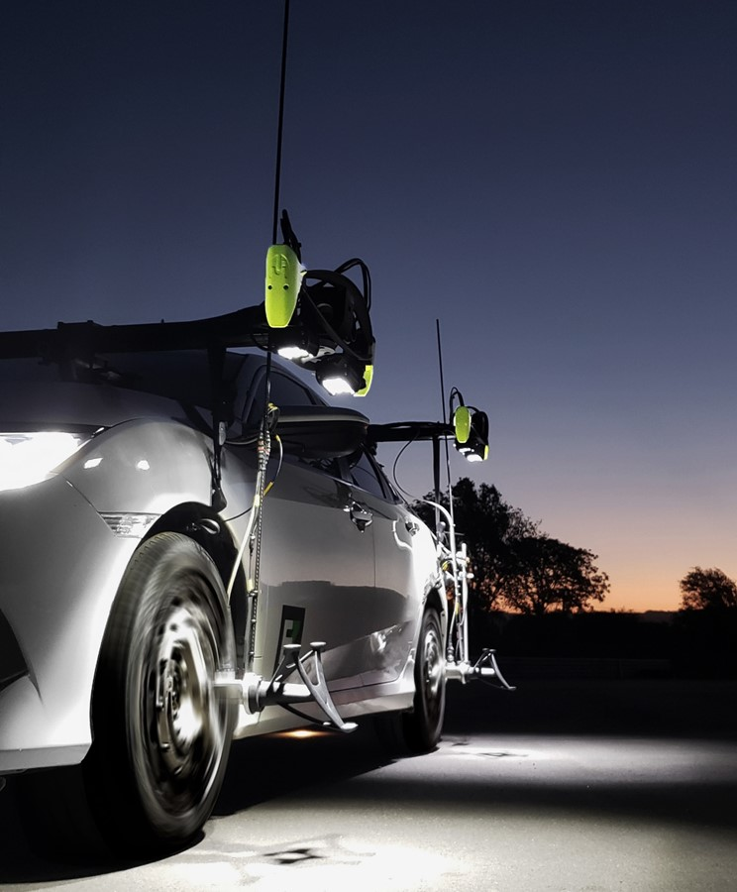
Index
Application
Wheel Packaging
Engine Packaging
SEPA004, Slide 2
© 2023 EZMetrology

Slide 3

1. Application
SEPA004, Slide 3
© 2023 EZMetrology

Slide 4

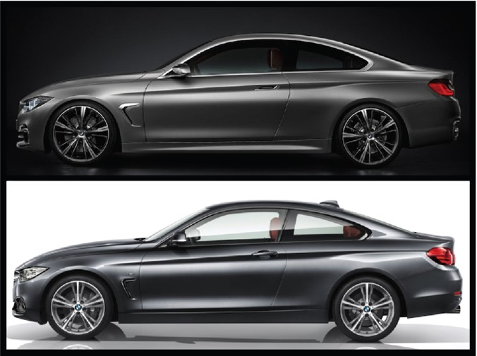
1. PACKAGING
1.1 CLEARANCE
Measuring the Required Clearance
AROUND THE WHEEL…
Make sure the tire does not hit the body while using the least amount of lost space.
AROUND THE ENGINE…
Make sure the engine does not hit any body or other parts
SEPA004, Slide 4
© 2023 EZMetrology

Slide 5
2. Wheel Packaging
SEPA004, Slide 5
© 2023 EZMetrology

Slide 6
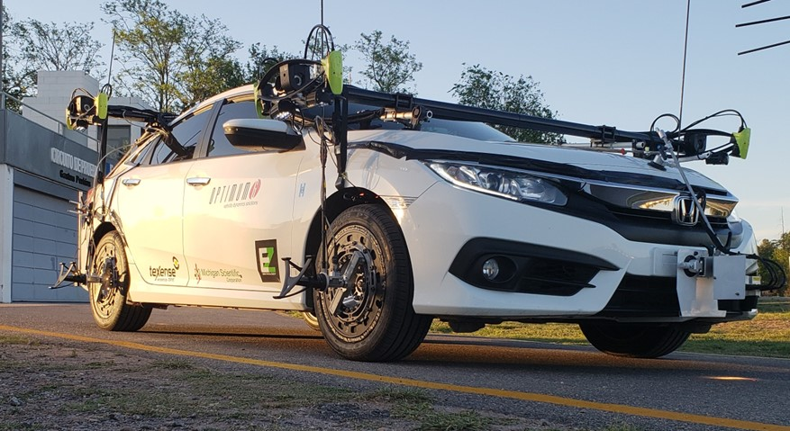
2. WHEEL PACKAGING
2.1 MEASUREMENT SETUP
EZMotion3 Measurement System
Capture the position and angle of the wheel during different driving events.
3D Camera System
Wheel Probe
SEPA004, Slide 6
© 2023 EZMetrology

Slide 7
2. WHEEL PACKAGING
2.2 TYPICAL TEST SCENARIO
Objective
Generate maximum travel upward, inward, forwards and backwards.
Sample Tests:
Driveway, 15°, 30° (Vertical Load, One Corner, Maximum Body Twist)
Pothole (Impact - One wheel)
Speed Bump (Impact - Full axle)
Curb (Slow Load, One Corner)
Forward Steer / Brake (Positive Load in X)
Reverse Steer / Brake (Negative Load in X)
SEPA004, Slide 7
© 2023 EZMetrology

Slide 8
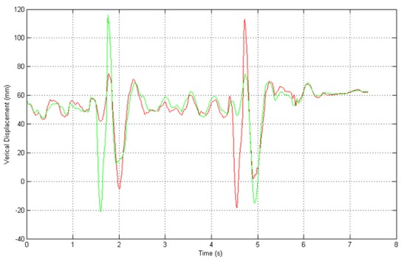
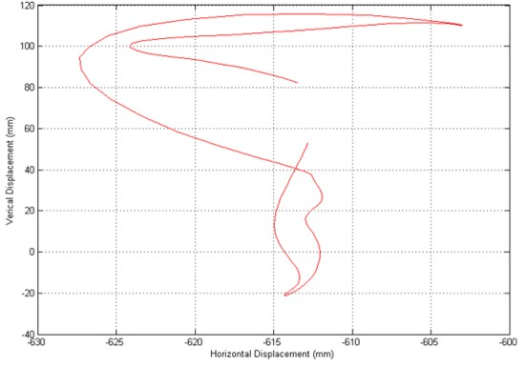
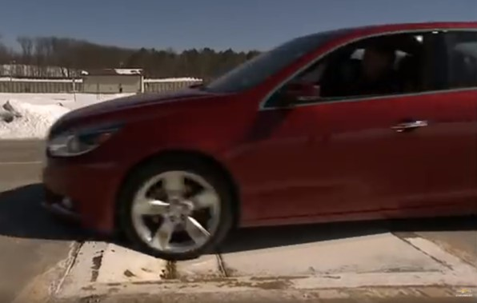
2. WHEEL PACKAGING
2.3 SAMPLE DATA
Wheel
  Position X,Y, and Z
  Orientation, Steer, and Camber
  Each single test describes a motion in time and space.
  `
Vertical Displacement (mm)
Time (s)
Vertical Displacement (mm)
Horizontal Displacement (mm)
SEPA004, Slide 8
© 2023 EZMetrology

Slide 9
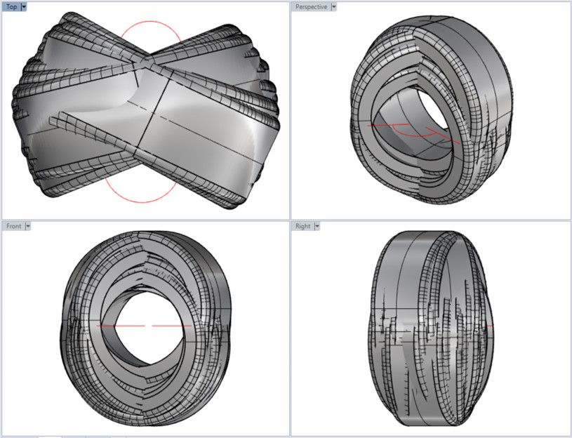
2. WHEEL PACKAGING
2.4 CONCLUSIONS
Combining all trajectories
  A test will generate a specific point where maximum vertical displacement + maximum steer + maximum braking will generate an extreme point.
  Other test will reach a maximum in other locations.
  All wheel positions can be combined in the CAD software to determine in which envelope the tire is moving.
  Design recommendations for body and suspension specifications are established to avoid collisions.
SEPA004, Slide 9
© 2023 EZMetrology

Slide 10
3. Engine Packaging
SEPA004, Slide 10
© 2023 EZMetrology

Slide 11
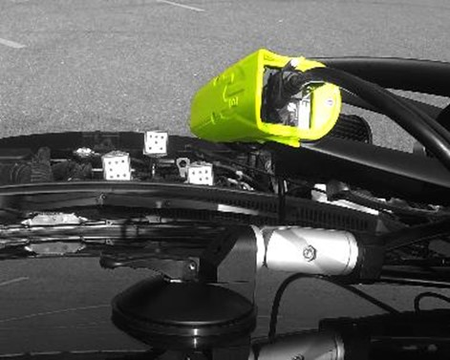
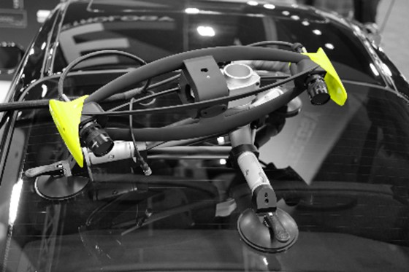
3. ENGINE PACKAGING
3.1 MEASUREMENT SETUP
EZMotion3 Measurement System
Camera Unit is mounted on the windshield pointing towards the engine bay. Lightweight engine targets are mounted on the engine block.
3D Camera System
Engine Probe
SEPA004, Slide 11
© 2023 EZMetrology

Slide 12
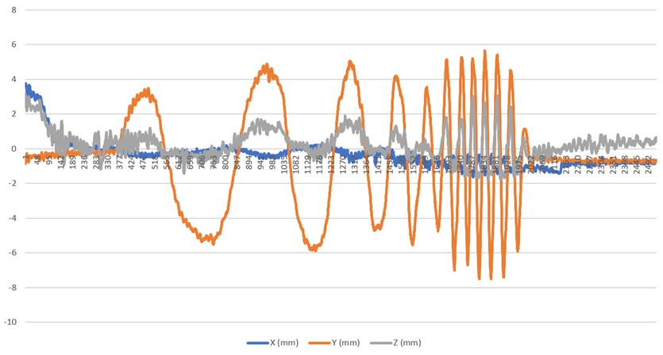
3. ENGINE PACKAGING
3.2 TYPICAL TEST SCENARIO
Purpose:
Generate maximum torque or G forces on the engine.
Sample Tests:
Sweep (Lateral G)
Clutch Release (Maximum Torque)
Speed Bump (Impact Full axle)
Engine Brake (Negative Torque)
Durability Course (Noise)
SEPA004, Slide 12
© 2023 EZMetrology

Slide 13
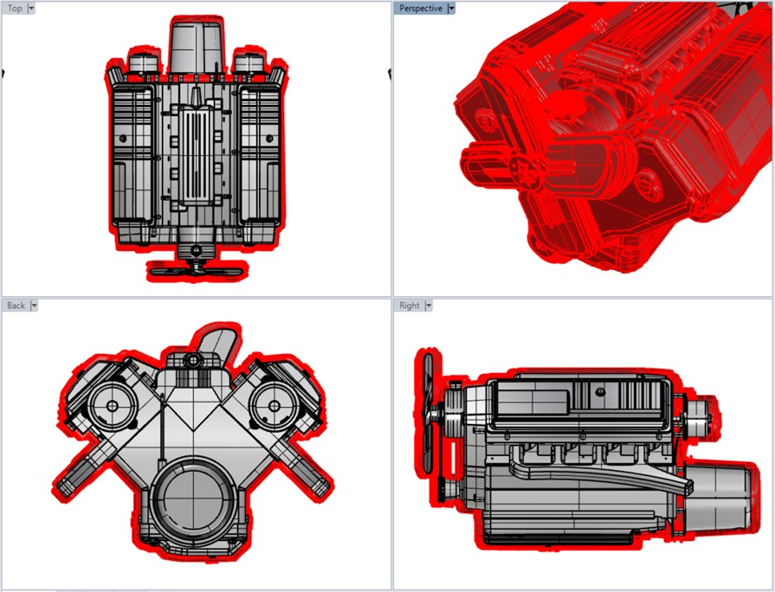
3. ENGINE PACKAGING
3.3 RESULTS AND CONCLUSIONS
  All data combined
  Maximum displacement combined with maximum rotation determines the extreme points.
  Design recommendations for body and engine mount specifications are established to avoid collisions.
  Static Volume
Dynamic Volume
SEPA004, Slide 13
© 2023 EZMetrology

Slide 14
THANK YOU.
info@ezmetrology.com
support@ezmetrology.com
www.ezmetrology.com
portal.ezmetrology.com
academy.ezmetrology.com
SEPA003, Slide 14
© 2023 EZMetrology

