Slide 1
EZMotion
Vehicle Dynamics
Use EZMotion technology to measure vehicle, suspension, and tire dynamics to improve understanding, modeling and handling.
© 2023 EZMetrology

Slide 2
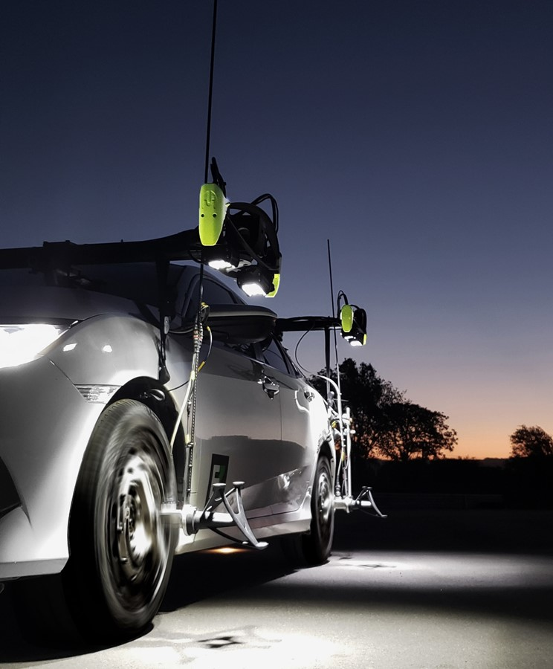
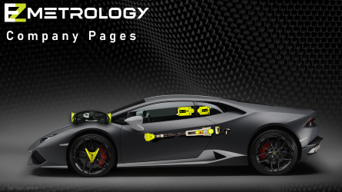

Index
Introduction
EZMotion Technology
Tire Dynamics
Suspension Dynamics
ADAS – Autonomous System
Wheel Clearance
Mobile Tire Scan
SEPA002, Slide 2
© 2023 EZMetrology

Slide 3
1. Introduction
SEPA002, Slide 3
© 2023 EZMetrology

Slide 4
1. Introduction
1.1 EZMotion
EZMotion Technology measures accurate data on axle position and angle during real-life driving events:
3D Position Data: Wheel movement and displacement in X, Y and Z directions
Steer and Camber Angles: Measure geometry changes depending on position or load
This data can be used to:
Optimize Tire Characteristics
Improve Simulation Models (Input or Validate)
Suspension Geometry Study (Kinematics & Compliance)
Develop Drive Files for Test Benches
Suspension Damper/Spring Tuning
SEPA002, Slide 4
© 2023 EZMetrology

Slide 5

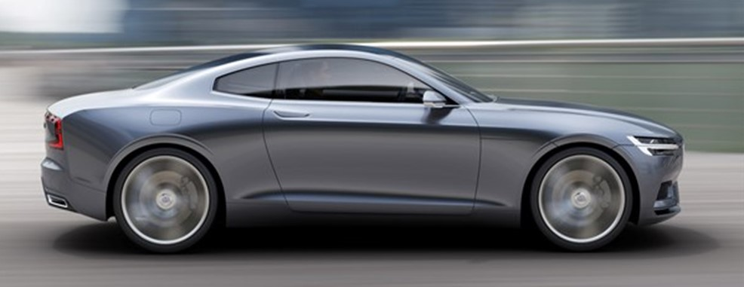
1. Introduction
1.2 Kinematic Chain
Why is wheel position data so important?
It provides the missing link between the body and road to identify and separate suspension and tire effects.
Car Body
Body Position: X,Y,Z,Roll,Pitch,Yaw
Suspension
Kinematics & Compliance
Spindle
Axle Position; X,Y,Z,Steer,Camber,Spin
Tire
Road
Slip Angle, Forces, and Deflections
Reference
SEPA002, Slide 5
© 2023 EZMetrology

Slide 6
1. Introduction
1.3 measurement solutions
Instrumentation example for full handling and performance analysis:
IOManager Suite
Car Body
Body Position: X, Y, Z, Roll, Pitch, and Yaw
Suspension
Kinematics & Compliance
Spindle
Axle Position: X, Y, Z, Steer, Camber, and Spin
Tire
Road
Slip Angle, Forces, and Deflections
Reference
Inertial Units, GPS, Ride Height
EZMotion Technology
Wheel Force Transducer
Slip Angle Sensor
SEPA002, Slide 6
© 2023 EZMetrology

Slide 7
2. EZMotion Technology
SEPA002, Slide 7
© 2023 EZMetrology

Slide 8
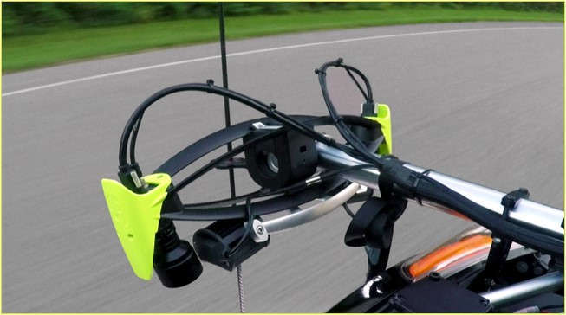
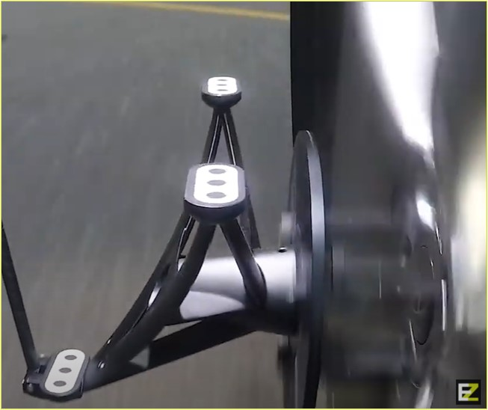
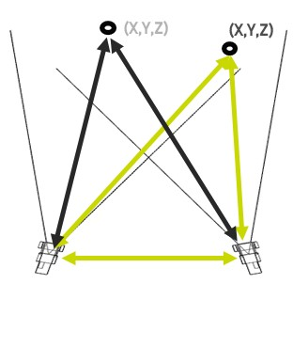
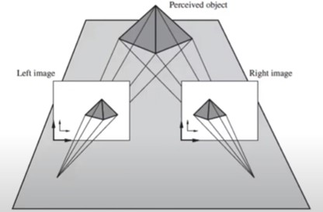
2. EZMotion Technology
2.1 Stereo Vision
Dual High-Speed Digital Cameras
EZMotion is composed of 2 high-speed, high-resolution cameras that track passive optical targets in the measurement volume. Proven stereo vision will provide superior accuracy.
The camera unit is firmly mounted to the body.
The composite wheel probe with passive targets is placed on the rim.
SEPA002, Slide 8
© 2023 EZMetrology

Slide 9
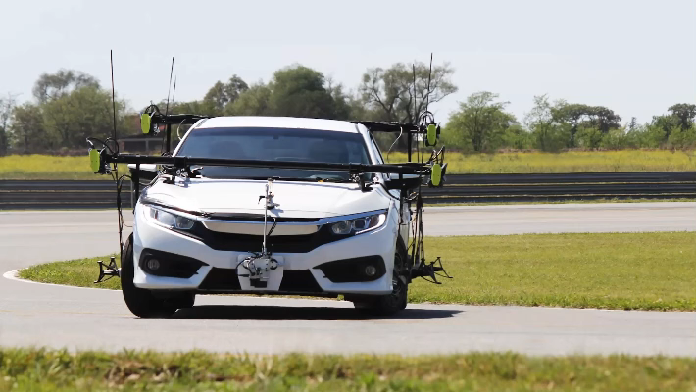
2. EZMotion Technology
2.2 Wheel Measurement
Video demonstrating EZMotion installation and vehicle monitoring.
SEPA002, Slide 9
© 2023 EZMetrology

Slide 10
2. EZMotion Technology
2.3 Technology advantages
EZMotion is designed to meet all of the requirements imposed by the operating conditions:
Solid State – No Moving Parts
    No mechanical or electrical connections to the wheel center
    No moving parts in the camara to increase shock resistance
Lightweight
    Almost no additional unsuspended mass
    Only a small lightweight composite probe holds the passive optical trackers to the spindle
High Speed
    Record 6D positions at up to 500Hz to capture sudden and transient dynamic events
Real-Time Processing
    Real-time processing for unlimited recording time and speed
Closed Loop for Steering Robot
    Real-time output can generate an input for a steering robot to achieve the target values of angles or displacements
SEPA002, Slide 10
© 2023 EZMetrology

Slide 11
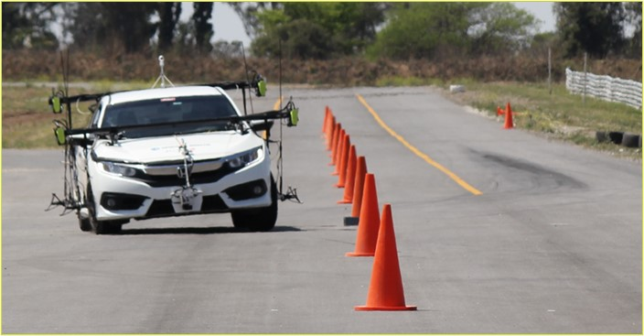
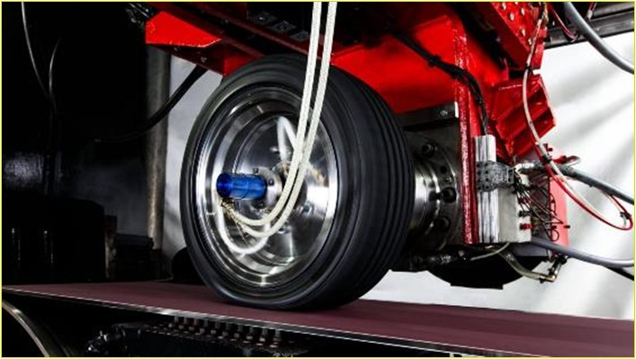
2. EZMotion Technology
2.4 InDOOR and Outdoor
EZMotion’s unique capability to collect both outdoor data on the track and reproduce the same recording indoors guarantees the best correlation.
Performant Optics
    Optimal lens and filters will enable the best image quality throughout the testing and ensure best accuracy.
Advanced Tracking
    The real-time image processing follows the movement of the wheel in real time and is able to feed the output back to a steering robot, if required.
Integrated Lighting
    Daylight will often be sufficient for outdoor measurements. Inside a building, the integrated light will enable the same test conditions to be accurately measured.
SEPA002, Slide 11
© 2023 EZMetrology

Slide 12
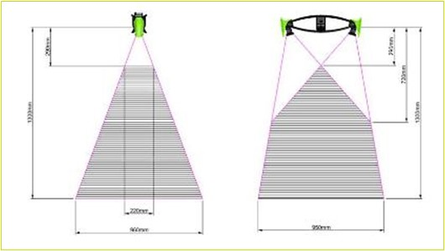
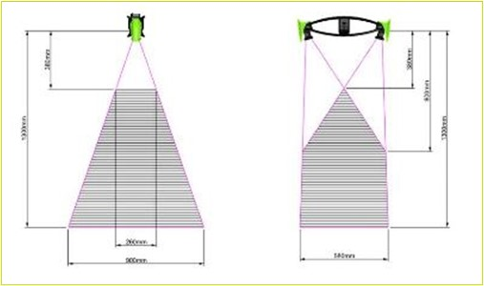
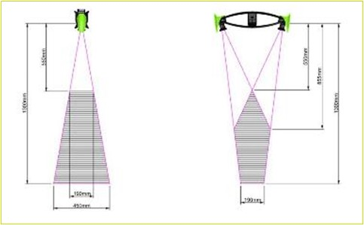
2. EZMotion Technology
2.5 Adaptability
EZMotion is designed to be practical and adapts to any vehicle for on track measurements:
Mechanical Modularity
    EZMotion’s modular mechanical mount can be adapted to any type of vehicle: SUV, truck, sedan, race car, or van.
Optical Tuning
    The high-speed cameras can be fitted with different lens sizes to accommodate varying measurement volumes for covering larger travel or steer angles if required.
SEPA002, Slide 12
© 2023 EZMetrology

Slide 13
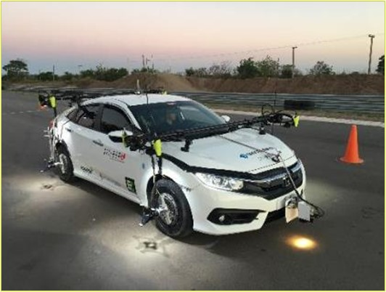
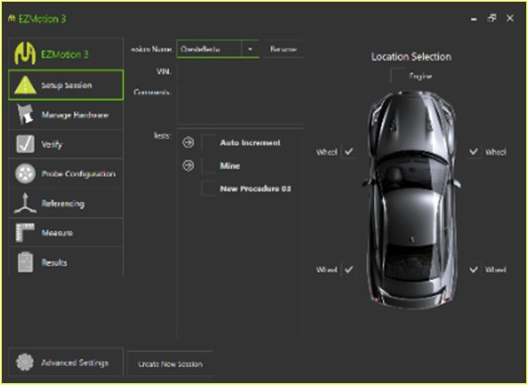
2. EZMotion Technology
2.6 vehicle oriented
EZMotion is designed to be practical and adapts to any vehicle for on track measurements:
Minimal Protrusion
    EZMotion has minimal equipment outside the body (~300mm) to facilitate the driving and execution of the manoeuvres.
Step-By-Step Installation
    Guided installation and configuration for fast, error- free setup.
Template Recording
    EZMotion data management via templates and scripted processing.
Software Designed for the Driver
    A graphical interface and touchscreen operation with real-time feedback to minimize distractions for the driver.
SEPA002, Slide 13
© 2023 EZMetrology

Slide 14
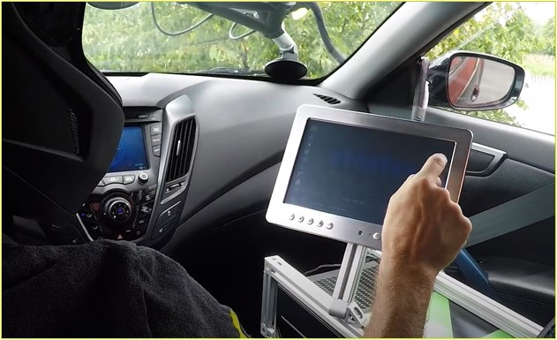
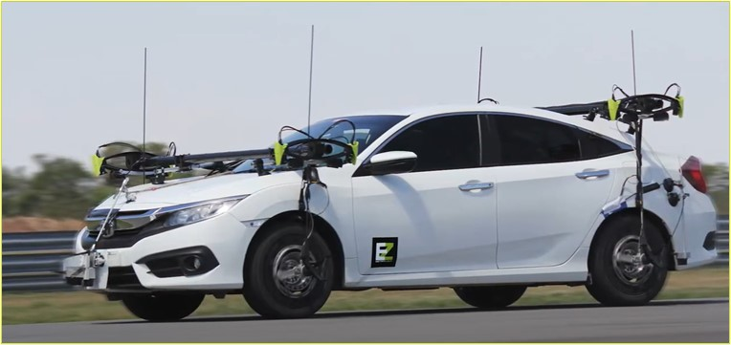
2. EZMotion Technology
2.7 Full Vehicle setup
EZMotion is modular and can be used for a single wheel or multiple axes:
Any Number of Wheels (4, 6, 8, or More)
    Track all wheels simultaneously to establish toe angles and relative positions of the full drivetrain.
Alignment Procedures
    The integrated alignment procedures sets a common reference system for all wheels. The relative position can now be reported. Different methods are available and can use, for example, initial camber and steer angles from a static alignment procedure.
SEPA002, Slide 14
© 2023 EZMetrology

Slide 15
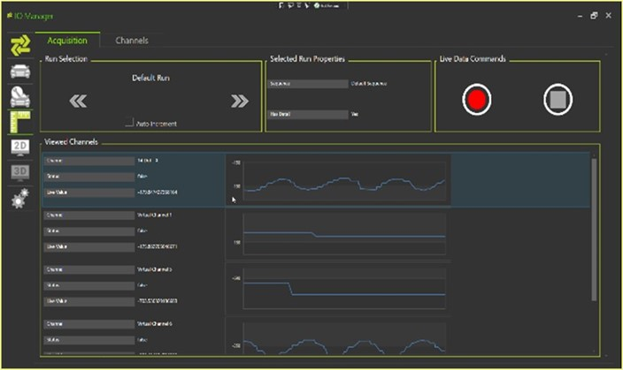
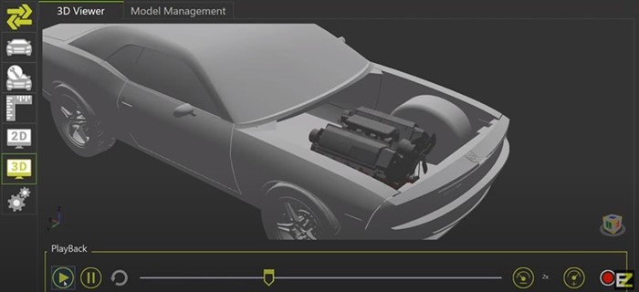
2. EZMotion technology
2.8 Iomanager Suite
IOManager can extend the capability of EZMotion by integrating other sensor technology and merging all recordings into a single environment.
Sensor Integration
    Integrating data streams from other sensors or systems, load cells, pressure gauges, accelerometers, GPS, CAN, and tire temperature
    Sensor Synchronization
    Processing
    Data Management
        Sessions, Multi-test, Multi-channel
    Real-time Processing
        Real-time calculations (toe, speed, acceleration), low-pass/high-pass filters
    Output
    TCPIP Stream, File, Analog, and 3D Animation
SEPA002, Slide 15
© 2023 EZMetrology

Slide 16
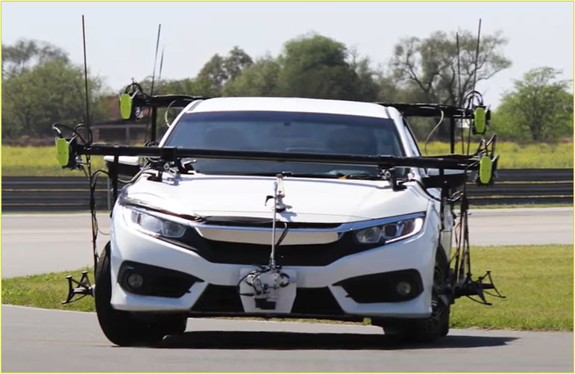
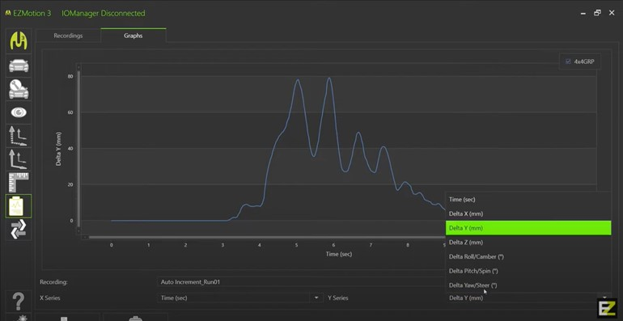
2. EZMotion technology
2.9 Track ready
Many different maneuvers can be run with EZMotion based on the objectives of the testing:
    Skid Pad
    Step Steer with or without Driving Robot
    Progressive Steering
    Belgian Blocks
    Emergency Braking
    Driveway 15 deg, 30 deg (Vertical Load, One Corner, Maximum Body Twist)
    Pothole (Impact One Wheel)
    Speed Bump (Impact Full Axle)
    Curb (Slow Load, One Corner)
    Forward Full Steer and Brake (Positive Load in X)
    Reverse Full Steer and Brake (Negative Load in X)
SEPA002, Slide 16
© 2023 EZMetrology

Slide 17
3. Tire Dynamics
SEPA002, Slide 17
© 2023 EZMetrology

Slide 18
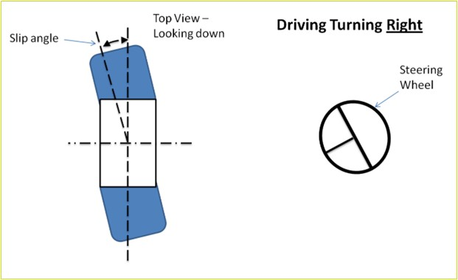
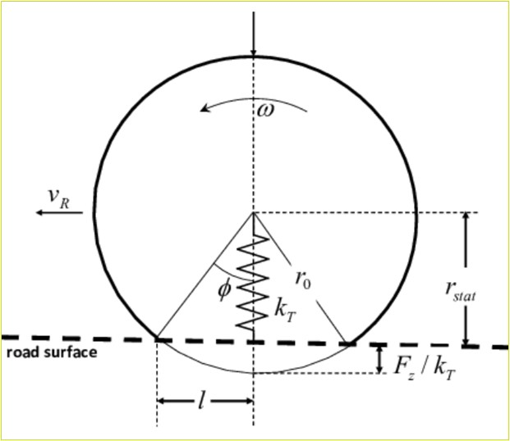
3. Tire dynamics
3.1 Spindle position
When the spindle position and orientation are recorded, the slip angle can be established with high fidelity.
Steer Angle Per Wheel
    For any given steer input, the actual individual steer angle is measured per wheel.
Camber Angle
    Camber angle is captured and monitored as a function of vertical displacement (Z) or lateral load.
Tire Compression
    When the spindle position is captured, the exact distance and tire compression can be derived..
Drive Train Geometry
    Get the full drivetrain, wheel, and tire geometry and correlate the results to the lateral acceleration (G).
Mathematical models can be refined based on the actual data as input or control points.
SEPA002, Slide 18
© 2023 EZMetrology

Slide 19
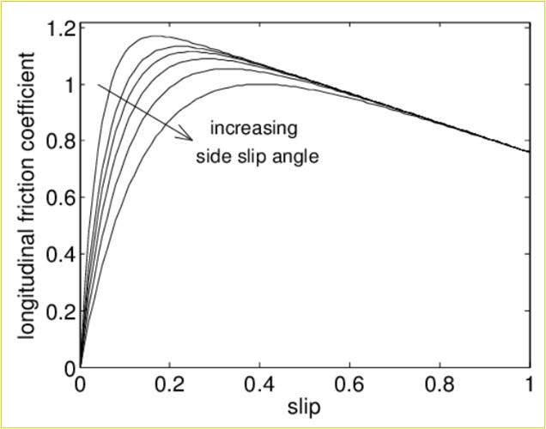
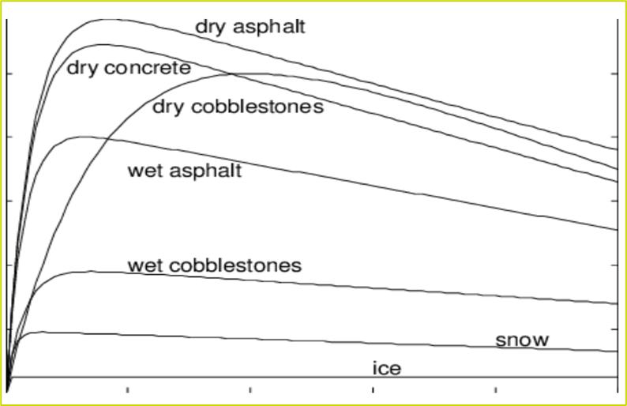
3. Tire dynamics
3.2 Lateral Force Curve
Simulation and Modelling: Example
Accurate data will directly improve the tire design process and parameters.
The accurate slip angle will improve the detail of the curve.
The answers will enable the engineers to select the optimal configuration to meet all specifications.
SEPA002, Slide 19
© 2023 EZMetrology

Slide 20
4. Suspension Dynamics
SEPA002, Slide 20
© 2023 EZMetrology

Slide 21
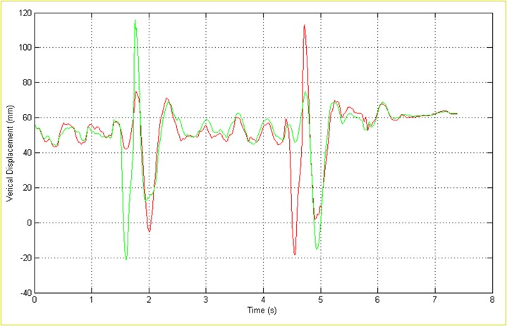
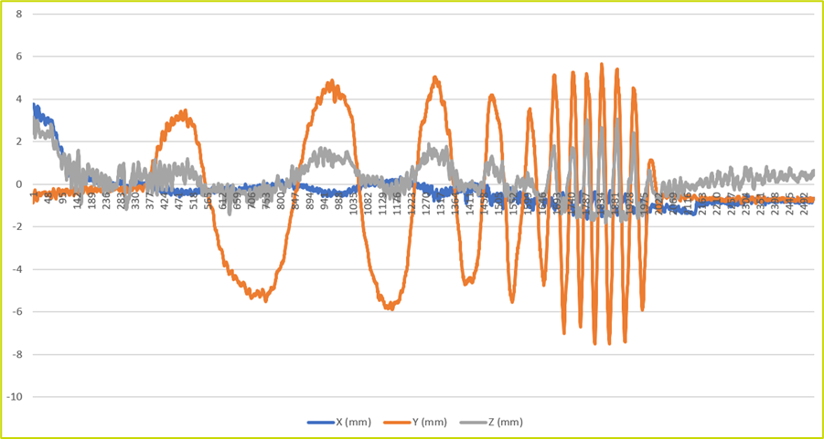
4. Suspension dynamics
4.1 Kinematics & Compliance on track
On Track
Accurate spindle position data can be collected for driving events on the track. Depending on the scope of the research different characteristics can be extracted:
Maximum – Minimum Vertical or Horizontal Travel (kinematics)
Camber as a Function of Z Position (kinematics)
Maximum Vertical Travel Speed (damper)
Deflection Under Brake (compliance)
Combined with a wheel force transducer, the system can provide load vs. displacement curves establishing the kinematics and compliance of the suspension assembly.
SEPA002, Slide 21
© 2023 EZMetrology

Slide 22
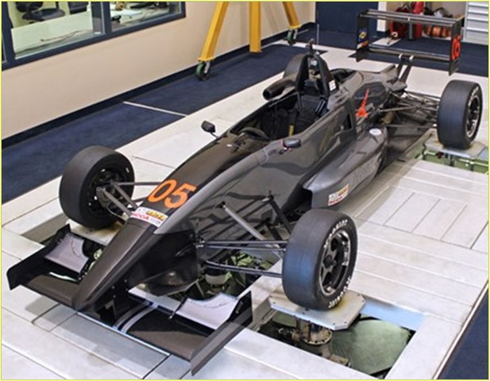
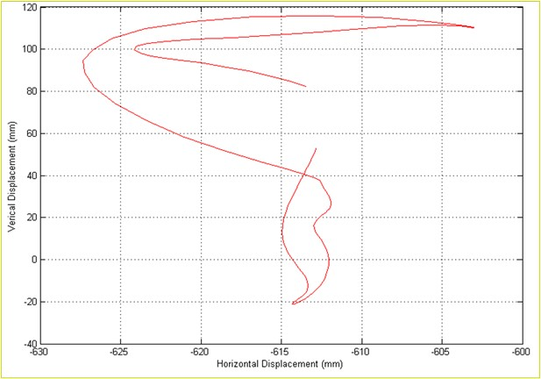
4. Suspension dynamics
4.2 Data Applications
Drive File Development
The recorded data from the track can be used for drive file generation on a test rig to simulate, study, and improve a suspension layout.
The data will ensure that the simulation is as representative as possible of the real-world case.
Aging of Suspension Characteristics
Observe how the initial suspension kinematics and compliance evolve over the lifecycle of a vehicle and how this will influence handling and safety.
SEPA002, Slide 22
© 2023 EZMetrology

Slide 23

5. ADAS – Autonomous Systems
SEPA002, Slide 23
© 2023 EZMetrology

Slide 24
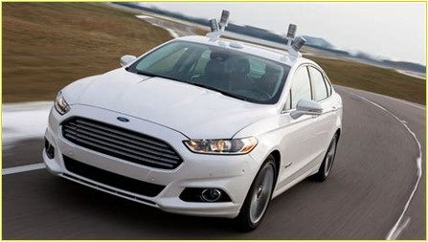
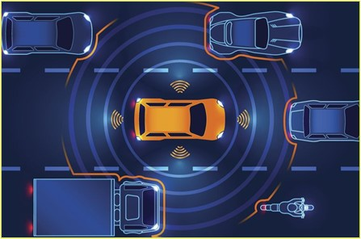
5. Autonomous systems
5.1 Response time
Cut-In Cut-Out Test / Emergency Brake / Avoidance
Decisions are made for each specific situation. Control systems are at the base but only a part of the chain. For optimal performance, the responding mechanical systems need to be equally capable.
Radar systems will, for example, detect obstacles or situations and make associated reactions to correct the trajectory.
System Response Time
To measure the overall system performance of these systems and compare to others, the often slower mechanical action should be included in the evaluation.
EZMotion establishes the intermediate mechanical response to identify the potential latency in the mechanical systems with the opportunity to improve the outcome.
Sensor
Latency
Bus System
Processing
Real-Time Latency
Algorithm
Response
Steer/Brake
Vehicle Trajectory
Multi-Sensor
Action Output
Mechanical System
Grip
Inertia
Bus system
Communication
Exposure
EVENT
CORRECTION
Electronics
Processing
Processing
Processing
Processing
Mechanics
Mechanics
Data
Synchronization
EZMotion
SEPA002, Slide 24
© 2023 EZMetrology

Slide 25
6. Wheel Clearance
SEPA002, Slide 25
© 2023 EZMetrology

Slide 26
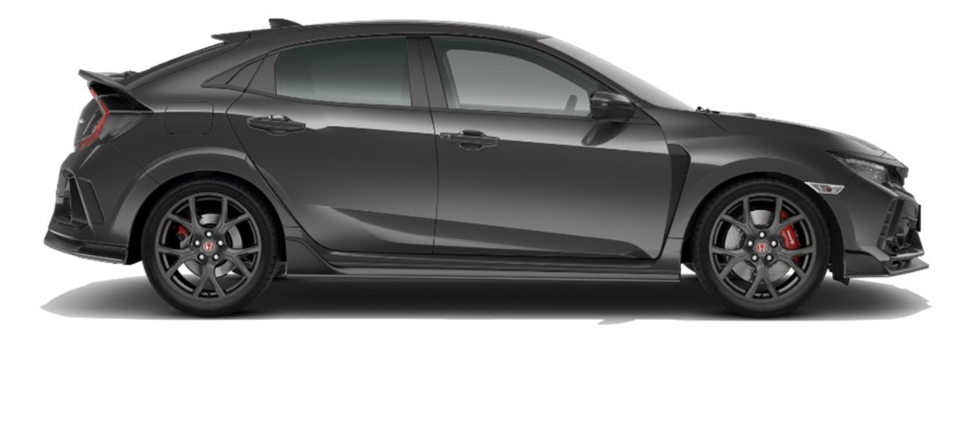
6. Wheel Clearance
6.1 Measuring the required Clearance
Around the Wheel
Ensure that the tire does not hit the body while minimizing the amount of lost space
SEPA002, Slide 26
© 2023 EZMetrology

Slide 27
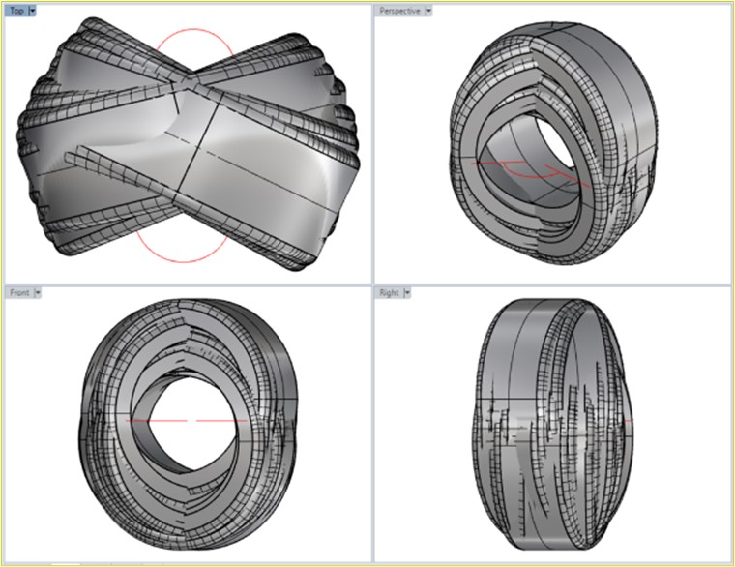
6. Wheel Clearance
6.2 VERIFY INTERFERENCE
Combining all Trajectories
A test will generate a specific point where maximum vertical displacement combined with maximum steering and maximum braking will generate an extreme point.
Other test will reach a maximum in other locations.
After all wheel positions have been combined, the CAD software will determine in which envelope the tire is moving.
Design recommendations to body and suspension specifications can be adjusted to avoid interference between tires and sheet metal.
SEPA002, Slide 27
© 2023 EZMetrology

Slide 28
7. Mobile Tire Scan
EZMetrology Solutions for Tire Wear
SEPA002, Slide 28
© 2023 EZMetrology

Slide 29
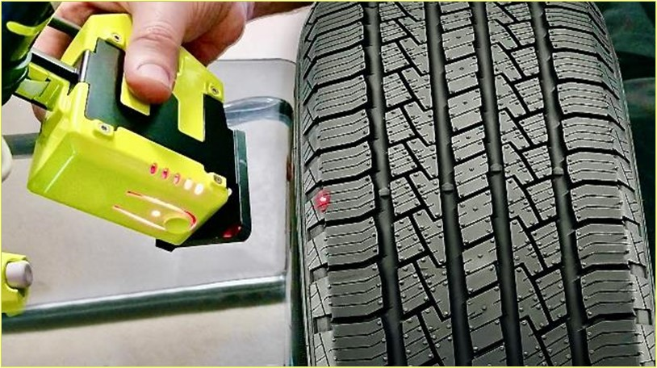
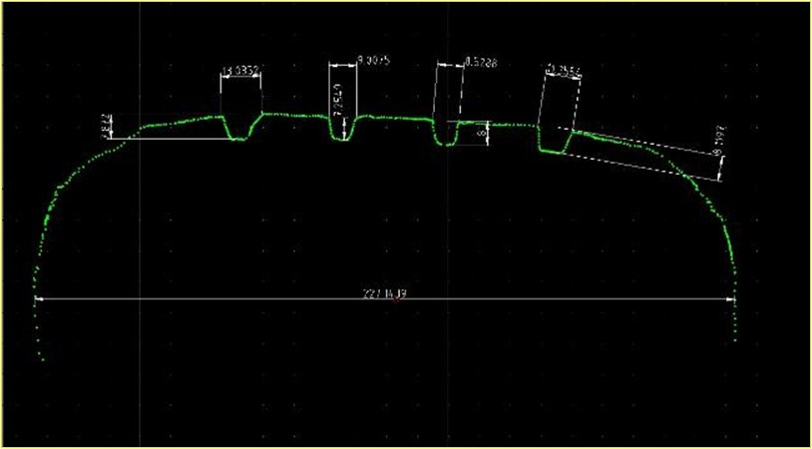
7. Tire Section
7.1 Tire profile
  SealScan is a mobile 2D laser scanner that rapidly captures a cross section of a tire all the way from the inside rim to the outside rim.
Cross Section
  Gather raw data of a tire section scan by using SealScan. The 2D scan will cover the rim (as a reference), the sidewall, and the thread surface.
Standard Report
  An autogenerated report contains all tables and graphs gathered from the scan to be used for a comprehensive understanding.
  Tire inspection:
  Tire deformation under pressure
  Wear pattern
SEPA002, Slide 29
© 2023 EZMetrology

Slide 30
THANK YOU.
info@ezmetrology.com
support@ezmetrology.com
www.ezmetrology.com
portal.ezmetrology.com
academy.ezmetrology.com
SEPA002, Slide 30
© 2023 EZMetrology

Slide 31
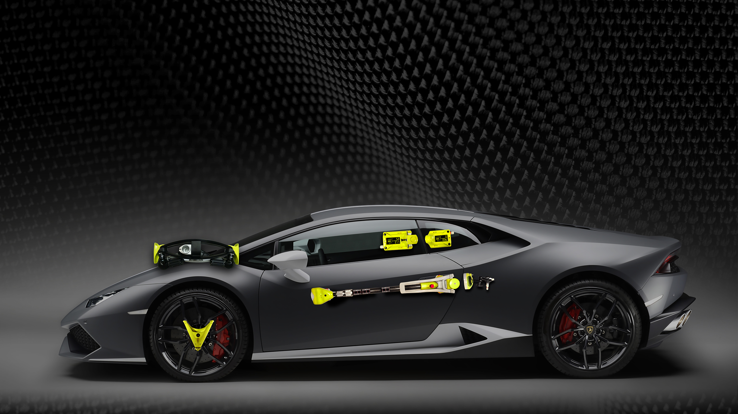

Company Pages
SEPA002, Slide 31

Slide 32
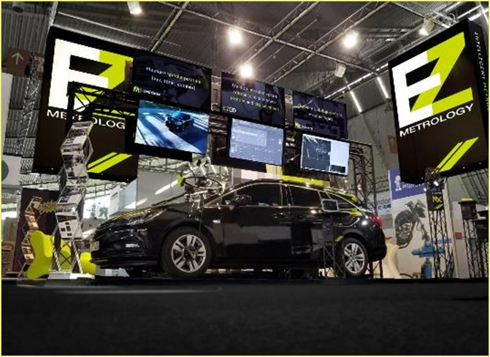
COMPANY OVERVIEW
Founded in 2006 by Carine Woldanski and Tom Van Esch.
Global Operations:
  Europe Headquarters in Europe
  USA Headquarters in Michigan
  Asia Partnerships
EZMetrology:
  70% Development and Engineering
    Fast product development and interactive evolutions
  20% Support and Training
    Ensuring a transfer of knowledge to our customers
  10% Administration and Sales
    Manage customs and sales procedures
Consistent annual growth of 50% over the past years.
Developing innovative, creative and practical products.
SEPA002, Slide 32
© 2023 EZMetrology

Slide 33

SHARING OUR PASSION WORLDWIDE WITH CUSTOMERS AT
ALPINE
ARRIVAL
AUDI
BMW
BROSE
CANOO
CATERPILLAR
CHRYSLER
DACIA
DAIHATSU
DAIMLER
DENSO
FAW
FAURECIA
FERRARI
FIAT
FORD
GAC
GENERAL MOTORS
GG MOTORS
HUMANETICS
HONDA
HYUNDAI
INFINITI
JAGUAR
JEEP
KASEIKOGYO
KIA
KIEKERT
LADA
MACK
MAHINDRA
MARUTI
MASERATI
MAZDA
MITSUBISHI
MULTIMATIC
NISSAN
NITTO DENKON
POLARIS
PORSCHE
PROTON
PSA
QOROS
RENAULT
RIVIAN
SAIC MOTOR
SEAT
SIEMENS
STELLANTIS
SUBARU
SUZUKI
TATA MOTORS
TESLA
TOGG
TOYODA GOSEI
TOYOTA
VOLKSWAGEN
VOLVO
VOLVO TRUCKS
SEPA002, Slide 33
- EZM HEADQUARTERS
- EZM PARTNERS
- EZM CUSTOMERS
© 2023 EZMetrology

Slide 34


