Slide 1
EZMotion
Towing Tank Application
Towing tank application and measurement of naval structures using EZMotion.
Confidential
© 2024 EZMetrology

Slide 2
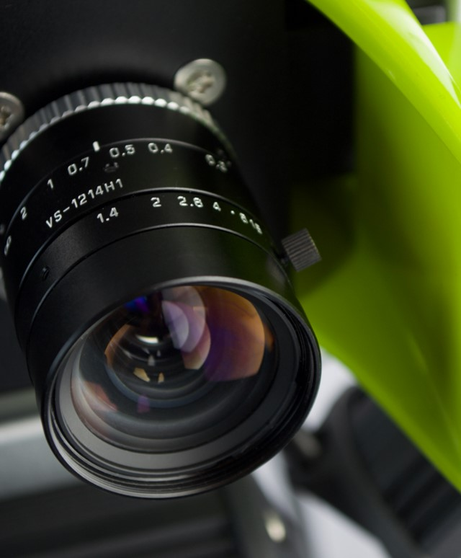


Index
Technology Platform
Tank Layouts
Offshore Layouts
Submersible
CTrack Interface
Confidential
© 2023 EZMetrology

Slide 3

1. Technology Platform
Confidential
© 2024 EZMetrology

Slide 4
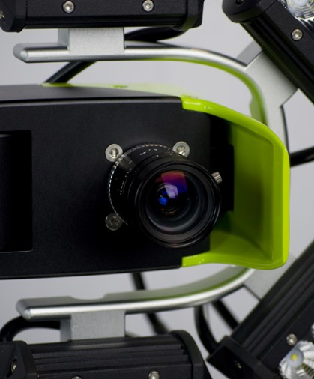
1. Technology platform
1.1 Camera Technology
Different aspects come into consideration when configuring EZMotion:
Accuracy / Resolution
    Requirements for Position Accuracy
    Requirements for Angular Accuracy
These can largely be controlled by camera geometry and target definition.
Acquisition Speed
    Frequencies are available from 1 Hz to 1 kHz.
Measurement Volume
    See chapter on different configurations.
Environment
    Standard system is splash proof.
    Underwater version release is expected end of 2024.
Confidential
© 2024 EZMetrology

Slide 5
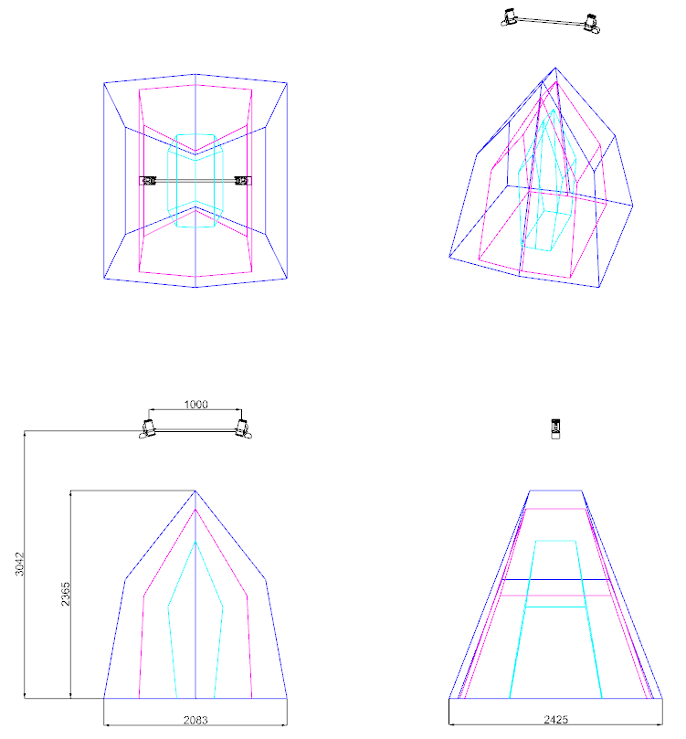
1. Technology platform
1.1.1 LENS Selection - Example
The camera size is defined by the distance between the two camera units, and for this example it is taken to be constant.
Geometry
    Example build with a width of 1 m.
    Available range goes from 0.5 m up to 2m.
    Ratio between width and standoff, ideally, 3 to 5.
    In the example, the reasonable distance between camera and object is about 3 to 5m.
Resolution
    The camera sensor has a resolution of 2600 x 2050 px.
    A 1/100 Pixel Interpolation is achievable with correct tracker size designed to be about 10 px.
Lens | Diagonal @ 3 m | Resolution
8 mm | 3000 mm | 0.011 mm
12 mm | 2500 mm | 0.009 mm
24 mm | 1100 mm | 0.004 mm
Confidential
© 2024 EZMetrology

Slide 6
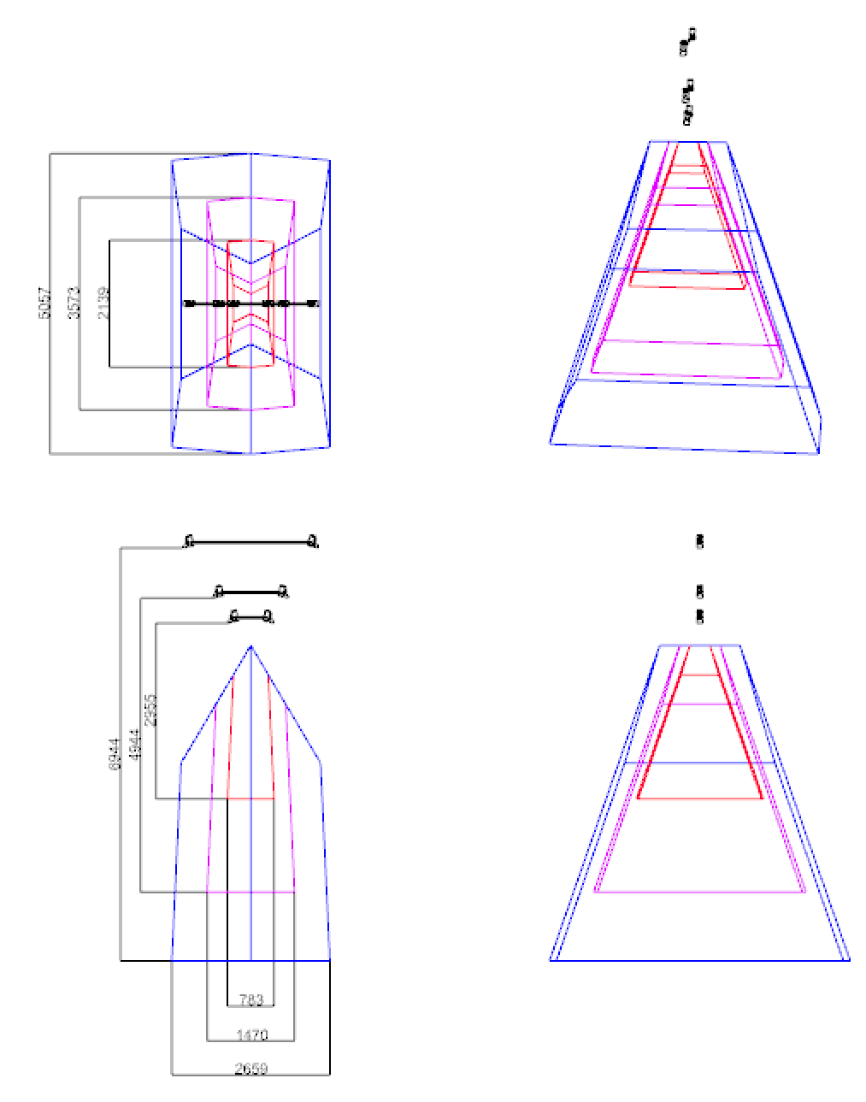
1. Technology platform
1.1.2 GEOMETRY - Example
The geometry can have an impact on performance. Any size can be selected.
Practical dimension range anywhere from 0.5 to 2 m. The ratio for width of camera to depth is ideally 3 to 5.
Lens
    Example set for standard 12 mm lens.
    Ratio for width of camera to depth is ideally 3 or 4.
Resolution
    Sensor 2600 x 2050 px
    1/100 Interpolation : Tracker size designed to be 10 px.
Width | Diagonal | Standoff | Resolution
0.5 m | 2200 mm | 3000 mm | 0.008 mm
1.0 m | 3700 mm | 5000 mm | 0.014 mm
2.0 m | 5500 mm | 7000 mm | 0.021 mm
Confidential
© 2024 EZMetrology

Slide 7
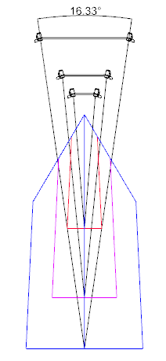
1. Technology platform
1.1.3 RESOLUTION - ACCURACY
While many parameters impact the conversion from resolution to accuracy, the following guidelines should be observed.
Systems Design
Ratio Width – Standoff: 3 to 5
Targets: 10 px
Accuracy is defined by the capability to measure approximately a 1000 mm length.
Frontal: X - Y
    Accuracy(X) = Accuracy(Y) = 4 x Resolution
Depth Perception: Z
    Accuracy = 4 x Accuracy(X) = 8 x Resolution
Width | Lens | Standoff | Resolution | Frontal Accuracy | Depth Accuracy
1000 mm | 12 mm | 3000 mm | 0.009 mm | 0.036 mm | 0.144 mm
2000 m | 12 mm | 4700 mm | 0.018 mm | 0.072 mm | 0.288 mm
Confidential
© 2024 EZMetrology

Slide 8
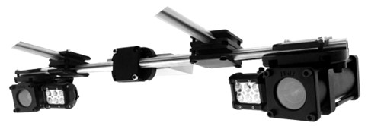
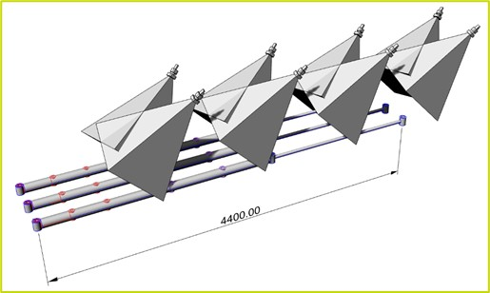
1. Technology platform
1.2 Triangulation – Camera Network
EZMotion systems can be used individually or as network for different objectives:
Single Pair
    EZMotion is composed of 2 cameras to calculate and track one or more object(s) in the measurement volume.
Camera Network : Line of Sight Requirements
    Optical tracking systems need line of sight between the camera and object. Multiple cameras can cover or track an object from different angles, allowing full rotations and the ability to see opposing faces.
Camera Network : Accuracy Improvements
  Multiple pairs will improve the ratio between volume and accuracy. A network of multiple cameras will result in high resolution in a large volume and, therefore, high performance.
Confidential
© 2024 EZMetrology

Slide 9
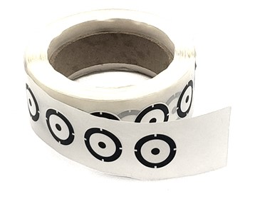
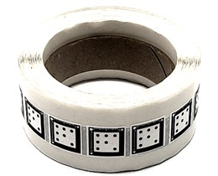
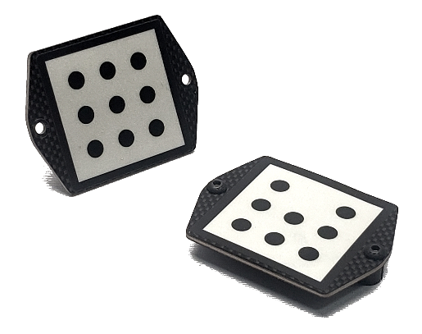
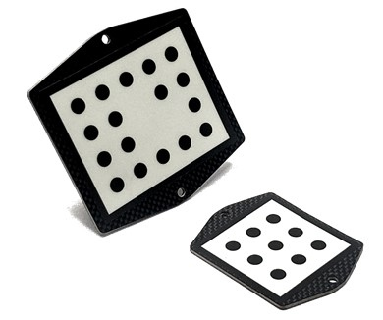
1. Technology platform
1.3 Optical Trackers
High-contrast optical trackers can be used to track objects on different levels.
Size and shape will be driven by the measurement volume, specified position accuracy, and specified angular accuracy (6D trackers).
Single Dot Tracker (3D)
    Track the XYZ Position of a point in space.
Tracker (6D)
    Track the XYZIJK position and orientation of a part in space.
Tracker Group (6D)
    Combine multiple trackers to establish a new 6D object.
    Track multiple objects and determine relative movements.
Confidential
© 2024 EZMetrology

Slide 10
2. Tank Layouts
Confidential
© 2024 EZMetrology

Slide 11
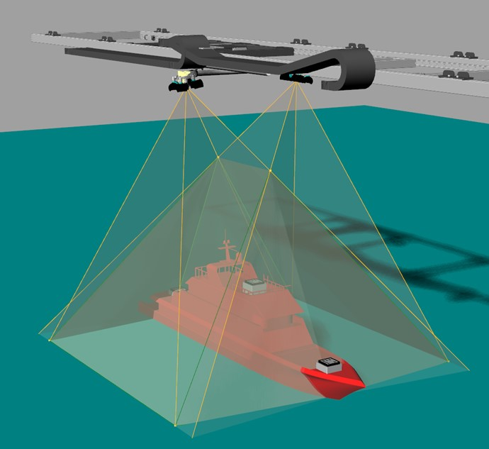
2. Tank LayoutS
2.1 overhead: overview
Confidential
© 2024 EZMetrology

Slide 12
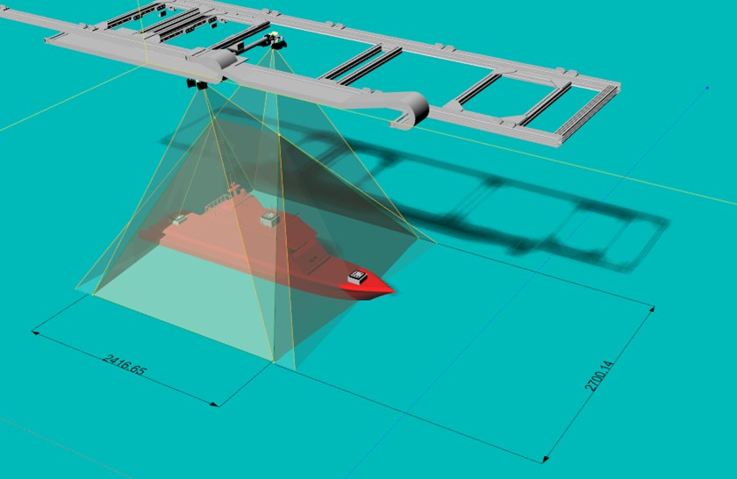
2. Tank LayoutS
2.2 overhead: Standard volume
Confidential
© 2024 EZMetrology

Slide 13
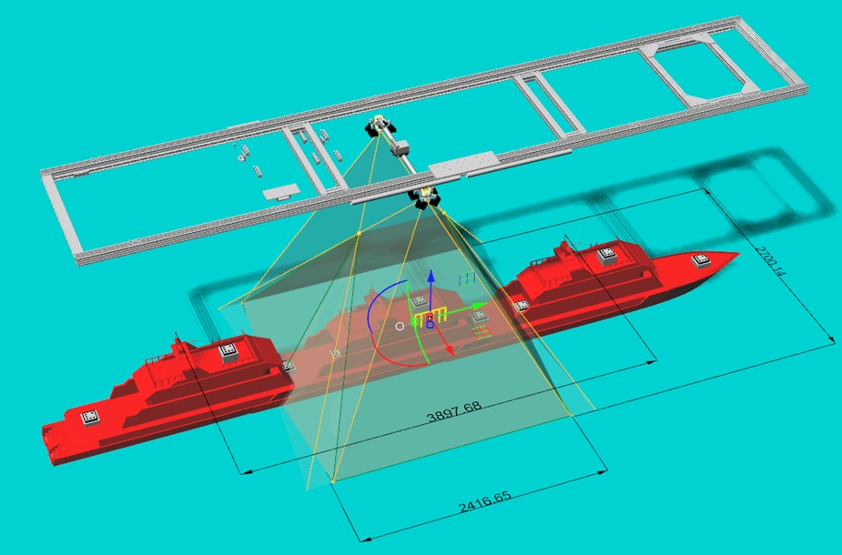
2. Tank LayoutS
2.3 overhead: Motion Range
Confidential
© 2024 EZMetrology

Slide 14
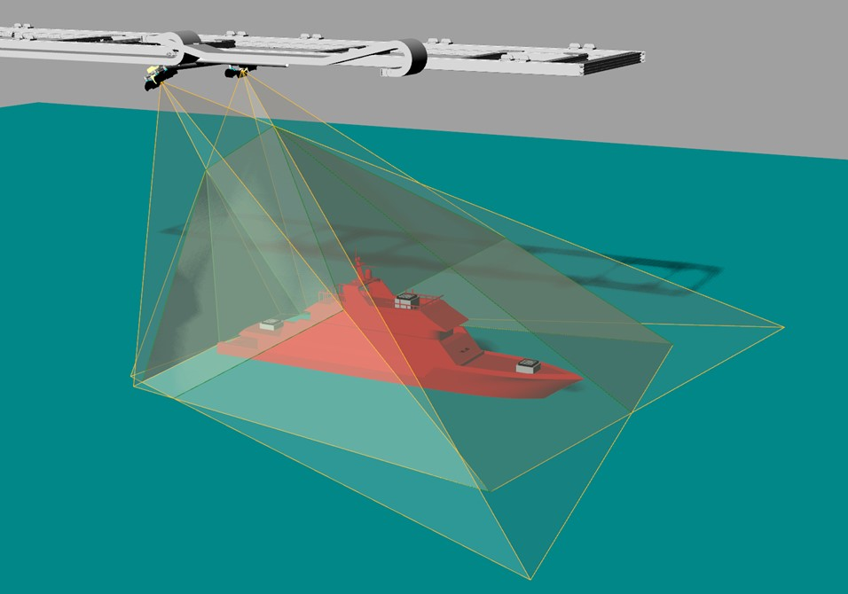
2. Tank LayoutS
2.4 Angled: Overview
Confidential
© 2024 EZMetrology

Slide 15
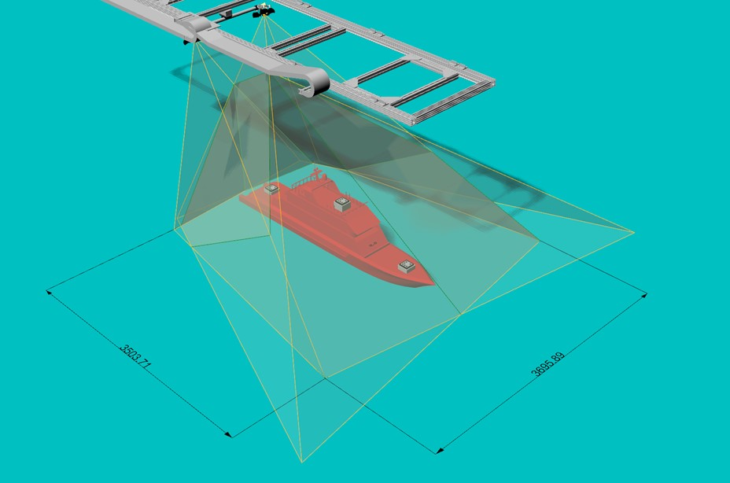
2. Tank LayoutS
2.5 Angled: Standard Volume
Confidential
© 2024 EZMetrology

Slide 16
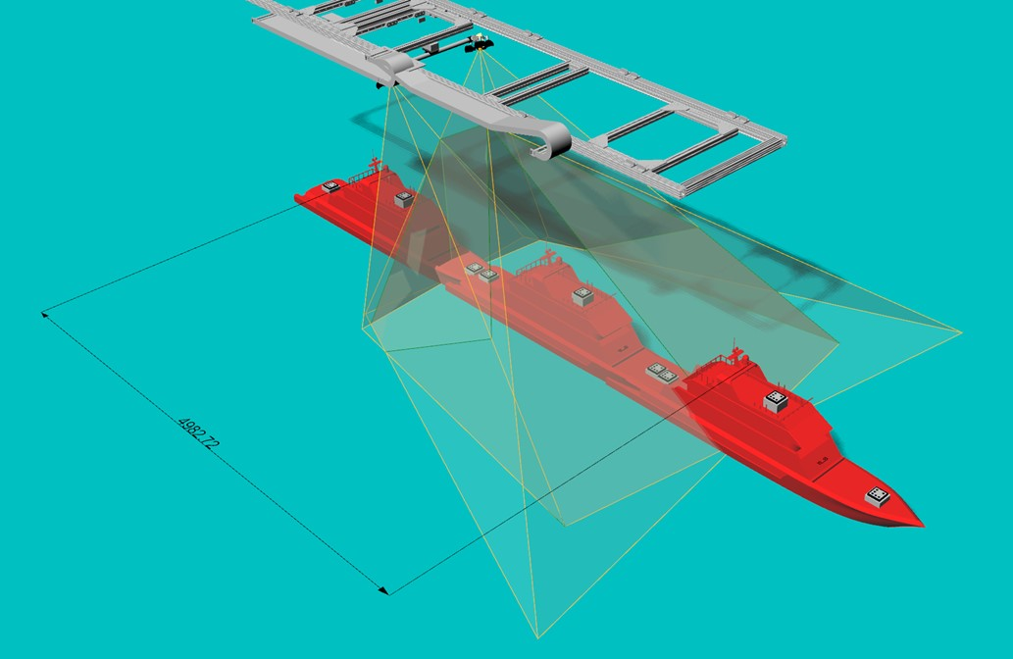
2. Tank LayoutS
2.6 Angled: Motion Range
Confidential
© 2024 EZMetrology

Slide 17
3. Offshore Layouts
Confidential
© 2024 EZMetrology

Slide 18
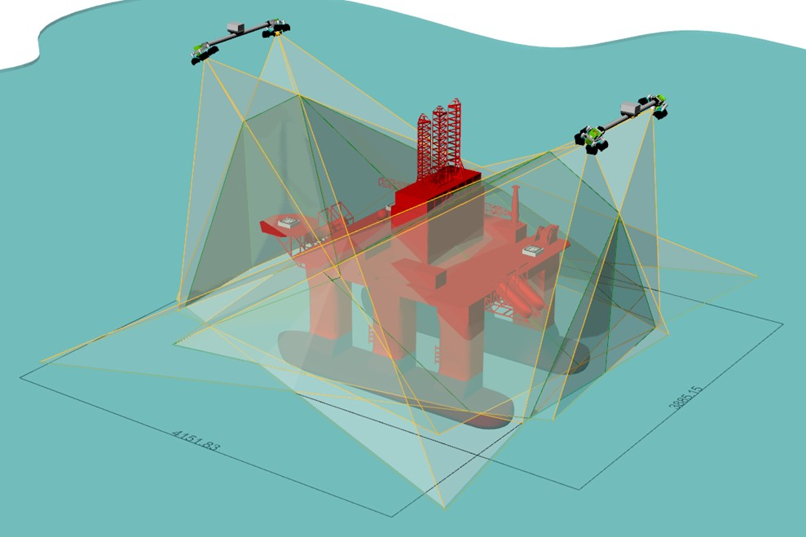
3. Offshore Layouts
3.1 Multi-Camera Setup
Confidential
© 2024 EZMetrology

Slide 19
4. Submersible
Confidential
© 2024 EZMetrology

Slide 20
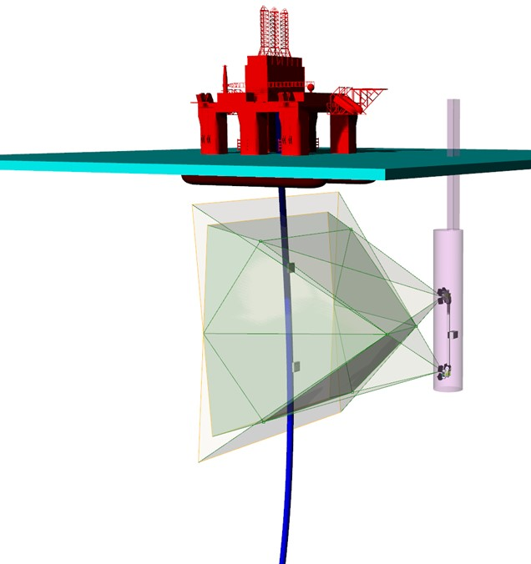
4. submersible
4.1 Submersible Concept
Confidential
© 2024 EZMetrology

Slide 21
5. CTrack Interface
Confidential
© 2024 EZMetrology

Slide 22
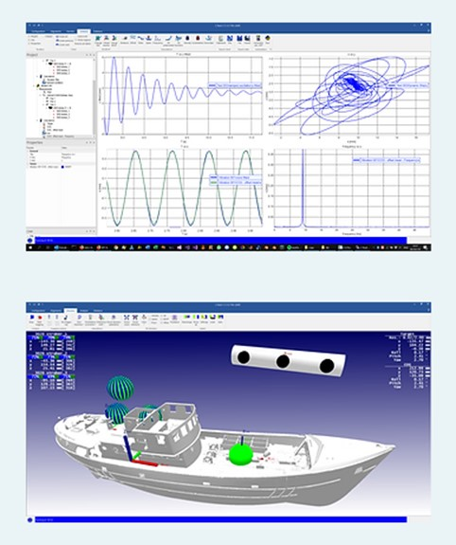
3. cTrack Interface
3.1 Procedures and processing
Upgrade from CTrack 1.9 to 4.0
Alignment
Tracking Feedback
Interface
Data Recording
Confidential
© 2024 EZMetrology

Slide 23
THANK YOU.
info@ezmetrology.com
support@ezmetrology.com
www.ezmetrology.com
portal.ezmetrology.com
academy.ezmetrology.com
SEPA009, Slide 23
Confidential
© 2024 EZMetrology

Slide 24


Company Pages
Confidential
© 2023 EZMetrology

Slide 25
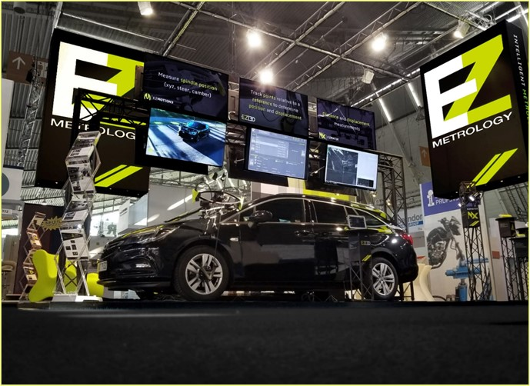
COMPANY OVERVIEW
Founded in 2006 by Carine Woldanski and Tom Van Esch.
Global Operations:
  Europe Office in Luxemburg
  USA Office in Michigan
  Asia Partnerships
EZMetrology:
  70% Development and Engineering
    Fast product development and interactive evolutions
  20% Support and Training
    Ensuring a transfer of knowledge to our customers
  10% Administration and Sales
    Manage customs and sales procedures
Consistent annual growth of 50% over the past years.
Developing innovative, creative, and practical products.
Confidential
© 2024 EZMetrology

Slide 26





SHARING OUR PASSION WORLDWIDE WITH CUSTOMERS AT
ALPINE
ARRIVAL
AUDI
BMW
BROSE
CANOO
CATERPILLAR
CHRYSLER
DACIA
DAIHATSU
DAIMLER
DENSO
FAW
FAURECIA
FERRARI
FIAT
FORD
GAC
GENERAL MOTORS
GG MOTORS
HUMANETICS
HONDA
HYUNDAI
INFINITI
JAGUAR
JEEP
KASEIKOGYO
KIA
KIEKERT
LADA
MACK
MAHINDRA
MARUTI
MASERATI
MAZDA
MITSUBISHI
MULTIMATIC
NISSAN
NITTO DENKON
POLARIS
PORSCHE
PROTON
PSA
QOROS
RENAULT
RIVIAN
SAIC MOTOR
SEAT
SIEMENS
STELLANTIS
SUBARU
SUZUKI
TATA MOTORS
TESLA
TOGG
TOYODA GOSEI
TOYOTA
VOLKSWAGEN
VOLVO
VOLVO TRUCKS
- EZM HEADQUARTERS
- EZM PARTNERS
- EZM CUSTOMERS
© 2024 EZMetrology

Slide 27


