Slide 1

EZMetrology
Technologies Portfolio
This presentation provides information about EZMetrology and its solutions for door and optical measurement systems
© 2023 EZMetrology

Slide 2

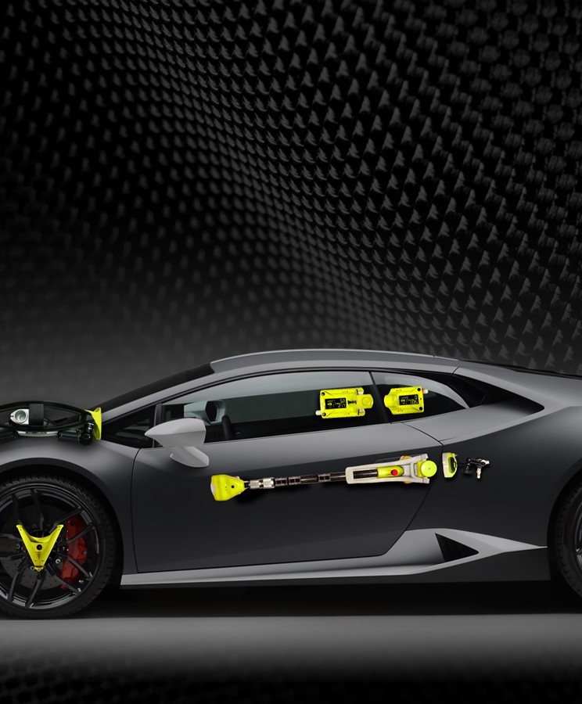


Index
Door System Analysis
Door System Inspection
Seal Gap Measurement
Static Deformation Measurement
Dynamic Deformation Measurement
On-Track Vehicle Dynamics
© 2023 EZMetrology

Slide 3

1. Door System Analysis: EZSlam
© 2023 EZMetrology

Slide 4
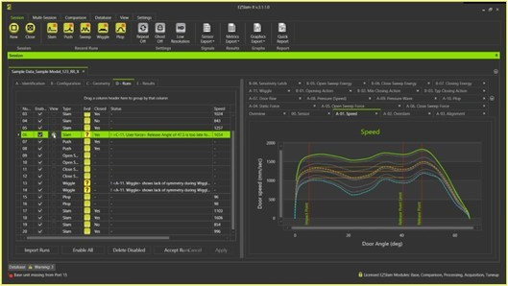
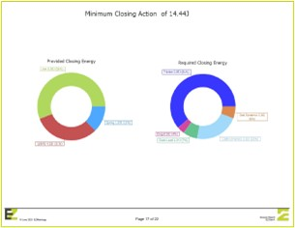
1. Door System Analysis: EZSlam
EZSlam is a unique dedicated closure measurement system providing precise full closing data during the complete closing event.
Benefits:
Up-to-date and state-of-the art technology and software to define “DNA of a door”
No competition; ideal partner for development departments
Applications:
Advance quality control in factories
Troubleshoot existing designs
Benchmarking competitors' cars
Assist with design and define influence of components
Defines characteristics per segment:
  Sedan, SUV, Luxury, Standard, Heavy Duty
Assist with new design and prototyping
Many Different Metrics Can Be Identified using EZSlam :
Striker Alignment
Latch Point
Minimum Closing Speed
Initial Speed
Speed Curve
Closing Force
Minimum Input Pulse Energy
Gravity Input
Kinetic Closing Energy
Door Check Force
Static Latch Energy
Swing Radius
Door Rise
Door Check Linearity
Door Check Slope
Inertia
Hinge Tip
Cabin Pressure Peak
Pressure Rise Time
Pressure Drop Time
Temperature
EZSlam Potential Customers:
R&D Center
Advanced Quality Control in Production
Launch Troubleshooting
© 2023 EZMetrology

Slide 5
2. Door System Inspection: Audit Station Solution
© 2023 EZMetrology

Slide 6
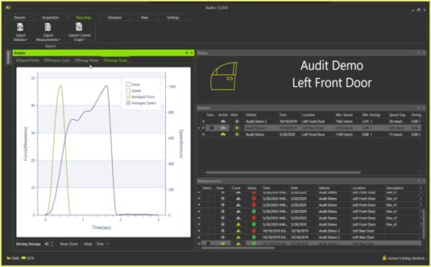
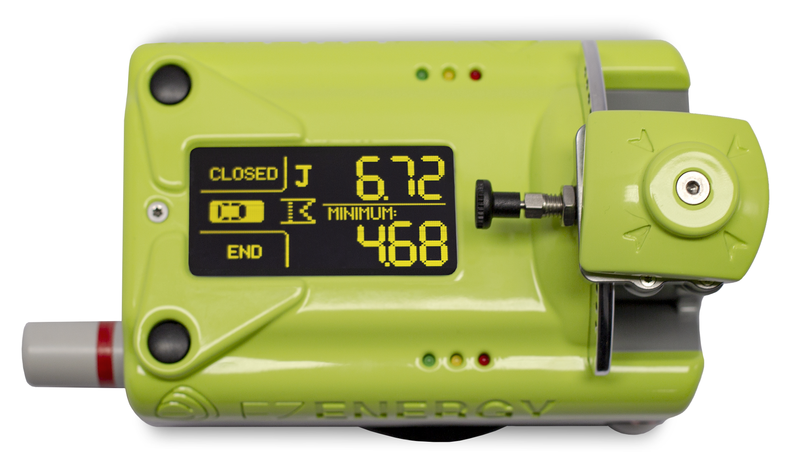

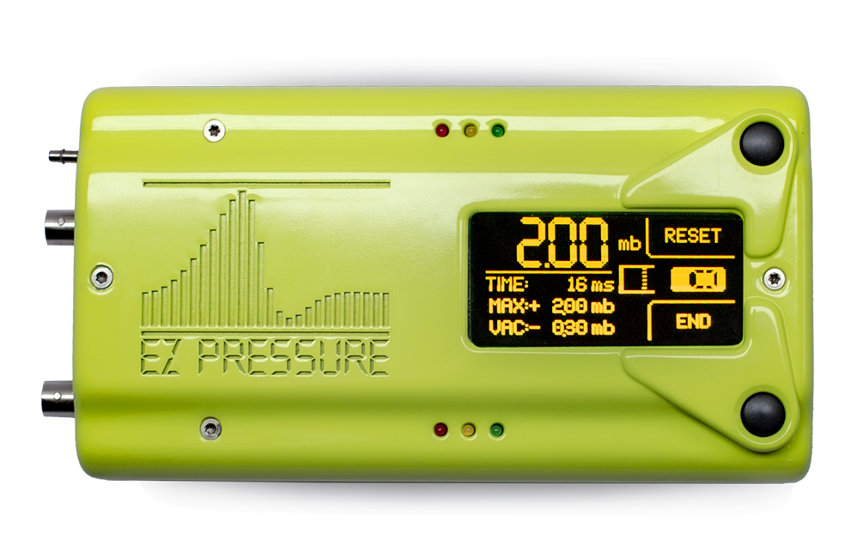
2. Door System Inspection: Audit Station
  Audit Software records, analyses, and reports data to measure door characteristics from SpeedPod, EZPressure, or EZEnergy separately or simultaneously.
  Compatible devices:
  EZEnergy - Measures the actual user input energy on a door system in order to latch, the closing force and peak speed during a full closing
  SpeedPod - Measures the speed of the door at closing point and calculates the minimal closing speed
  EZPressure - captures the cabin pressure peak and profile during closing event
  Audit Station Solution Benefits:
  Quick and easy to set up
  Capability to test all doors, hoods, trunks, windows
  Real-time Feedback
  VIN traceability • Data management • Simultaneous recording of multiple units • Graphical representation • Download force/speed/pressure curve (with associated devices) • Export data • Optional bar code input
  Audit Solution Applications:
  Testing Door Behavior: Speed vs cabin pressure or force vs cabin pressure, e.g. seal study
  Auditing, Aging Testing at the end of production line
  Durability Testing for components like seals in Audit environment for cars, SUVs, trucks
    Audit Solution Potential Customers:
    Automotive factories for cars, trucks and industrial vehicles
    End of line station control
    Testing integrators
    Door system design
    Latch manufacturers
    Hinge manufacturers
© 2023 EZMetrology

Slide 7
2. Door System Inspection: PLS Solution
© 2023 EZMetrology

Slide 8
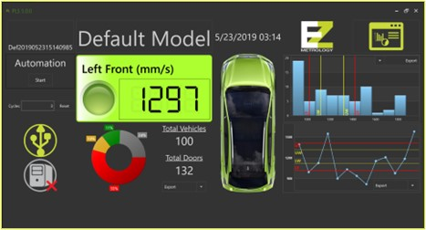
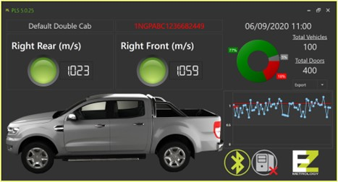

2. Door System Inspection: PLS Solution
The Production Line Software (PLS) is used to log data from SpeedPod and EZEnergy via Bluetooth and is designed specifically to operate on a production line. PLS verifies tolerances for all car doors, samples specific car doors for launches, and enhances quality control of production lines.
Compatible Devices:
SpeedPod - Measures the speed of the door at closing point
EZEnergy - Measures the actual user input energy on a door system in order to latch, the closing force and peak speed during a full closing
PLS Specifications:
Records data with graph and tolerance status
VIN number scanning through barcode reader
Automatic adjustment of doors and tolerances from VIN number (VIN decoding)
Data export in different formats – contains full information of Vehicle VIN, date, time
Log-in system with different user profiles at different privilege levels
Automatic connection and uploading of data to quality control system database
Configurable graph charts for separate export – to plug as pictures into presentations
Lockable interface with removal of start bar to prevent unintended use
  PLS Potential Application:
    End of line testing for door closing efforts
© 2023 EZMetrology

Slide 9
2. Door System Inspection: EZSpeedBox
© 2023 EZMetrology

Slide 10
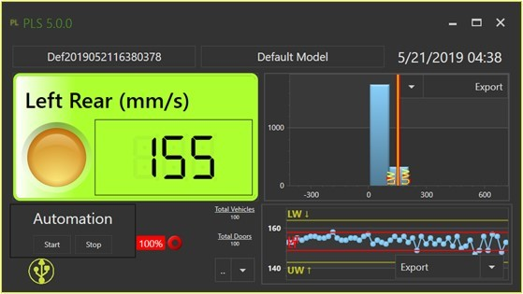
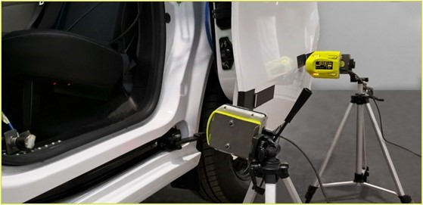
2. Door System Inspection: EZSpeedBox
EZSpeedBox is dedicated to automated speed testing typically used for long term monitoring of durability fixtures or for closed loop system control. The data received from the EZSpeedBox is given a timestamp, logged, and available as a feedback mechanism to the robot.
EZSpeedBox Benefits:
The system is quick and easy to set up using a snap-on base
Accurate readings of door velocity
Real-time feedback
Allows testing of all doors, hoods, trunks, windows
Uninterrupted power and communication over USB
Lots of positive feedback in USA and Europe
Applications:
Durability testing cycles over 100,000 closings per door
Automated stand
Long-term monitoring
Dedicated software with analytical capacity for repetitive testing on all doors
EZSpeedBox potential customers:
Testing integrators
Door system design
Latch manufacturers
Hinge manufacturers
Automated testing facilities for OEM
© 2023 EZMetrology

Slide 11
2. Door System Inspection: PinchPod
© 2023 EZMetrology

Slide 12
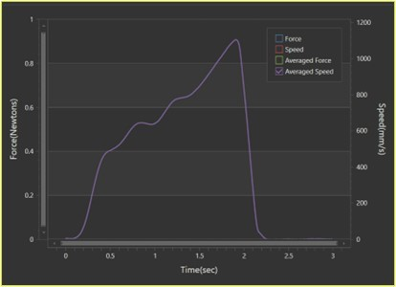
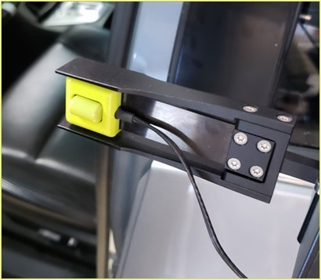
2. Door System Inspection: PinchPod
With the rising popularity of automated doors that close with a push of a button, there is an increased demand
for safety concerns regarding pinching. Two main challenges:
Force: During the final trajectory of an automated closure, the higher seal loads will
require higher driving forces. A small obstruction becomes harder to detect.
Response time: Seen that pinching happens in the final motion; the difference
between interrupting the drive at 10mm and 4mm will result in a significant outcome.
Two Solutions Available as Stand-Alone and Wireless Options:
1-Obstruction Detection: (at 100mm from flush)
In this situation, the sensor is placed using the standoff to generate an obstruction for the closure at a significant distance away from the closing position.
Obstruction Measurement:
PinchPod can be placed at a distance from flush to simulate an obstruction.
The sensor itself is spring loaded so a displacement is allowed while the system is activated and measuring.
A force (vector) is recorded in the form of a maximum value or a full curve of the recorded event if desired.
2-Pinch Detection: (at 20mm from flush or less)
The sensor is positioned between the body and door to replicate an exact pinch situation.
The 3D loadcell captures the force independent of the mounting orientation.
Pinch Measurement:
The sensor can be placed between body and closure during the final moments.
The overload protection will prevent the system from crunching the sensor in case the safety fails.
A force (vector) is recorded in the form of a maximum value or a full curve of the event.
© 2023 EZMetrology

Slide 13
3. Seal Gap Measurement: SealScan
© 2023 EZMetrology

Slide 14
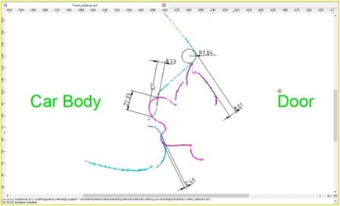
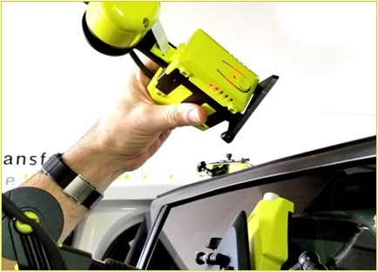
3. Seal Gap Measurement: SealScan
SealScan (NEW RELEASE) a quick 2D-scanning system dedicated to seal measurements. SealScan obtains crucial information about seal compression and mating surface geometry—everywhere 2 seals mate to each other during a closing process. Very popular for users of EZSlam and in Audit environment to study seal and door behavior.
SealScan Benefits:
Quick and easy
No need to remove or damage seals
Simple to use and reduces time spent on collecting data
Lots of positive feedback in USA and Europe
SealScan Applications
Seal Gap
Seal Compression
Panel alignment
SealScan Potential Customers:
Every OEM
Seal companies
Heavy Duty vehicles and Trucks for cabin pressure and seal studies
Construction trucks for cabin pressure and seal studies
© 2023 EZMetrology

Slide 15
4. Static Deformation Measurement: EZ3D
© 2023 EZMetrology

Slide 16
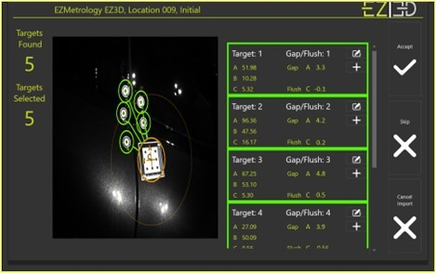
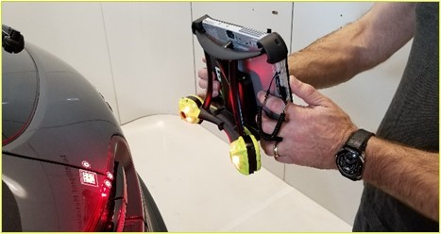
4. Static Deformation Measurement: EZ3D
EZ3D is a handy, portable stereo vision system utilizing a single snapshot to collect accurate flush and gap data from a collection of points on assemblies. The data will show the drift or change of the fit and finish throughout all cycles.
Applications:
Measures 3D Deformation before and after an object has been put under
any possible constraint (force, temperature, torque)
Report: 3D or Flush & Gap
The EZ3D can be utilized in a variety of climate testing chambers including:
    Low Temperature Chambers
    High Temperature Chambers
    Solar/Photovoltaic Chambers
EZ3D Potential Customers:
Industries using climate chambers (all automotive): Cars, trucks, industrial vehicles
Interior and exterior assemblies
Engineering companies
Machine builders: Cranes, CNC machines
© 2023 EZMetrology

Slide 17
6. Dynamic Deformation Measurement: EZMotion
© 2023 EZMetrology

Slide 18
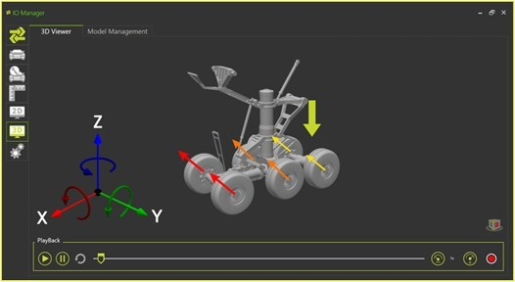
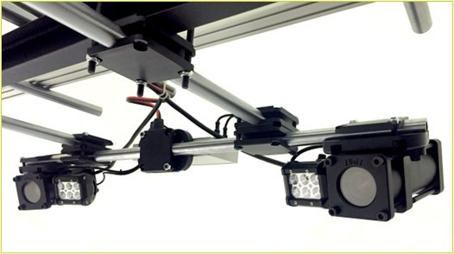
6. Dynamic Deformation measurement: EZMotion
EZMotion is a modular high-speed stereo vision motion and deformation measurement solution. It is adaptable to any application, interactable with other systems, and reconfigurable to evolve and meet new challenges.
Applications:
3D kinematic inspection in Industrial environments
Inspect travel, speed, stability, structural stiffness, and dynamic response of assemblies
Multiple systems can be combined to cover large areas with unprecedented accuracy
Available for different speed and volume configuration
EZMotion Benefits:
Up-to-date and state-of-the art components and software
Compact and easy to setup
Volume expandable
Speed: up to 2000Hz
Multi-unit configurations
IP68 Industrial environment compatible
Target customers:
Hydraulic manufacturers
Hydraulic systems
Industrial machinery
© 2023 EZMetrology

Slide 19
5. On-Track Vehicle Dynamics: EZMotion (Tire)
© 2023 EZMetrology

Slide 20
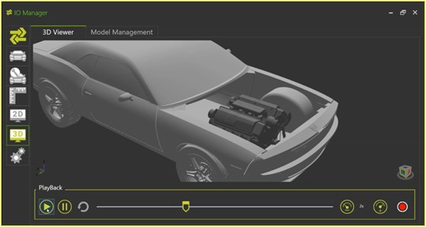
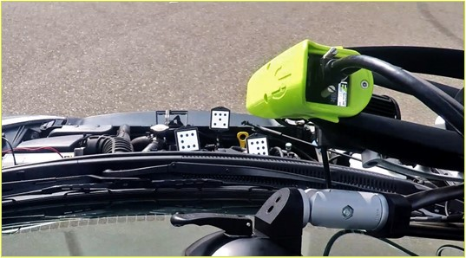
5. On-track Vehicle Dynamics: EZMotion (Tire)
EZMotion (Tire) is an advanced 3D/6D in-motion measurement system
Applications:
Measures movements of steering parts / wheels / engines under stress
Avoids interference and damage; validate CAD simulations
Configure and run shaker units.
EZM Benefits:
Up-to-date and state-of-the art components and software
Compact and easy to setup
EZMotion Potential Customers:
Every OEM making vehicles, light or heavy
Automotive
Suspension suppliers
Suspension kinematics
Tires companies
© 2023 EZMetrology

Slide 21
THANK YOU.
info@ezmetrology.com
support@ezmetrology.com
www.ezmetrology.com
portal.ezmetrology.com
academy.ezmetrology.com
© 2023 EZMetrology

Slide 22


Company Pages

Slide 23
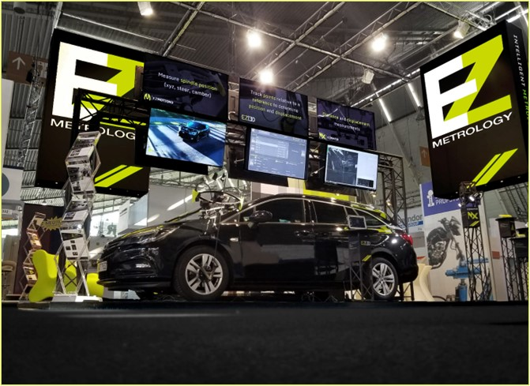
COMPANY OVERVIEW
Founded in 2006 by Carine Woldanski and Tom Van Esch.
Global Operations:
  USA Headquarters in Michigan
  Europe Support office in Luxemburg
  Asia Partnerships
EZMetrology:
  70% Development and Engineering
    Fast product development and interactive evolutions
  20% Support and Training
    Ensuring a transfer of competence to our customers
  10% Administration and Sales
    Manage customs and sales procedures
Consistent annual growth of 50% over the past years.
Developing innovative, creative and practical products.
SEPG001, Slide 23
© 2023 EZMetrology

Slide 24

SHARING OUR PASSION WORLDWIDE WITH CUSTOMERS AT
ALPINE
ARRIVAL
AUDI
BMW
BROSE
CANOO
CATERPILLAR
CHRYSLER
DACIA
DAIHATSU
DAIMLER
DENSO
FAW
FAURECIA
FERRARI
FIAT
FORD
GAC
GENERAL MOTORS
GG MOTORS
HUMANETICS
HONDA
HYUNDAI
INFINITI
JAGUAR
JEEP
KASEIKOGYO
KIA
KIEKERT
LADA
MACK
MAHINDRA
MARUTI
MASERATI
MAZDA
MITSUBISHI
MULTIMATIC
NISSAN
NITTO DENKON
POLARIS
PORSCHE
PROTON
PSA
QOROS
RENAULT
RIVIAN
SAIC MOTOR
SEAT
SIEMENS
STELLANTIS
SUBARU
SUZUKI
TATA MOTORS
TESLA
TOGG
TOYODA GOSEI
TOYOTA
VOLKSWAGEN
VOLVO
VOLVO TRUCKS
- EZM HEADQUARTERS
- EZM PARTNERS
- EZM CUSTOMERS
© 2023 EZMetrology

Slide 25


