Slide 1

EZ3D
3D Point Analysis
A comprehensive description of EZ3D technology, a compact and portable 3D technology for fast and accurate part deformation measurements.
Confidential
© 2023 EZMetrology

Slide 2

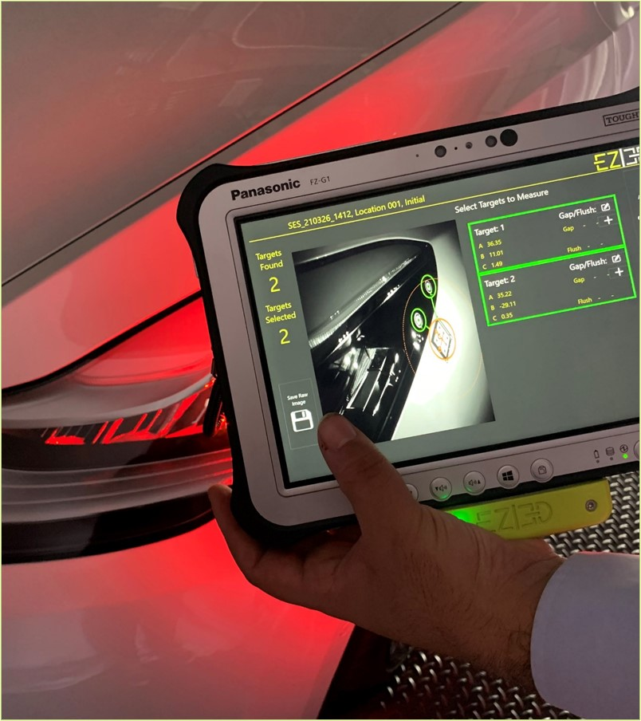

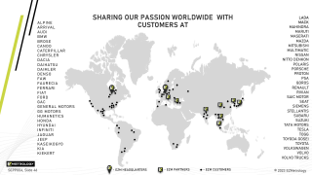
Index
Introduction
Technology
Process
Applications
Conclusion
Confidential
© 2023 EZMetrology

Slide 3

1. Introduction
Confidential
© 2023 EZMetrology

Slide 4
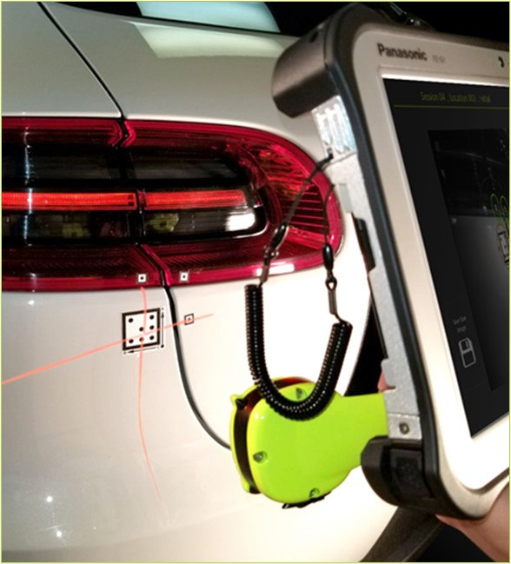
1. introduction
1.1 Concept and applications
Concept
A 3D measurement system.
  Reliable stereo vision technology to establish 3D location of optical targets
  Real-time feedback and graphical representation of results
  Tablet-based system for portability and accessibility
  Designed for extreme environments
Applications
  Flush & gap inspections
  Part alignment and progressive adjustment
  Lateral shifting of character lines
  Deformation due to
    Temperature (climate chamber)
    Forces or load application
    Pressurization
  Elongation, shrinking and torsion effects in assemblies
Confidential
© 2023 EZMetrology

Slide 5
2. Technology
Confidential
© 2023 EZMetrology

Slide 6
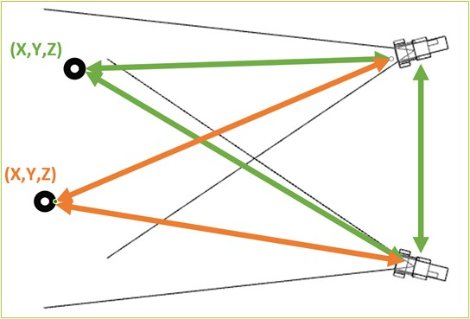
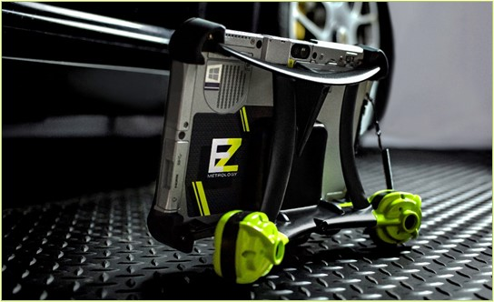
2. Technology
2.1 Hardware
Stereo Vision
Two high resolution cameras utilize image processing and triangulation to determine the 3D position of optical targets in the measurement volume
Technicalities
  High resolution images
  Superior accuracy of < 0.1 mm
  Lightweight system <2 kg (4.4 lbs)
  Wide temperature range
    -40 to 60 °C device temperature
    -40 to 80 °C part temperature
  MIL-STD-810G, IP65 grade tablet
User Advantages
  Intuitive touch screen operation
  Integrated lighting for dark environments
  Laser-guided positioning
  Live on-screen feedback
Confidential
© 2023 EZMetrology

Slide 7
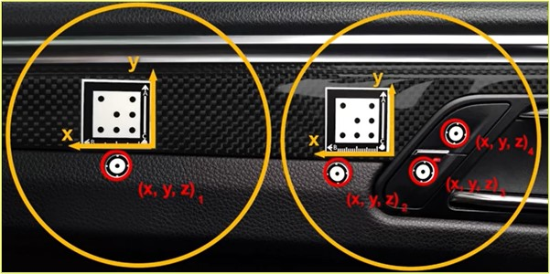
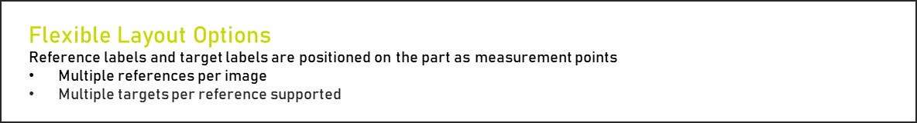

2. Technology
2.2 Targets and references
Part A. Reference Label
    Square-coded optical pattern
    Establishes a local XYZ reference for all surrounding points
    Sizes ranging from 20 to 70 mm
Part B. Target Label
    Round single dot target
    Actual 3D point that will be observed with respect to the nearby reference
    Sizes ranging from 6 to 25 mm
Confidential
© 2023 EZMetrology

Slide 8
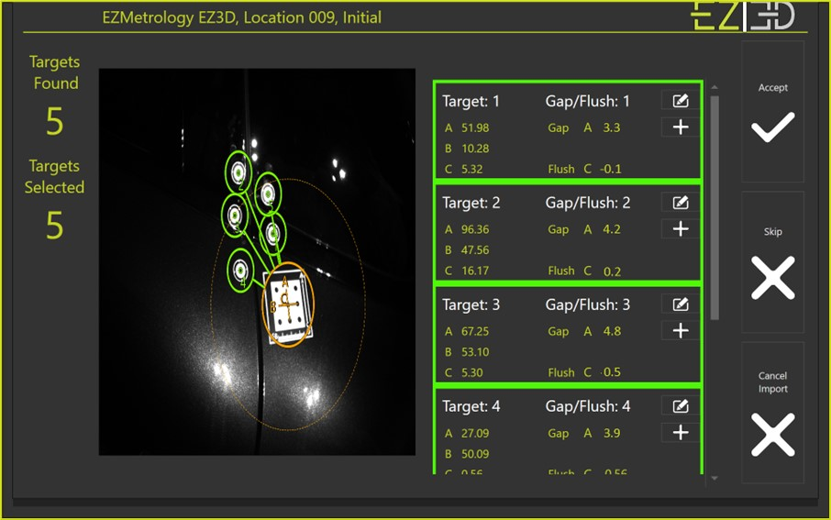
2. Technology
2.3 Software OPERATION
EZ3D software can manage multiple test sessions at once to optimize the utilization time and maximize flexibility.
Operation
  Session Database
  Touch Control Software
  Location Templates
  Cycle Templates
  Session Picture
  Tolerance Monitor
  Verification Procedure
  Import / Export Data
Confidential
© 2023 EZMetrology

Slide 9
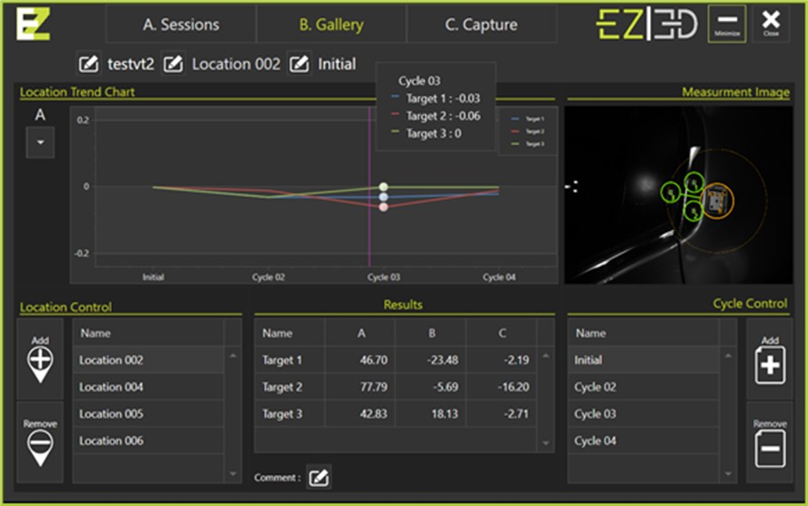
2. Technology
2.4 Software DATABASE AND REPORTING
Database
  Location Finder with Preview
  Flexible Naming
    Locations
    Cycles
  Automatic or Manual Control
  Built-In Verification
  Trend Line
  Numerical Table
  XYZ or Flush and Gap View
  Picture per Measurement
Reporting
  Automated Report Generation
  Reporting to Excel
  Including Pictures and Numerical Data
  Including Verification Procedure
  Including Color-Coded Tolerances
Confidential
© 2023 EZMetrology

Slide 10
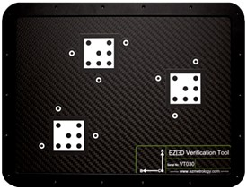
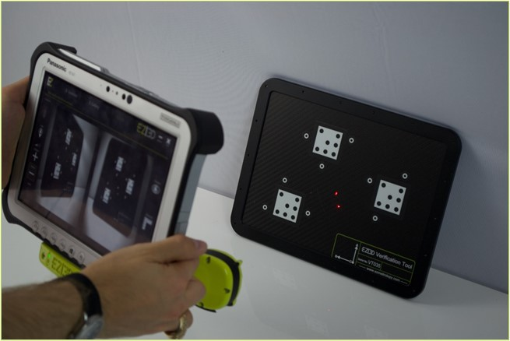
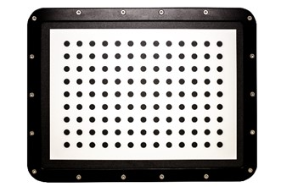
2. Technology
2.5 CALIBRATION AND Verification
Integrated System Verification
  EZ3D comes with an accessory and built-in procedure to verify the performance over the lifetime of the device
  Guarantee the performance and accuracy of results
Confidential
© 2023 EZMetrology

Slide 11
3. Process
Confidential
© 2023 EZMetrology

Slide 12

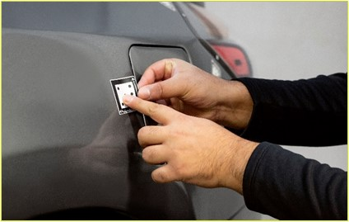
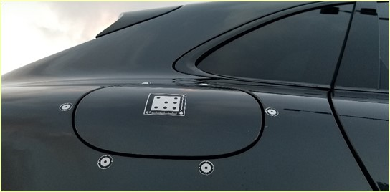
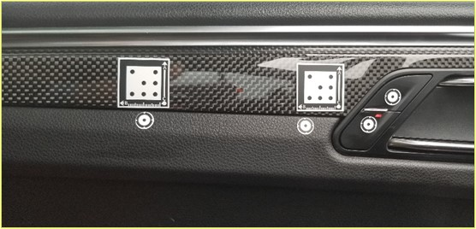
3. Process
3.1 Place Targets and references
Step 1. Install References and Targets on the Part
  Place the adhesive targets and references on the parts or assemblies
    Coded reference labels are placed on the parts to establish a local reference
    Compact single point target labels are placed on the adjacent parts
  Time Savings
    Can be placed in seconds but real time saving happens as the measurement is reduced to taking a picture
    while testing in different conditions or extreme climates
Confidential
© 2023 EZMetrology

Slide 13
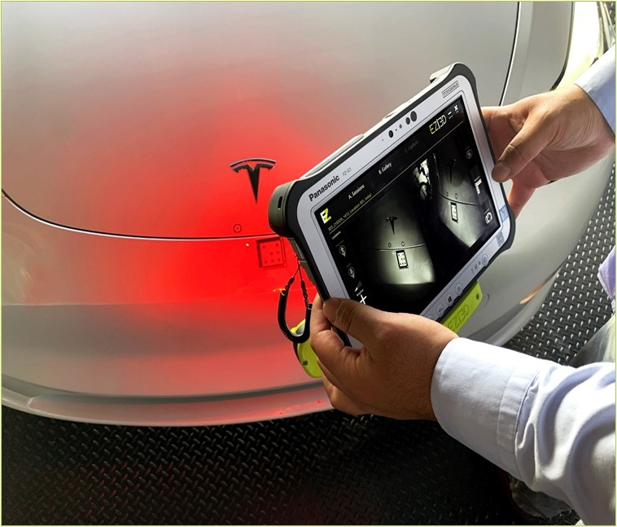
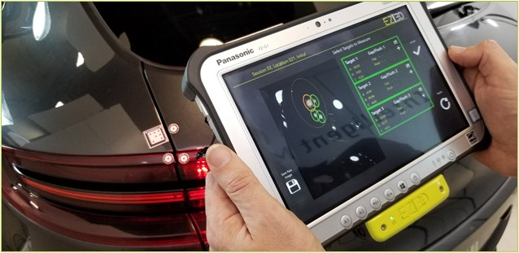
3. Process
3.2 Record Initial Cycle
Step 2. Take a Reference Picture
Point the camera at the target and capture an image
For all the future cycles, this measurement cycle will be considered as the starting point or the (0,0,0) coordinate for all points
The exact 3D location of the target(s) will be calculated with respect to the nearest reference(s)
Confidential
© 2023 EZMetrology

Slide 14
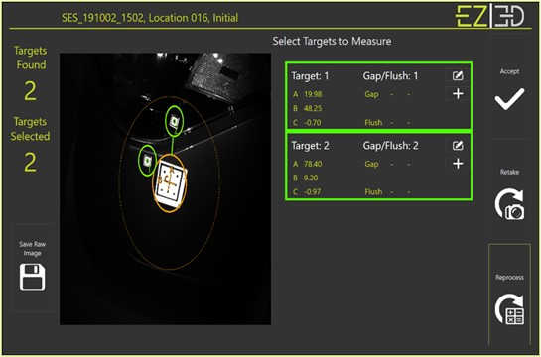
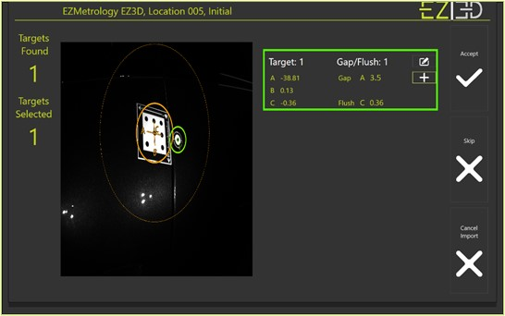
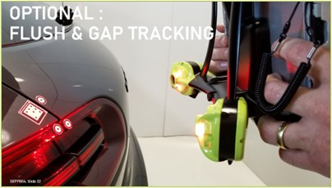
3. Process
3.3 View results
Step 3. Review and Confirm Collection
References and targets are identified, numbered and associated to each other
Points can be selected or deselected from the list
The relative 3D location from the target is measured and documented
User has the option to retake or reprocess the current measurement
Optional Step : Flush and Gap Definition
The 3D measurement can be reduced to a flush and gap reading to be in line with an inspection plan – use link below to find out how
Confidential
© 2023 EZMetrology

Slide 15
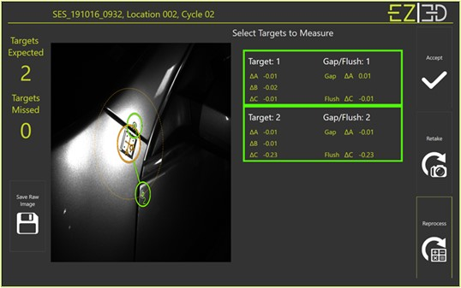
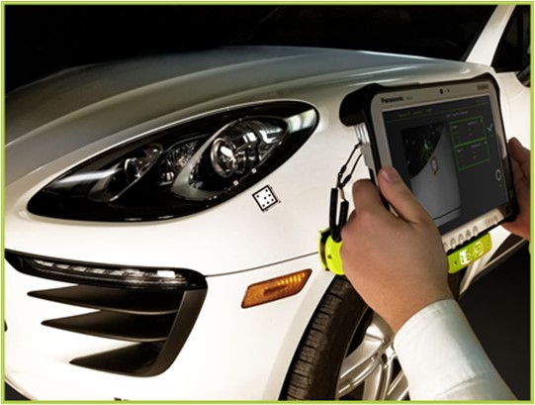
3. Process
3.4 Record Consecutive Cycles
Step 4. Consecutive Cycles
  When a measurement cycle is repeated, the new XYZ values or the delta values of the point will be calculated and immediately displayed.
  Optional Location Finder
  A ghost or transparent overlay image guides the operator through all measurement points and ensures that the current picture is paired with the right location.
  Efficient
  Running consecutive cycles is made routine with fast execution and accurate results to limit time in, for example, a climate chamber.
Confidential
© 2023 EZMetrology

Slide 16
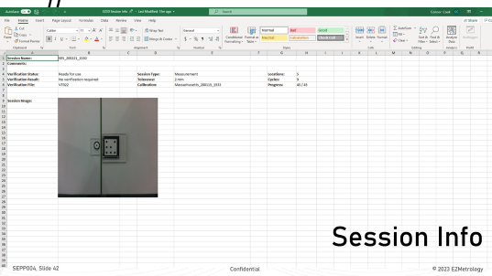

3. Process
3.5 Automatic Reporting
  Step 5. Automatic Excel Report
  Upon completion of the inspection, the report can be generated with a click of one button
    Session Information header
    Data Points
    Deltas
    Flush and Gap Values
    Flush and Gap Delta Values
    Session Location and Cycle Comments
    Session Snapshots
    Verification Results
    Images with Markings
Confidential
© 2023 EZMetrology

Slide 17
4. Applications
Confidential
© 2023 EZMetrology

Slide 18
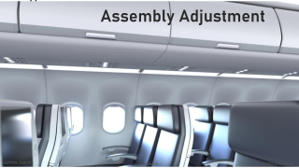
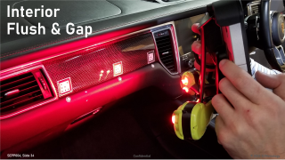


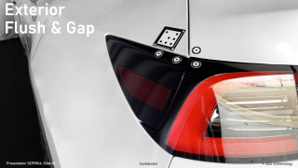
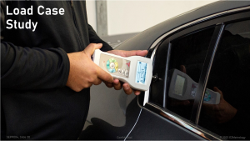

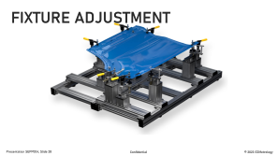




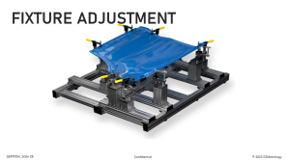
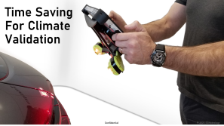


4. Applications
Confidential
© 2023 EZMetrology

Slide 19
5. Conclusion
Confidential
© 2023 EZMetrology

Slide 20

5. Conclusion
EZ3D IS A compact and easy to use 3D measurement system THAT will facilitate and speed up the inspection process.
DURING THE OPERATION PROVIDES real time feedback, Digital and visual registration.
Upon completion of the inspection a report can be generated with a click on a button.
Confidential
© 2023 EZMetrology

Slide 21
Thank you.
info@ezmetrology.com
support@ezmetrology.com
www.ezmetrology.com
portal.ezmetrology.com
academy.ezmetrology.com
Confidential
© 2023 EZMetrology

Slide 22
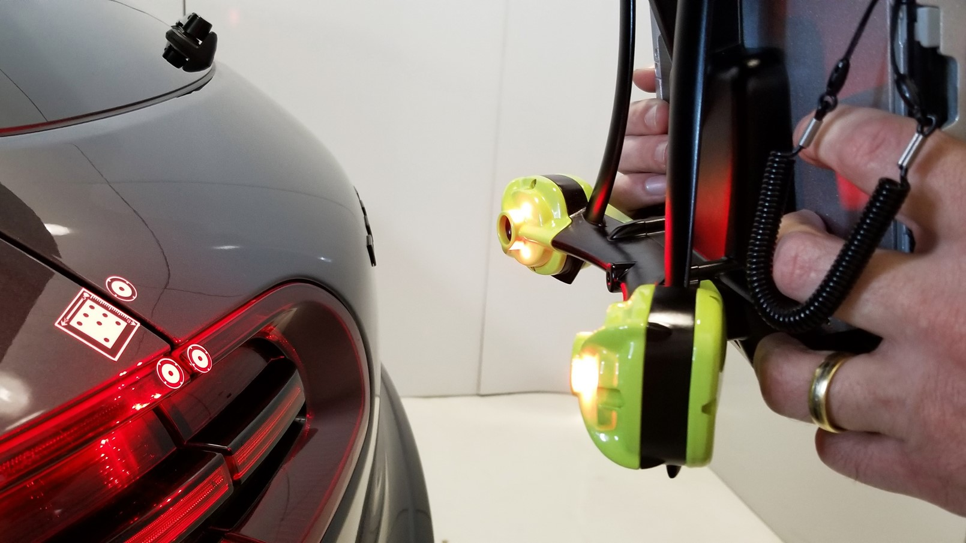
Optional : flush & GAP tracking
Confidential
© 2023 EZMetrology

Slide 23
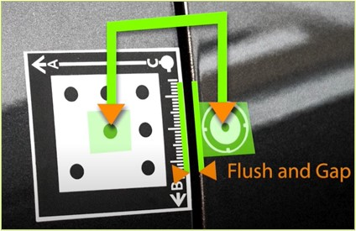
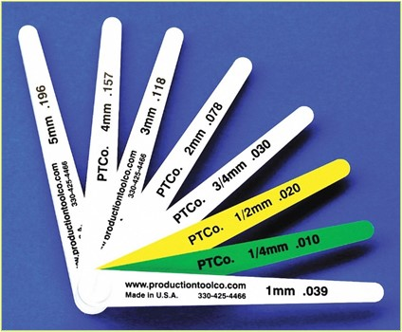
3. Process
Optional Step: Gap – Flush Tracking
  The initial flush and gap values can be established with 3 cases
  Method 1. Label Based – Delta
    The location of the labels is not critical for the results
    The evolution of flush and gap is accurately determined
  Method 2. Label Based – Absolute
    The value corresponds to the actual distance between the edge of the reference and target label
    The labels must be placed to represent the visual gap
  Method 3. Independent Gauge
    Third-party gauge measurement can establish values in line with current methods:
      Feeler gauges
      Laser systems
      Calipers
  This action would only be required once for a measurement campaign
  Significant time savings can be expected for the overall process.
Confidential
© 2023 EZMetrology

Slide 24
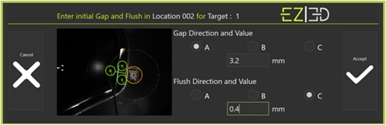
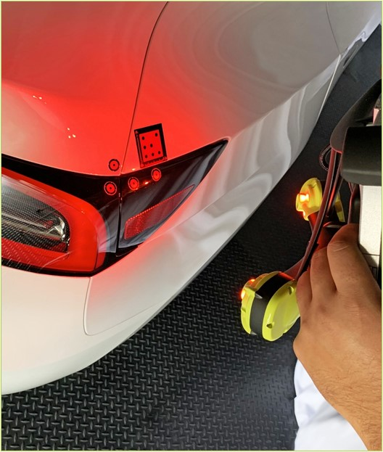
3. Process
Optional Step: Gap – Flush Tracking
  Step 1. Initial Cycle - Select Option
  A check box on the touch screen allows the conversion during the initial cycle
3D to Flush and Gap
  During the initial cycle, a 3D point XYZ measurement can be converted into a flush and gap dimension
  Step 2. Consecutive Cycles - Automatic
  No further input is required
  The target point and the measured drift will be measured and will be reported as “Flush and Gap” or “Change of Flush and Gap”
  Efficient System
  This system enables much faster cycle times, making it an important time-saving technology
Confidential
© 2023 EZMetrology

Slide 25
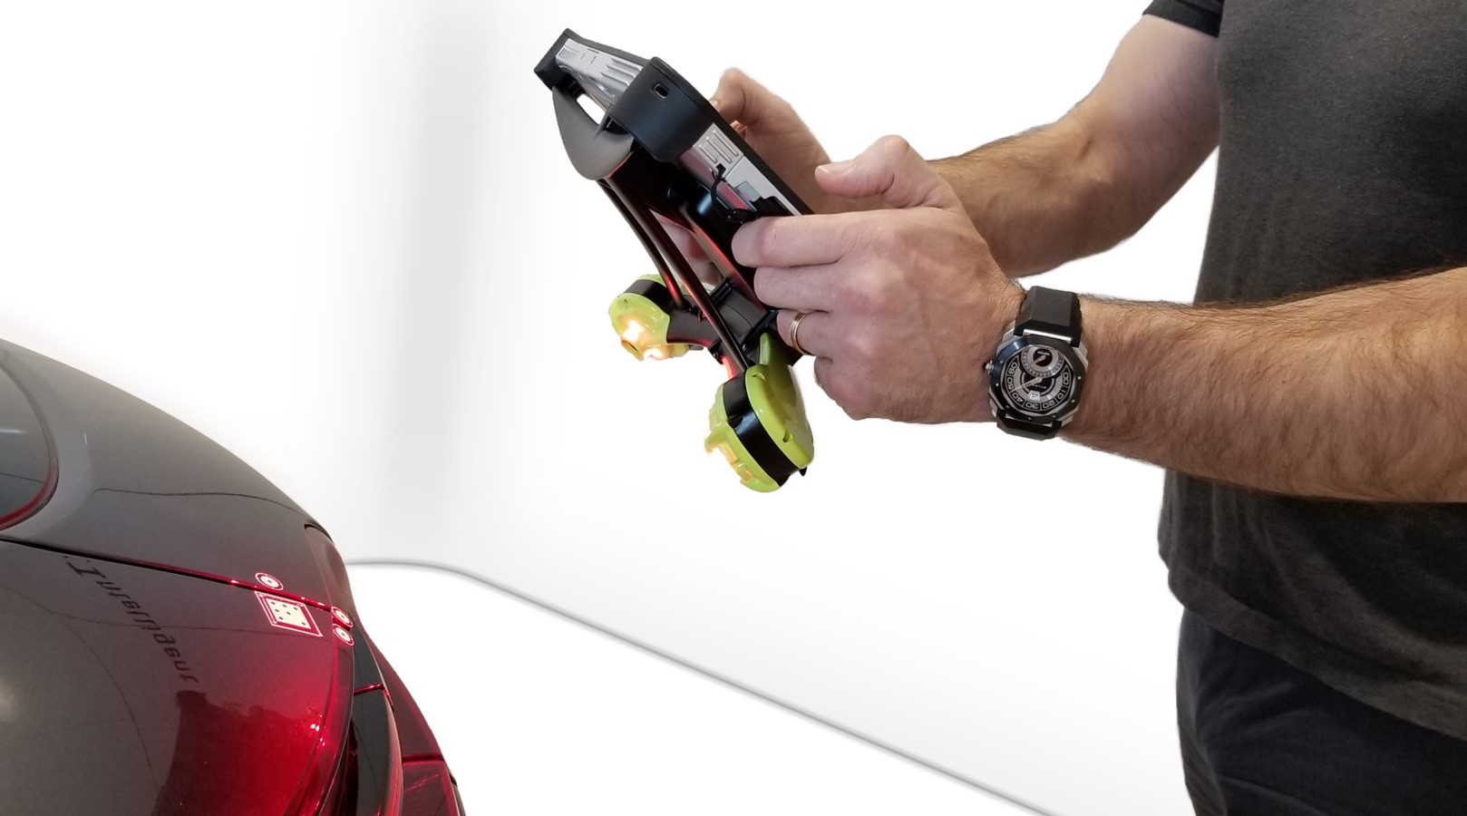
Time Saving
For Climate Validation
SEPP004, Slide 25
Confidential
© 2023 EZMetrology

Slide 26
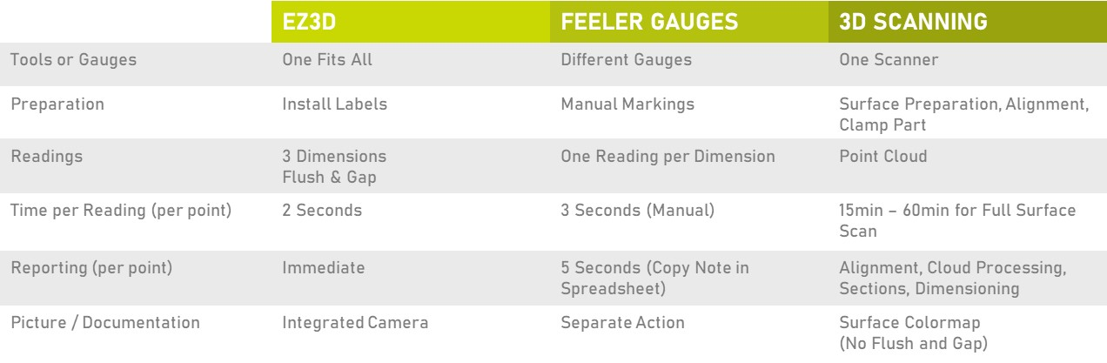
application
Time Saving for Climate Testing
To understand the time benefit, a time estimate can be established to complete a typical test cycle.
Sample Test Definition
  1 Part (surface)
  30 Inspection points (flush and gap)
  10 Cycles (example: different temperature cases)
Confidential
© 2023 EZMetrology

Slide 27
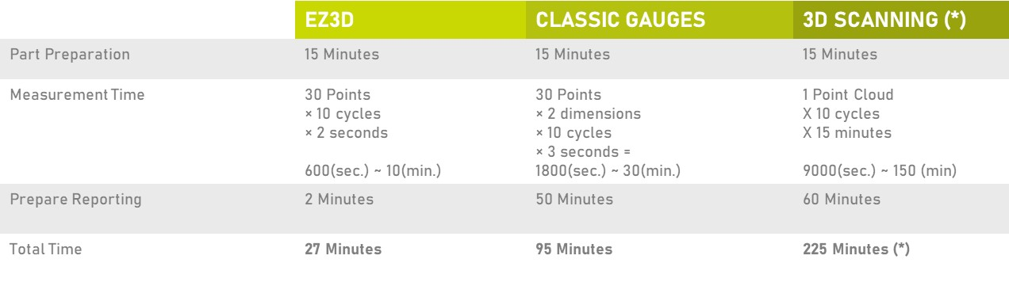
application
Time Saving for Climate Testing
  (*) Due to the sensitivity of 3D scanning equipment, this type of measurement requires the part to be removed from the environmental chamber. Alternatively, data collection is reduced to a single measurement, ignoring the data in transitions.
Confidential
© 2023 EZMetrology

Slide 28
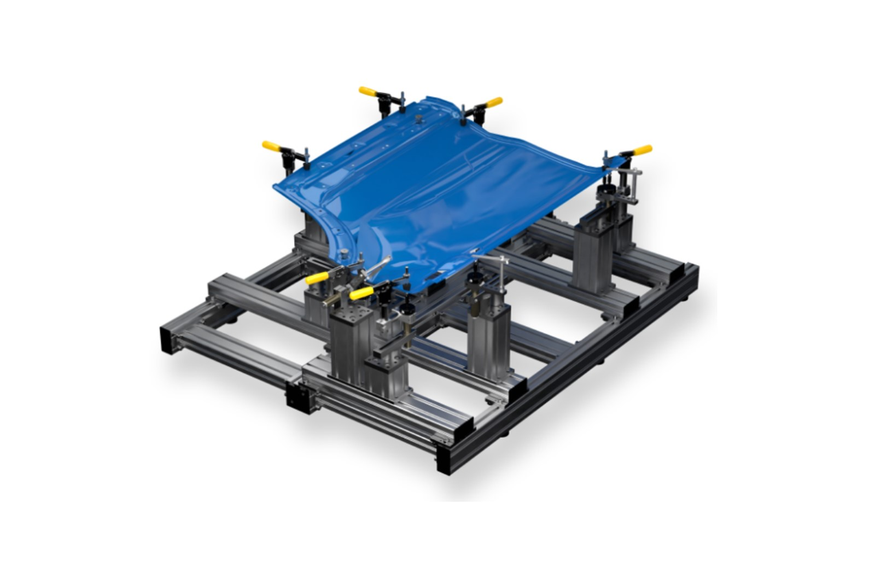
FIXTURE Adjustment
Confidential
© 2023 EZMetrology

Slide 29
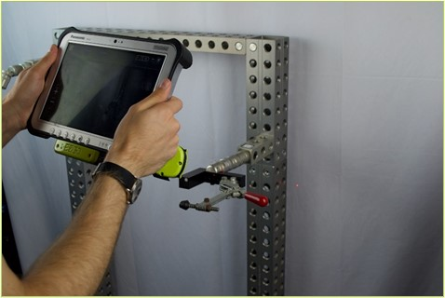
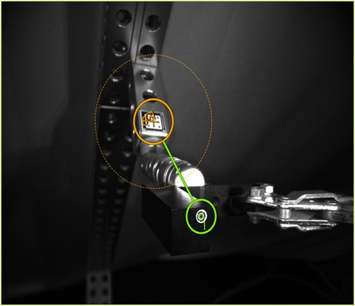
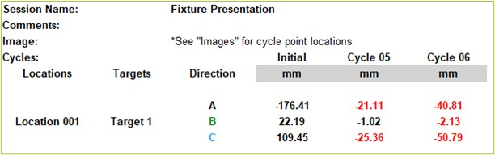
Application
Fixture Adjustment
Step 1. Establish Target Values
  An independent procedure can establish that a test stand, or system setup must be adjusted for a given amount. As it takes time to get the values, the system can now be reassigned while the mechanical adjustment will be made using EZ3D.
  Step 2. Capture Gradual Adjustment
  From the initial state, a snapshot can be taken for every movement and the 3D evolution of the adjustment can be observed. The operator can focus on the mechanical adjustment.
  Step 3. Final Position
  Once the system confirms that the current position matches the desired adjustment, the operation is completed.
Confidential
© 2023 EZMetrology

Slide 30
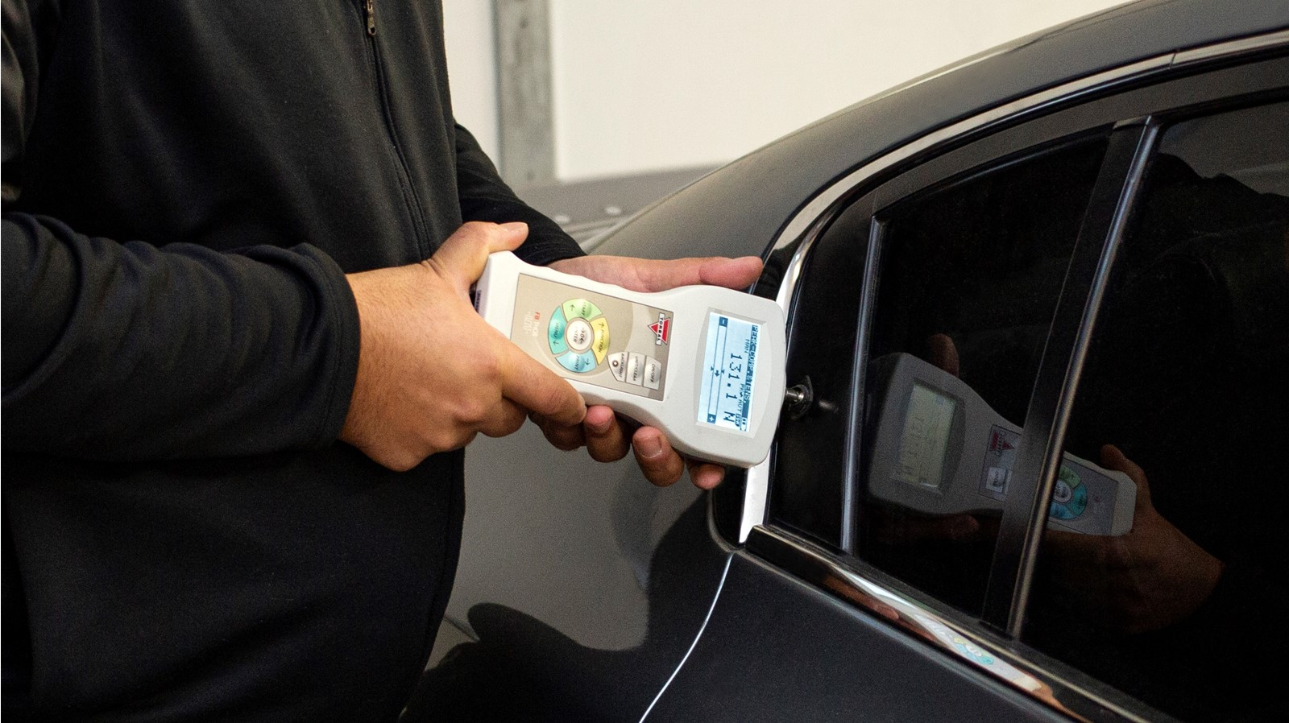
Load Case Study
Confidential
© 2023 EZMetrology

Slide 31
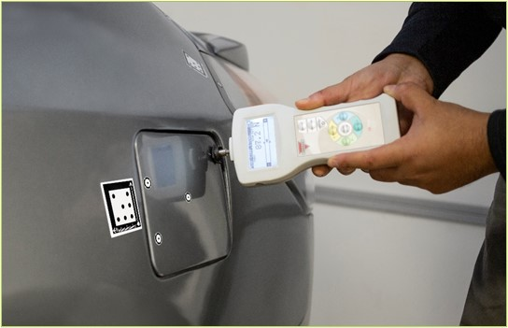
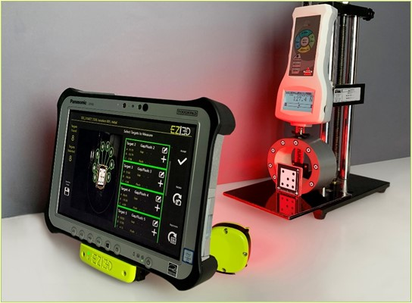
Application
Load case study
Step 1. Unloaded Condition
  Capture the shape or geometry of the structure under normal unloaded conditions
Step 2. Deflection Under Load
  Take snapshots under different load conditions and establish the 3D deformation of multiple points on the structure
Step 3. Return To Unloaded
  At the end, a final capture can establish if there was any plastic or permanent deformation of the structure during the test
  Results can be an accurate deflection curve as a function of the force
Confidential
© 2023 EZMetrology

Slide 32
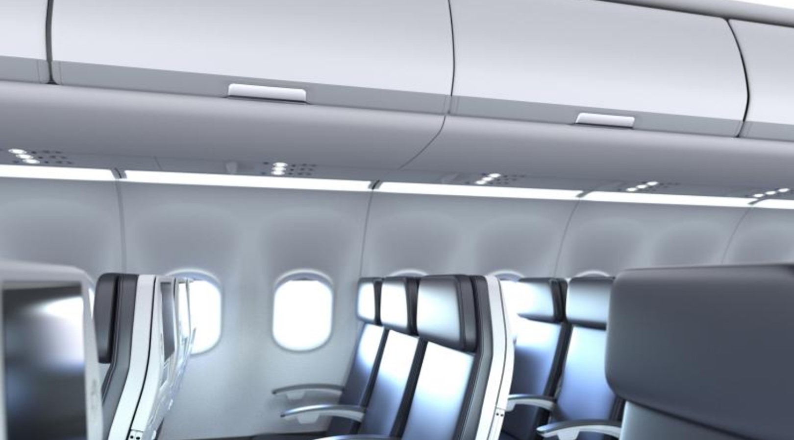
Assembly Adjustment
Confidential
© 2023 EZMetrology

Slide 33
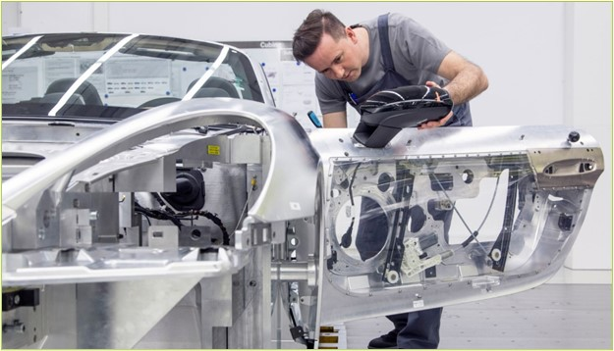

Application
Assembly Adjustment
  Use EZ3D to assist the operator to set a part or assembly to specific build conditions:
  Step 1. Set Nominal
  Set the build condition to nominal using standard tools
  Determine this state as the reference position of the part and associated measurement points
  Step 2. Upper Tolerance Situation
  Adjust the parts to meet the upper tolerance situation
  Perform an evaluation test on the object such as leak test, speed test, force test
  Step 3. Lower Tolerance Situation
  Adjust the parts to meet the lower tolerance situation
  Perform the evaluation test on the object
Confidential
© 2023 EZMetrology

Slide 34
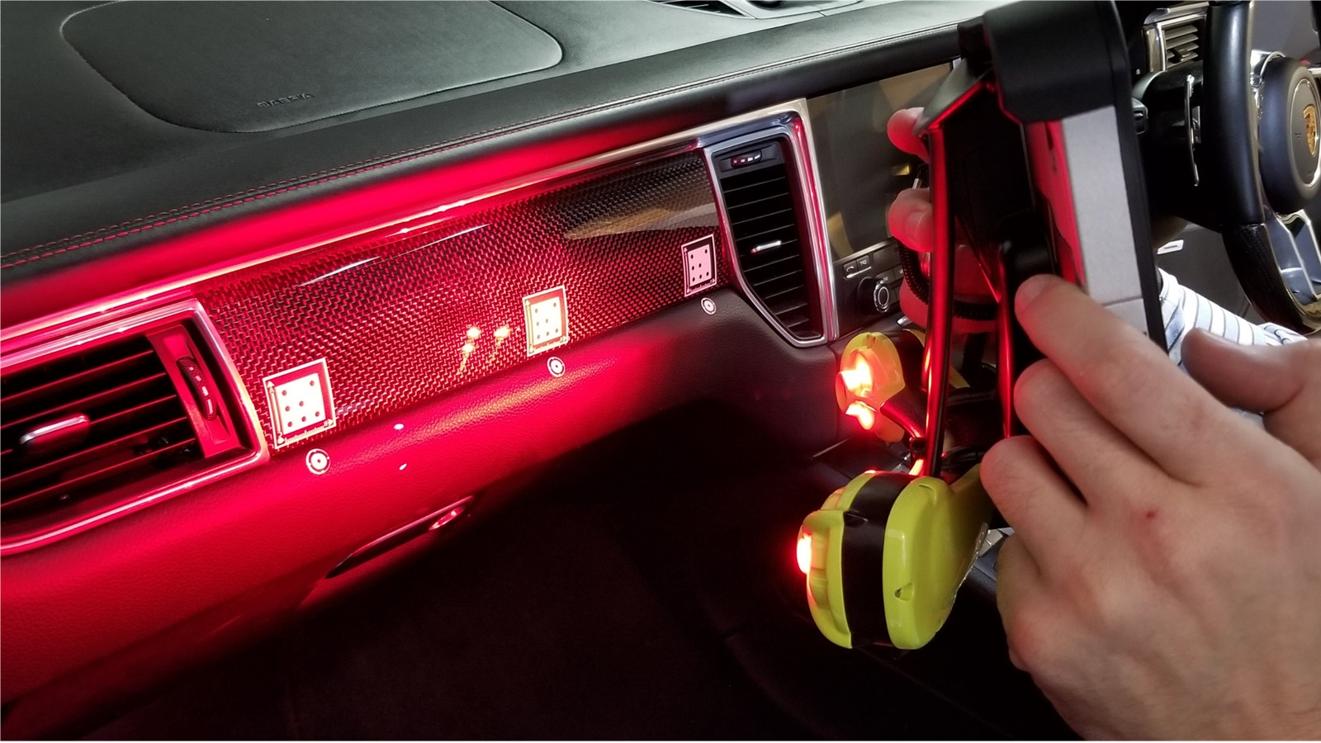
Interior
Flush & Gap
Confidential
© 2023 EZMetrology

Slide 35
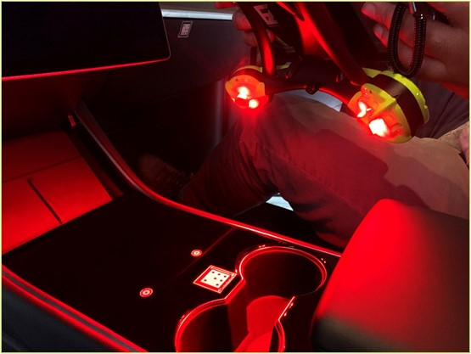
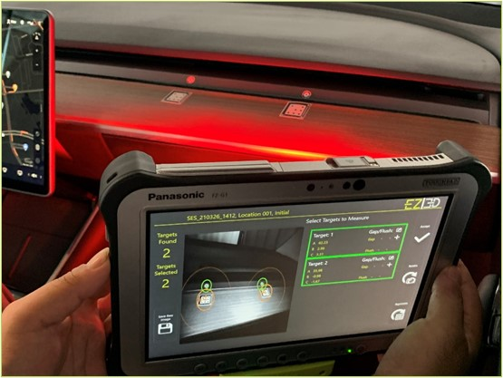
Application
Interior Flush and Gap
  Trim Assembly
  Establish flush and gap for mating trim elements under different conditions
  Button Deflection
  Establish button behaviors and fit under different conditions
  Moving Elements
  Observe kinematic behavior and fit of moving parts such as glove compartments and console covers
  Configuration Characterization
    Documenting the quality, look, and feel of interiors for different configurations
      Durability tests
      Temperature Influence
Confidential
© 2023 EZMetrology

Slide 36

Exterior Flush & Gap
Confidential
© 2023 EZMetrology

Slide 37



Application
Exterior Gap and flush
  The mix of different materials, the assembly methods, and the fit and finish under all conditions influences the perceived quality of the assembly.
  Exterior Trim Panel
  Fit and finish of trim panels on body or in assemblies
  Front facia, side trim, spoilers
  Moving Elements
  Observe kinematic behavior and fit of moving parts:
    Glove compartment
    Console cover
    Gas/ charging cover
    Doors or compartments
  Configuration Characterization
    Documenting the quality, look, and feel of interiors for different configurations
  Observe kinematic behavior and fit of moving parts:
    Durability tests
    Temperature Influence
Confidential
© 2023 EZMetrology

Slide 38

Pressurization
Confidential
© 2023 EZMetrology

Slide 39




Application
Pressurization
Structural Deformation Under Influence Of Pressure
  Measure and quantify the deformation under the influence of pressure levels for
  Panel surface (deflection)
  Assemblies and their flush and gaps
  Hose connections
  Valve operation
Confidential
© 2023 EZMetrology

Slide 40

Mini and Micro Mechanics
Confidential
© 2023 EZMetrology

Slide 41




Application
Mini and Micro Mechanics
Mini Mechanical Characteristics and Performance
  Measure and quantify the behavior of mechanical systems in the assembly:
  Fit and Finish
    Repeatability
    Durability
  Travel of System
  Loose Play or Deflection
  Typical applications are Door Handles, Trays, Cabinets, Cabinet Handles, Cup Holders, Coverings
Confidential
© 2023 EZMetrology

Slide 42

Session Info
Confidential
© 2023 EZMetrology

Slide 43

ABC Data
Confidential
© 2023 EZMetrology

Slide 44

ABC Deltas
Confidential
© 2023 EZMetrology

Slide 45

Gap/Flush Data
Confidential
© 2023 EZMetrology

Slide 46





SHARING OUR PASSION WORLDWIDE WITH CUSTOMERS AT
ALPINE
ARRIVAL
AUDI
BMW
BROSE
CANOO
CATERPILLAR
CHRYSLER
DACIA
DAIHATSU
DAIMLER
DENSO
FAW
FAURECIA
FERRARI
FIAT
FORD
GAC
GENERAL MOTORS
GG MOTORS
HUMANETICS
HONDA
HYUNDAI
INFINITI
JAGUAR
JEEP
KASEIKOGYO
KIA
KIEKERT
LADA
MACK
MAHINDRA
MARUTI
MASERATI
MAZDA
MITSUBISHI
MULTIMATIC
NISSAN
NITTO DENKON
POLARIS
PORSCHE
PROTON
PSA
QOROS
RENAULT
RIVIAN
SAIC MOTOR
SEAT
SIEMENS
STELLANTIS
SUBARU
SUZUKI
TATA MOTORS
TESLA
TOGG
TOYODA GOSEI
TOYOTA
VOLKSWAGEN
VOLVO
VOLVO TRUCKS
- EZM HEADQUARTERS
- EZM PARTNERS
- EZM CUSTOMERS
© 2023 EZMetrology

