Slide 1

EZMetrology Door Solutions
A Complete Technology Platform for Door Quality
An overview of EZMetrology's technology and turn-key solutions for accurate door system performance control
Confidential
  © 2024 EZMetrology

Slide 2

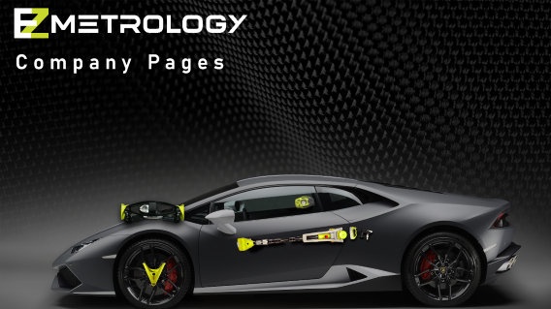

INDEX
Introduction
Full Door DNA - EZSlam
Key Metrics - Pods
Seal Gap - SealScan
Dynamic Deformation - EZMotion
Static Deformation - EZ3D
Coming Soon
Confidential
  © 2024 EZMetrology

Slide 3

1. Introduction
Confidential
  © 2024 EZMetrology

Slide 4
1. Introduction
Our Mission on the subject of Door Systems
1. Provide a measurement platform able to cover needs from benchmarking to production quality.
2. Designing application-oriented, “EZ” tools for detailed analysis or fast-paced inspection.
3. Foundation for standardization and consistency throughout an organization.
Benchmark
Objectively document performance of a wide variety of door systems.
Specification
Test multiple components to evaluate their performance with respect to targets.
Launch
During a rapid changing launch process, identify as soon as possible faulty or out-of-spec components.
Quality
Verify current production output using the original design targets.
Vehicle Life Cycle
Design
Compile data to establish a desired feel of the door.
Proto - Pilot
Validate and tune the process or system to the desired objectives.
Process
Review the process capability and identify specific process variation that contributes to closing efforts.
Confidential
  © 2024 EZMetrology

Slide 5
2. Full Door DNA - EZSlam
Confidential
  © 2024 EZMetrology

Slide 6
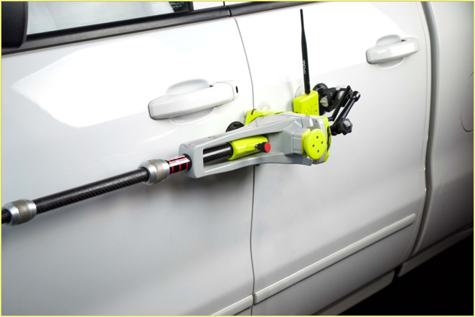
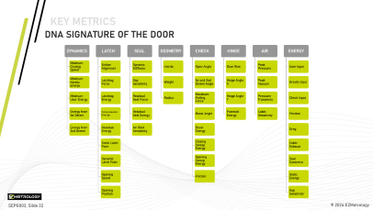
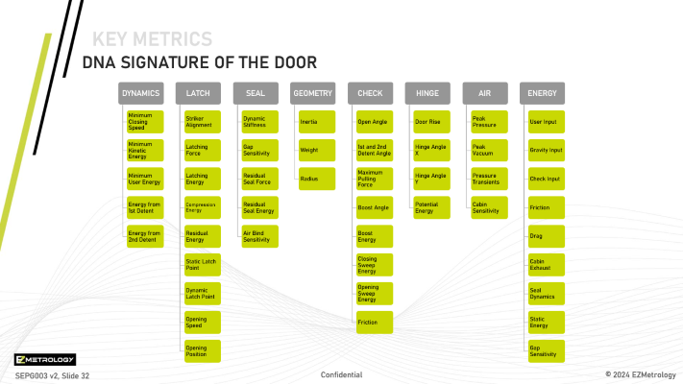
2. FULL DOOR DNA - EZSLAM
2.1 ezslam Concept
Overview
EZSlam is a dedicated door measurement system comprised of speed, force, pressure, alignment, and acceleration sensors.
The system integrates the procedure, data collection and processing of the static and dynamic effects during door opening and closing cycles.
The “DNA” results include metrics that relate to
  Customer experience
  Individual component performance
  Overall relative contributions
Confidential
  © 2024 EZMetrology

Slide 7
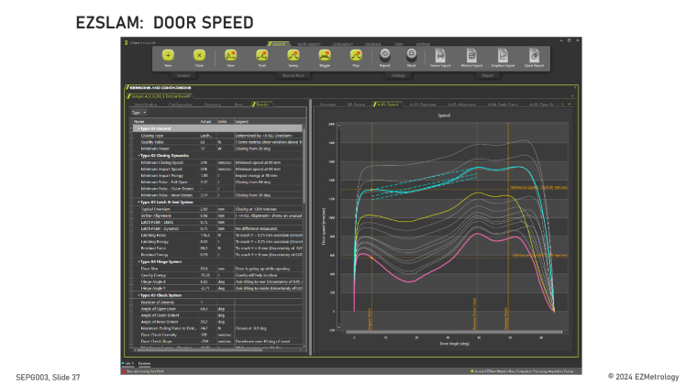
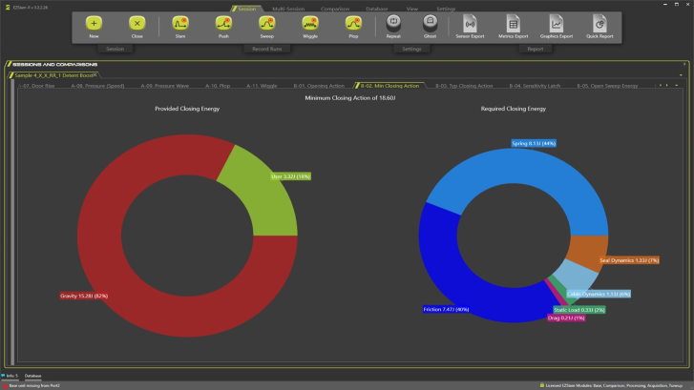
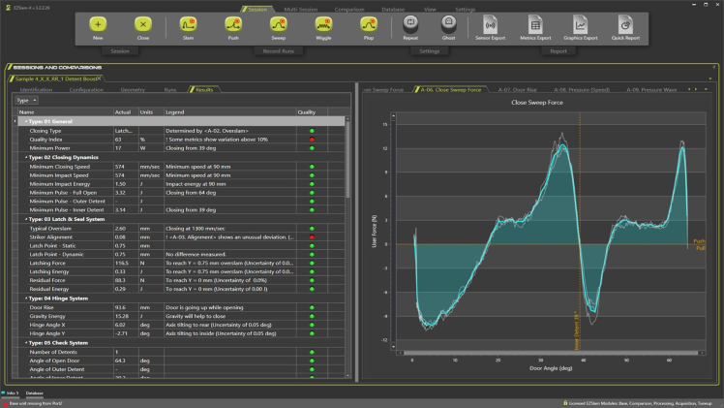
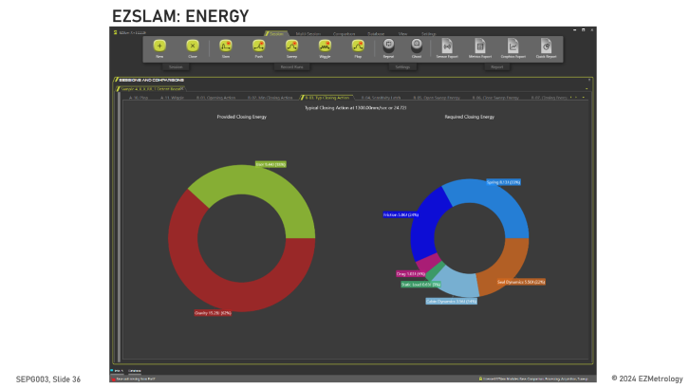
2. FULL DOOR DNA - EZSLAM
2.2 ezslam APPLICATIONS
Applications
  Benchmarking of different design choices
  Compare “Good” vs “Bad”
  Identify weakest link to improve closing efforts
  Quantify design expectations
  Evaluate component contributions
  Quality control and troubleshooting
Advantages
  Only 15 to 20 minutes per door for full “DNA”
  Standard operating procedure: 5 types of standard tests
  Standard Processing
  Standard Reporting
Confidential
  © 2024 EZMetrology

Slide 8
3. Key Metrics - Pods
Confidential
  © 2024 EZMetrology

Slide 9
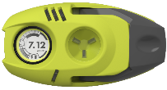
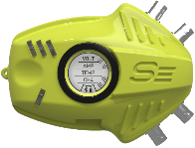
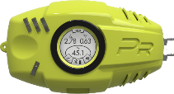
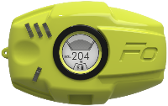
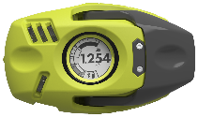
3. Key Metrics - Pods
3.1 POD PLATFORM
Energy
Speed
Force
Applications
  Measurement of key characteristics
    Force, Speed, Energy, Pressure…
  Fast, simple operation and deployment
  Modular platform for doors, hoods, frunks, trunks, and liftgates
Advantages
  On-board processing
  Values and evaluation is displayed on screen, or with led’s
  Go/no-go or True Value mode
  Multiple Data collection platforms
  Wireless logging
Analog Signal
Digital Signal
Cabin Pressure
Force
Pinch
Speed
Angle
Confidential
  © 2024 EZMetrology

Slide 10
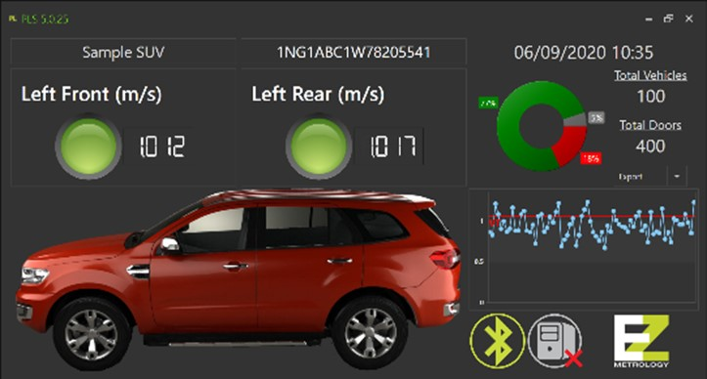
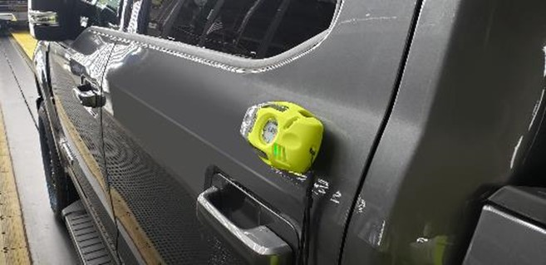
3. Key Metrics - Pods
3.2 DATA POINTS with PLS
Overview
Production Line Solution
Automated data collection platform.
  Scan VIN (Bar Code or line PLC)
  Run inspection routine based on test plan
  Provide real time feedback
  Send data to a quality system
Applications
  Key metric logging (speed, energy, and force)
  Repetitive product audits or 100% in-line inspection
  Quality control, trends, and data distribution
Advantages
  Fully automated
  Data traceability
  Fixed station (desktop) or roaming (tablet based)
Confidential
  © 2024 EZMetrology

Slide 11
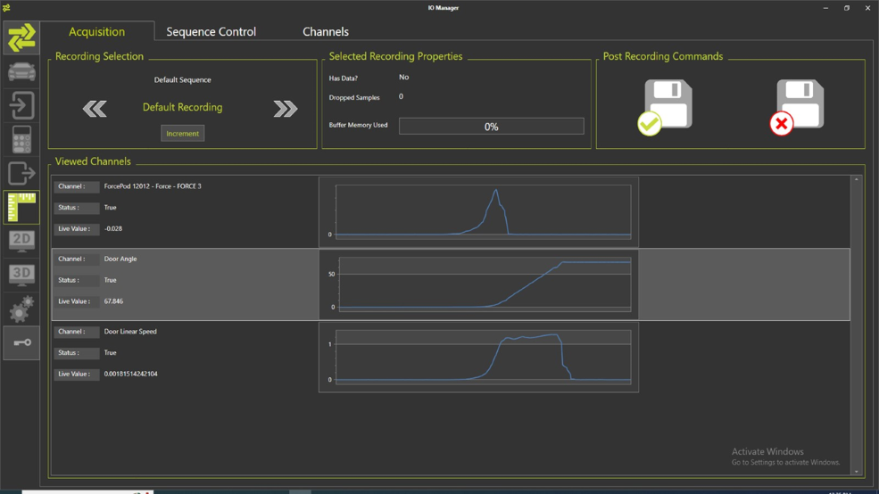
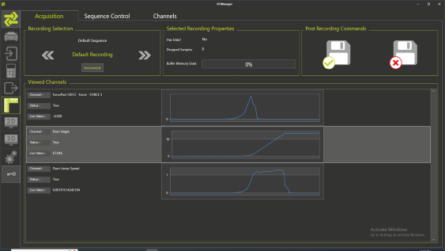
3. Key Metrics - Pods
3.3 DATA STREAM WITH IOMANAGER
Overview
Signal recording for synchronized data acquisition from all Pod devices
  Synchronization
  Template-based acquisition
  Template-based processing
  Template-based reporting
Applications
    Automated doors or closures
  Physical behavior (speed, force, and acceleration)
  Electrical signals (volt, amp, signals)
  Include CAN signals
Advantages
  Easy to use
  Data traceability
Confidential
  © 2024 EZMetrology

Slide 12
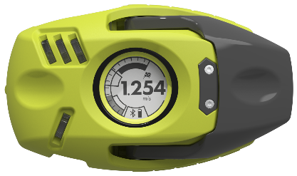
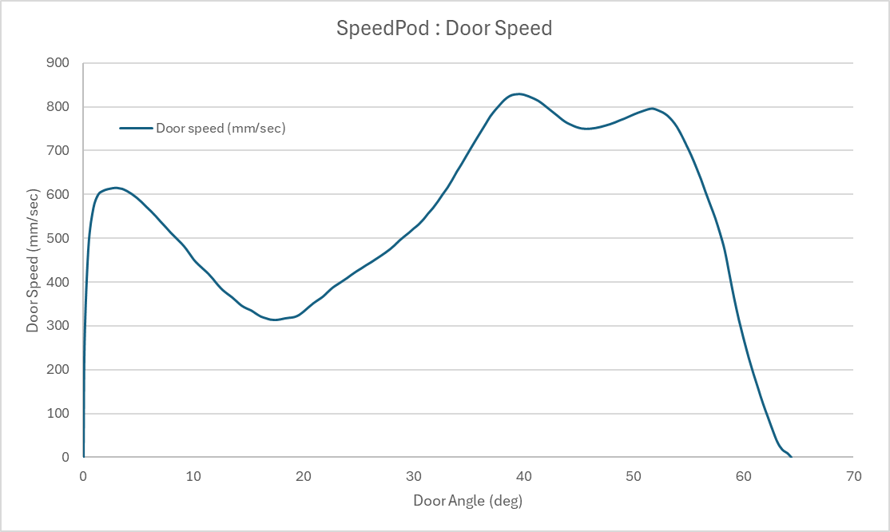
3. Key Metrics - Pods
3.4 SPEEDPOD
Technology
A pod to capture minimum closing speed with minimum user interaction. Specialized inertial sensors with onboard processing and smart algorithms to detect
  Mounting on the closure
  Opening or closing movement
  Latched or Not Latched
  Closing speeds from 0.01 to 4.3 m/sec.
Applications
  Minimum closing speed (Go/no-go or Gap Mode)
  Hinge tip (rotation axis vs. gravity)
  Friction
  Door angle
  Speed vs. angle curve
Confidential
  © 2024 EZMetrology

Slide 13
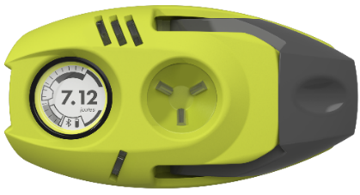
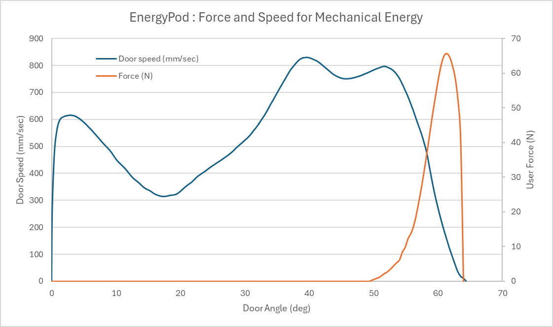
3. Key Metrics - Pods
3.5 ENERGYPOD
Technology
A pod to capture minimum closing energy with minimum user interaction through a combination of specialized inertial sensors and a 3D Vector Loadcell with onboard processing and smart algorithms to detect
  Mounting on the closure
  Opening or closing movement
  Latched or not latched
  Closing energy from 0.1 to 100 J
Applications
  Minimum closing energy
  Minimum closing speed
  Hinge tip (rotation axis vs. gravity)
  Friction
  Door angle
  User force
  Speed vs. angle curve
  Force vs. angle curve
Confidential
  © 2024 EZMetrology

Slide 14
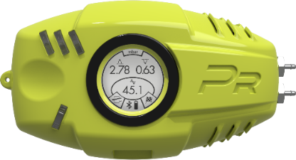
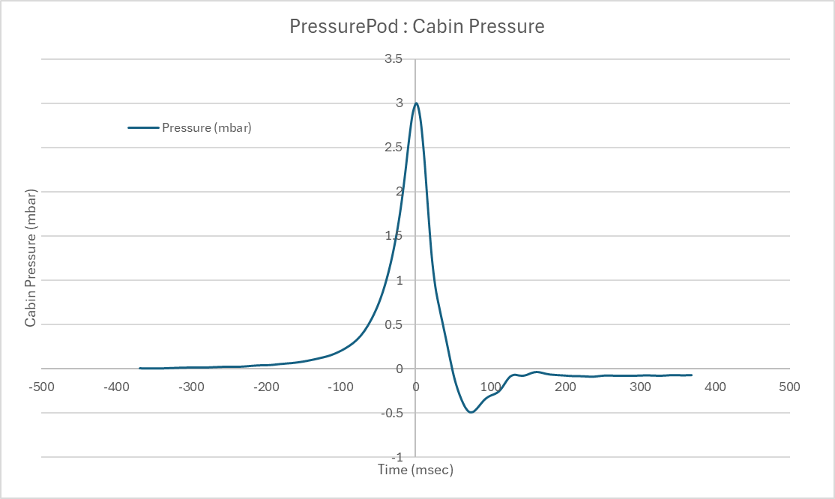
3. Key Metrics - Pods
3.6 PRESSUREPOD
Technology
A pod to capture cabin pressure dynamics utilizing a specialized sensitive pressure sensor with built-in level control to quantify air extraction performance.
Multiple units can be combined to study additional pressure transient behavior. PressurePod is often combined with SpeedPod to incorporate cabin pressure dependency on door closing speed.
Applications
  Cabin pressure peak
  Cabin pressure vacuum
  Peak width
  Pressure vs. time curve
  © 2024 EZMetrology
Confidential

Slide 15
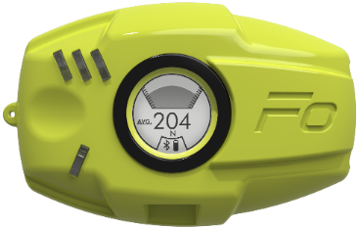
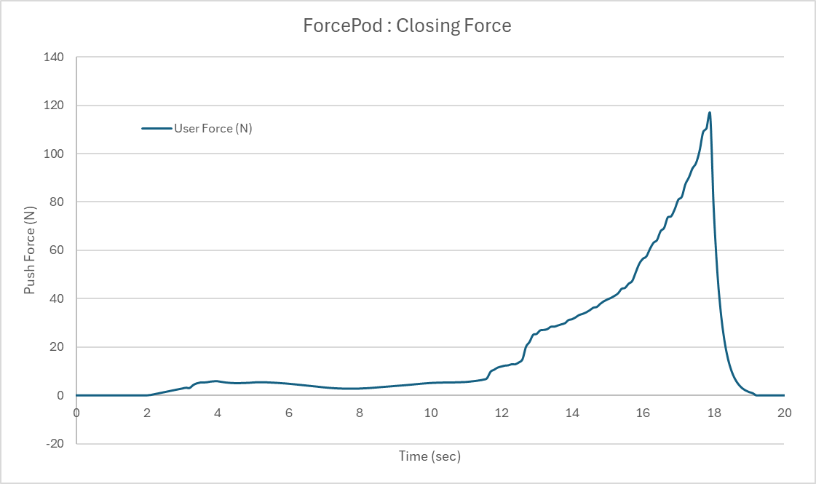

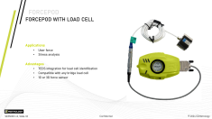
3. Key Metrics - Pods
3.7 FORCEPOD
Technology
A pod compatible with a wide variety of load cells to have synchronized data between force interaction and movement of the closure.
  Push force
  Static closing force
  Door check forces
  Pinch force (EZMetrology’s Pinch sensor)
Applications
  Peak Force
  Final Force
  Force vs Time
Examples
Confidential
  © 2024 EZMetrology

Slide 16
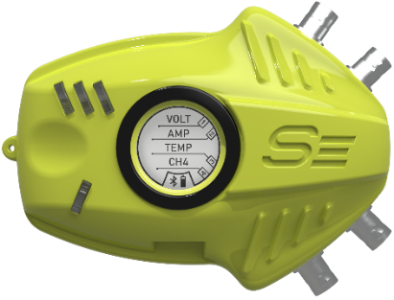
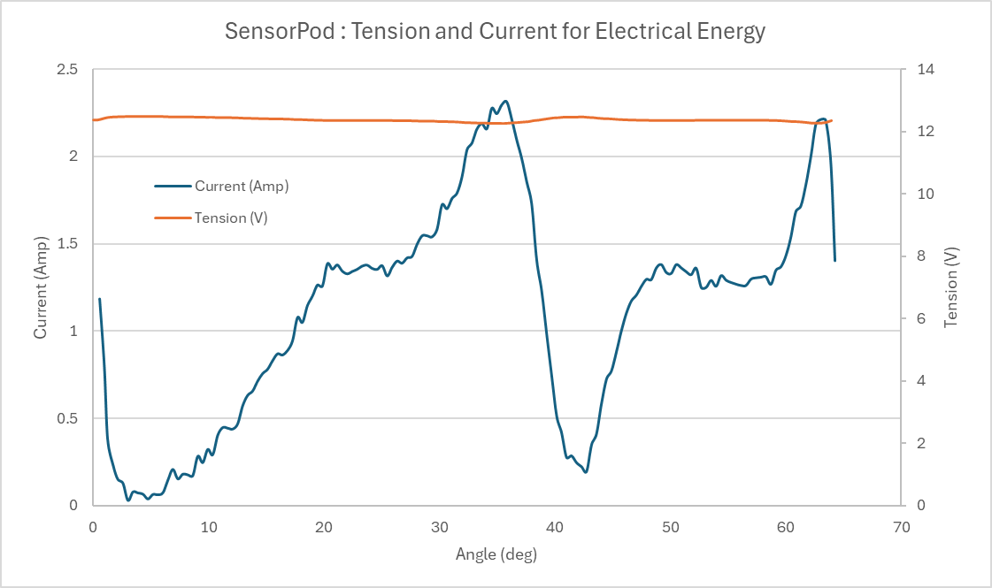


3. Key Metrics - Pods
3.8 SEnsorPod
Technology
A compact gauge with 4-channel 24-bit simultaneous sampling, programmable gain, and offsets to capture external analog or digital signals.
  Voltage
  Current
  Control signals
    Often combined with IOManager for synchronized data collection.
Applications
  Electrical power
  System latency
Examples
Confidential
  © 2024 EZMetrology

Slide 17
4. SealGap - SealScan
Confidential
  © 2024 EZMetrology

Slide 18
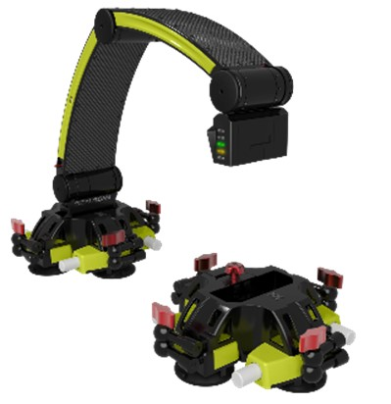
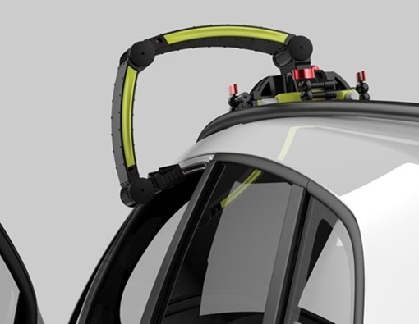
4. Sealgap - sealscan
4.1 Sealscan concept
Overview
    SealScan is a non-contact 2D measurement system. The lightweight 3-axis articulated arm can be mounted on any surface, and its patented symmetrical design allows capture of both mating surfaces to determine the seal gap and seal interference.
    Key points:
  Vehicle on wheels
  Non-destructive
  Simple operation (2D)
  Fast, immediate results
  Compare to CAD
Applications
  Capture 2D cross-section of mating surfaces
  Seal fitting and interference
  Windowsill alignment
  Trim geometry and positioning
  Seal geometry and positioning
Confidential
  © 2024 EZMetrology

Slide 19
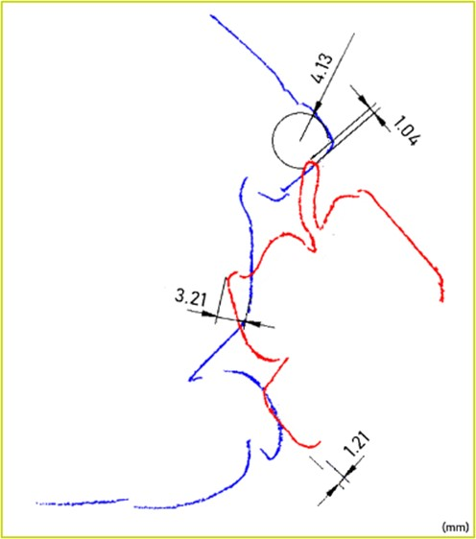
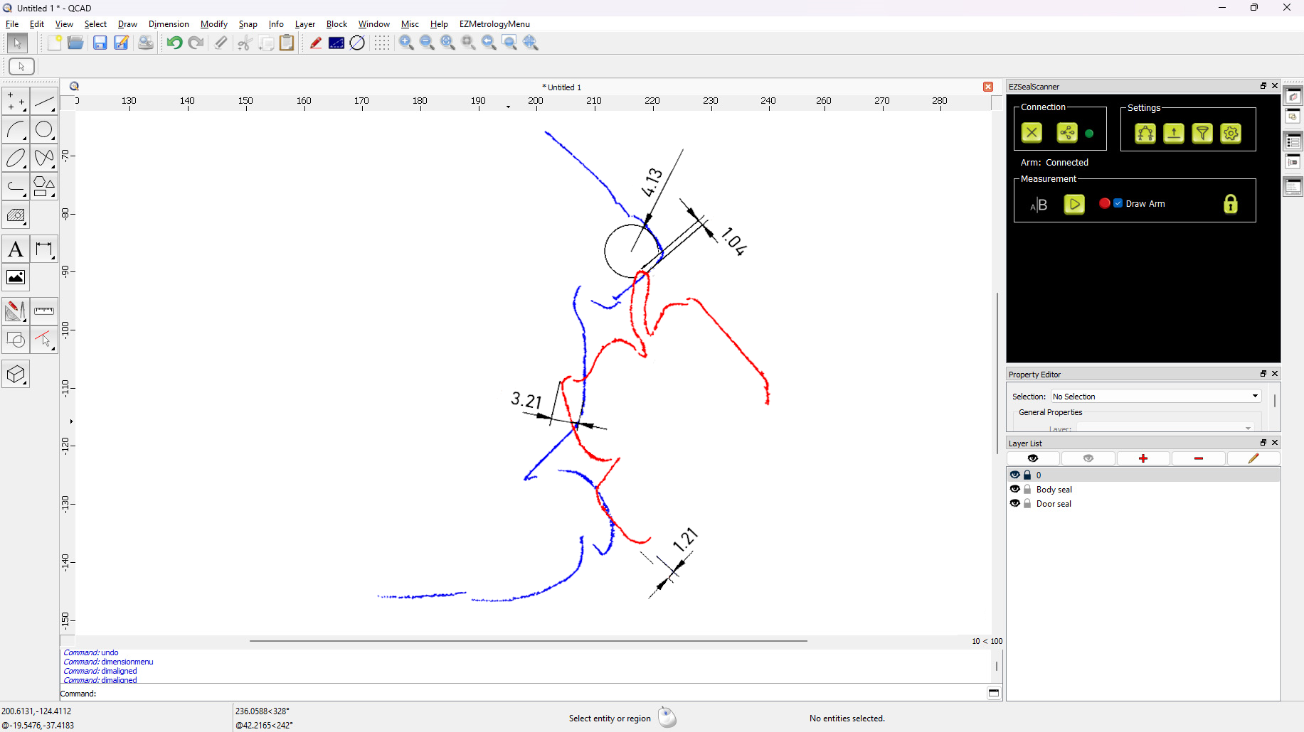
4. Sealgap - sealscan
4.2 Sealscan APPLICATIONS
Advantages
  For use on doors, trunks, liftgates, and sliding doors
  True seal gap including door deformation due to seal load
  Easy-to-use hardware and software
  2D section dimensioning and alignment
  Free form seal gap designs
  From a single reading
    Referenced from body
    Location of door
    Location of seals
    Dimensions of the seals
    Contact point and interference
Confidential
  © 2024 EZMetrology

Slide 20
5. Dynamic Deformation - EZMotion
Confidential
  © 2024 EZMetrology

Slide 21
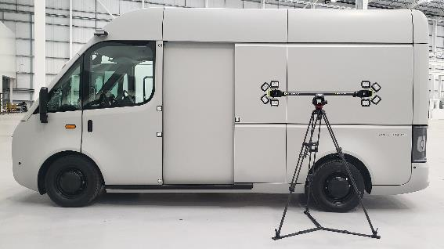
5. DynAmic Deformation - EZMotion
5.1 EzMotion: Complex Motions
Technology
A camera-based 3D tracking system for complex motion analysis. The stereovision technology records 3D or 6D displacements and trajectory information of one or many points in an absolute or relative space.
    Trajectory information up to 500 Hz
    Position
    Angle
    Speed
    Acceleration
  Single or multiple points simultaneously
  Relative motion between objects or parts
  Synchronized with other sensors or signals
    SensorPod, ForcePod
    CAN
Confidential
  © 2024 EZMetrology

Slide 22
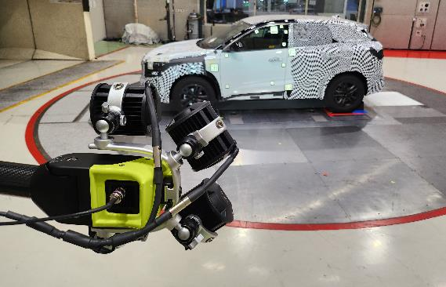
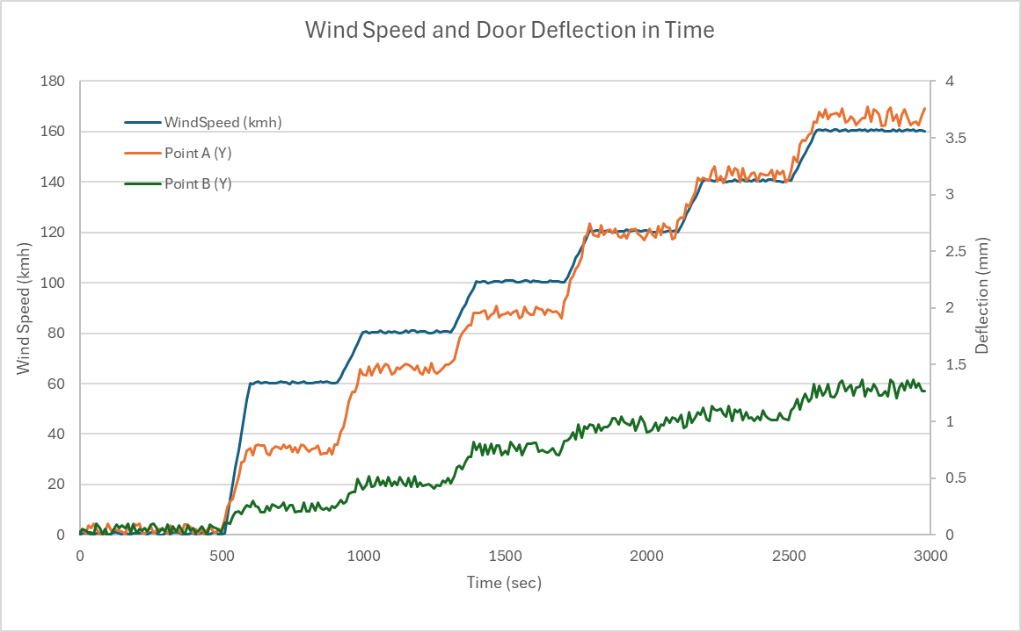
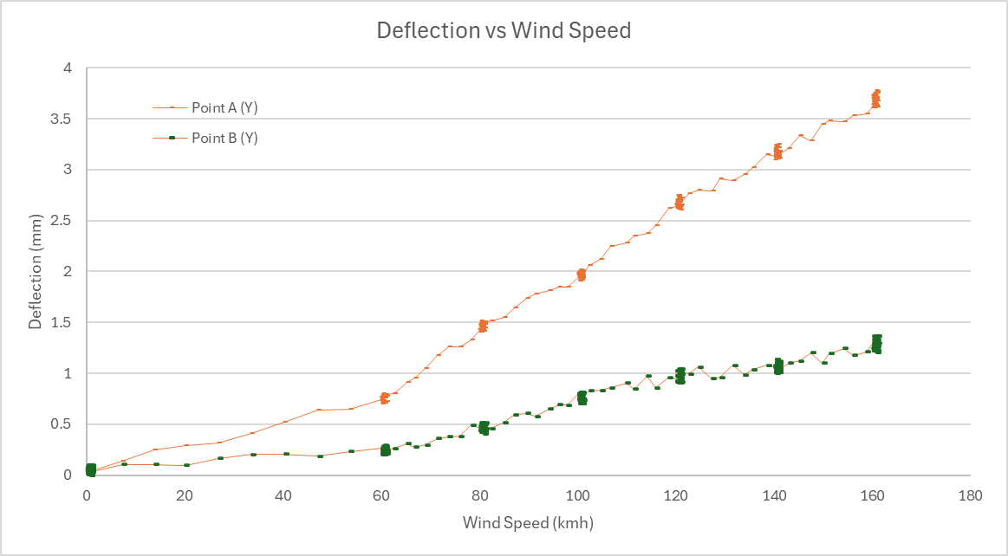
5. DynAmic Deformation - EZMotion
5.2 EzMotion APPLICATIONs
Applications
  Sliding door kinematics
  Convertible roof trajectory
  Structural deformation under load
  Power window stick effect
  Kinematic alignment
  Wind tunnel testing
Advantages
  Easy installation
  Multiple, lightweight targets
  Adaptable to testing environment requirements
    Distance
    Resolution
    Accuracy
    Frequency
Confidential
  © 2024 EZMetrology

Slide 23
6. Static Deformation- EZ3D
Confidential
  © 2024 EZMetrology

Slide 24
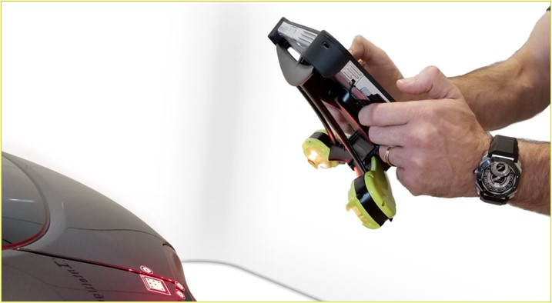
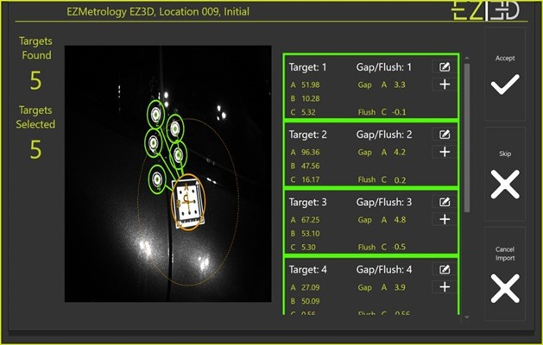
6. STATIC DEFORMATION – Ez3D
6.1 EZ3D
Technology
Camera-based 3D measurement system to determine deformation, drift, and misalignment of parts or assemblies during repetitive test cycles.
Applications
  Flush and gap drift of assemblies in climate chambers
  Deformation under static load or pressure
  Door settings for tolerance validation
  Progressive and fixture adjustment
Advantages
  Easy-to-use picture-based system
  Tablet operated
  Gap, flush, and sheer monitoring
  Real-time results
  Automatic numerical and graphical reporting
  Rugged for extreme climates
Confidential
  © 2024 EZMetrology

Slide 25
7. Coming Soon
Confidential
  © 2024 EZMetrology

Slide 26
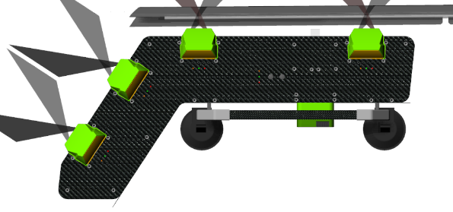
7. COMING SOON
7.3 Window PENETRATION
Technology
Laser-based measurement of window seal penetration.
Applications
  In-line inspection and validation of window setting
  Fast installation
  Fully Automated
  Advantages
  Digital verification of key window settings
  Real time feedback
  User Independent
Confidential
  © 2024 EZMetrology

Slide 27
Thank you.
info@ezmetrology.com
support@ezmetrology.com
www.ezmetrology.com
portal.ezmetrology.com
academy.ezmetrology.com
Confidential
  © 2024 EZMetrology

Slide 28
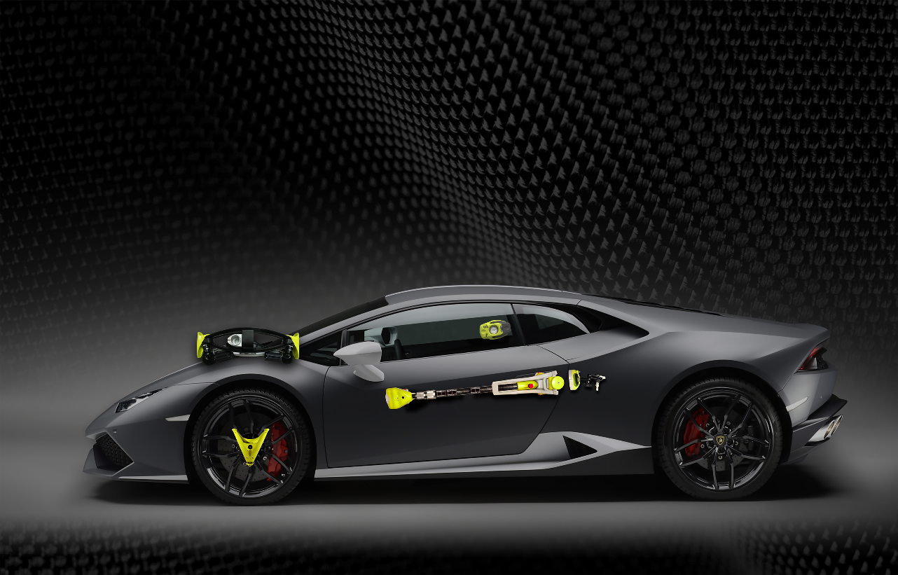

Company Pages

Slide 29
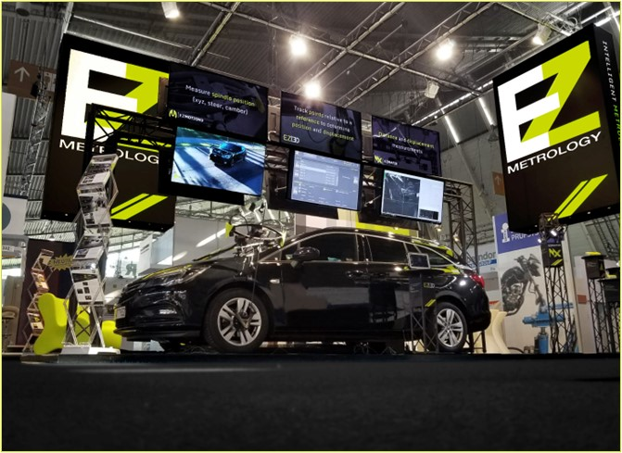
COMPANY OVERVIEW
Founded in 2006 by Carine Woldanski and Tom Van Esch
Global Operations:
  USA Headquarters in Michigan
  Europe Support office in Luxemburg
  Asia Partnerships
EZMetrology:
  70% Development and Engineering
    Fast product development and interactive evolutions
  20% Support and Training
    Ensuring a transfer of knowledge to our customers
  10% Administration and Sales
    Manage customs and sales procedures
Consistent annual growth of 50% over the past years
Developing innovative, creative and practical products
Confidential
  © 2024 EZMetrology

Slide 30

SHARING OUR PASSION WORLDWIDE WITH CUSTOMERS AT
ALPINE
ARRIVAL
AUDI
BMW
BROSE
CANOO
CATERPILLAR
CHRYSLER
DACIA
DAIHATSU
DAIMLER
DENSO
FAW
FAURECIA
FERRARI
FIAT
FORD
GAC
GENERAL MOTORS
GG MOTORS
HUMANETICS
HONDA
HYUNDAI
INFINITI
JAGUAR
JEEP
KASEIKOGYO
KIA
KIEKERT
LADA
MACK
MAHINDRA
MARUTI
MASERATI
MAZDA
MITSUBISHI
MULTIMATIC
NISSAN
NITTO DENKON
POLARIS
PORSCHE
PROTON
PSA
QOROS
RENAULT
RIVIAN
SAIC MOTOR
SEAT
SIEMENS
STELLANTIS
SUBARU
SUZUKI
TATA MOTORS
TESLA
TOGG
TOYODA GOSEI
TOYOTA
VOLKSWAGEN
VOLVO
VOLVO TRUCKS
- EZM HEADQUARTERS
- EZM PARTNERS
- EZM CUSTOMERS
  © 2024 EZMetrology

Slide 31


Slide 32
Key Metrics
DNA signature of the door
DYNAMICS
Minimum Closing Speed
Minimum Kinetic Energy
Minimum User Energy
Energy from 1st Detent
Energy from 2nd Detent
LATCH
Striker Alignment
Latching Force
Latching Energy
Compression Energy
Residual Energy
Static Latch Point
Dynamic Latch Point
Opening Speed
Opening Position
SEAL
Dynamic Stiffness
Gap Sensitivity
Residual Seal Force
Residual Seal Energy
Air Bind Sensitivity
GEOMETRY
Inertia
Weight
Radius
CHECK
Open Angle
1st and 2nd Detent Angle
Maximum Pulling Force
Boost Angle
Boost Energy
Closing Sweep Energy
Opening Sweep Energy
Friction
HINGE
Door Rise
Hinge Angle X
Hinge Angle Y
Potential Energy
AIR
Peak Pressure
Peak Vacuum
Pressure Transients
Cabin Sensitivity
ENERGY
User Input
Gravity Input
Check Input
Friction
Drag
Cabin Exhaust
Seal Dynamics
Static Energy
Gap Sensitivity
Confidential
  © 2024 EZMetrology

Slide 33
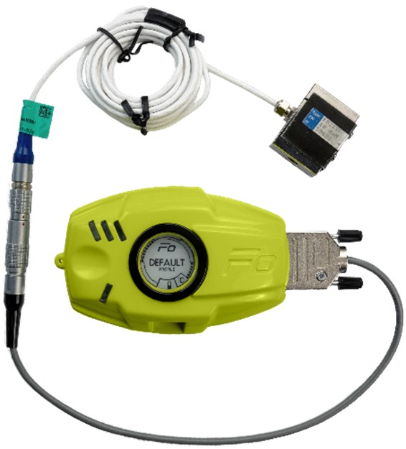
FORCEPOD
FORCEPOD WITH LOAD CELL
Applications
  User force
  Stress analysis
Advantages
  TEDS integration for load cell identification
  Compatible with any bridge load cell
  1D or 3D force sensor
Confidential
  © 2024 EZMetrology

Slide 34
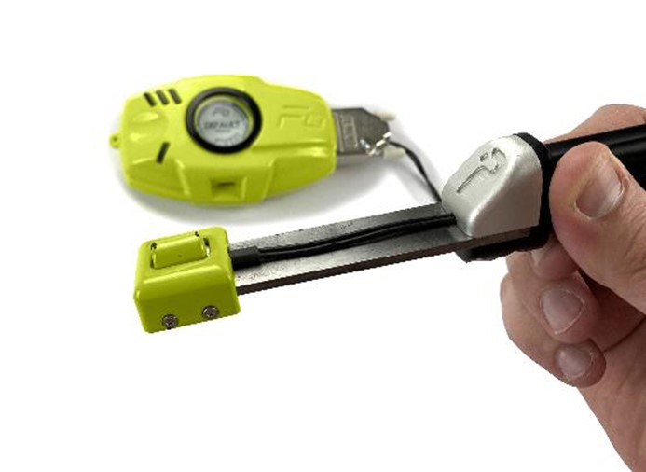
FORCEPOD
FORCEPOD WITH Pinch SENSOR
Applications
  Finger pinch force
  Force-based obstacle detection
  Window pinch force
Advantages
  Compact size
  Build in deflection
  3D force sensor for accurate vector detection
  Overload protection and failsafe mechanism to avoid sensor or vehicle damage
  Custom contact shapes
Confidential
  © 2024 EZMetrology

Slide 35
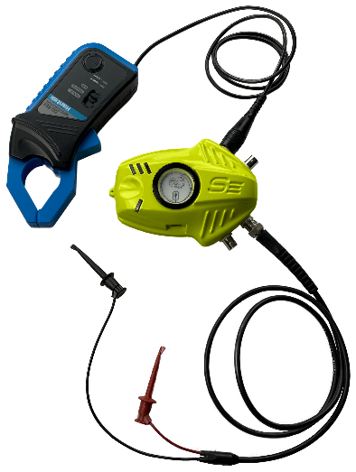
SENSORPOD
SENSORPOD WITH ELECTRICAL CONNECTIONS
Applications
  Electrical current
  Circuit tension
  Button input
Advantages
  Synchronization with other pods
  High resolution
Confidential
  © 2024 EZMetrology

Slide 36

  © 2024 EZMetrology

Slide 37
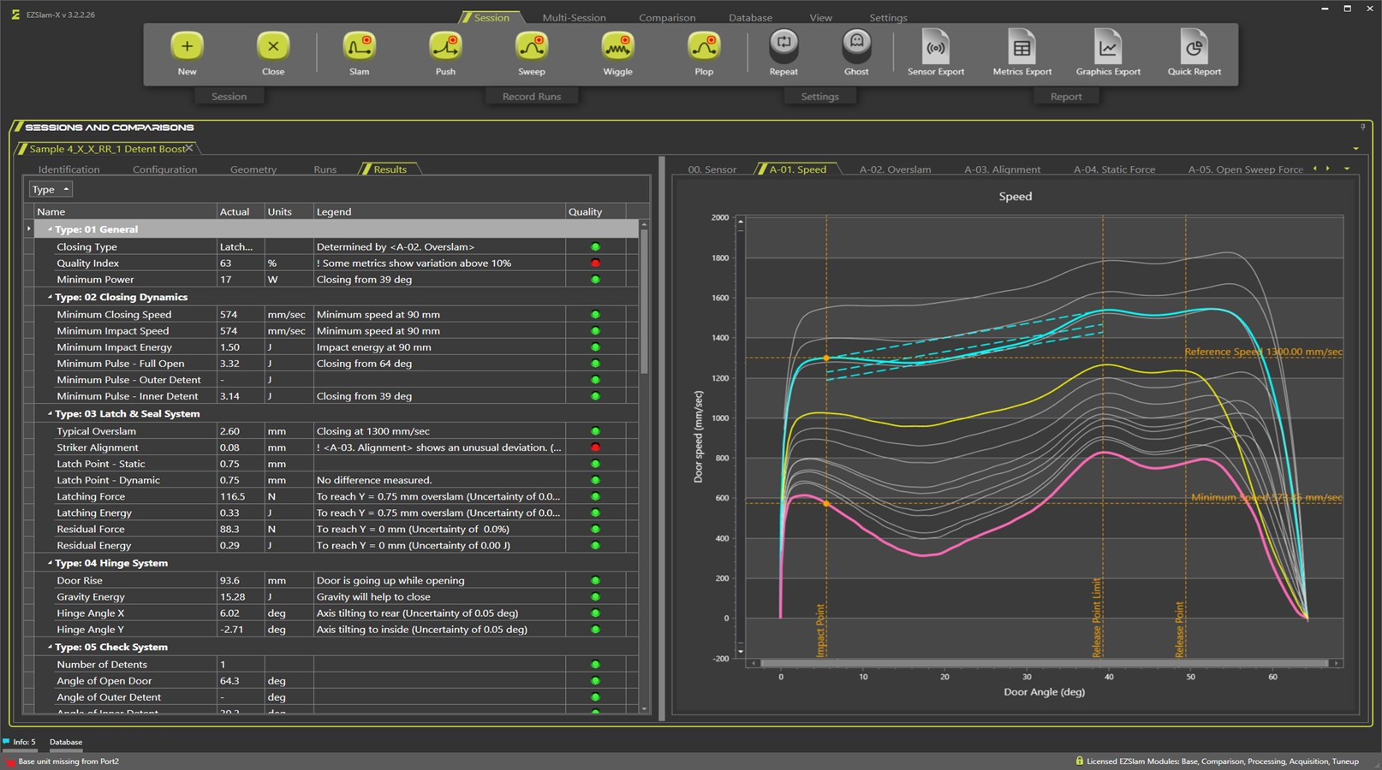
  © 2024 EZMetrology

Slide 38
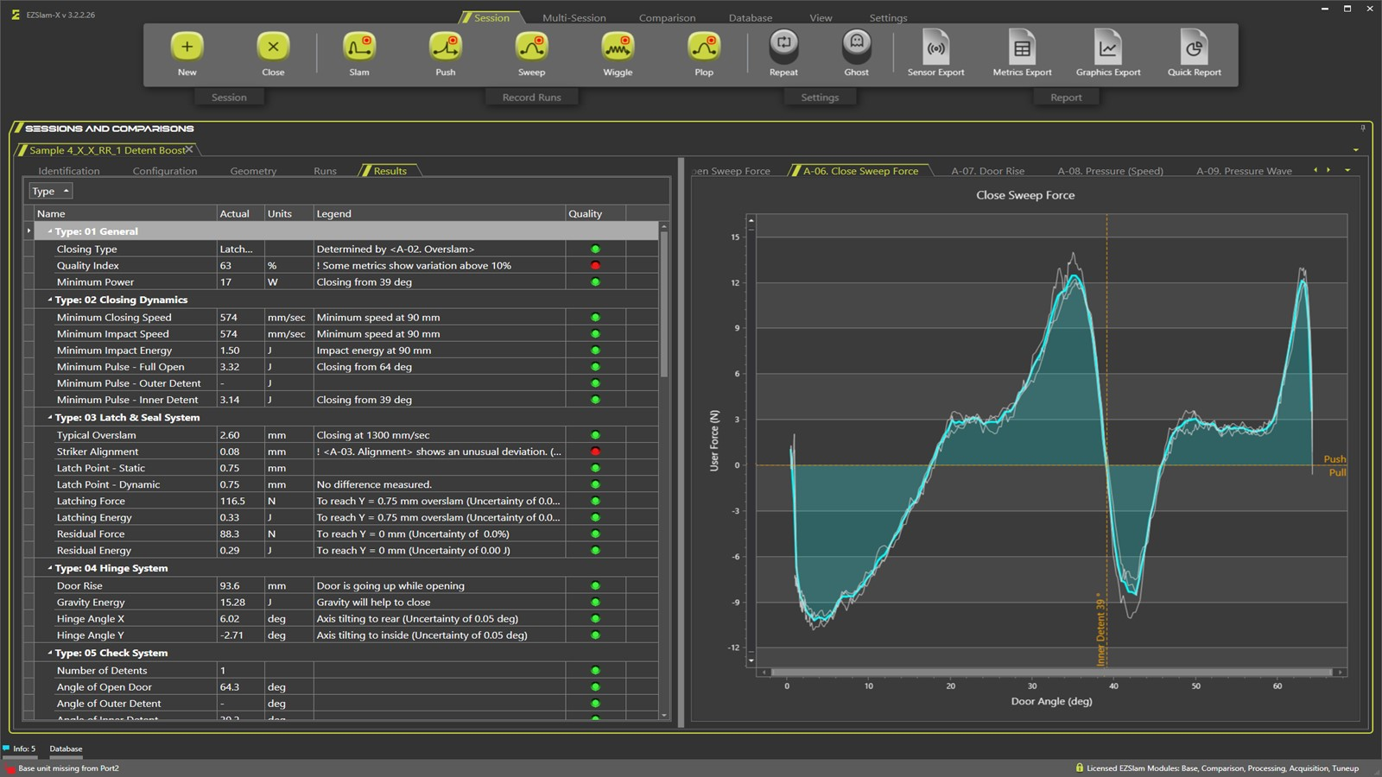
  © 2024 EZMetrology

Slide 39
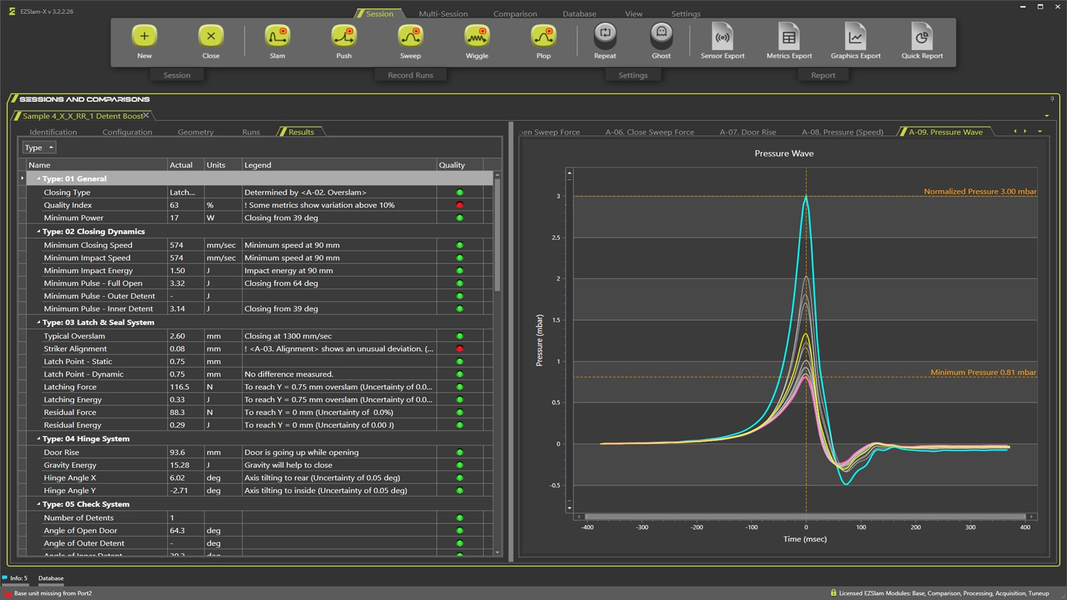
  © 2024 EZMetrology

Slide 40
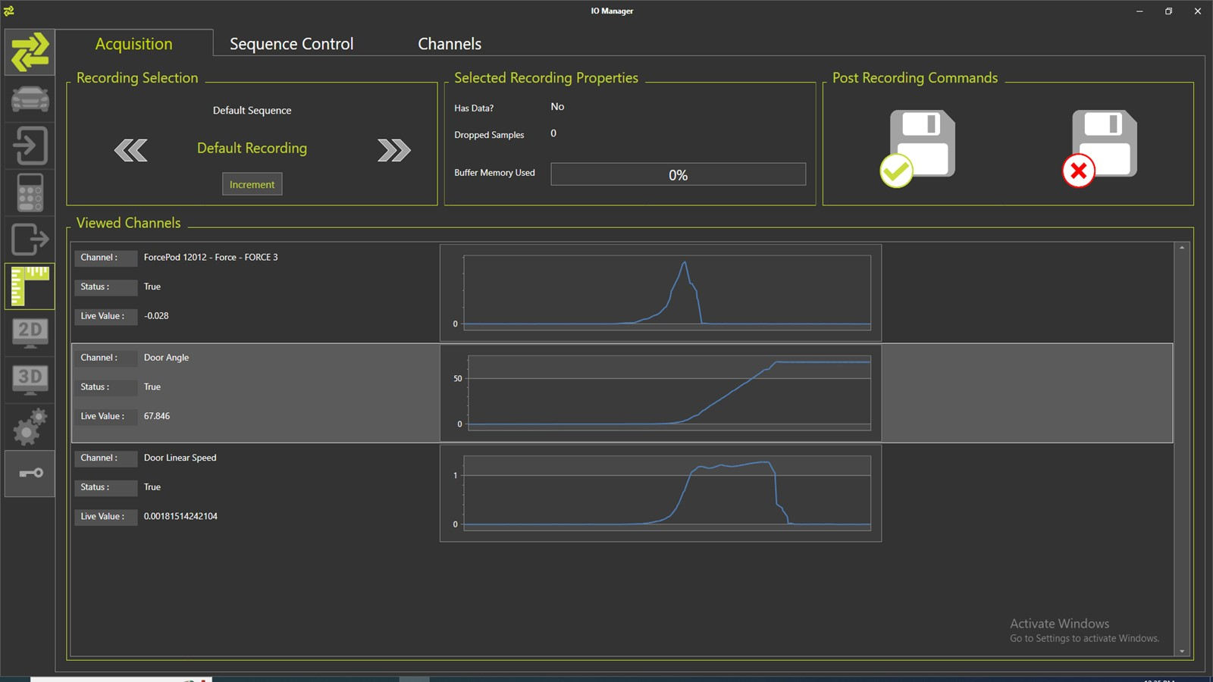
  © 2024 EZMetrology

Slide 41
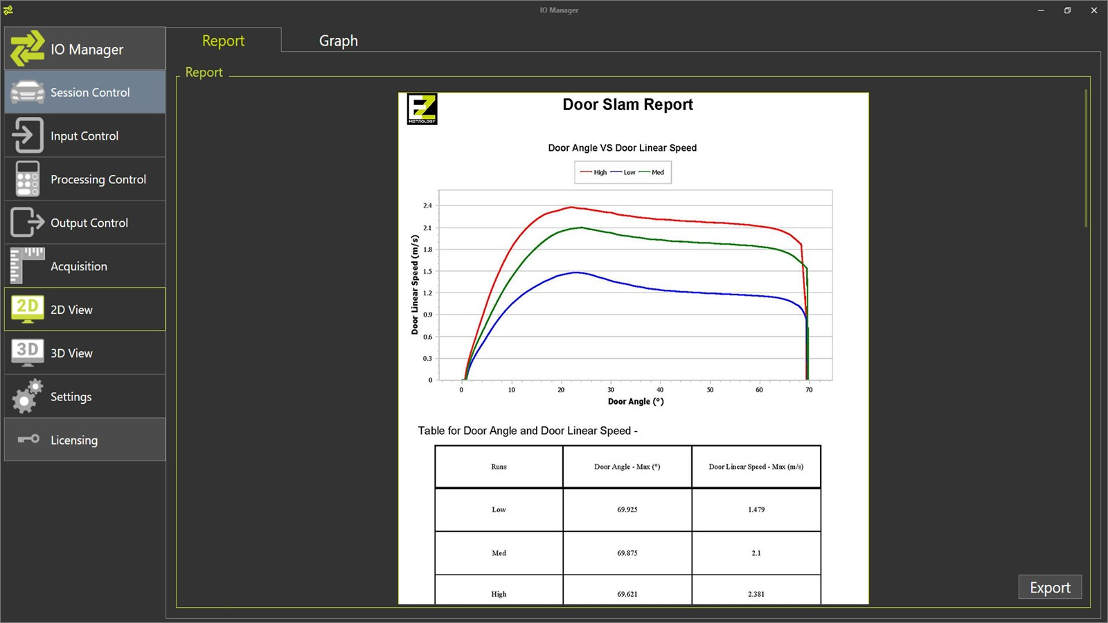
  © 2024 EZMetrology

