Slide 1

The Door as an Energy System
© 2024 EZMetrology

Slide 2
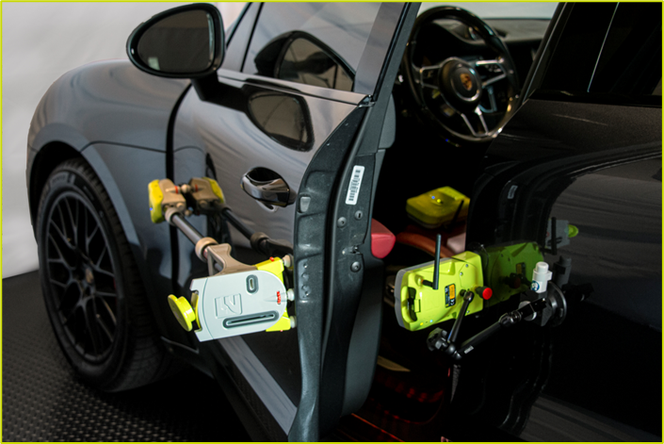
Index
Measurements
Conversion to Energy
Case Study: Optimization Door System
Conclusion
SEPA010, Slide 2
© 2024 EZMetrology

Slide 3

1. Measurements
SEPA010, Slide 3
© 2024 EZMetrology

Slide 4

  Answering the following type of questions:
  <> What is a “GOOD” door?
  <> When does it become a “BAD” door?
  <> How do the tolerances influence the performance?
  <> What is the difference between these two types of doors?
  <> What happens when we exchange a component?
1. MEASUREMENT
1.1 GOALS
  What are we are looking for in our measurement data?
  a) Technical Subjective Opinion of the samples.
  b) Objective Data – describing the door system in high level of detail
SEPA010, Slide 4
© 2024 EZMetrology

Slide 5
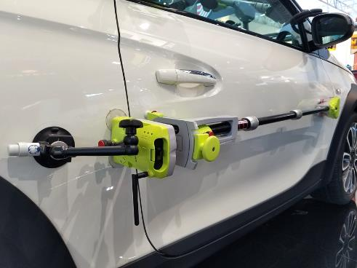
1. MEASUREMENT
1.2 THREE ESSENTIAL PRINCIPLES
1 – DOOR FUNCTION
  Be as close to the end-user experience as possible.
  Perform studies on fully assembled vehicles.
2 – SYSTEMATIC METHOD
  Systematic acquisition, user-independent methods, and objective data.
3 – FAST EXECUTION
  Evaluation should cover all aspects and be achievable within 20 minutes to enable a large sample size.
SEPA010, Slide 5
© 2024 EZMetrology

Slide 6
1. MEASUREMENT
1.3 TOOL 1: EZSLAM TECHNOLOGY
MULTI SENSOR (EZSLAM2)
Force, Accelerometer, Gyroscope, Pressure Sensor, 2D Position (YZ)
STATIC MEASUREMENTS
Multiple Push (Static Closing)
Multiple Sweep (Operation / Closing Force)
DYNAMIC MEASUREMENTS
Multiple Slams (Closing from Full Open)
Wiggle (Shake)
AUTOMATIC DATA PROCESSING
Extract data from each specific run
Re-iterate the overall analysis based on information from newly added data
“DNA” OF THE DOOR
Establish: Minimum Closing Speed, Closing Energy, Hinge Angle, Peak Pressure, Minimum Vacuum, Latch Force, Seal Compression, Latch Point, Striker Alignment, Air Bind, Open Angle, Operational Force, Inertia, Opening Speed…
SEPA010, Slide 6
© 2024 EZMetrology

Slide 7
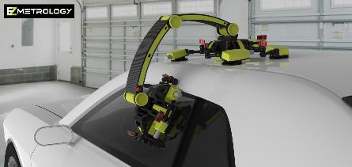
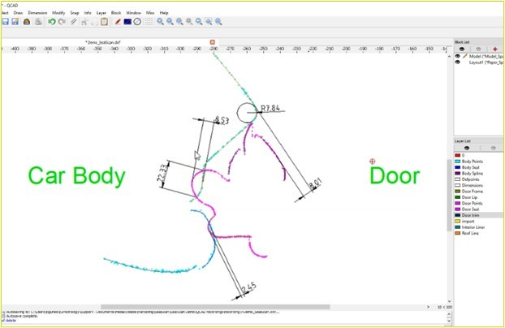
  Why SealScan as the tool?
  <> Fast operation: large sample size
  <> Final configuration (including seal load)
  <> Non-Destructive
  <> Full Cross- Section Cad Compare
  A measurement can detect
  <> Seal Dimensions
  <> Seal Location
  <> Relative Door Position (BIW)
1. MEASUREMENT
1.3 TOOL 2: SEALSCAN TECHNOLOGY
SEPA010, Slide 7
© 2024 EZMetrology

Slide 8
2. Conversion to Energy
SEPA010, Slide 8
© 2024 EZMetrology

Slide 9
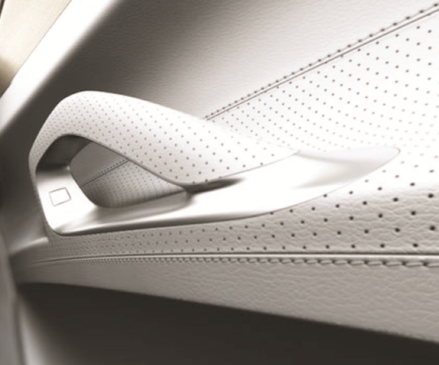
2. CONVERSION TO ENERGY
2.1 LEVELING THE PLAYING FIELD
1. User Input
5. Pressure
6. Seal
4. Friction
2. Speed
3. Hinge Inclination
N
m / sec
Degrees
Nm
mbar
N / mm
A wide variety of characteristics can be established. However, the diverse physical nature of all elements makes it nearly impossible to compare or correlate.
SEPA010, Slide 9
© 2024 EZMetrology

Slide 10
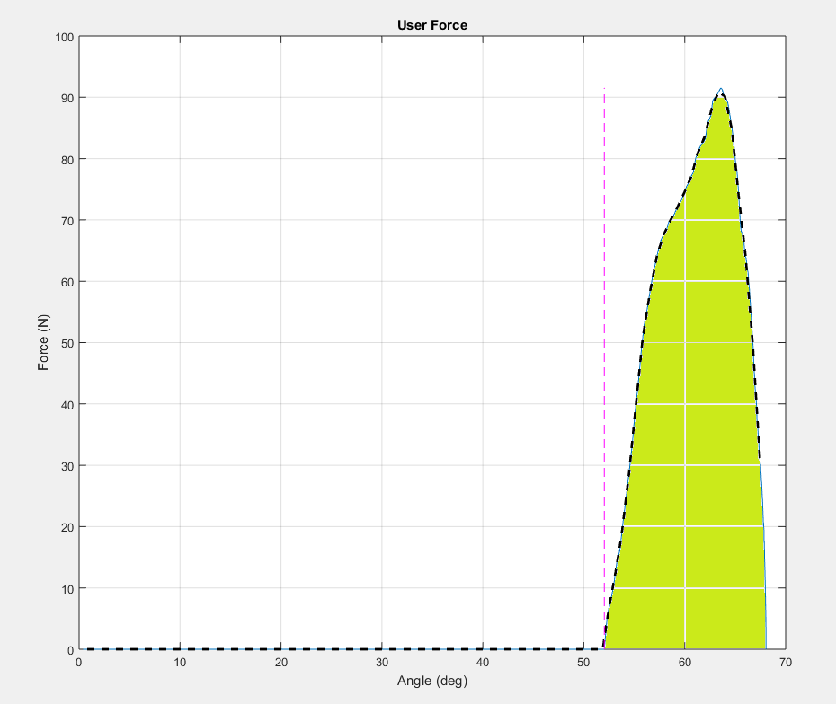
2. CONVERSION TO ENERGY
2.2 USER INPUT
1. User Input
5. Pressure
6. Seal
4. Friction
2. Speed
3. Hinge Inclination
N
Joule
[User Force] x [Travel] = Energy
m / sec
Degrees
N·m
mbar
N / mm
The force applied by the operator, combined with the measured travelled distance, the mechanical energy can be calculated.
SEPA010, Slide 10
© 2024 EZMetrology

Slide 11
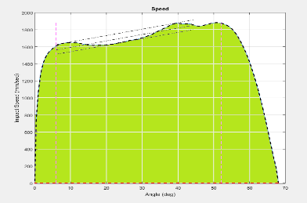
2. CONVERSION TO ENERGY
2.3 DOOR SPEED
1. User Input
5. Pressure
6. Seal
4. Friction
2. Speed
3. Hinge Inclination
N
Joule
[Angular Speed]² x [Inertia] / 2 = Energy
Joule
m / sec
Degrees
N·m
mbar
N / mm
Once the system identifies the inertia of the door, the speed can be recalculated as kinetic energy.
SEPA010, Slide 11
© 2024 EZMetrology

Slide 12
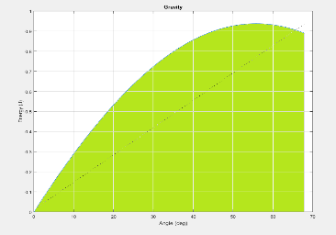
2. CONVERSION TO ENERGY
2.4 HINGE INCLINATION
1. User Input
5. Pressure
6. Seal
4. Friction
2. Speed
3. Hinge Inclination
N
Joule
[Mass] x [Rise] x 9.81 = Energy
Joule
m / sec
Joule
Degrees
N·m
mbar
N / mm
As soon as the system determines the weight and the hinge inclination, the door rise and associated potential energy can be determined.
SEPA010, Slide 12
© 2024 EZMetrology

Slide 13
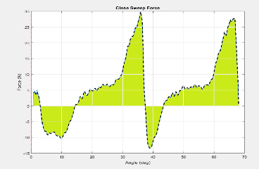
2. CONVERSION TO ENERGY
2.5 DOOR CHECK FRICTION
1. User Input
5. Pressure
6. Seal
4. Friction
2. Speed
3. Hinge Inclination
N
Joule
[Force] x [Displacement] = Energy
m / sec
Joule
Degrees
Joule
Joule
Nm
mbar
N / mm
The friction of the hinge and door check can be determined as a continuous force across a sweep angle.The travel and force can be integrated and provide the total net energy.
SEPA010, Slide 13
© 2024 EZMetrology

Slide 14
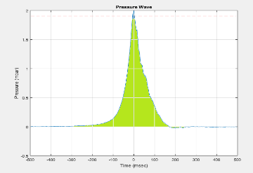
2. CONVERSION TO ENERGY
2.5 CABIN PRESSURE
1. User Input
5. Pressure
6. Seal
4. Friction
2. Speed
3. Hinge Inclination
Joule
N
m / sec
[Pressure] x [Area] x [Displacement] = Energy
Joule
Joule
Degrees
Joule
Nm
mbar
Joule
N / mm
The cabin pressure generates a counterforce based on the door area. This force acting against the travel of the door provides energy loss.
SEPA010, Slide 14
© 2024 EZMetrology

Slide 15
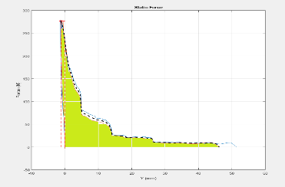
2. CONVERSION TO ENERGY
2.6 STATIC SEAL COMPRESSION
1. User Input
5. Pressure
6. Seal
4. Friction
2. Speed
3. Hinge Inclination
N
Joule
m / sec
[Force] x [Displacement] = Energy
Joule
Joule
Degrees
Joule
Nm
Joule
mbar
Joule
N / mm
Seal compression can also be reduced to force times the displacement.
Now, all elements are translated into an energy value, allowing relative comparisons.
SEPA010, Slide 15
© 2024 EZMetrology

Slide 16







2. CONVERSION TO ENERGY
2.7 LEVEL PLAYING FIELD
1. User Input
N
Joule
2. Speed
m/ sec
Joule
3. Hinge Inclination
Degrees
Joule
4. Friction
Nm
Joule
5. Pressure
mbar
Joule
6. Seal
N / mm
Joule
All effects of a different nature are all expressed in unit of Energy and making relative comparison possible...
SEPA010, Slide 16
© 2024 EZMetrology

Slide 17
3. Energy Balance
SEPA010, Slide 17
© 2024 EZMetrology

Slide 18
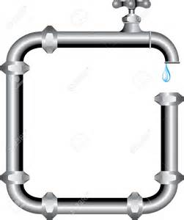
3. ENERGY BALANCE
3.1 THE CASES
  The door will require and use energy to change states:
    Opening
    Closing
  Energy is always conserved, or “what goes in, must come out.”
    Energy Providers:
  User, Door Check, Gravity
    Energy Absorbers:
  Hinge and check Friction, Seals (static and dynamic), Cabin Air
SEPA010, Slide 18
© 2024 EZMetrology

Slide 19
3. ENERGY BALANCE
3.2 Action 1: Opening Energy (29.6 J)
SEPA010, Slide 19
© 2024 EZMetrology

Slide 20
3. ENERGY BALANCE
3.3 Action 2: Minimum Closing Energy (21.0 J)
The relative importance can be visualized.
Further improvements or considerations to rearrange the balance can be made.
SEPA010, Slide 20
© 2024 EZMetrology

Slide 21
4. Case Study :Optimization Door System
SEPA010, Slide 21
© 2024 EZMetrology

Slide 22

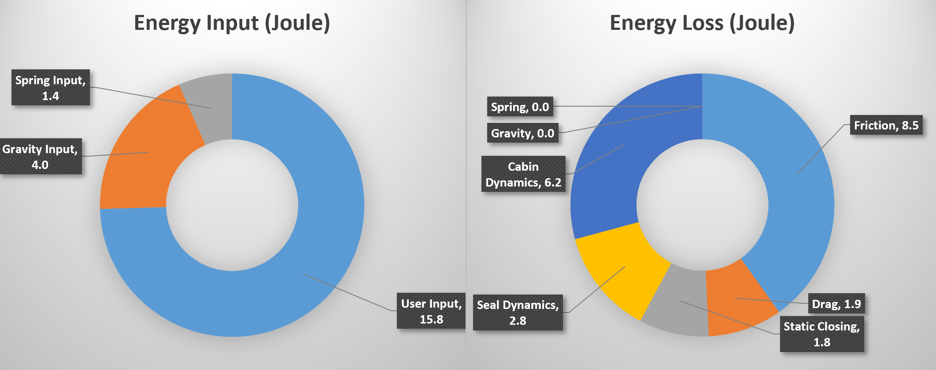

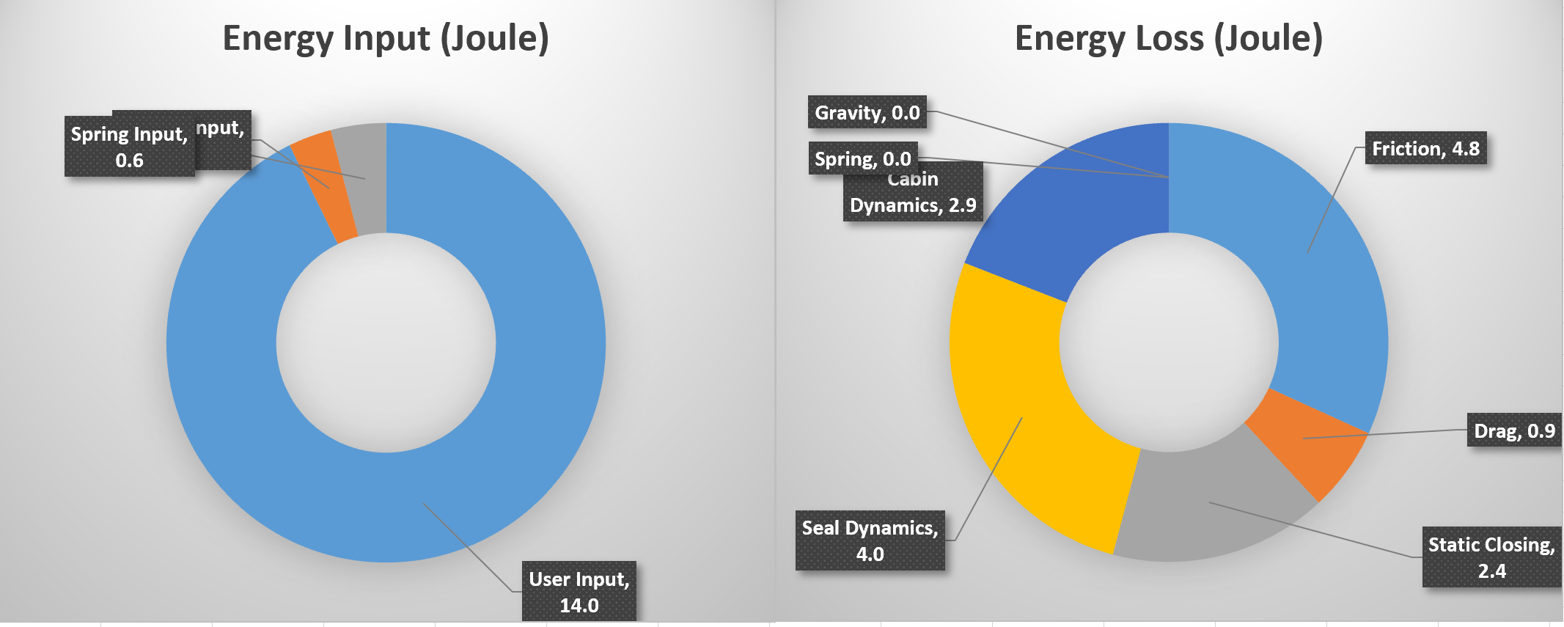

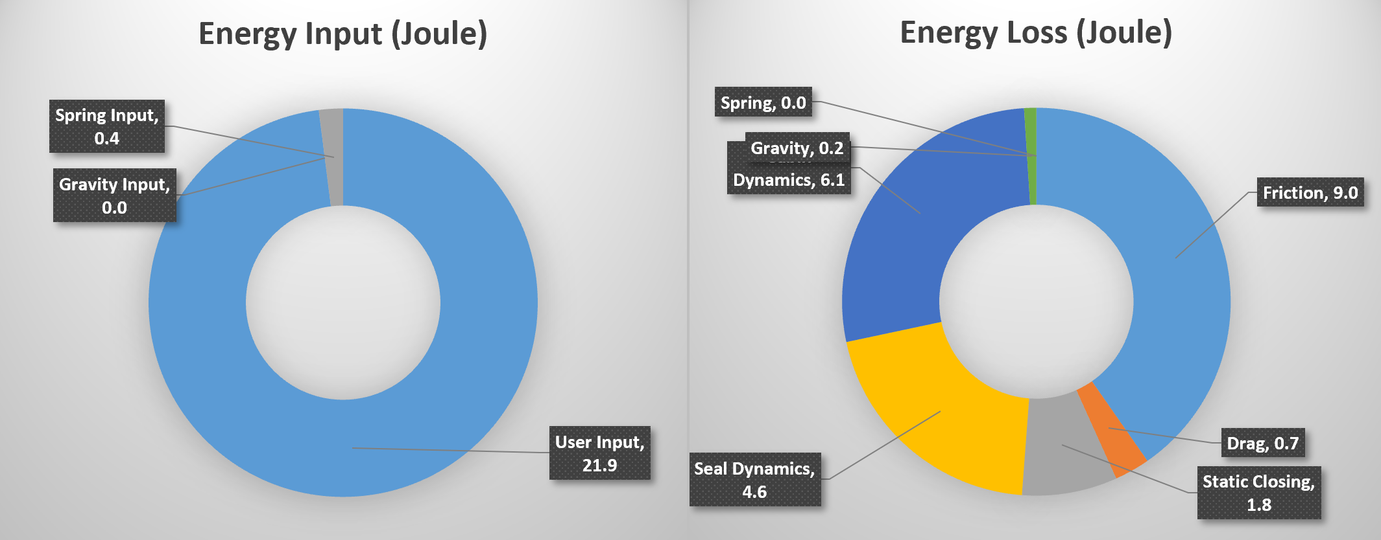
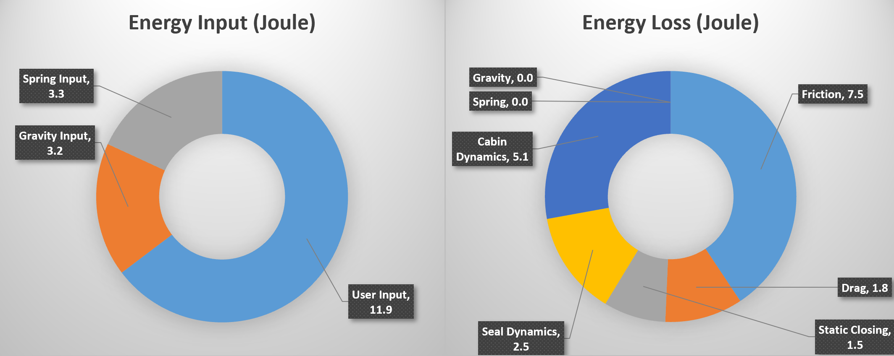
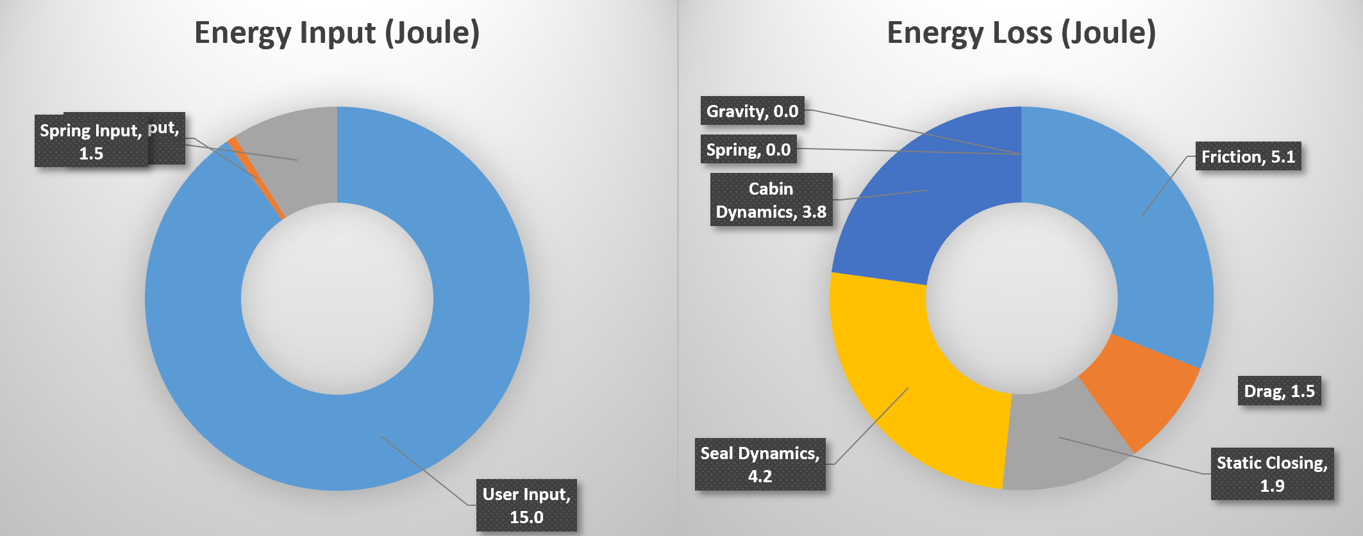
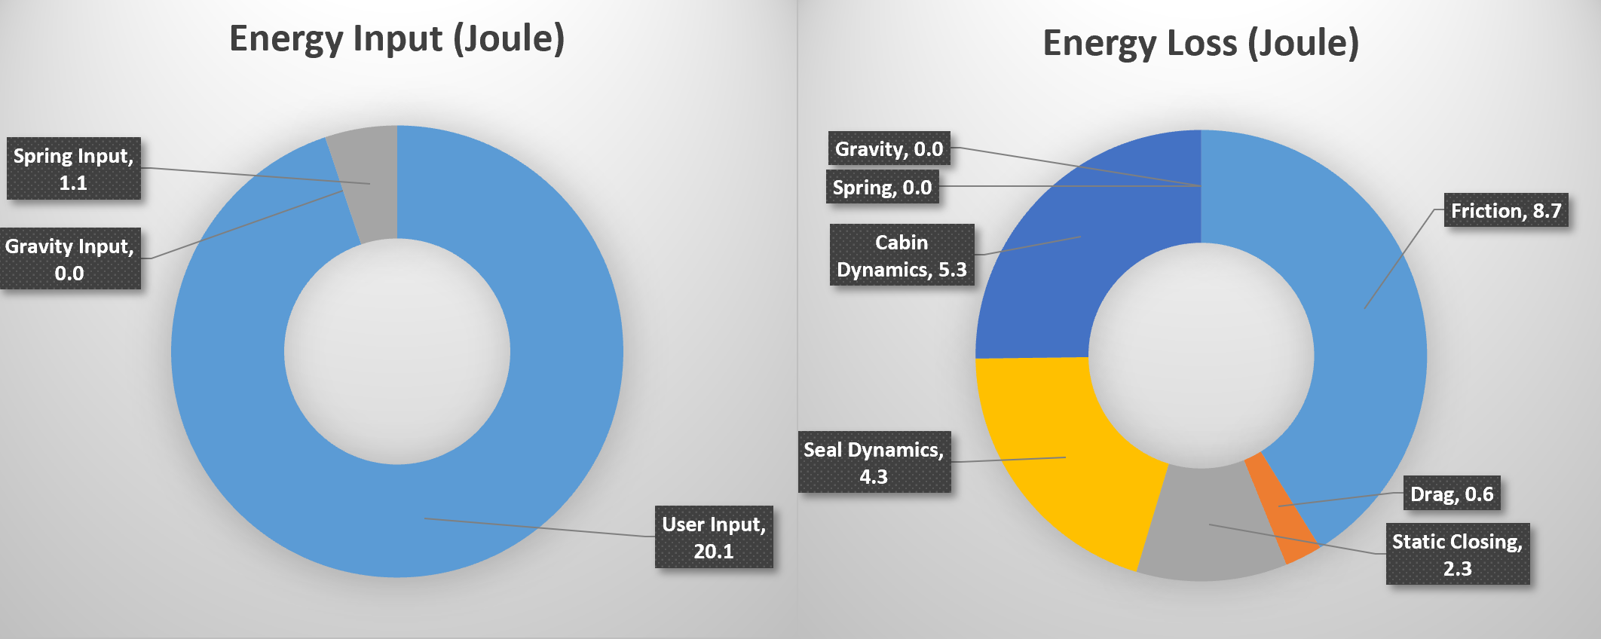
4. CASE STUDY: OPTIMIZATION OF DOOR SYSTEM
4.1 BENCHMARKING
  A measurement campaign will allow to understand the boundaries and opportunities of the door system.
SEPA010, Slide 22
© 2024 EZMetrology

Slide 23
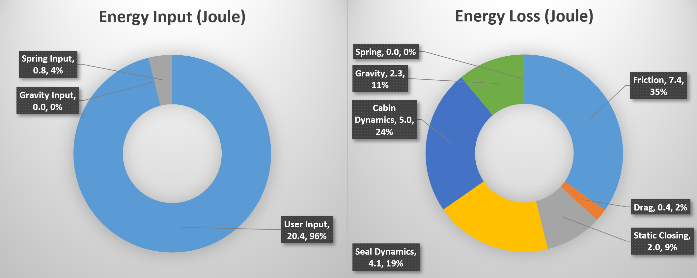
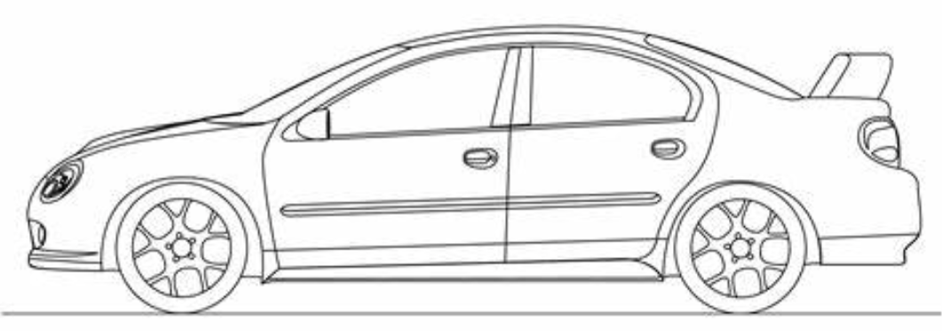
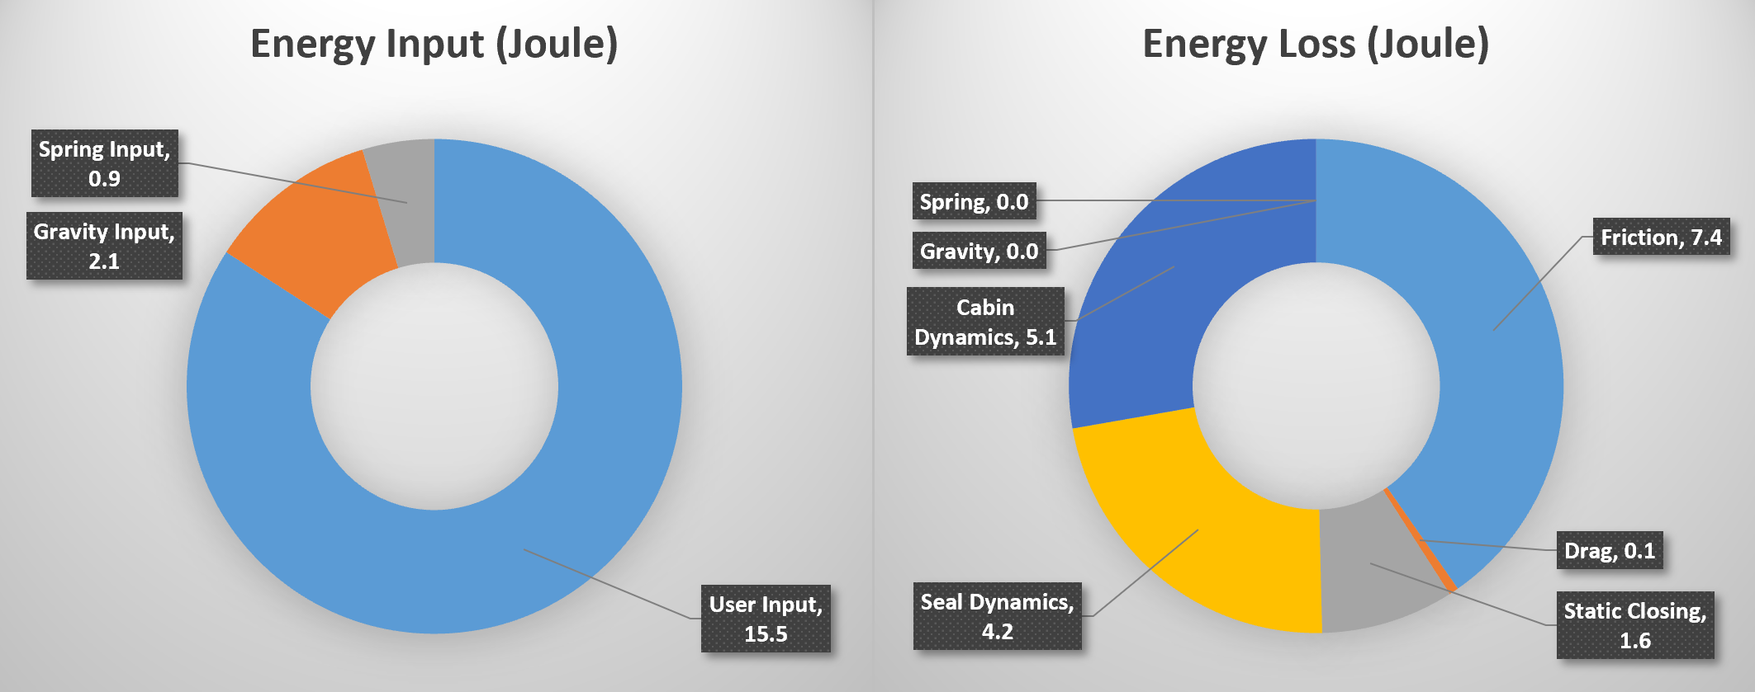
4. CASE STUDY: OPTIMIZATION OF DOOR SYSTEM
4.2 HINGE INCLINATION
  Adjusting the hinge inclination, improved the energy obtained from the movement. A change as small as 0.5 degree inboard and 0.5 degree rearward, provided and extra 2 Joule.
SEPA010, Slide 23
© 2024 EZMetrology

Slide 24
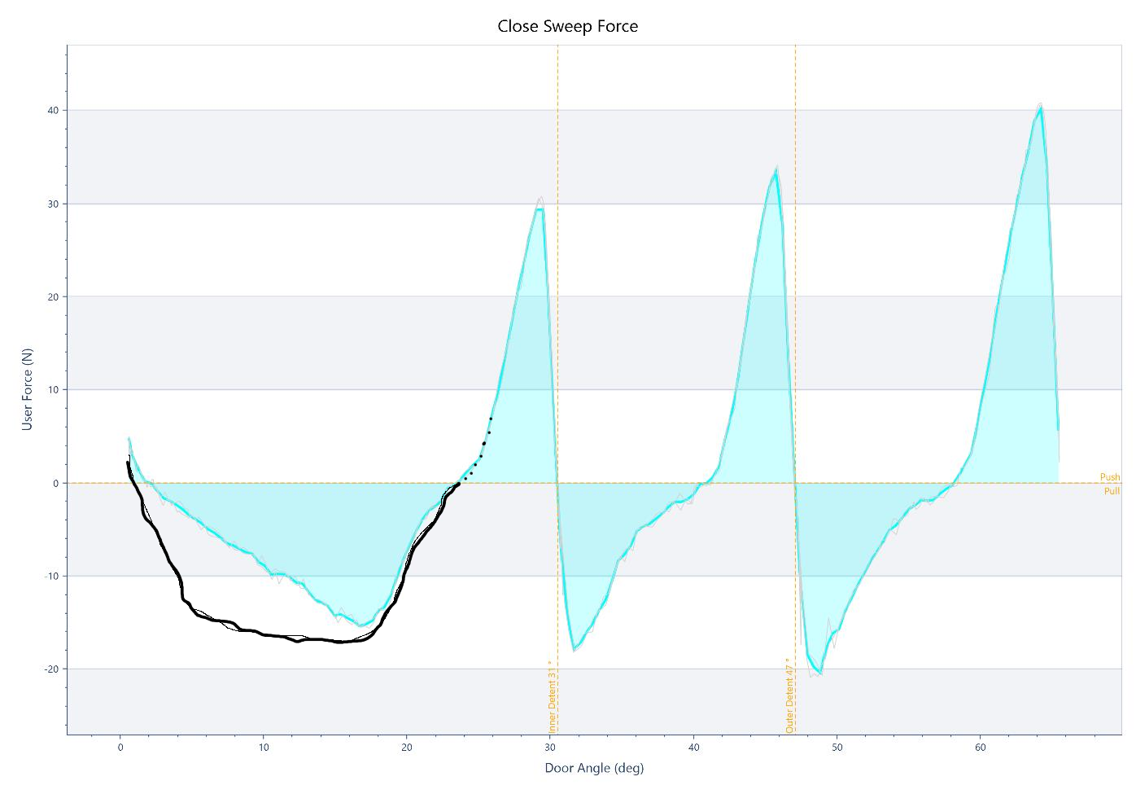
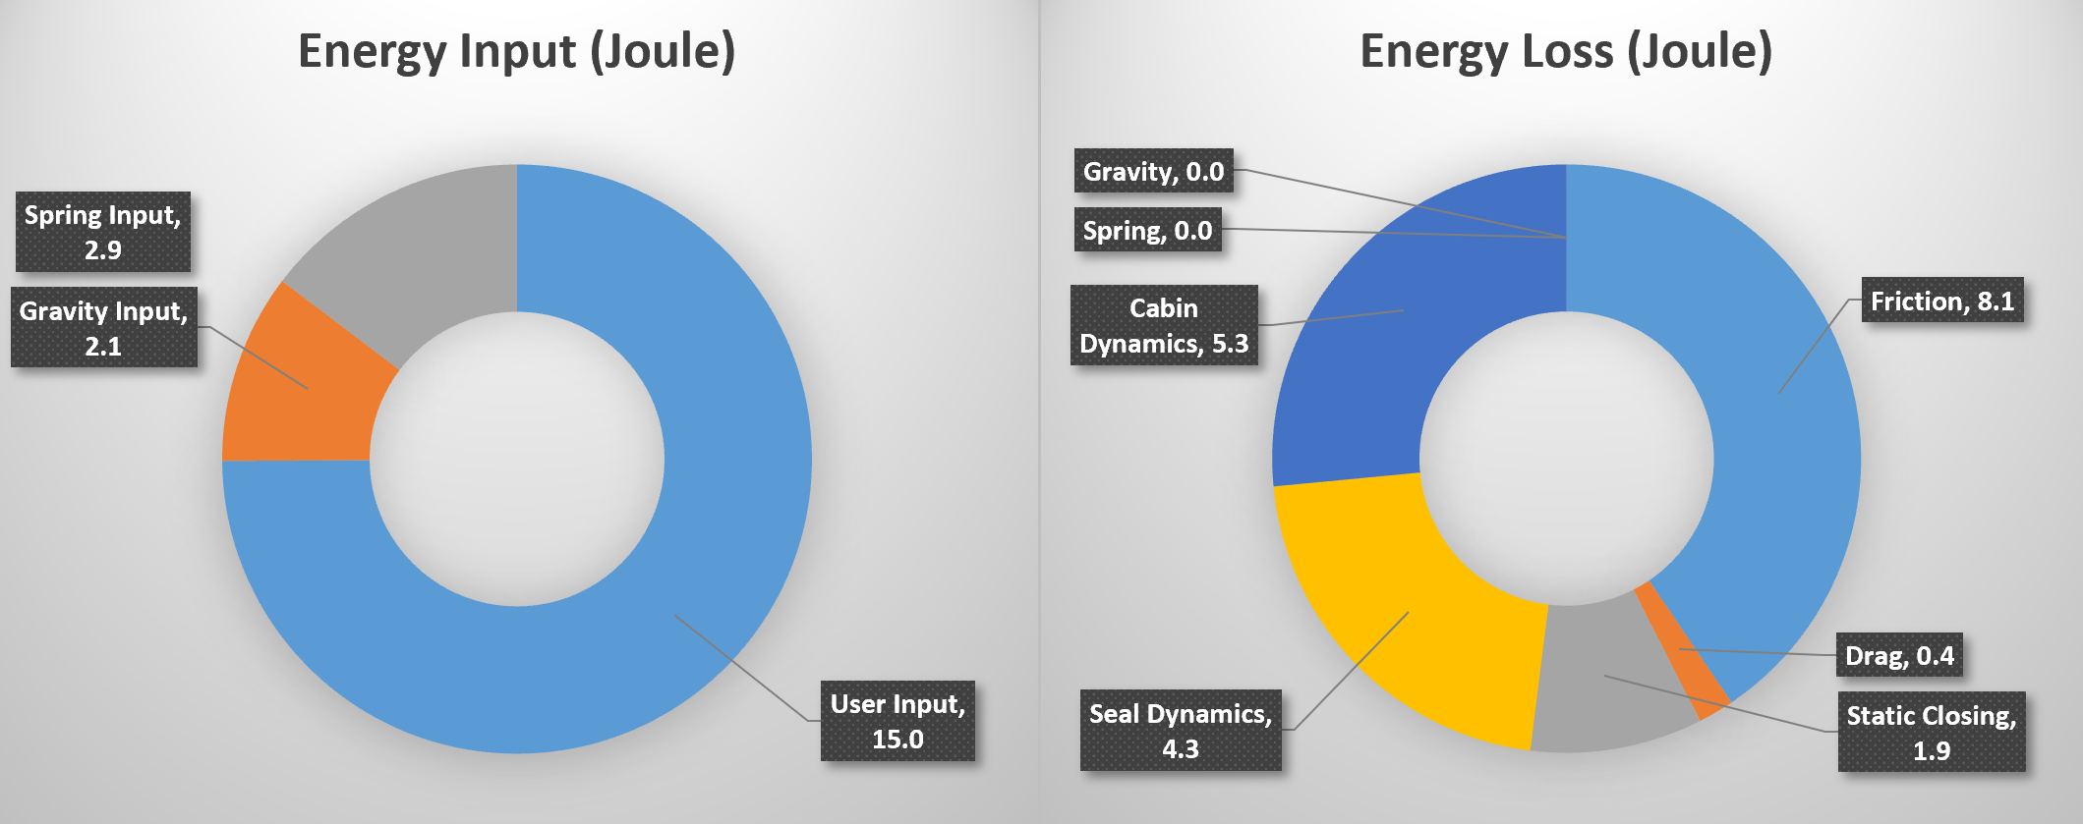
4. CASE STUDY: OPTIMIZATION OF DOOR SYSTEM
4.3 DOOR CHECK
  A minor adjustment to the door check profile and increasing the final boost of the door check from 0.9 to 2.9J. The adjustment comes with a small penalty on the friction.
The potential variation in closing efforts due to striker adjustment to meet flushness criteria is displayed with a high degree of sensitivity.
SEPA010, Slide 24
© 2024 EZMetrology

Slide 25
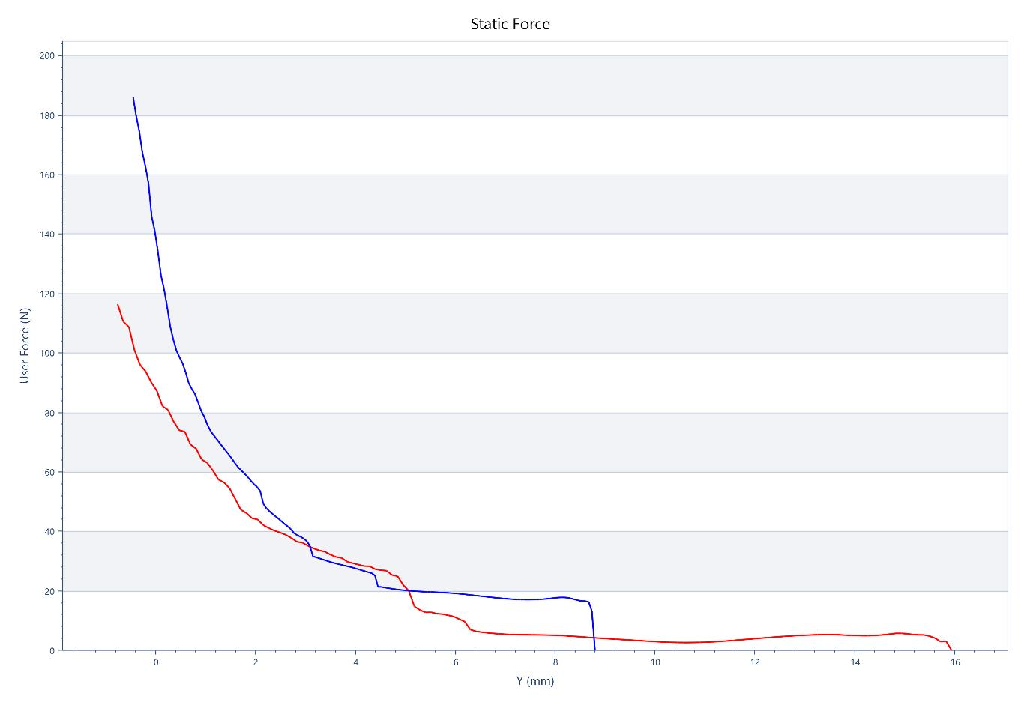
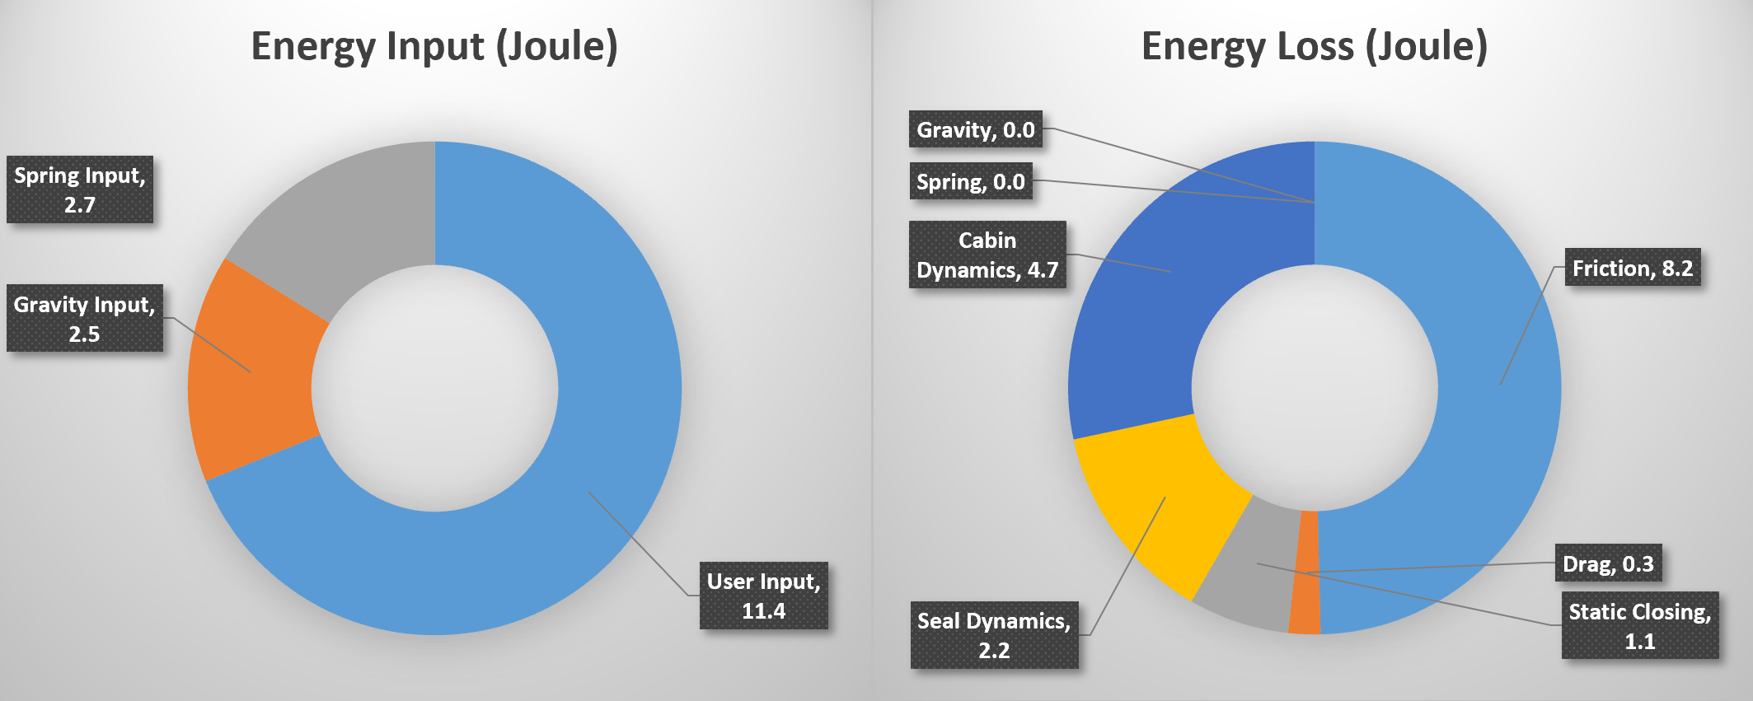
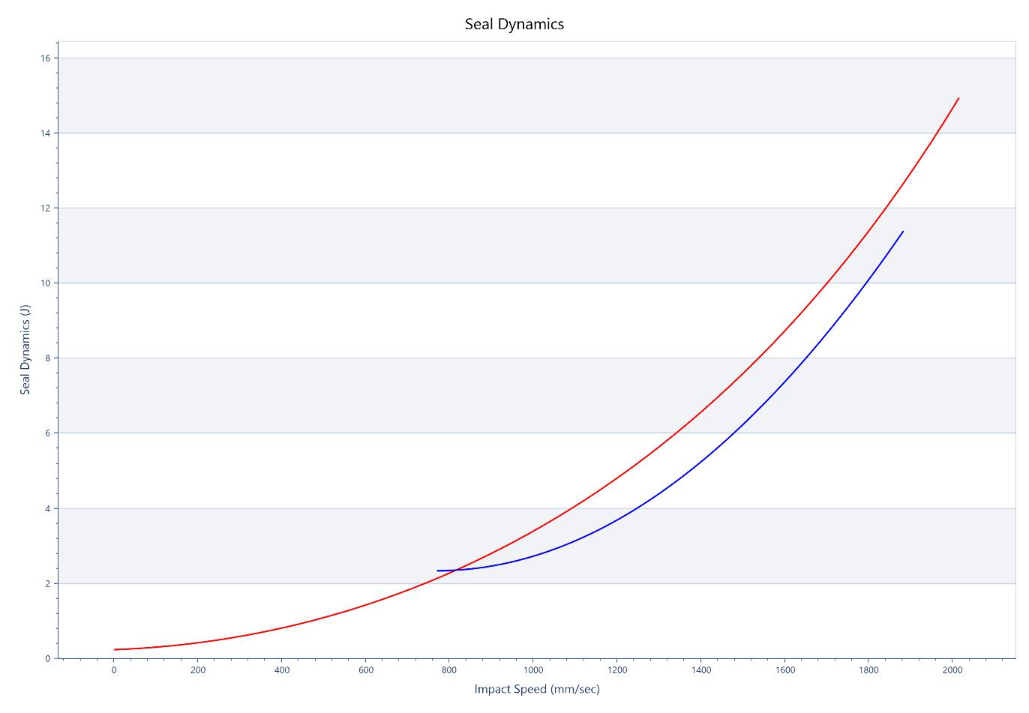
4. CASE STUDY: OPTIMIZATION OF DOOR SYSTEM
4.4 SEAL COMPRESSION
  The measured sealgap section indicated an incorrect seal location. The corrected assembly reduced static compression load by nearly 80N or 0.8J. A more important extra gain of 2.1J comes from the reduced dynamic compression energy.
SEPA010, Slide 25
© 2024 EZMetrology

Slide 26
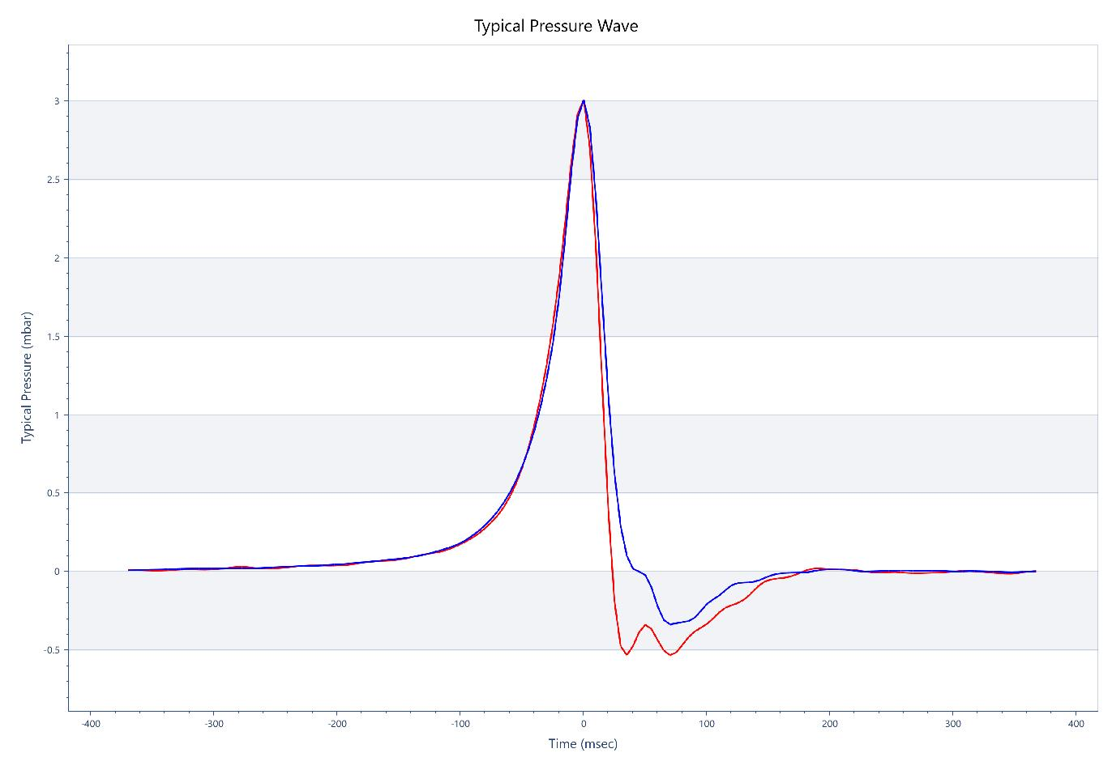
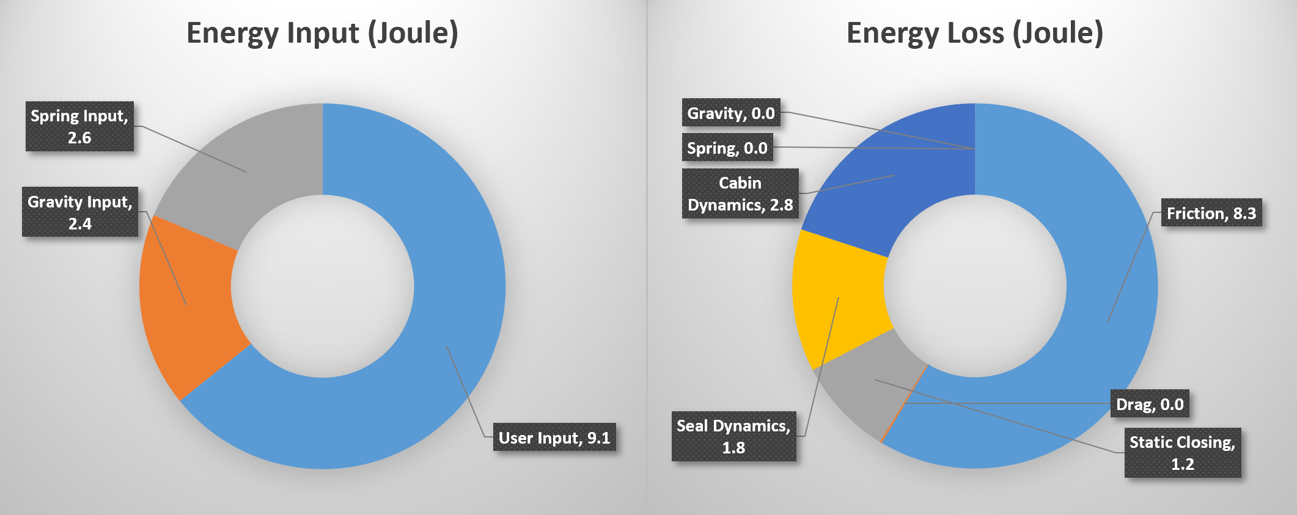
4. CASE STUDY: OPTIMIZATION OF DOOR SYSTEM
4.5 CABIN AIR MANAGEMENTSION
  Based on benchmark numbers, adjustments to path to and behavior of the extractor valve. Providing a gain of about 2J on the cabin management.
SEPA010, Slide 26
© 2024 EZMetrology

Slide 27
4. CASE STUDY: OPTIMIZATION OF DOOR SYSTEM
4.6 OVERALL RESULTS
  An original user experience was an excessive 20.4J for closing energy. Basic adjustments, guided by the energy consumption of each, provided an overall reduced energy of only 9.1J.
  Before
  After
SEPA010, Slide 27
© 2024 EZMetrology

Slide 28
6. Conclusion
SEPA010, Slide 28
© 2024 EZMetrology

Slide 29
6. CONCLUSIONS
6.1 ENERGY BALANCE
Monitor Quality
Compare Designs
Identify Quality Trends
Troubleshoot
Determine Key Differences
Improve Designs
User Satisfaction
Tune to Target Values
Chart Subjective Impressions
Determine Door Signature
Analyze Influence of Components
Mimic Door Signature
Durability and Degradation
The Energy Balance is the key signature of a door system, will capture the behavior and sensation.
SEPA010, Slide 29
© 2024 EZMetrology

Slide 30
THANK YOU.
info@ezmetrology.com
support@ezmetrology.com
www.ezmetrology.com
portal.ezmetrology.com
academy.ezmetrology.com
SEPA010, Slide 30
© 2024 EZMetrology

