Slide 1

EZMotion
Step Correlation
Evaluation of the dynamic performance of EZMotion with a servo controlled magnetic drive and a linear position sensor
Confidential

Slide 2

INDEX
Correlation Study
Measurements
Confidential
© 2024 EZMetrology
.

Slide 3

1. Correlation Study
Confidential

Slide 4
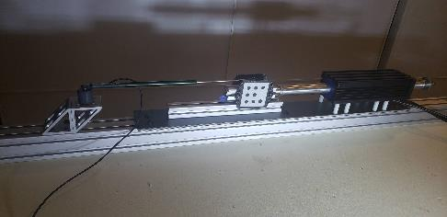
1. Correlation Study
1.1 introduction
To evaluate the dynamic performance of EZMotion a fixed setup has been created composed of the following.
Servo Controlled Magnetic Drive
  DunkerMotoren STA2506S-155-S-So3D
  Xenus Servo Drive
Ezmotion 3x3 Target
  3x3 Tracker
  Standard Setup
  Distance Camera – Tracker 800mm
  Lens Type 8mm
Linear Position Sensor
  Linear Potentiometer
  Celesco MLP150
Confidential
© 2024 EZMetrology
.

Slide 5
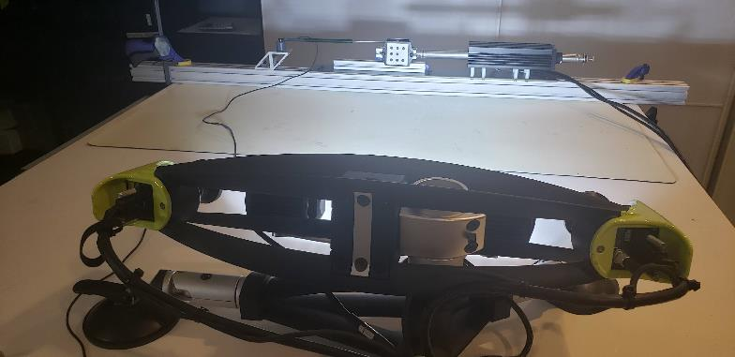
1. Correlation study
1.2 programmed motions
62.7 mm “Instantaneous” Displacement
Confidential
© 2024 EZMetrology

Slide 6
1. Correlation study
1.3 sensor information
EZMotion:
  Optimal acquisition rate (~450Hz)
  CSV export in mm
  Main movement in the Y direction (alignment)
  Other directions (X, Z, RX, RY, RZ) are near 0 mm
Analog Linear Sensor
  Scale 15.16 mm/increment
Servo Drive
  Incremental steps
  Scale 0.502 mm/increment
  Memory buffer at 400 Hz limited to 1.25 seconds
  Each movement is relative to the start position
  Signal corresponds to the actual position of the piston and not the programmed position
Confidential
© 2024 EZMetrology

Slide 7
2. Measurement
Confidential

Slide 8
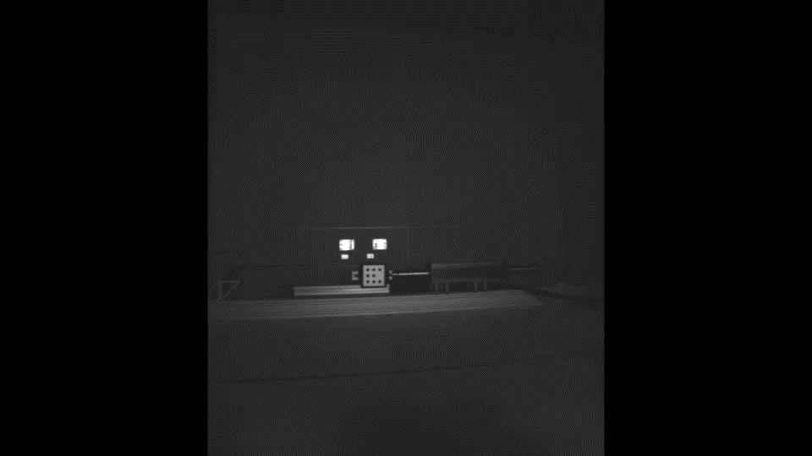
2. Measurement
2.1 Image of setup for 62.7 mm step
Confidential
© 2024 EZMetrology

Slide 9
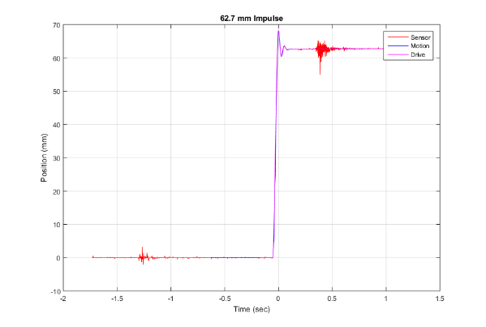
2. measurement
2.2 movement: “Instantaneous” displacement to reach maximum velocity
  Observations:
The analog position sensor has some parasite (periodic) signals from the magnetic drive.
NO filters are applied to any data set.
Confidential
© 2024 EZMetrology

Slide 10
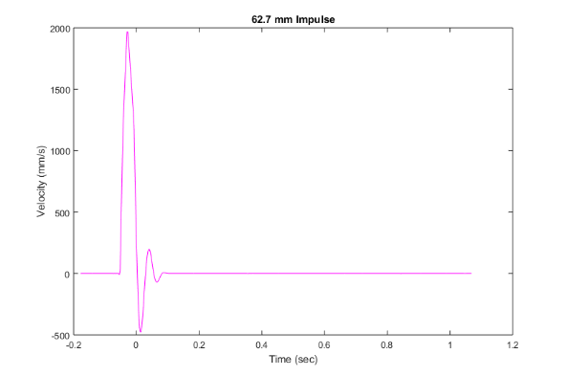
2. measurement
2.3 movement: 50 mm“Instantaneous” displacement
  Observation:
The peak velocity is nearly 2 m/s.
Confidential
© 2024 EZMetrology

Slide 11
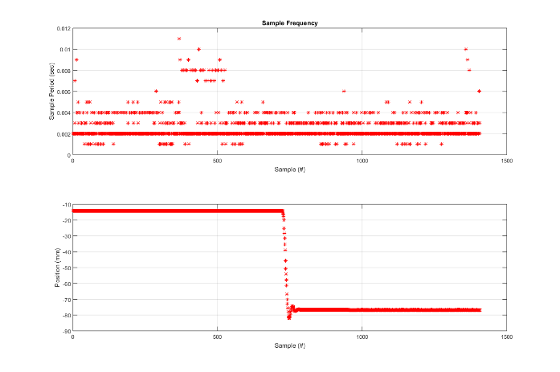
2. measurement
2.4 recording frequency
  Observations:
EZMotion will operate at optimal acquisition.
Instantaneous sampling period is shown in top graph, and matching position is shown in the bottom graph.
Typical sampling period is 2 msec, especially during high velocity motion.
Confidential
© 2024 EZMetrology

Slide 12
Thank you.
info@ezmetrology.com
support@ezmetrology.com
www.ezmetrology.com
portal.ezmetrology.com
academy.ezmetrology.com
Confidential

