Slide 1

EZMetrology
Audit Solution
Software solution for traceability and documentation of door closing efforts, inspection stations, and quality control
Confidential
© 2023 EZMetrology

Slide 2

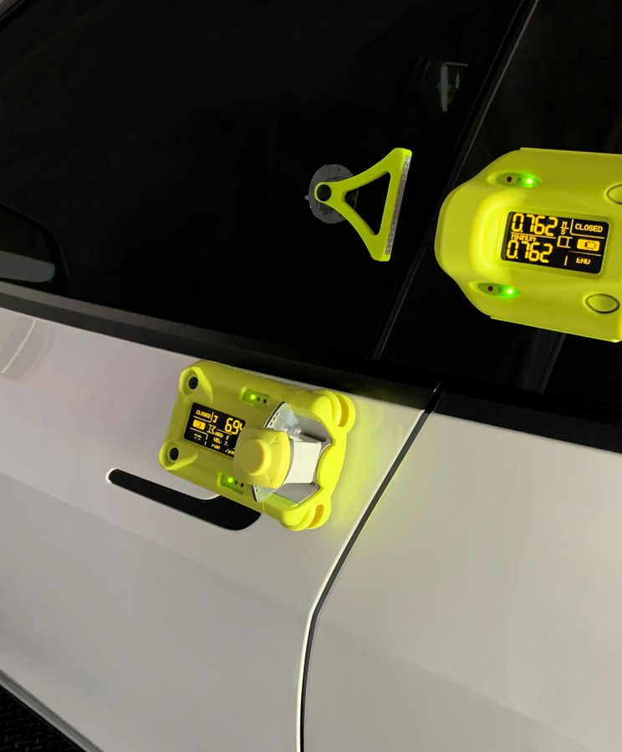


Index
Introduction
Sensor Compatibility
Application
Software Functions
Training Plan
Conclusion
Confidential
© 2023 EZMetrology

Slide 3

1. Introduction
Confidential
© 2023 EZMetrology

Slide 4
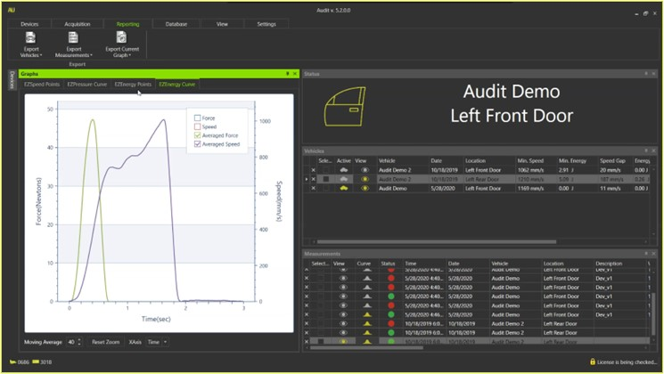
1. Introduction
1.1 Audit Solution
  Audit software uses any or all devices to take high-fidelity measurements during the closing of a door.
  The software platform will track speed and force curves along with pressure for a comprehensive look at the interactions of a door. The active database associates the data with a VIN number and door location for traceability.
  Audit Software has been used at many OEM’s NVH, benchmarking, and quality stations, helping them to improve their door quality over the years.
Confidential
© 2023 EZMetrology

Slide 5
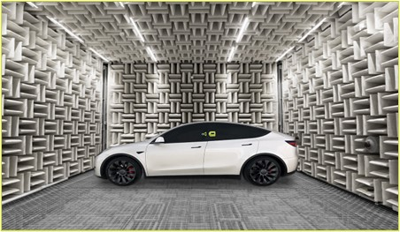
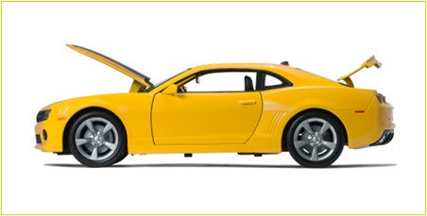
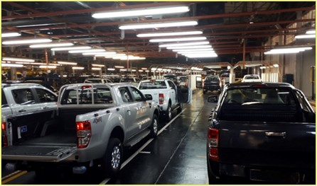
1. Introduction
1.2 Focus
  Audit is equipped with top-notch technology to comply with different engineering analysis.
NVH Study
A vehicle’s noise and vibration characteristics are becoming more important with the rise of electric vehicles. All door kit devices have unique features to analyze each impact factor and contributor.
B. Benchmarking
Different models/doors can be measured and reported in the Audit software. Also, contribution studies can be made easily and recorded in the Audit software.
C. Line Sampling
Weekly or monthly, a sequence of cars can be processed in the Audit Station and doors can be tested via EZDoorkit and Audit software.
NVH Studies
Benchmarking
Audit Stations
Confidential
© 2023 EZMetrology

Slide 6
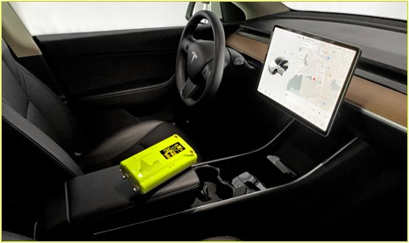
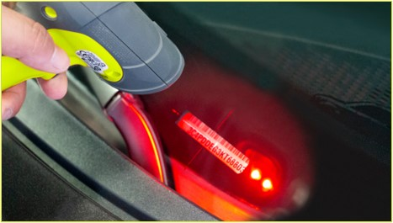
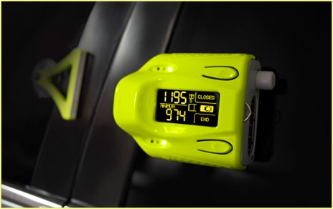
1. Introduction
1.3 features
  Audit has many features which make door closures testing easier and efficient.
  The software has improved over many years of experience, including these features:
Real-time visual graphic measurement display
Red/light green/dark green and closed/not closed evaluation
Easy-to-use interface for changing device settings, modes, units and tolerances
Different graphs presenting the measurement data for analysis:
  Force/time, force/angle, speed/time, speed/angle, air pressure rise and drop/time, EZEnergy measurement points, EZSpeed measurement points
Synchronized multiple device support; EZSpeed, EZEnergy, Pinch and EZPressure
Configurable charts for comparison and exporting
Confidential
© 2023 EZMetrology

Slide 7
2. Sensor Compatibility
Confidential
© 2023 EZMetrology

Slide 8

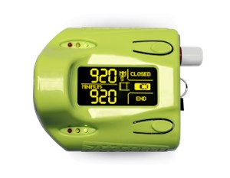
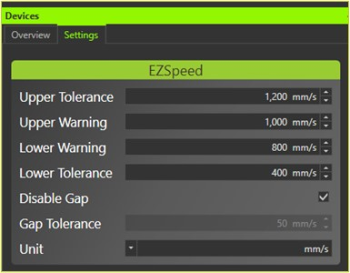
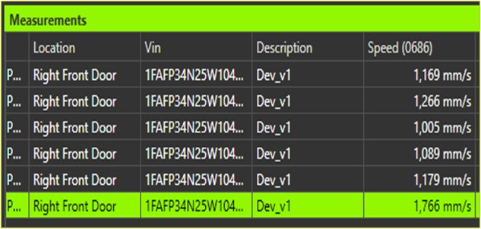



2. Sensor compatibility
2.1 Devices/EZSpeed
  Audit can be used with three different devices based on the metric requirements.
  EZSpeed:
  Records all Minimum Closing Speeds
  All speed data can be sent live to Audit software
  All door types can be measured
  Bluetooth or Wi-Fi device options
or
Confidential
© 2023 EZMetrology

Slide 9
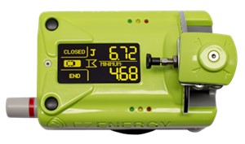
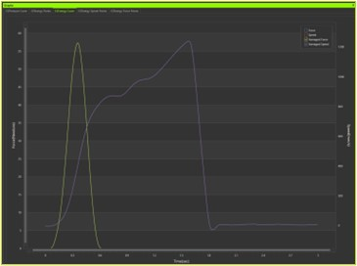
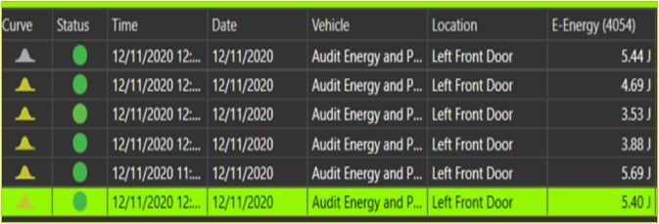

2. Sensor compatibility
2.2 Devices/EZEnergy
  Audit can be used with three different devices based on the metric requirements.
  EZEnergy:
  Records Force, Energy, Speed, Door Angle, Maximum Speed
  All data can be sent live to Audit software
  All door types can be measured excluding sliding doors
  Bluetooth or Wi-Fi device options
or
Confidential
© 2023 EZMetrology

Slide 10

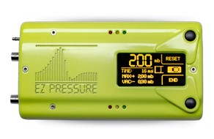
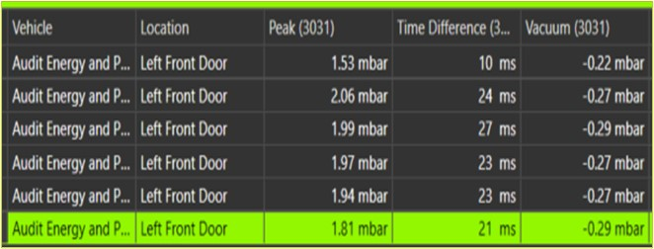
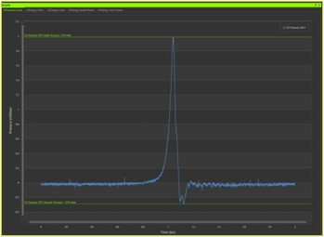

2. Sensor compatibility
2.3 Devices/EZPressure
  Audit can be used with three different devices based on the metric requirements.
  EZPressure
  Records Pressure increase and drop over time
  Records vacuum pressure
  Operation of multiple EZPressure units is supported for trunk, cabin, frunk studies
  Bluetooth or Wi-Fi device options
or
Confidential
© 2023 EZMetrology

Slide 11
3. Application
Confidential
© 2023 EZMetrology

Slide 12
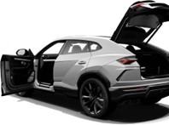
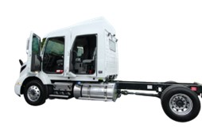
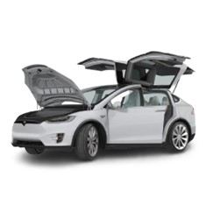
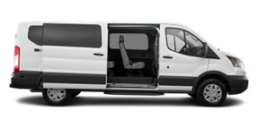
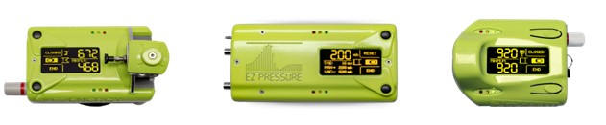
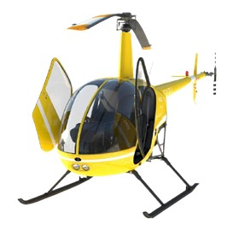
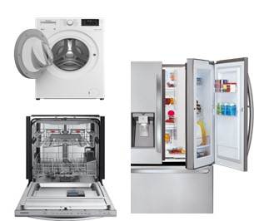
3. Application
3.1 Door types
  Our EZDoorkit devices can be easily mounted on all door types for different applications:
Pivot Door
Power Door
Sliding/Pocket Doors
Trunk/Frunk
Tailgate/Lift Gate
Roll Up
Specific Doors (Aerospace)
Appliances
Confidential
© 2023 EZMetrology

Slide 13
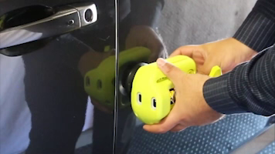
3. Application
3.2 Measurement with EZSpeed
Confidential
© 2023 EZMetrology

Slide 14
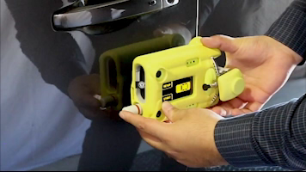
3. Application
3.3 Measurement with EZEnergy
Confidential
© 2023 EZMetrology

Slide 15
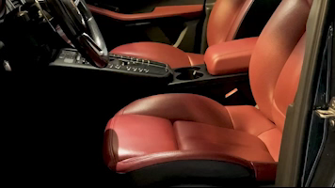
3. Application
3.4 Measurement with EZPressure
Confidential
© 2023 EZMetrology

Slide 16
4. Software Functions
Confidential
© 2023 EZMetrology

Slide 17
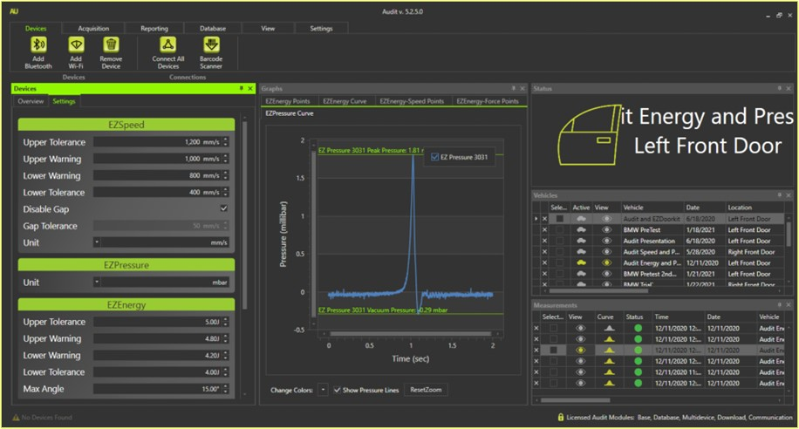
4. Software functions
4.1 General features
  Audit has an easy-to-use interface for everything from connecting to devices, changing units and device modes, downloading graphs, comparing measurements.
  Optimized layouts improve the efficiency of the operation for NVH tests, random car sampling tests or benchmarking tests.
Confidential
© 2023 EZMetrology

Slide 18
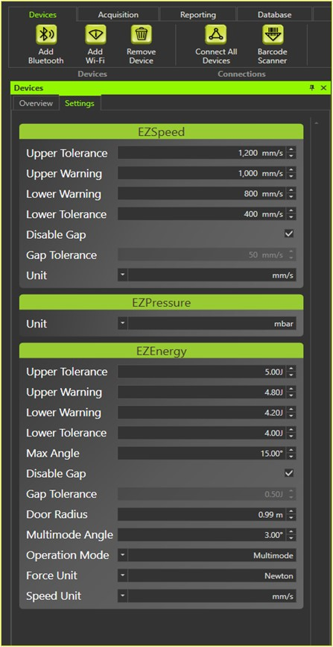
4. Software functions
4.2 remote Device control
  For all door kit devices, tolerances and units can be changed via Device settings screen.
  This includes but is not limited to:
  Device tolerances
  Device units
  Device modes
  Gap mode enable/disable
  Operation modes
Confidential
© 2023 EZMetrology

Slide 19
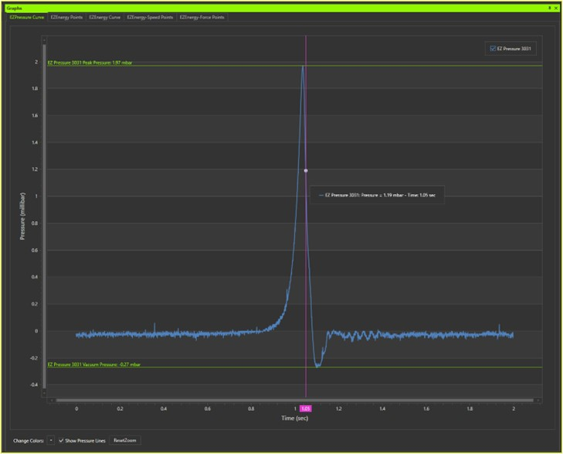
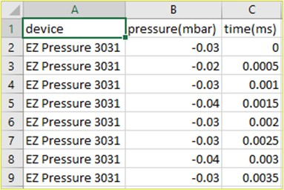
4. Software functions
4.3 pressure Graph - EZPressure
  Pressure vs Time data
  After door closing event, the EZPressure data can be downloaded and graphed .
  It is also possible to download the raw data.
  Operation and Result screen
Confidential
© 2023 EZMetrology

Slide 20
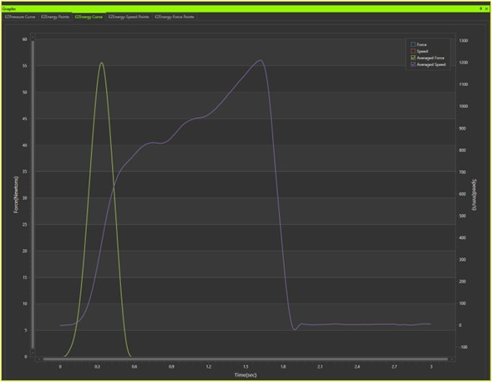
4. Software functions
4.4 Force and Speed curve in time - EZEnergy
  Force and Speed vs Time data
  After a door closing event, the EZEnergy data can be downloaded and graphed.
  Force vs Time represents the change in the closing force impact during the measurement time.
  Speed vs Time represents the change in the closing speed impact during the measurement time.
  Operation and Result Screen
Confidential
© 2023 EZMetrology

Slide 21
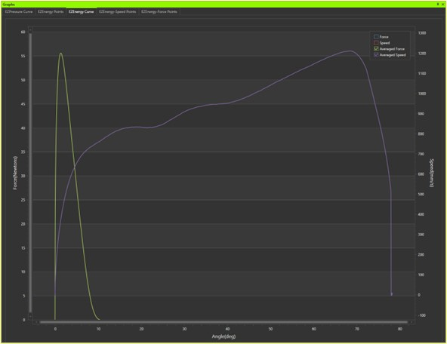
4. Software functions
4.5 force Speed curve in angle - EZEnergy
  Force and Speed vs Angle data
  After a door closing event, the EZEnergy data can be downloaded and graphed.
  Force vs Angle represents the change in the closing force impact for the travel of the door.
  Speed vs Angle represents the change in the closing speed for the travel of the door.
  Operation and Result Screen
Confidential
© 2023 EZMetrology

Slide 22
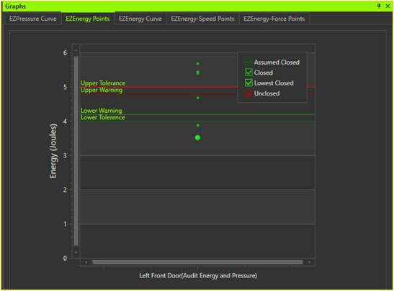
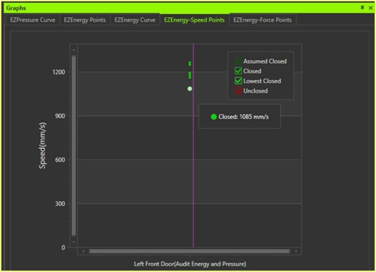
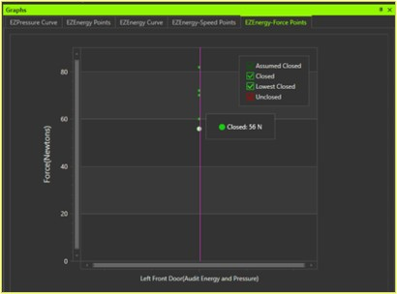
4. Software functions
4.6 Energy, Force, Speed trend line - EZEnergy
  EZEnergy has more to offer and there are more graphs to help engineers.
  EZEnergy Points will show all the energy measurements taken for each closing event.
  EZEnergy Force Points will show all force measurements for each closing event.
  EZEnergy Speed Points will show all speed measurements for each closing event.
Confidential
© 2023 EZMetrology

Slide 23
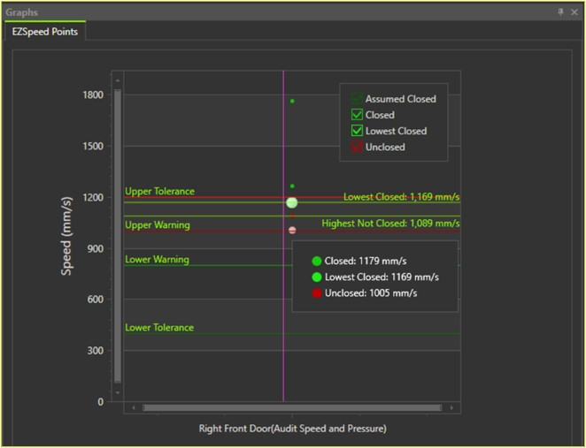
4. Software functions
4.7 Speed Trend Line - EZSpeed
  EZSpeed Measurement Points
  After door closing event, all EZSpeed data would be shown on an EZSpeed graph.
  Also based on the tolerance settings, the measurements can easily be compared with the door tolerances.
  Operation and Result Screen
Confidential
© 2023 EZMetrology

Slide 24
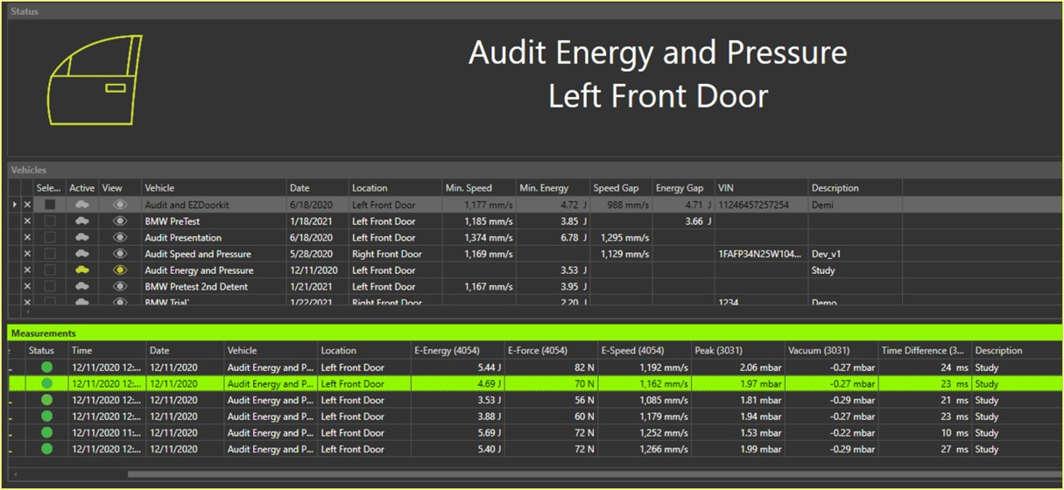
4. Software functions
4.8 Consolidated database
Confidential
© 2023 EZMetrology

Slide 25
5. Training Plan
Confidential
© 2023 EZMetrology

Slide 26

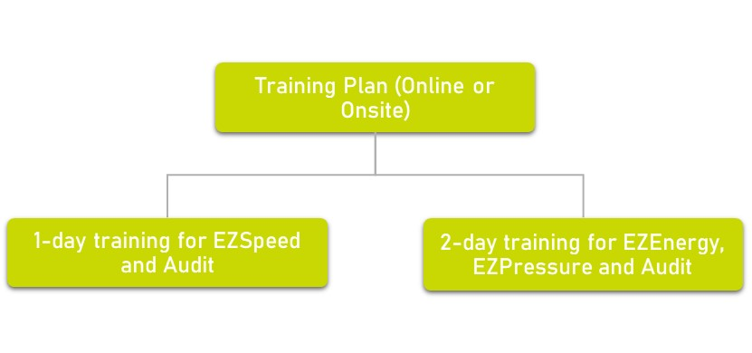

5. Training plan
  At EZMetrology, we put our utmost effort into our customer training and make sure they learn all the details of both hardware and software solutions.
  1-day training is designed for the customers with EZSpeed devices.
  2-day training is designed for the customers with EZEnergy and/or EZPressure devices.
Confidential
© 2023 EZMetrology

Slide 27
6. Conclusion
Confidential
© 2023 EZMetrology

Slide 28
6. conclusion
  Advantages of Audit:
  Features
  Quick and easy to set up and take measurements
  Capable of testing all doors, hoods, trunks, and windows
  Data management
  Measurements
  VIN traceability with optional bar code input
  Simultaneous recording of multiple units
  Graphical representation
  Download force/speed/pressure curves with devices
  Optional bar code input
  Reporting
  Export data
  Export graphs
  EZMetrology Door Solutions enjoy worldwide usage and support with onsite/online installations and training.
Confidential
© 2023 EZMetrology

Slide 29
THANK YOU.
info@ezmetrology.com
support@ezmetrology.com
www.ezmetrology.com
portal.ezmetrology.com
academy.ezmetrology.com
SEPP003, Slide 29
Confidential
© 2023 EZMetrology

Slide 30


Company Pages

Slide 31
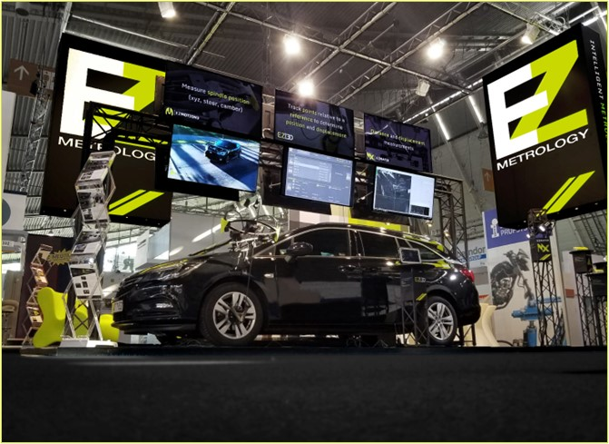
COMPANY OVERVIEW
Founded in 2006 by Carine Woldanski and Tom Van Esch
Global Operations:
  USA Headquarters in Michigan
  Europe Support office in Luxemburg
  Asia Partnerships
EZMetrology:
  70% Development and Engineering
    Fast product development and interactive evolutions
  20% Support and Training
    Ensuring a transfer of knowledge to our customers
  10% Administration and Sales
    Manage customs and sales procedures
Consistent annual growth of 50% over the past years
Developing innovative, creative and practical products
Confidential
© 2023 EZMetrology

Slide 32

SHARING OUR PASSION WORLDWIDE WITH CUSTOMERS AT
ALPINE
ARRIVAL
AUDI
BMW
BROSE
CANOO
CATERPILLAR
CHRYSLER
DACIA
DAIHATSU
DAIMLER
DENSO
FAW
FAURECIA
FERRARI
FIAT
FORD
GAC
GENERAL MOTORS
GG MOTORS
HUMANETICS
HONDA
HYUNDAI
INFINITI
JAGUAR
JEEP
KASEIKOGYO
KIA
KIEKERT
LADA
MACK
MAHINDRA
MARUTI
MASERATI
MAZDA
MITSUBISHI
MULTIMATIC
NISSAN
NITTO DENKON
POLARIS
PORSCHE
PROTON
PSA
QOROS
RENAULT
RIVIAN
SAIC MOTOR
SEAT
SIEMENS
STELLANTIS
SUBARU
SUZUKI
TATA MOTORS
TESLA
TOGG
TOYODA GOSEI
TOYOTA
VOLKSWAGEN
VOLVO
VOLVO TRUCKS
- EZM HEADQUARTERS
- EZM PARTNERS
- EZM CUSTOMERS
© 2023 EZMetrology

Slide 33


